Slide 1
Fundamentals of Lifespan Development
September 10, 2014 – Genetic and Environmental Foundations

Slide 2
Video
Epigenetics and the influence of our genes: Courtney Griffins

Slide 3
Genetic Code – Key Terms
Phenotype – Direct observable characteristics
Genotype – Blend of genetic information that influences all our unique characteristics
Chromosomes – Store and transmit genetic information
Deoxyribonucleic Acid (DNA) - A nucleic acid that carries the genetic information in the cell and is capable of self-replication and synthesis of RNA. DNA consists of two long chains of nucleotides twisted into a double helix and joined by hydrogen bonds between the complementary bases adenine and thymine or cytosine and guanine. The sequence of nucleotides determines individual hereditary characteristics.
Gene – Segment of DNA along the length of the chromosome
Autosomes – Chromosomes that are not sex chromosomes

Slide 4
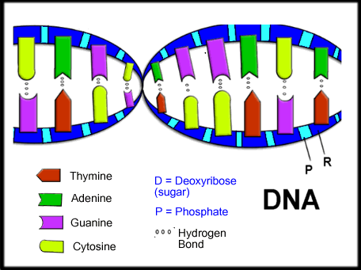
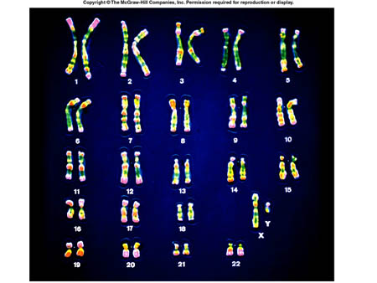
Genetic Code

Slide 5
Mitosis vs Meiosis
Mitosis
meiosis

Slide 6
Key Terms in Cell Creation
Gametes – Sperm and ovum
Zygote – The resulting cell after the sperm and ovum unite at conception
Fraternal (Dizygotic) Twins – Twins resulting from the fertilization of two ovum
Identical (Monozygotic) Twins – When a zygote forms two clusters of cells develop into two individuals with identical DNA

Slide 7
Patterns of Inheritance
Dominant | Recessive
Dark Hair | Blond Hair
Normal Hair | Pattern Baldness
Curley Hair | Straight Hair
Normal Hearing | Some Forms of Deafness
Normal Sight | Nearsightedness
Farsightedness | Normal Vision
Cannot make Phenylalanine | Phenylketonuria (PKU)

Slide 8
Pedigree Chart

Slide 9
Pedigree Chart

Slide 10
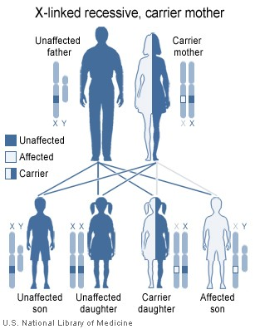
Pedigree Chart X-Linked

Slide 11
Key Terms Patterns of Genetic Inheritance
Allele – The form of gene that occurs in pairs at the same place on the chromosome, one inherited by the mother and one from the father.
Homozygous – Displays inherited trait because the alleles from both parents are alike
Heterozygous – The relationship between dominant and recessive relationships determine the phenotype
Incomplete Dominance – A pattern of inheritance in which both alleles are expressed in the phenotype, resulting in a combined trait, or one that is intermediate between the two
Genomic Imprinting – Alleles are imprinted, or chemically marked, so that one pair member (either mother’s or the father’s) is activated, regardless of its makeup
Polygenetic inheritance – Many genes influence the characteristic in question
Mutation – A sudden permanent change to a segment of DNA
Germline mutation – Takes place in the cells that give rise to gametes
Somatic mutation – Takes place in cells over the course of one’s lifetime

Slide 12
Chromosomal Abnormalities
Down syndrome
Translocation – Mainly occurs during meiosis due to improper separation of the 21st chromosome
Mosaic pattern – Occurs during mitosis
Different forms of sex chromosome expression
Turner Syndrome – X0
Triple-X Syndrome – XXX
Klinefelter Syndrome – XXY
XYY Syndrome – XYY

Slide 13
Genetic Counseling and Parental Diagnosis
A communication process designed to help couples assess their chances of giving birth to a baby with a hereditary disorder and chose the best course of action in view of risks and family goals
What are some of the pros and cons of genetic engineering?
Other options = adoption

Slide 14
Understanding the Relationship Between Heredity and Environment
Nature and nurture work together in human development
They affect each other in a bidirectional fashon
How much does heritability contribute to specific factors?
Some claim as high as .8 correlations (intelligence) or .4 - .5 (personality)
These studies have limitations and/or can be misapplied
Gene-Environment Interaction – Because of their genetic make up, people differ in the way they respond to their environments
Gene-Environment Correlation – Active vs Passive
Epigenesis – Development resulting from ongoing, bidirectional exchanges between heredity and all levels of the environment

Slide 15
Environmental Contexts for Development
Direct influences
Indirect Influence
Third Party
Co-parenting style
Chronosystem – Ever-changing

Slide 16
Factors that Affect Development
Socioeconomic status
Poverty
Affluence
Community Ties
Social Programs
Public Policy
Cultural Values and Practices

Slide 17
Discussion - Analysis
How does the Ecological Systems theory apply to our own development?

