Slide 1
Fundamentals of Lifespan Development
October 3, 2014 – Preparation for midterm exam

Slide 2
Structure of Exam
The exam is made up of two sections:
1 – Conceptual/Definitions
2 – Essay Question
You will have to define 10 concepts from the text book
You will also have to answer two essay questions

Slide 3
Conceptual/Definition Section
You will define 10 of 11 concepts
These concepts will be derived from the text book and lecture slides
Exploring Lifespan Development, 3rd edition by Laura Berk
You will have 5 min per concept for a total of 50 minutes
To study for this section, you should memorize the definitions of the concepts in the textbook as well as the lecture slides – not word for word but you must demonstrate that you know what the concept means

Slide 4
Essay Question
You will be asked to apply your knowledge of human development by answering 2 of 3 essay questions
You will have 10 minutes per question for a total of 20 minutes
To study for this section, you should be able to describe aspects of human development from conception up to and including middle childhood. You should also know the history and strategies of developmental research (as written in the textbook)

Slide 5
Structure of Exam
10 definitions at 5 min = 50 min
2 essay questions at 10 min = 20 min
Total = 70 min
Class time = 75 min
5 min left for review

Slide 6
Content to Study
PowerPoint slides
Text Laura Berk from chapter 1 up to and including chapter 10
Page 1 to page 285
Helpful hint – Go over chapter summaries
Make sure you can explain sections of the text by looking at the table of contents

Slide 7
You do NOT Need To
Memorize anatomy charts from the text book
Memorize content from the videos I show in class
Memorize the studies that are being used as examples in the textbook

Slide 8
Practice Test
Define the following terms
Intermodal Perception
Babbling
Goodness of Fit Model
Autonomy vs Shame and Doubt
Behaviourism

Slide 9
Practice Test
Define the following terms
Intermodal Perception – When we make sense of these running streams of light, sou8nd, tactical, odor, and taste information perceiving them as integrated wholes.
Babbling – When an infant repeats consonant-vowel combinations in long strings, such as “bababababababa” or “nanananana”. Children begin babbling at about 6 months of age.
Goodness of Fit Model – A model that describes how temperament and environment together can produce favorable outcomes. Goodness of fit involves creating child-rearing environments that recognize each child’s temperament while encouraging more adaptive functioning.
Autonomy vs Shame and Doubt – Erik Erikson’s second stage of development that occurs between the ages of about 1(or 2) to 3. In this stage infants use newly acquired motor skills to use material objects and explore the world. In this stage, parents can help their infant develop a sense of autonomy by guiding and encouraging them in their explorations. If parents shame the infant, they may develop a sense of doubt.
Behaviourism – A field of study that began in the early nineteenth century by John Watson. Behaviourists study directly observable events like stimuli and responses. Two forms of behaviourism are classical conditioning and operant conditioning.

Slide 10
Essay Question
Please use the information processing model to describe the cognitive processes of a two month old infant.

Slide 11
Essay Question
Please use the information processing model to describe the cognitive processes of a two month old infant.
A good answer will:
Describe the information processing model
Use each feature of the model to relate to the cognitive abilities of a 2 month old infant
Be clear and concise

Slide 12
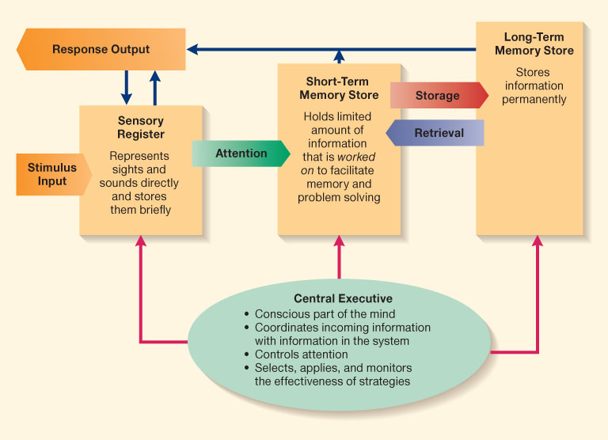
Information Processing Model

