Slide 1
Fundamentals of Lifespan Development
November 12, 2014 – Emotional and social development in early adulthood

Slide 2
Video
Why 30 is not the New 20 – Ted Talk

Slide 3
Expectations for Presentation
Marks will be given for
Presentation clarity
Content of what you present
Notes to the class (over and above powerpoint)
Time management
YOU MUST SHOW UP OR YOU DO NOT GET ANY POINTS FOR THE PRESENTATION

Slide 4
Notes Should Contain
3 to 5 terms with their definition and a short summary about how they apply to a phase of development
For example,
Assimilation refers to a process during which we use our current schemes to interpret the external world.
Assimilation is one of the processes in Piaget’s theory of adaptation. In the sensory motor stage of Piaget’s cognitive development theory, a child will accommodate – create new schemes to interpret the world – or assimilate to make sense of the external world. These two processes are in a state of equilibrium or disequilibrium.
Brief summary of your topic
Short abstract

Slide 5
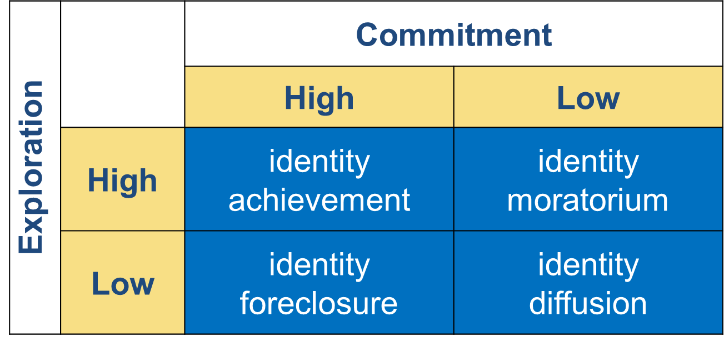
Paths to Identity

Slide 6
Emerging Adulthood
Explore alternatives in:
Education
Work
Personal values and behavior
Routes to adult responsibility vary in:
Timing
Order
Develop a more complex self-concept

Slide 7
Identity Development in Emerging Adulthood
Explore in breadth and depth
Depth: higher in self-esteem, well-being, adjustment
Too much breadth: poor adjustment, anxiety, depression, deviant behavior
Dual-cycle model
Fluctuating between making new commitments and evaluating old ones

Slide 8
Cultural Change, Cultural Variation and Emerging Adulthood
Cultural change
Entry-level positions require more education
Wealth, longevity free young people from immediate entry to work force
Emerging adulthood largely limited to:
Middle- and high SES in industrialized nations
Wealthy, privileged few in developing countries
Some researchers question whether emerging adulthood is a distinct period

Slide 9
Resilience
Resilience – The capacity to overcome challenges and adversity.
Factors that foster resilience in emerging adulthood
Cognitive Attributes
Emotional Attributes
Social Attributes
Social Support

Slide 10
Erik Erikson – Intimacy vs Isolation
Intimacy
Making a permanent commitment to intimate partner
Redefining identity
Secure identity associated with fidelity
Isolation
Loneliness, self-absorption
State of searching

Slide 11
Levinson’s Seasons of Life
Early adult transition
Dream
Women have “split dreams”
Mentor
“Age-30 transition”
Men “settle down”
Women remain unsettled
Occupational or relationship commitments

Slide 12
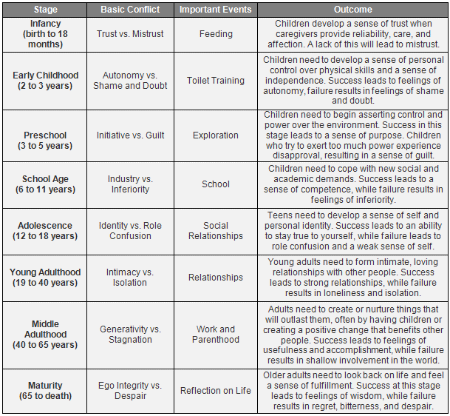
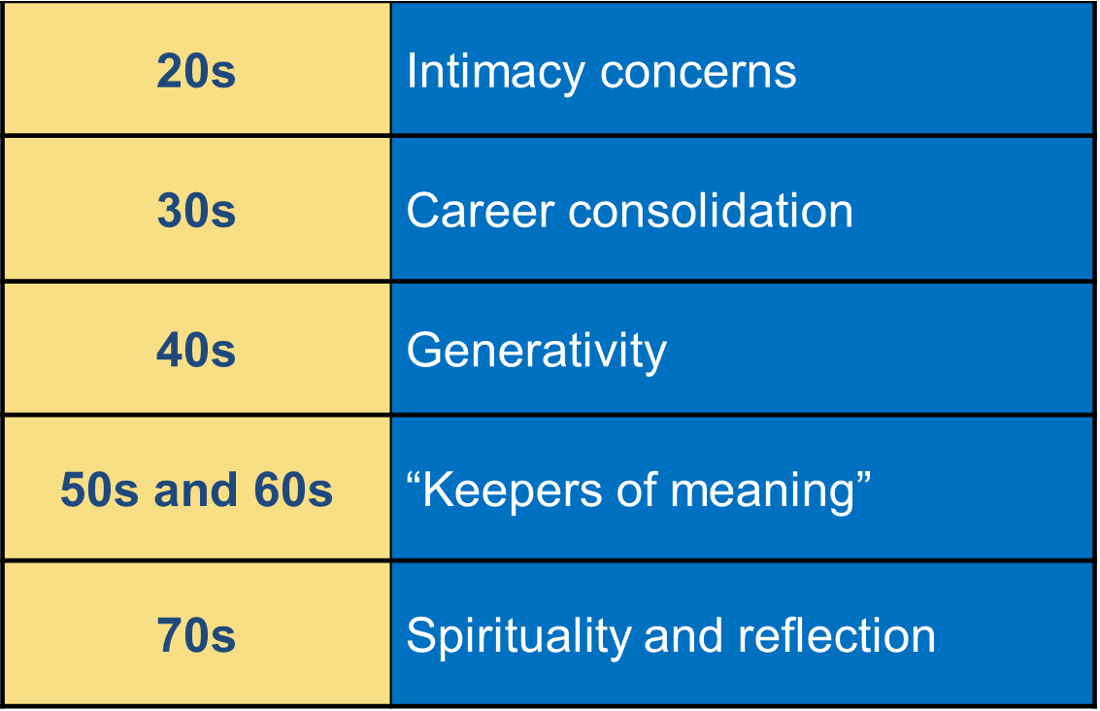
Vaillant’s Adaptation to Life

Slide 13
Social Clock
Age-graded expectations for life events
Less rigid than in earlier generations
Following a social clock lends confidence, contributes to social stability
Distress if not following or falling behind

Slide 14
Relationships
What do you look for in a relationship?
Gender differences?
Most select partners similar to themselves
Evolutionary perspective
Social learning view
Higher value placed on attributes that contribute to relationship satisfaction

Slide 15
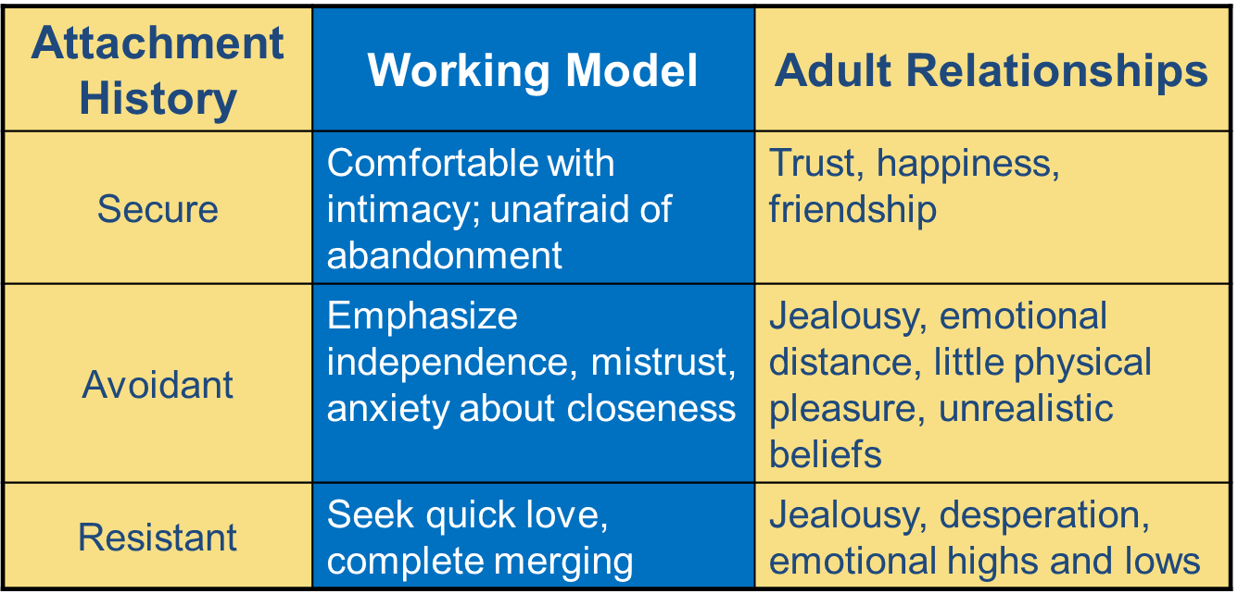
Attachment Patterns and Adult Relationships

Slide 16
Triangular Theory of Love
Intimacy: warm, tender concern
Passionate love: sexual attraction
Companionate love: affection and caregiving
Passionate love early, companionate love later
Passion gradually fades, while intimacy and commitment strengthen

Slide 17
Friendships
Same-sex
Other-Sex
Siblings
Parents

Slide 18
Family Life Cycle
Family Life Cycle – A series of Phases characterizing the development of most families around the world.
Leaving home
Getting Married
Divorce
Singlehood
Cohabitation
Parenthood
The Nag Factor – The Corporation
Step-Parent Hood
Career

Slide 19
Factors Related to Marital Satisfaction
Family backgrounds
Age at marriage
Timing of first pregnancy
Relationship to extended family
Marital patterns in extended family
Financial and employment status
Family responsibilities
Personality characteristics
Positive biases of partner’s attributes

