Slide 1
Fundamentals of Lifespan Development
February 3rd – Social and Personality development in infancy

Slide 2
Video
Erik Erikson – 5:40
Harry Harlow
Mary Ainsworth
John Bowlby

Slide 3
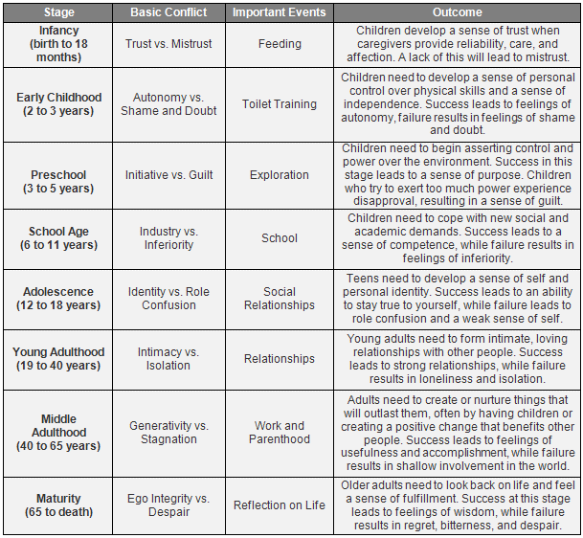
Erikson’s Psychosocial Stages

Slide 4
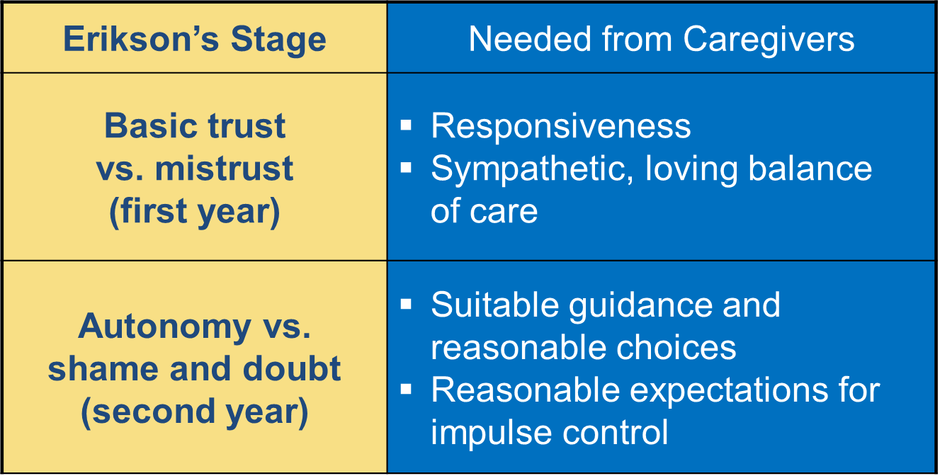
Erikson’s Psychosocial Stages

Slide 5
Bowlby’s Ethological Theory of Attachment
Non-focused orienting and signaling (Birth to 3 months) – Babies want attention from anyone whom they come in contact. Grasping, crying, smiling, gazing, etc..
Focus on one or more figures (3 to 6 months) – Direct attention from less people.
Secure base behavior (6 – 24 months) – Proximity seeking from ‘safe bases’. Primary caregiver (or multiple ‘primary care givers”).
Internal model (24 months +) – Reciprocal exchanges in developing bonds with caregivers.
Key words
Attachment – Emotional bond
Synchrony – Mutual pattern of attachment behaviours
Stranger anxiety – Afraid of strangers
Separation anxiety – Don’t want to be away from primary caregiver
Social referencing – Looking for cues by their attachment figures to help them figure out what to do in situations

Slide 6
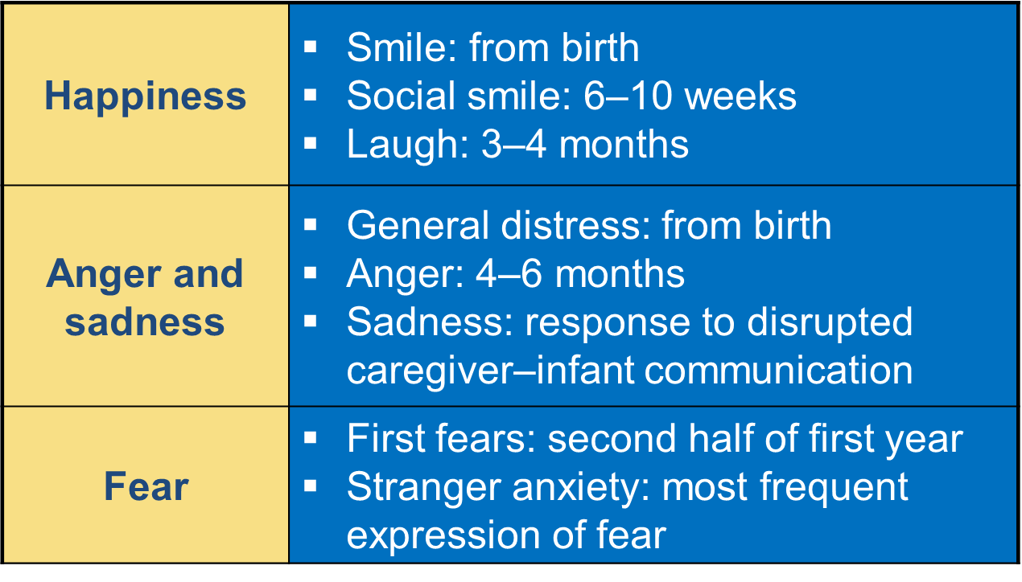
Development of Basic Emotions

Slide 7
Ainsworth Attachment Styles
Strange Situation Paradigm
Secure attachment (60%)
Avoidant attachment (15%)
Resistant attachment (10%)
Disorganized/disoriented attachment (15%)
Cultural Variations
Factors that affect attachment
Early emotional availability of consistent caregiver
Contingent responsiveness
Marital status & socioeconomic status & mental health of primary caregivers
Infant characteristics
Parents’ internal working models
Multiple Attachments to:
Mothers
Fathers
Siblings
Grandparents
Professional caregivers

Slide 8
Dimensions of Temperament
Thomas & Chess (1977)
Easy child (40%)
Difficult child (10%)
Slow to warm up (15%)
Not in a category (35%)
New Theories
Activity level
Approach/positive emotionally/sociability
Inhibition and anxiety
Negative emotionality/irritability/anger
Effortful control/task persistence
Origins: Heredity, neurological process, environment, goodness of fit

Slide 9
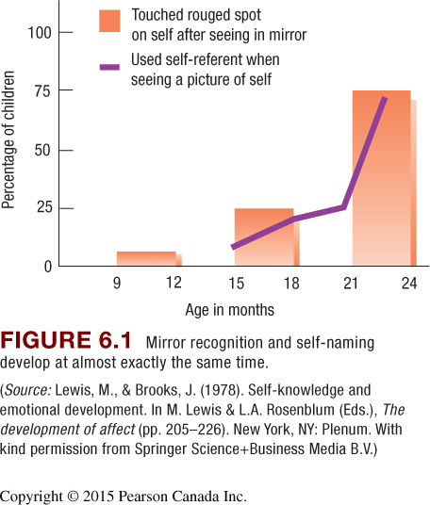
The Self
Self concept
Internal model
Object permanence
Daily interaction with objects (goal directed behavior)
Subjective self
Separate from others
Interaction with the environment (assimilation & accommodation)
Objective self
Awareness of self as a separate unique individual (defined through various categories)

Slide 10
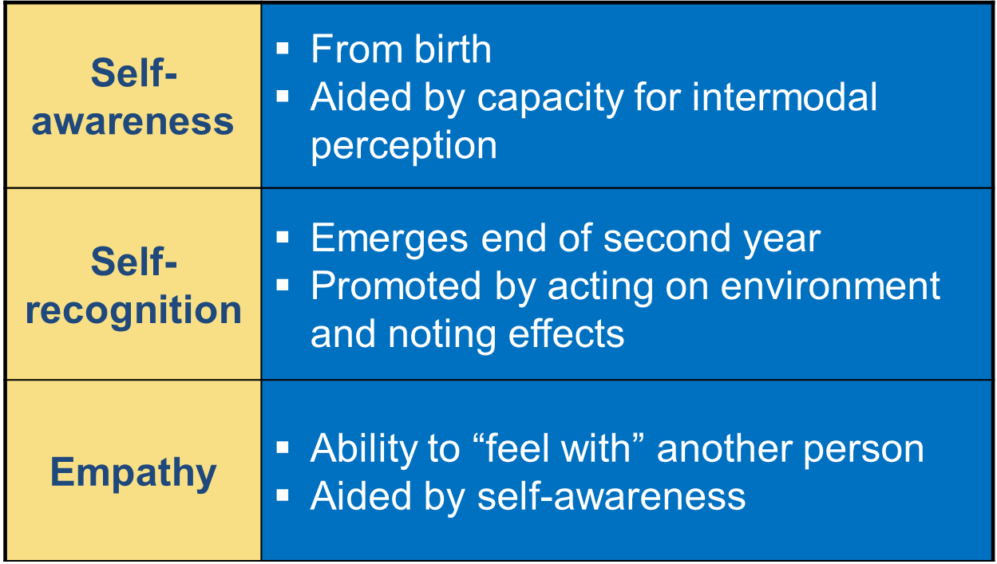
Self-Development
Self-categorization (2nd year) – Develops along with language
Self-control
inhibit impulses
manage negative emotions
behave in socially acceptable ways
Self-control depends on:
awareness of self as separate, autonomous being
confidence in directing own actions
memory for caregiver’s directives

Slide 11
Discussion
What would your parents say about your temperament as an infant?
When you were young, what was your attachment style with your parents? Secure, ambivalent, avoidant, or disorganized? What factors may have contributed to your attachment style?

