Slide 1
Fundamentals of Sensation and Perception
The world, mind and brain
Erik Chevrier
September 14th, 2015

Slide 2
Reality & Representations
How do you know if the things we sense and perceive are real?
Do we see reality as it is?

Slide 4
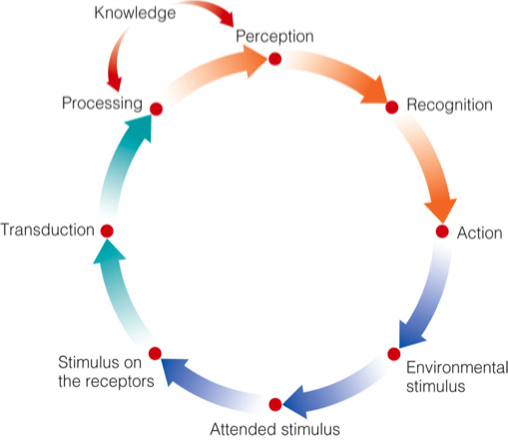
Sensation and Perception

Slide 5
Neurons and Neural Signals

Slide 6
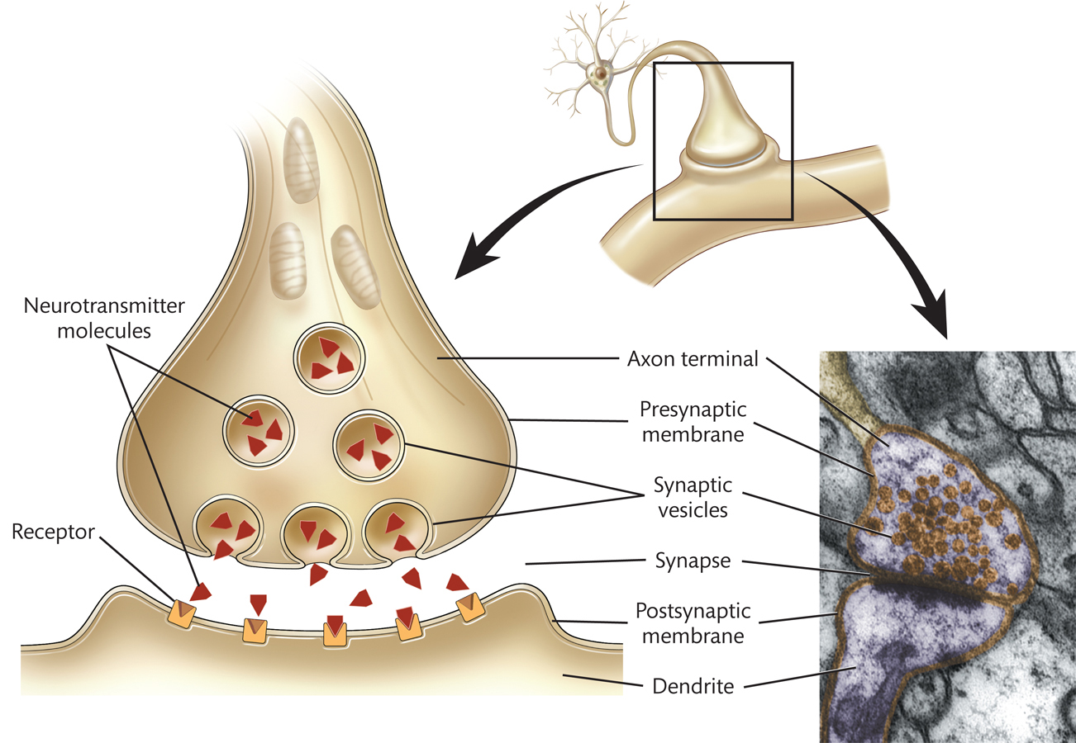
Neurotransmitters

Slide 7
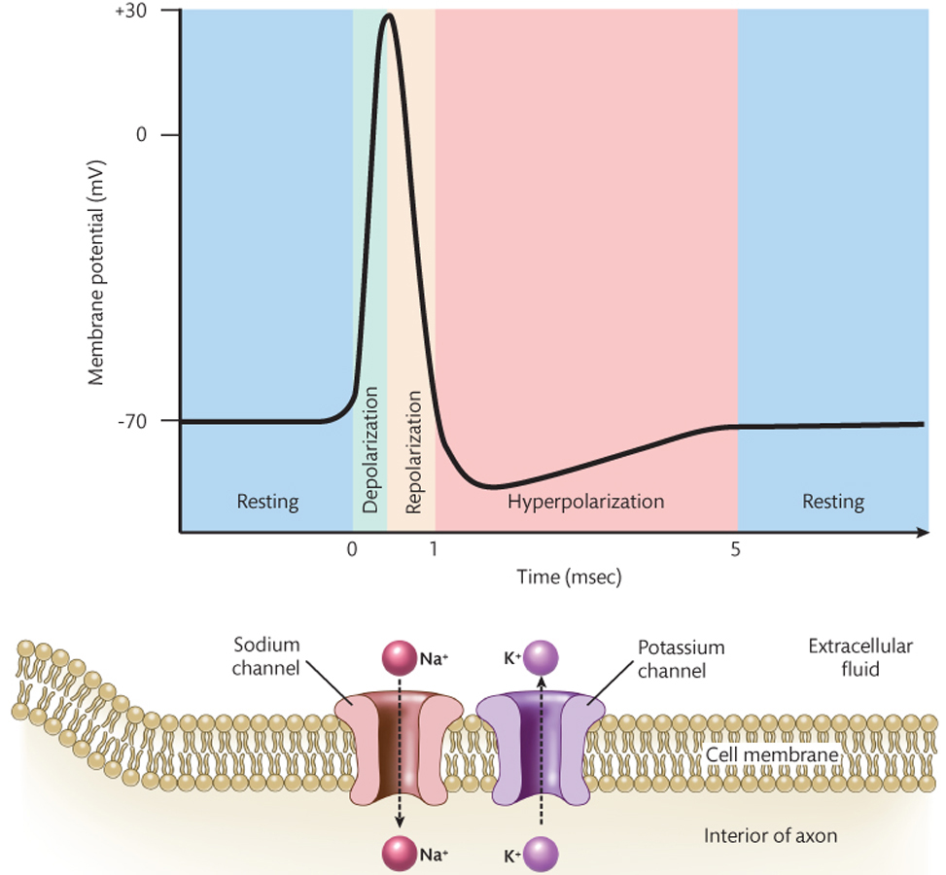
Action Potential

Slide 8
Transmitting Signals Between Neurons
Excitatory Neurotransmitters – Have excitatory effect on post-synaptic neuron, increasing probability of action potential. (EPSP; excitatory postsynaptic potential)
Inhibitory Neurotransmitters – Have inhibitory effect on post-synaptic neuron, decreasing the probability of action potential. (IPSP; inhibitory post synaptic potential)

Slide 9
The Brain
Cerebral Cortex – Outer most layer of cerebral hemispheres
Grey – Mainly cell bodies of neurons, makes up cerebral cortex
White matter – Myelin covered axons of cortical neurons
Corpus callosum – Major connection between the two hemespheres
Gyrus – Elongated bump on the surface of the cerebral hemispheres
Sulcus – Indentation between two giri on the surface of the cerebral cortex

Slide 10
The Brain
Amygdala – Important for Emotion
Hippocampus – Important for Memory
Thalamus – Most neural signals from sensory organs pass through

Slide 11
Cognitive Neuropsychology
Cognitive Neuropsychology – The investigation of perceptual and cognitive deficits in individuals with brain damage in order to discover how perception and cognition are carried out in the normal, undamaged brain.
Modularity – The idea that the human brain consists of distinct modules, each of which carries out one or more specific functions.
Dissociation – In cognitive neuropsychology, a pattern of brain damage and impaired function in which damage to some specific brain region is associated with impairment of some specific function but not impairment of another function.
Double Dissociation – In cognitive neuropsychology, a pattern of brain damage and impaired functioning in which damage to some specific brain region is associated with impairment of some function A but not with impairment of another function B, along with a pattern (in a different patient) in which damage to a different region is associated with impairment of function B but not with impairment of function A.
Assumption of Cognitive Uniformity – The assumption that the functional organization of human cognition and of the brain is essentially the same in everyone.

Slide 12
Functional Neuroimaging
Electroencephalography (EEG) – Measurement of electrical fields associated with brain activity.
Magnetoencephalography (MEG) – Measurement of magnetic fields associated with brain activity.
Positron Emission Tomography (PET) – Measurement of changes in blood flow associated with brain activity.
Functional Magnetic Resonance Imaging – Measurement of the changes in blood oxygenation associated with brain activity.

Slide 13
Videos
Mapping the Brain
Neurons – Function of and Types if Neurons
Bittersweet Biology – Action Potentials

