Slide 1
Fundamentals of Sensation and Perception
Group project
Erik Chevrier
September 28th, 2015

Slide 2
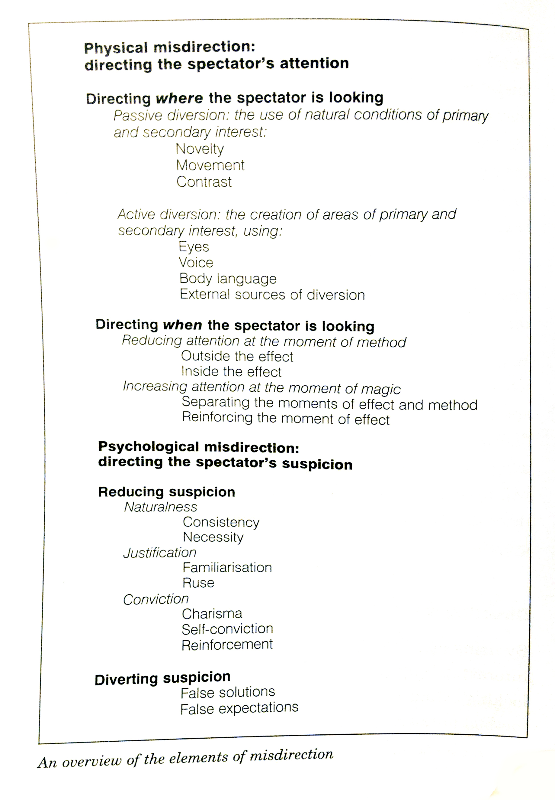
Attention and Magic

Slide 3

Perception of the World Via Media

Slide 4
Advertising and Attention
Compare and contrast ads!
Dove Evolution
http://www.youtube.com/watch?v=hibyAJOSW8U
Axe Body Spray
http://www.youtube.com/watch?v=7DpoavYXMK4&feature=related

Slide 5
From Now Until The Midterm Exam
September 28th Group Project
September 30th Sound and the Ears Chapter 9
October 5th Sound and the Ears Chapter 9
October 7th The Auditory Brain Chapter 10
October 14 The Auditory Brain Chapter 10
October 19 Group Project – Readings Discussion
October 21 Midterm Exam
The Midterm will cover:
  Chapters 1, 8, 9, and 10
  Anything else covered in class
  PowerPoint Slides

Slide 6
Group Project
1 – Pick a topic from the text book (today)
  We will make 10 groups of 6 people based on the topic that interests you
2 – You will perform a literature search based on the topic you chose
  Each member of the group will perform a literature search on the topic
  Each member will write a list of articles that they found
  Each member will chose 3 articles from the list, and read them before October 19th
3 – On October 19th, the groups will discuss the readings
  The group will discuss the articles they read with other group members
  The group will revise/refine the reading list
  The group will pick about 10 – 20 sources for the final project

Slide 7
Group Project
4 – Reading for final project
  Each member of the group will read the articles from the revised list
5 – Reading Discussion 2 – Date to be announced
  Each group will meet and discuss the full set of readings
6 – Groups will divide into two subsections – Presentation or Paper
  Group members in charge of the presentation will prepare a 20 minute presentation on the topic
  Group members in charge of the final paper will be in charge of the final paper
  Everyone is in charge of editing the other subgroup’s material
7 – Presentation/submit final paper – December 10th
  Each of the presentation subgroup will present on the day set aside for the presentation
  Final paper will be due on the last day of class – December 8th

Slide 8
Grade Breakdown
Final Project = 10 %
Preliminary assessment = 2
Final Paper or presentation = 8
Literature review results are to be submitted on October 19th. Those who fail to submit the list of articles will be penalized 2 marks off the final project.

Slide 9
Pick a topic and form groups
One person should be in charge of taking notes
Exchange e-mail addresses and circulate the meeting notes
Submit a list of your group members and a topic your group wants to focus on

