Slide 1
Fundamentals of Sensation and Perception
The visual brain
Erik Chevrier
November 17, 2015

Slide 2
Video
What are all those Floaty Things in Your Eye?
The Evolution of the Human Eye
Optical Illusions Show How We See

Slide 3
Structure and Function of the Eye - Review

Slide 4
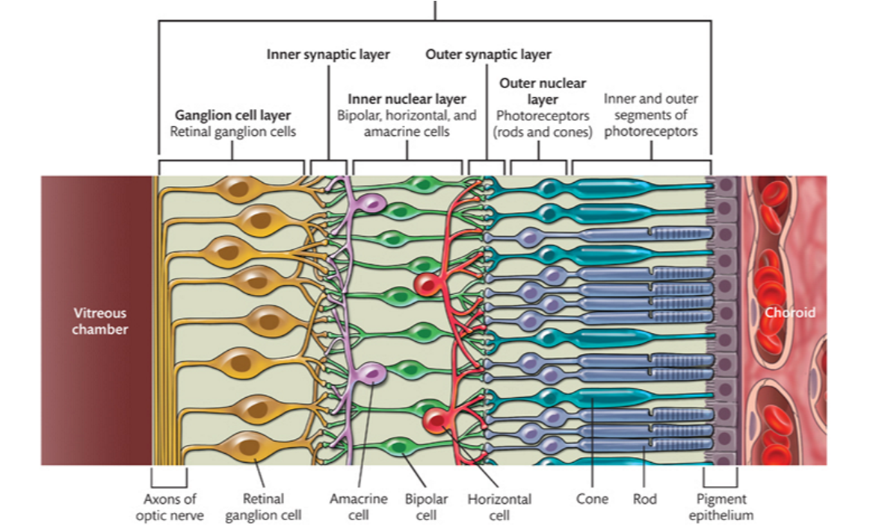
Retina - Review

Slide 5
Retina - Review

Slide 6
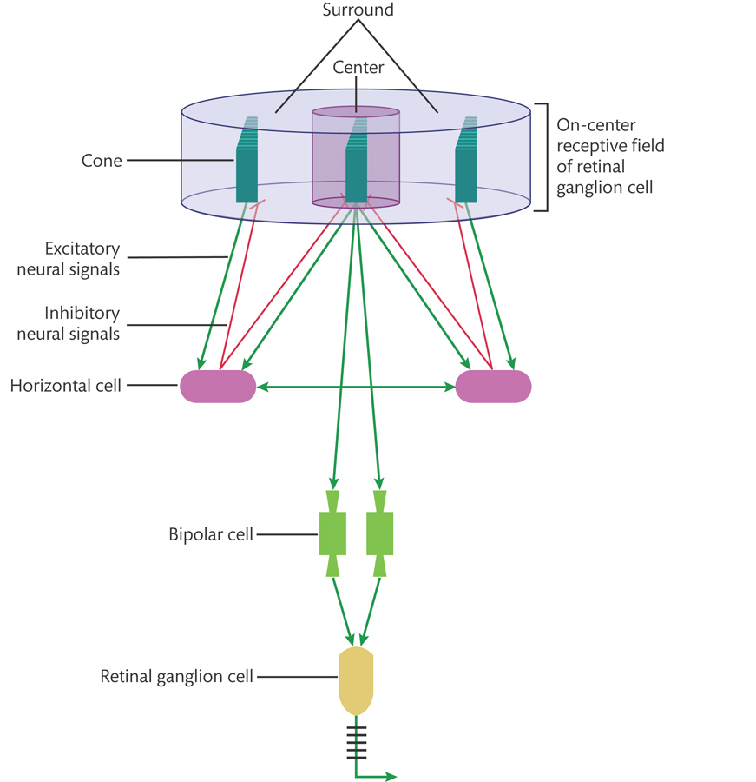
RGC Center-Surround Receptive Field - Review

Slide 7
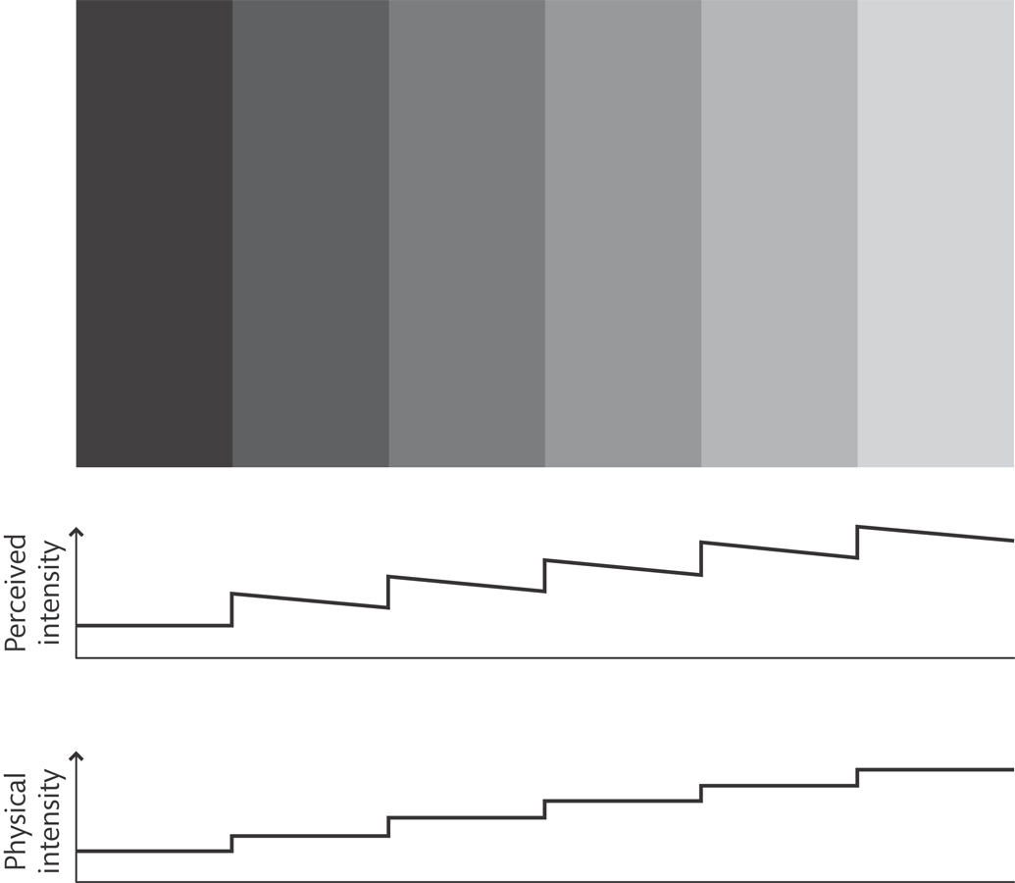
RGC Center-Surround Receptive Field - Review

Slide 8
The Visual Brain
Pathways and networks are organized by their:
Functional specialization
Shape, colour, motion, depth
Retinotopic mapping
Spatial arrangements of brightness and colour in the retinal image are echoed by the arrangement of the neurons throughout the visual system

Slide 9
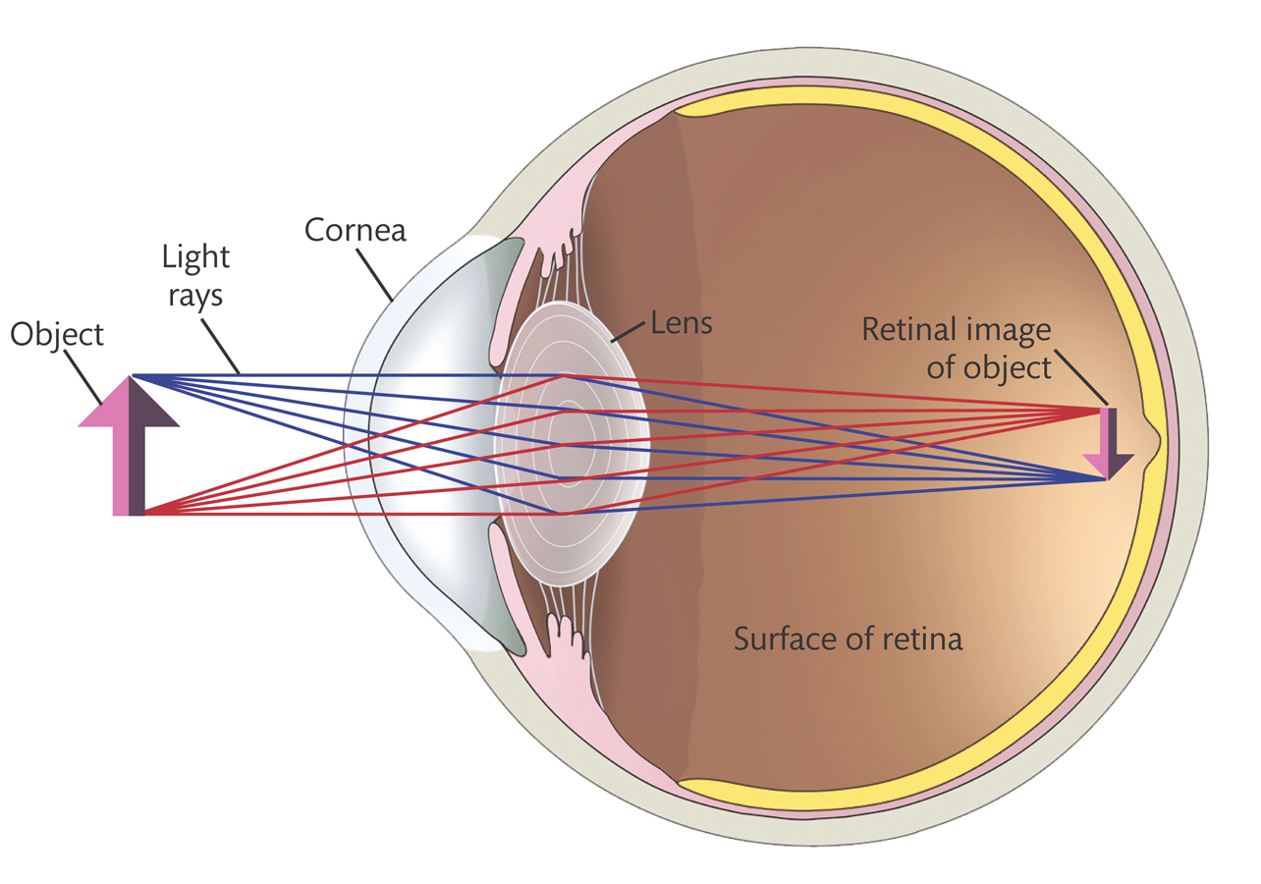
Transduction of an Optical Array

Slide 10
From Eye to Brain

Slide 11
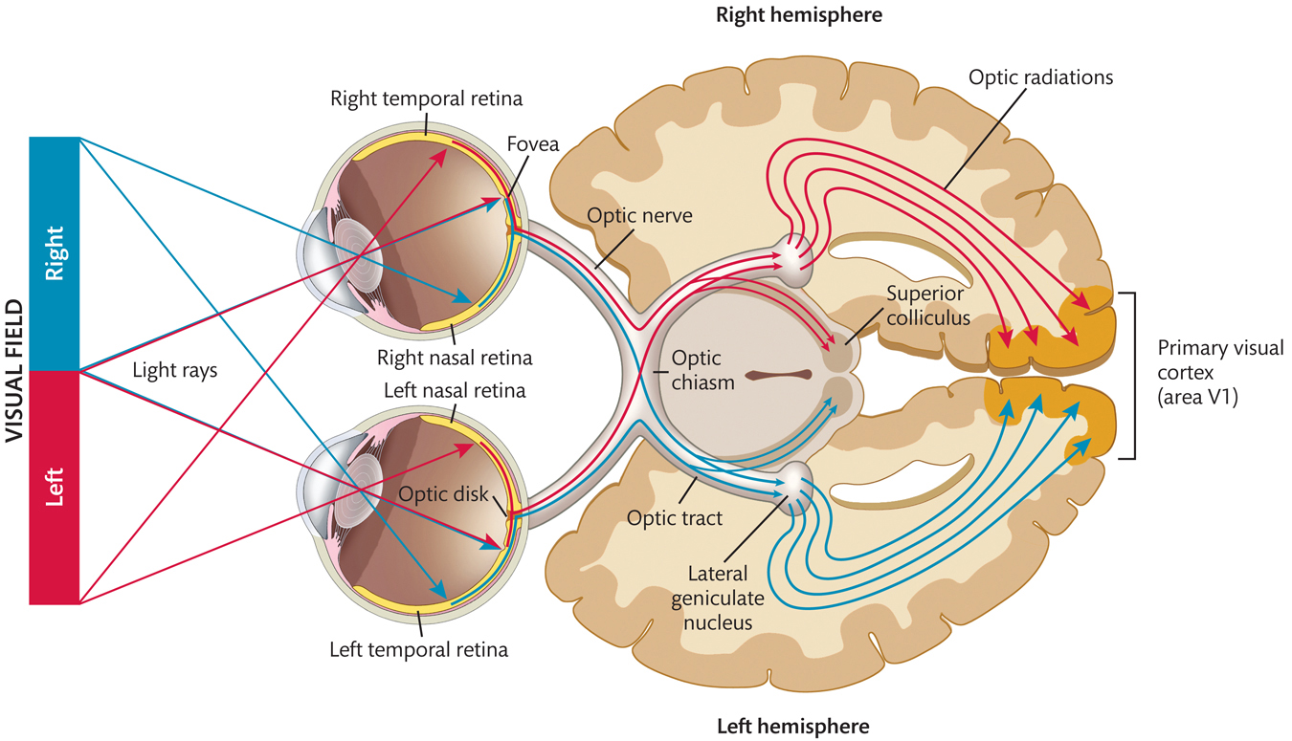
Lateral Geniculate Nucleus (LGN)

Slide 12
Lateral Geniculate Nucleus (LGN)

Slide 13
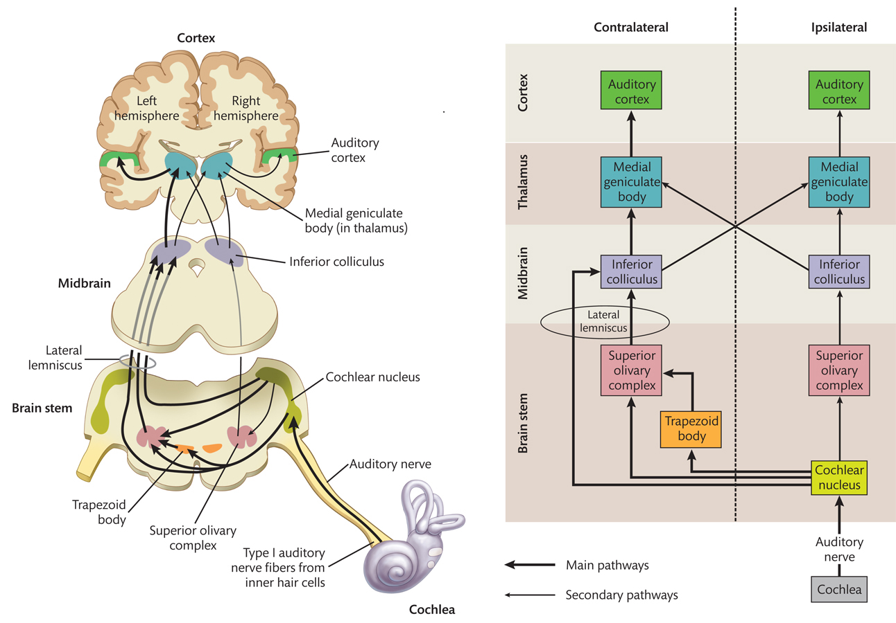
Audio and Visual Pathways

Slide 14
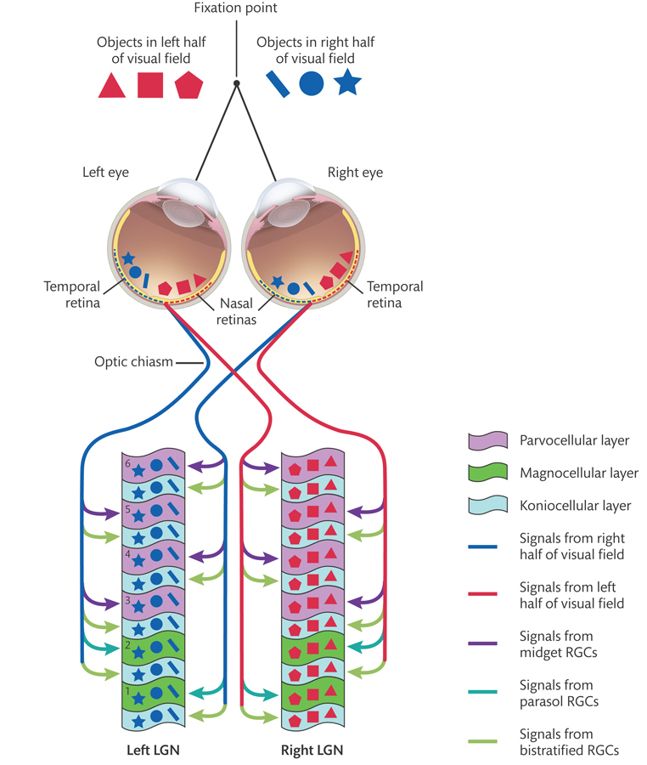
LGN

Slide 15
Function and Specialization of LGN
Magnocellular
Signals from parasol RGCs
Motion, flicker
Parvocellular
Signals from midget RGCs
Colour, texture, form, depth
Koniocellular
Signals from bistratified RGCs
Colour

Slide 16
Information Flow and Attention

Slide 17
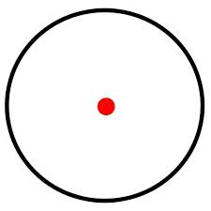
Information Flow and Attention

Slide 18
Superior Colliculus

Slide 19
Superior Colliculus
Principal function is to control rapid eye movements to visual targets
Cells are more concerned with where things are rather than what they are
Arrive almost immediately after leaving the eye
Travels from retina to areas beyond V1 receptor (Blindsight)
Receives signals from auditory and somatosensory systems (multisensory organ)
Systems reinforce each other

Slide 20
Primary Visual Cortex – Area V1
Two forms of cells
Simple
Complex
Preferred orientation to specific angles of edges
Also convey information about other features like colour, motion, length, size, depth.
Some neurons are selective to one type of feature, others respond to more than one feature.

Slide 21
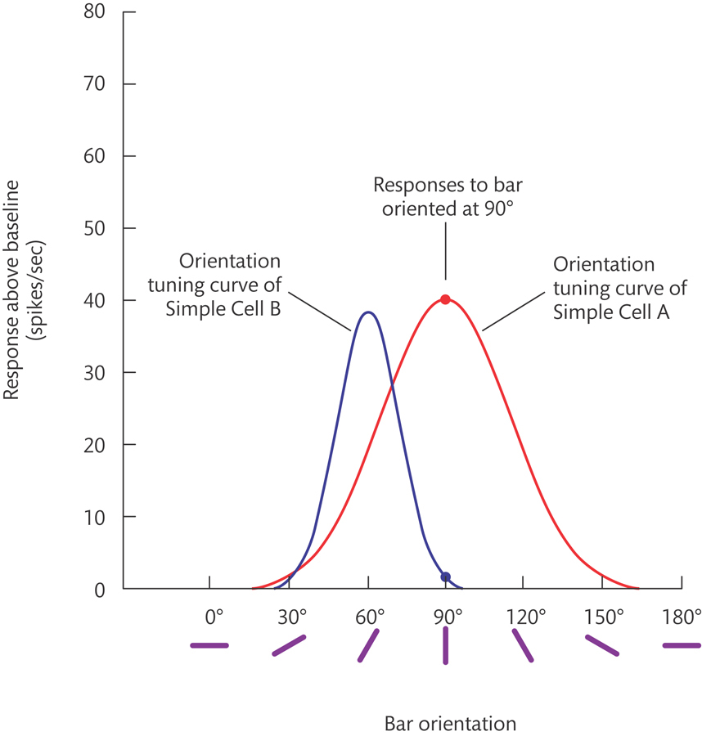
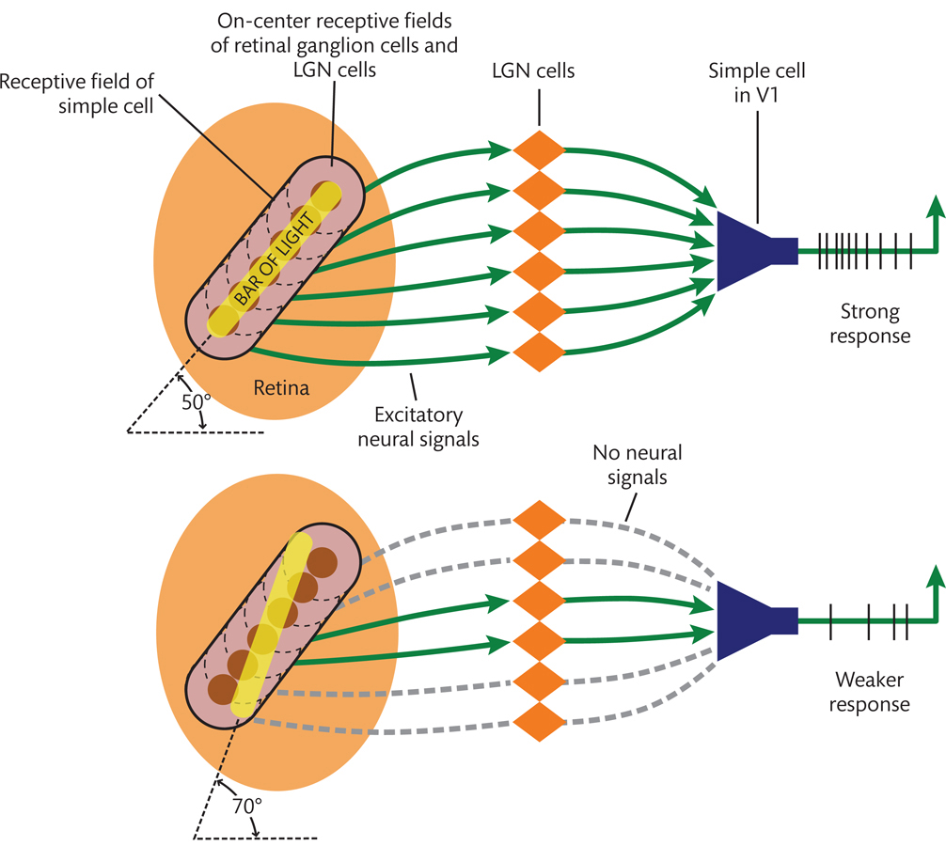
V1 Simple Cells

Slide 22
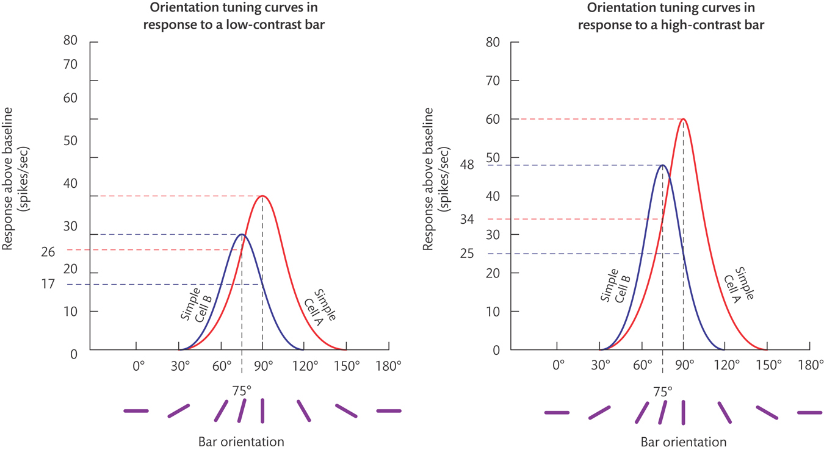
V1 Contrast

Slide 23
Complex Cells
Complex cells are like simple cells, they are tuned for orientation – they respond well to bars within a specific range of orientations flashed on their receptive field.
They are unlike simple cells in two main ways:
1 – Complex cells respond as well to a light on a dark background as to a dark bar on a light background. Simple cells respond well to one or the other, but not both.
2 – Complex cells respond equally well to a bar at almost any location within their receptive field. Simple cells respond best to a bar at a very specific location within their receptive field.

Slide 24
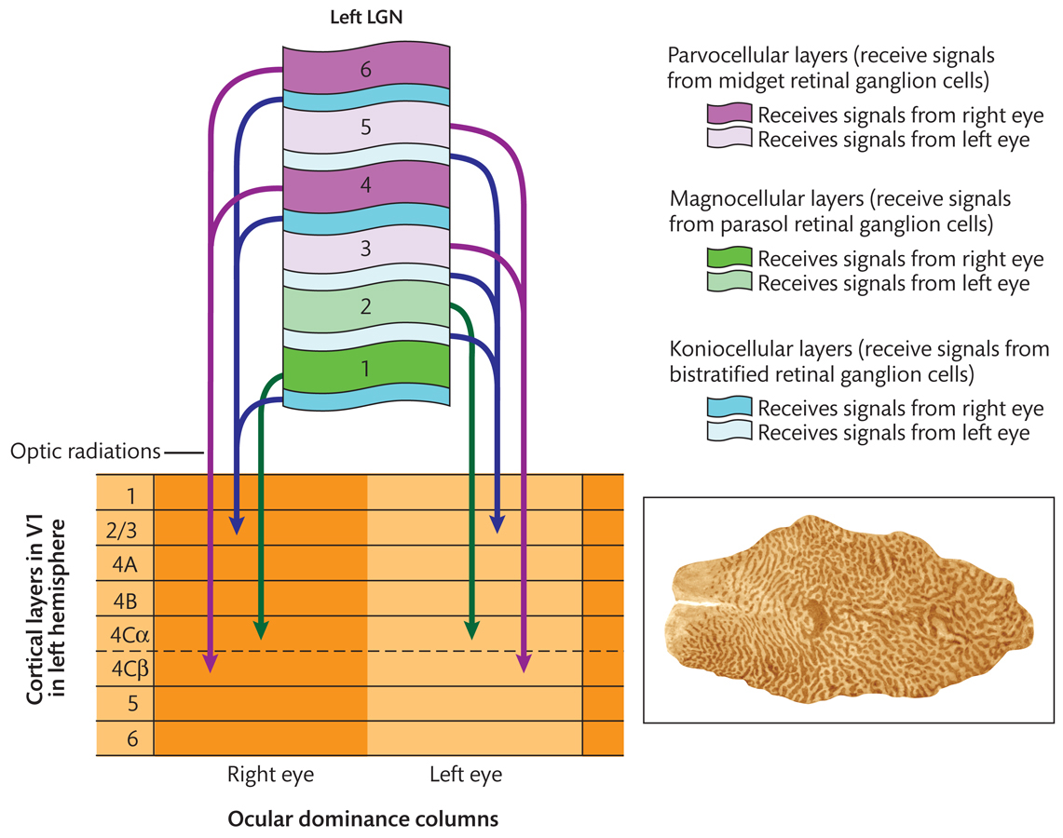
Organization of V1

Slide 25
Organization of V1

Slide 26
Organization of V1 Neurons
Ocular dominance columns
Adjacent columns have receptive fields in adjacent areas

Slide 27
Retinotopic Maps and Cortical Magnification

Slide 28
Retinotopic Maps and Cortical Magnification

Slide 29
Functional Areas, Pathways and Modules

Slide 30
Functional Areas
Differ according to the types and distributions of neurons within them
Differ according to the other areas in the brain from which they receive signals or to which they send signals
Differ according to the properties to which their constituent neurons are tuned
Each visual area contains a retinotopic map of the visual field

Slide 31
Pathways to the Brain’s Visual Area

Slide 32
Functional Modules
V4
Colour & curvature
Lateral occipital cortex
Complex shapes
Inferotemporal cortex
Fusiform face area
Parahippocampal place area
MT
Motion (direction and speed)
Intraparietal sulcus (parietal lobe)
Role in visually guided action

Slide 33
Questions?
Have a great day!

