Slide 1
Media, Technology and Politics
Media in the Political and Socio-Economic Environment
Erik Chevrier
July 10th, 2017

Slide 2
Instructions for Short Paper
Chose a media product – message, campaign, blog post, video, movie, song
Perform an analysis of the media product using the Nesbitt-Larking Model of Politics, Society and the Media (page 2 of the course-pack)
Must be between 3 and 5 pages (double spaced; not including references & title page)
Must include at least 5 references (peer-reviewed journals and/or reliable sources of information)
Point allocation:
8 points – Comprehension of the Nesbitt-Larking Model: Politics, Society and the Media — How well did you describe your media product according to the model? Did you take into consideration each concept (owners & tools, texts, readings, socio-political environment) and the relationships between these concepts?
5 points – The clarity of the report – Are the arguments clear and concise? Is the report organized properly? - When in doubt, use this formula – main argument, support, evidence
5 points – Information in the report – Is the evidence convincing, relevant, and valid/reliable?
2 points – Grammar and citation– Has the report been properly proofread? Is every reference properly cited?

Slide 3
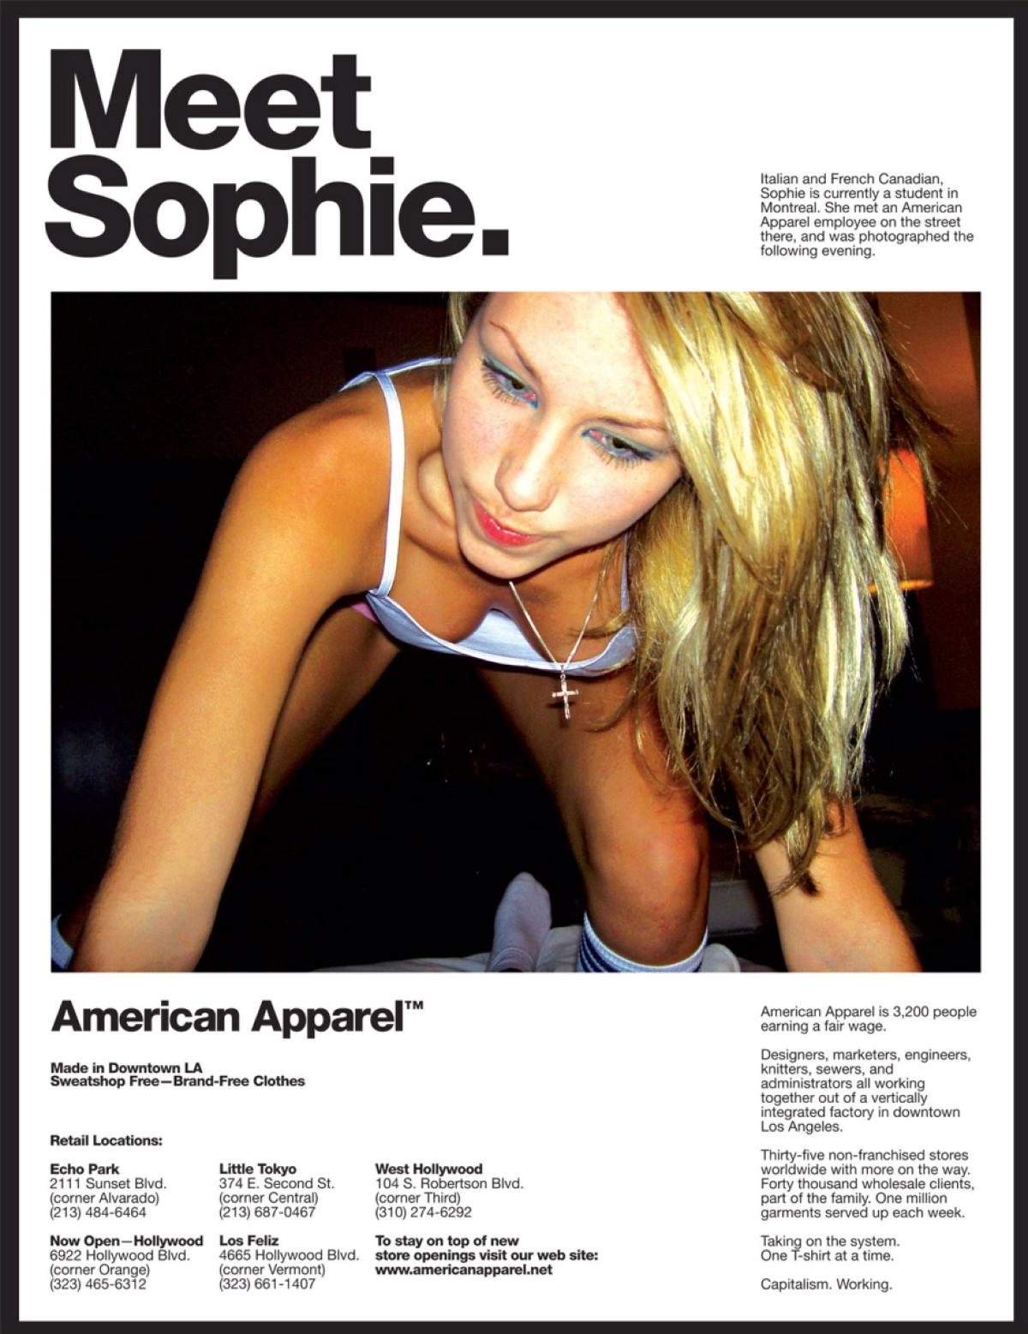
General Framework
Paul Nesbitt-Larking. Politics, Society and the Media (2nd Edition). Broadview Press. 2009.
Example:

Slide 4
How to Study for the Exam
1 –The exam will contain questions about the readings – make sure you do all the readings.
2 – The exam will contain questions about topics we discussed in class – review all the PowerPoint slides and know what we talked about in class.
3 – You DO NOT need to know the Red Campaign or the Axe/Dove ads. You also DO NOT need to know the videos from the slide titled, In the Media. These videos were shown to generate a discussion about how to analyze media products.
4 – The exam will consist of 11 questions – you must answer 10 of them.

Slide 5
Revisited from Last Class
CRTC Upholds the Broadcasting Act – Content that meets the needs and Interests of Canadians
CRCT regarding censorship – The CRTC is not a board of censors, and can't tell broadcasters what they can air. However, certain standards apply to the content of programs, and broadcasters are expected to comply with these standards.
Complaints regarding content should be directed to the broadcaster in question
CBC complaints go to the CBC Ombudsperson
Canadian Broadcast Standards Council – Handles broadcast complaints from members.
AD Standards – Handles broadcast complaints from advertisers
Hate speech is handled by the Canadian Human Rights Commission
For sexual harassment and child sex abuse – Complaints are to be directed to CyberTip

Slide 6
Define the following…
How would you define this object?
Where did the meaning of the object derive?
Does the meaning of this object depend on time and space? If so, how?
Are there alternative ways of defining this object? If so, what are they?
What is the media’s role in constructing the meaning of this object?
What is a commodity?

Slide 7
Media and Culture
According to Nesbitt-Larking, culture is…
The general process of intellectual, spiritual, and artistic development of a people.
The entire way of life of a people, in terms of those practices and facts through which they express their meaning.
High culture – the works and practices of intellectual artistic activity
Culture is the way of life of a people, in particular their evolving ideas, beliefs, and values as they are understood, communicated and represented.
Ideologies are deliberate and partial fabrications of beliefs, values and ideals.
An ideological gambit mines the deepest seams of common sense and gives a particular and partial reading of the world, while appearing to be universal and uncontroversial.
What is Canadian culture?

Slide 8
What Makes up Canadian Culture?
I am Canadian I am not Canadian Tim Horton's Molson Hockey Ad Heritage Minute

Slide 9
Institutions that Maintain Ideology
Urie Bronfenbrenner – Ecological Systems Theory

Slide 10
Hegemony (Nesbitt-Larking, 2009)
Antonio Gramsci
Hegemony – People come to accept the legitimacy of the economic and political system when it is carefully articulated in a manner that approximates their already existing common sense.
Rule by consent – people produce and re-produce political and economic systems via their participation in the system. Capitalism is produced and re-produced everyday by people who produce, distribute and consume products.
1 – Although people can be persuaded, coerced and even seduced, they are never entirely lacking creative capacity to question versions of reality that are suggested to them.
2 – People have the capacity to go along with something even when they only half believe or scarcely believe it.
3 – The arena of common sense is constantly open for appropriation.

Slide 11
What is Capitalism?
Private ownership of the means of production
Labourers work for capitalists
Capital is virtual and physical
An exchange based system (money)
A system that permits the endless accumulation of wealth
Profit motive
Workers do not own the products of their labour
Alienation/exploitation/monopoly
Can manifest in many ways
Corporatism
No state intervention

Slide 12
The Birth of Consumerism
We Deliver Young People
YUL-LAB
Advertising and the End of the World

Slide 13
Early Capitalism (1600 - 1900)
Little to no leisure time for working class
Rampant poverty
Mostly subsistence wages
Work mainly done by hand or with assistance from basic machines and animals
Billboard and print advertising
People mainly consumed what they needed to survive

Slide 14
Middle Capitalism (Late 1800 - 1950)
Development of more advanced machinery
Fordism & the introduction of more efficient assembly line practices
Workers are better paid
Work hours were reduced (more leisure time)
Introduction of psychology into advertising
Workers are able to consume luxury items over and above what they need to survive

Slide 15
Later Capitalism (1950 - today)
Rapid advancement of science and technology
Planned obsolescence
Global expansion of industrialized capitalism
Expansion of products and services
Consumption is a central part of the market
Advanced advertising techniques
Workers must be able to continuously consume in order for the capitalist market to function

Slide 16
Rise of Modern Advertising
Begin at about late 1600 in France billboard
1700 – Newspaper & magazine & advertising agencies as brokers
1900 – Sears & Cosmopolitan Magazine
1920 – Psychology & Ed Bernays & Radio
1950 – Television & motion picture
1980 – Internet & data mining
2000 – Product integration & interactive advertising
Today – Multiple profuse convergent network (clutter)

Slide 17
How is this Relevant to Media?
Media can be produced by governments, companies, groups, and individuals.
In a capitalist system:
Media companies are capitalist firms in a global market
Media messages (adverting) facilitate consumerism
Media products are sold on the capitalist market
Media produces and reflects the ideology of capitalism

Slide 18
Three Main Theories – Nesbitt-Larking
Liberal Pluralism:
Unified totality, with common values & ideals that have come to sustain society
Everyone pursues private interest
A set of responsive institutions that enact demands from the plurality (liberal democracy)
Media are mirrors reflecting reality (they do not shape reality)
Competition of ideas (everyone can express their viewpoint)
Elite Theory:
Small group of men control the means of production of communication
Culture is determined by the small group of men who control communications
Masses are passive consumers who are being manipulated
Critical Theory:
Marx, Gramsci, Raymond Williams
Media produces and reflects hegemonic ideology
Media is owned by wealthy elite but each have their own interests (profit)

Slide 19
Political Culture, Ideology, and Media
Signs – A combination of signifier and signified
Signifier – The physical existence of what carries meaning
Signified – The mental representation that is the meaning
Denotative meaning – Common sense, obvious meaning
Connotative - Interaction of denotative meaning and one’s subjective feelings
Sub/counter ideology?
Factors that influence the extent to which people are impacted by cultural symbols (Schudson)
Retrievable in memory (priming)
Rhetorical force (ability to move us)
Resonance (ability to tie to other cultural symbols)
Institutional retention (linking to existing structures of power and influence)
Resolution (ability to motivate, convince, structures understanding, inmstigate)

Slide 20
Modern Signs and Symbols

Slide 21
Modern Signs and Symbols

Slide 22
Modern Signs and Symbols

Slide 23
Modern Signs and Symbols
First MacDonald's TV Ad

Slide 24
Characteristics of ‘Media Shock’(Taras, 2015)
1 – Media changes rapidly and suddenly 2 – Web-based media have permeated virtually every aspect of life 3 – Individuals can alter top down flows of information 4 – There is a greater concentration of media than ever before 5 – Media is converging 6 – Traditional media is loosing audience 7 – Television continues to dominate public and cultural life but in radically new ways 8 – Media facilitates global communication 9 – Social media have created a new cultural, business and political dynamic 10 – Government, political parties and corporations are gathering vast amounts of personal information

Slide 25
Concerns Regarding ‘Media Shock’(Taras, 2015)
Negative effects on news industry
Mass audiences are becoming a thing of the past
Production of a drop-out culture, ‘peek-a-boo’ citizens
- Crisis in traditional media - Crisis in public broadcasting - Crisis in news and journalism - Crisis in citizen engagement

Slide 26
Culture Jamming
Reverend Billy
Banksy
Culture Jam
Global Invisible Theater

Slide 27
Questions?
Questions or concerns?

