Slide 1
Food and Culture
Sustainable Food and culture
Erik Chevrier
October 31st, 2017

Slide 2
Discussion About Readings
November 2 – Slow Food and Culture Couninham, C., Van Estrik, P. (2013) Food and Culture; A Reader, Routledge. Chapter 28 – Leitch, A., (2009) Slow Food and the Politics of “Virtuous” Globalization, pp. 409 – 425. Chapter 29 – Taco Bell, Maseca, and Slow Food: A Postmodern Apocalypse for Mexico’s Peasant Cuisine?, pp. 426 – 436.
November 7 – Race, Class, Food and Culture White, M. M., (2011) D-Town Farm: An African American Resistance to Food Insecurity and the Transformation of Detroit, Environmental Practice, 13, 4.
November 9 – Who Really Feeds the World – Agroecology and Soils Shiva, V. (2016) Who Really Feeds the World, North Atlantic Books. Introduction Chapter 1 – Agroecology Feeds the World, Not a Violent Knowledge Paradigm, pp. 1 – 14. Chapter 2 – Living Soils Feeds the World, Not Chemical Fertilizers, pp. 15 – 26
November 14 - Who Really Feeds the World – Pollinators and Biodiversity Shiva, V. (2016) Who Really Feeds the World, North Atlantic Books. Chapter 3 – Bees and Butterflies Feeds the World, Not Poisons and Pesticides, pp. 27 – 40. Chapter 4 – Biodiversity Feeds the World, Not Toxic Monocultures, pp. 41 – 54.
November 16 - Who Really Feeds the World – Seed Sovereignty and Small-Scale Farmers Shiva, V. (2016) Who Really Feeds the World, North Atlantic Books. Chapter 5 – Small-Scale Farmers Feed the World, Not Large-Scale Industrial Farms, pp. 55 – 65. Chapter 6 – Seed Freedom Feeds the World, Not Seed Dictatorship, pp. 67 – 84.
November 21 - Who Really Feeds the World – Localization and Women Shiva, V. (2016) Who Really Feeds the World, North Atlantic Books. Chapter 7 – Localization Feeds the World, Not Globalization, pp. 85 – 111. Chapter 8 – Women Feed the World, Not Corporations, pp. 111 – 124. Chapter 9 – The Way Forward, pp. 125 – 139.

Slide 3
Discussion
What is true? What is objective?

Slide 4
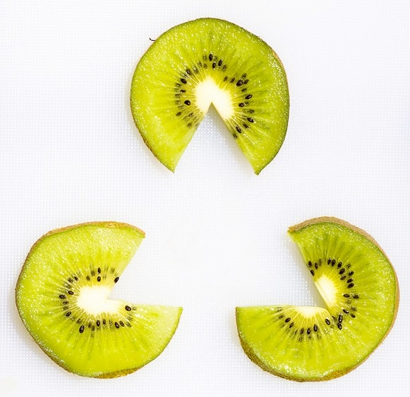
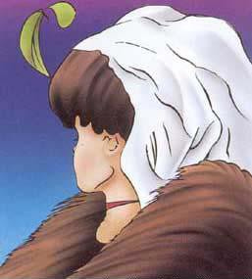
Perception is Subjective

Slide 5
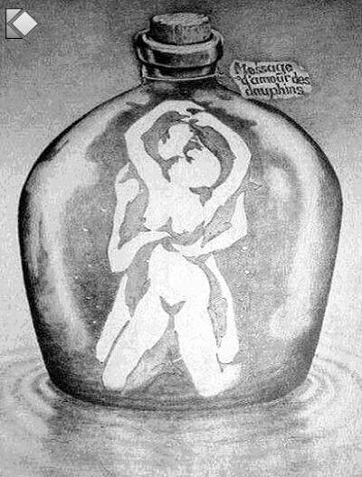
Perception is Deceptive

Slide 6
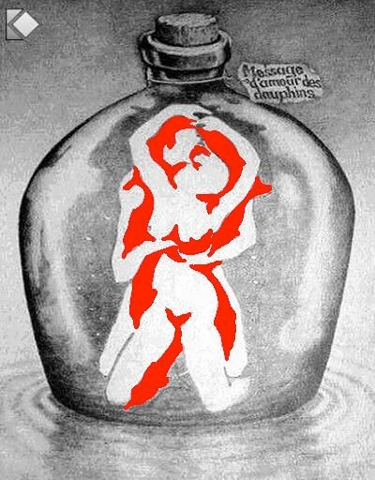
Perception is Deceptive

Slide 7
Sometimes we cannot even notice what’s right in front of us!

Slide 8
Group Assignments
Why are the group assignments important?
It is important to challenge the problematic dominant epistemological understandings of food.
Instead we should produce ontological formations of the world we want by co-creating and co-recreating social relations that produce positive outcomes on people and the planet.
Action based learning theories incorporate students and facilitators as co-learners and co-collaborators. Together, they learn by doing. They also connect with the community.
Epistemology – A term meaning “theory of knowledge,” which gets at the how we know about the social world that lies behind all theoretical approaches. (Frampton, Kinsman, Thompson, Tileczek, (2006))
Ontology – Assumptions relating to how the social comes into being that inform all theories and ways of writing the social. (Frampton, Kinsman, Thompson, Tileczek, (2006))
Overview and report back from each group

Slide 9
The Dominant Epistemological View of Food?
The world has or will soon have the agricultural technology available to feed the 8.3 billion people anticipated in the next quarter of a century. The more pertinent question today is whether farmers and ranchers will be permitted to use that technology. Extremists in the environmental movement, largely from rich nations and/or the privileged strata of society in poor nations, seem to be doing everything they can to stop scientific progress in its tracks. It is sad that some scientists, many of whom should or do know better, have also jumped on the extremist environmental bandwagon in search of research funds. When scientists align themselves with antiscience political movements or lend their name to unscientific propositions, what are we to think? Is it any wonder that science is losing its constituency? We must be on guard against politically opportunistic, pseudo-scientists…
Borlaug, N., E. (2000) Ending World Hunger. The Promise of Biotechnology and the Threat of Antiscience Zealotry, Plant Physiology, 124(2) pp. 488.

Slide 10
Critique of Dominant Epistemological View of Food
When poisons are introduced into agriculture to control pests, or when GMOs are introduced under the argument of “feeding the world,” the justification given is always “science”. But “science” does not have a singular entity, and it did not come into existence within a vacuum. Today, what we generally refer to as “science” is in fact Western, mechanistic, reductionist modern science, which became the dominant practice of understanding the world during the Industrial Revolution and has continued as the dominant paradigm….To shape the industrial system in the form of new, violent technologies, and to shape the capitalist system in the form of new, profit-driven economics, a certain type of science was promoted and privileged as the only scientific knowledge system. Two scientific theories came to dominate this new, industrial paradigm, and they continue to shape practices of food, agriculture, health, and nutrition even today. The first is a Newtonian-Cartesian idea of separation: a fragmented world made of fixed, immutable atoms…The second significant theory that has framed the knowledge paradigm for industrial agriculture is Darwin’s theory of competition as the basis for evolution…The Newtonian-Cartesian theory of fragmentation and separation and the Darwinian paradigm of competition, have led to a nonrenewable use of Earth’s resources, a nonsustainable model for food and agriculture, and an unhealthy model of health and nutrition. An emphasis on the legitimacy of these arguments as the sole “scientific” approach has created a knowledge apartheid by discounting the knowledge of Mother Earth.
Shiva, V. (Shiva, V. (2016) Who Really Feeds the World, North Atlantic Books, pp. 4 – 7.

Slide 11
Transitioning Toward Sustainable Food and Farming: Interactions between Learning and Practice in Community Spaces (Braun, Bogdan, 2017)
Opening paragraph:
Food is increasingly becoming a powerful arena in the struggle for a more ecological and socially just society. There is growing recognition that the choices people make around food have significant environmental and social impacts, both on their communities and around the globe.
How do we create social change regarding food practices?
What are desirable outcomes?

Slide 12
Transformative Learning Theory (Braun, Bogdan, 2017)
Transformative learning theory:
Examines how adults learn to negotiate and act on their own purposes, values, feelings and meanings – rather than those they have uncritically assimilated from others – to gain greater control over their lives as socially responsible decision makers.
Demands that people become aware of how they come to knowledge and of the values that lead them to their perspectives.
Occurs when an individual’s frame of reference, or structure of assumptions, shifts to one that is more inclusive, differentiating, permeable (open to other viewpoints), critically reflective of assumptions, emotionally capable of change, and integrative of experience.
Change can be sudden or incremental
Small change can produce ripple effects

Slide 13
Transformative Learning Theory (Braun, Bogdan, 2017)
Shift in Assumptions
Assumptions lead people to think and act without questioning their frame of reference and rejects ideas that do not fit in or the way they interpret their surroundings or experiences.
A shift of in frame of reference can occur through critical reflection on the assumptions upon which habits of mind or points of view are based.
Habits of mind are durable broad, abstracting, orienting, habitual ways of thinking, feeling, and acting influenced by assumptions that structure the way we interpret our experiences. Habits of mind become articulated in a specific point of view that is changeable and is composed of specific attitudes, beliefs, feelings, and values that filter interpretation.
Shifts in assumptions can occur through involvement in communicative learning or instrumental problem solving.

Slide 14
Instrumental Learning & Communicative Learning (Braun, Bogdan, 2017)
Instrumental learning:
Involves learning how to manipulate or control people or the environment to enhance performance through:
Scientific and technical knowledge
Legal administrative, and political procedures
Social and Economic knowledge
Evaluations of potential risks and impacts
Communicative learning:
Occurs when the following change:
Insight into one’s own interest
Insight into the interests and experiences of others
Communication strategies and methods through sharing knowledge
Social mobilization
Instrumental and communicative learning does not always produce transformative results

Slide 15
Social Practice Theory & Communities of Practice (Braun, Bogdan, 2017)
Social Practice Theory The principal implication of a theory of social practice is that the sources of changed behaviour lie in the development and enactment of practices themselves.
Practice as entity
Practice as performance
Shove et. al. (2012) practice consists of materials, competencies and meanings.
Communities of Practice CoP are groups of people informally bounded together by shared expertise and passion for a joint enterprise who share their experience and knowledge in free-flowing, creative ways that foster new approaches to problems. CoP theories examine how people learn socially from peers in their community.

Slide 16
Activist Methods Smith, G. (1990) Political Activist as Ethnographer, Social Problems, 37(4), 629 – 648.
1 – Start with the actual lives of people and undertake an analysis of a world known reflexively,
2 – Stake out an ontological commitment to a social order constituted in the practices and activities of people
3 – Take their analytic, the notion of “social relations”
4 – Are based on the use of meetings with government officials and professional cadres as ethnographic data
5 – Analyze texts such as media reports of government departments, in developing a description of how the ruling regime works
6 – Illustrate the necessity of the bracketing ordinary political explanations – the technique of the materialist epoch, in order to provide a scientific account of the social organization of a ruling regime.

Slide 17
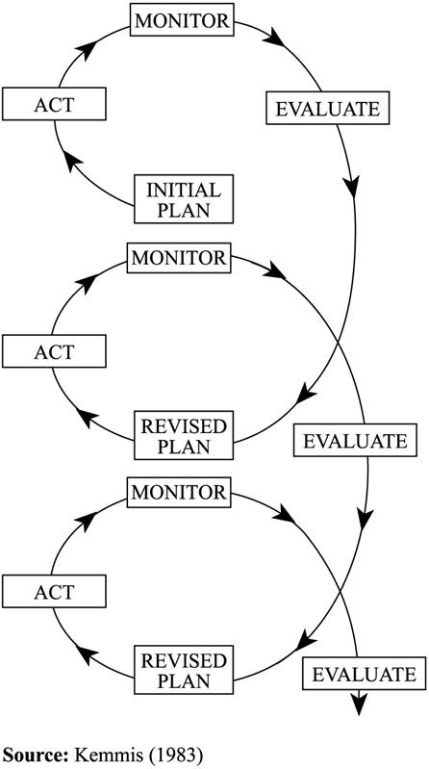
Action Research
1 – Action research integrates research and action. 2 – Action research is conducted by a collaborative partnership of participants and researchers. 3 – Action research involves the development of knowledge and understanding of a unique kind. 4 – Action research starts from a vision of social transformation and aspirations for greater social justice. 5 – Action research involves a high level of reflexivity and senility to the role of the self in mediating the whole research process. 6 – Action research involves explanatory engagement with a wide range of existing knowledge drawn from psychology, sociology, and other fields of science, in order to test its explanatory power and practical usefulness. 7 – Action research engenders powerful learning for participants through combining research with reflection on practice. 8 – Action research locates the inquiry in an understanding of broader historical, political and ideological contexts that shape and constrain human activity at even the local level, including economic factors and international forces such as the structuring power of globalization.
Somekh, B. (2006) Action Research: A Methodology for Change and Development, Open University Press, pp. 6 – 8.

Slide 18
Forms of Action Research
Participatory action research involves participants as co-researchers .
Critical participatory action research involves participants as co-researchers and addresses what is unsustainable, unjust, and irrational.
There are many other types of action research.

Slide 19
Erik Olin Wright
1 – Desirable
2 – Viable
3 – Achievable

Slide 20
Discussion
How do we build an environmentally sustainable food system?
What are practices that should be promoted?
What are practices that should be avoided?
What are potential barriers to change?
How can we overcome the existing barriers?
How do we facilitate social change?

Slide 21
Thanks!
Questions or concerns?

