Slide 1
Motivation and Emotion in Daily Life
Motivation in Historical perspective
January 15th, 2018
Erik Chevrier

Slide 2
Check-In!
You were supposed to…
Think about why you do the things you do!
What did you notice?
What motivates you…
Motivational states?
Cognition
Needs
Emotions
Antecedent conditions?

Slide 3
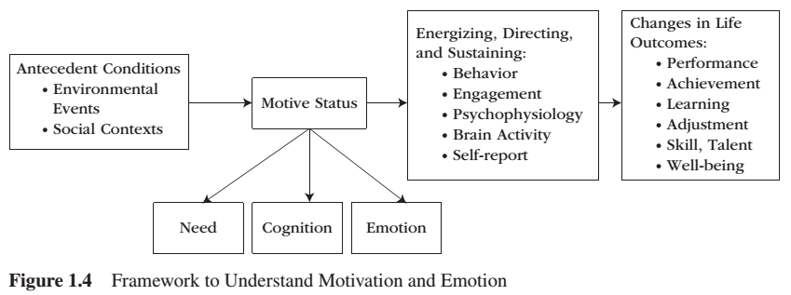
Framework to Understand Motivation and Emotion

Slide 4
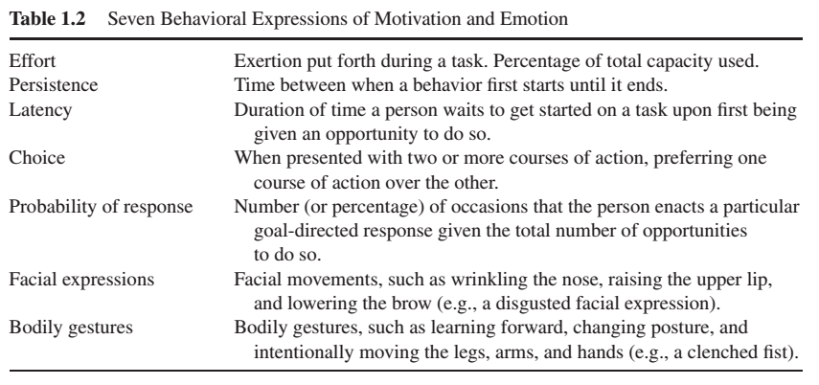
Seven Behavioral Expressions of Motivation and Emotion

Slide 5
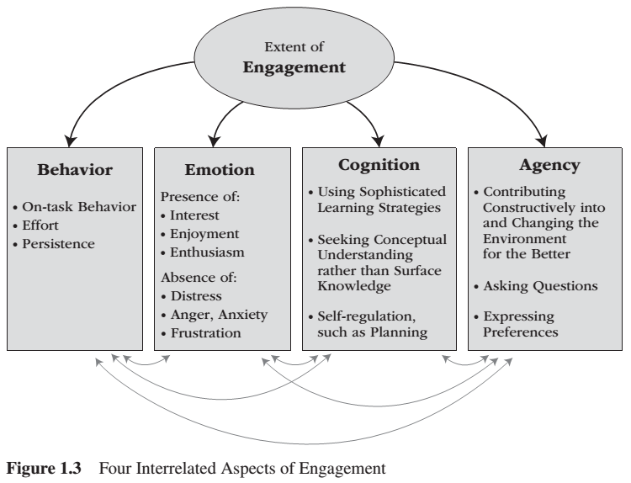
Extent of Engagement

Slide 6
Get Into Groups of 3 (-1+)
You were supposed to read chapter 2 of Understanding Motivation and Emotion.
Did you complete the task? What motivated you to do the readings or why weren’t you motivated to complete the readings?
Please describe how you read the chapter according to the seven behavioural expressions of motivation and emotion. (Table 1.2)
Please describe how engaged you were with the readings. (Figure 1.3)

Slide 7
Motivation in a Historical Perspective
Grand Theories
Will
Instinct
Drive
Mini Theories
Active nature of the person
Cognitive revolution
Socially relevant questions

Slide 8
Philosophical Origins of Motivational Concepts
Ancient Greece
Plato – Tripartite of the Soul
Appetitive – appetites and desires
Competitive – socially referenced standards
Calculating – decision making
Aristotle – Tripartite Psyche
Nutritive – most impulsive
Sensitive – regulate hedonic pleasure
Rational – idea-related, intellectual, contained the WILL
Dualism – Body & Mind
Thomas Aquinas
Body provides irrational pleasure-based motivational impulses
Mind provides rational will based motivations
Rene Descartes
Body was mechanical and passive agent
Will was the immaterial and motivational active agent

Slide 9
Grand Theories
The Will
Choosing
Striving
Resisting
Ill understood faculty. It somehow became endowed with purpose
Instincts
Darwin’s influence:
influence because of the theory of adaptation
Instincts arose from a physical substance, from genetic endowment
Instincts were focused on biological, bodily urges, and appetites
William James:
Physical & Mental instincts = impulse for action in the presence of an appropriate stimulus
William McDougall:
Instincts are irrational and impulsive motivational forces that orient a person towards one particular goal.
Instincts biased perception, generated emotionality, elicited purposive behaviour towards inherently desired goal
Tendency to confuse naming and explaining

Slide 10
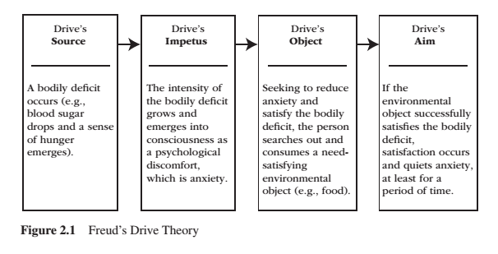
Freud’s Drive Theory

Slide 11
Hull Drive Theory
E = Strength of the behaviour (excitatory potential) in the presence of a particular stimulus
H = Habit strength
D = Drive
K = Motivational incentive

Slide 12
Drive Theory
Three assumptions
Drive emerged from biological needs
Drive energized behaviour
Drive reduction was reinforcing and produced learning
Critique
Some drives emerged without corresponding biological need
External sources of motivation could energize behaviour
Learning often occurred without drive reduction

Slide 13
Post Drive Theories
Incentive (pull vs push)
Could study effects of incentives and expectancies
Motivational states could be acquired through experience, not just biology
Portrayal of motivation highlighted moment to moment changes
Arousal
Represents a variety of processes that govern alertness, wakefulness, and activation
A person’s arousal level is mostly a function of how stimulation the environment is
A moderate level of arousal coincides with the experience of pleasure and optimal performance
People engage in strategic behaviour to increase or decrease their level of arousal
When under-aroused, people seek opportunities to increase their arousal
When over-aroused, people seek opportunities to decrease their arousal

Slide 14
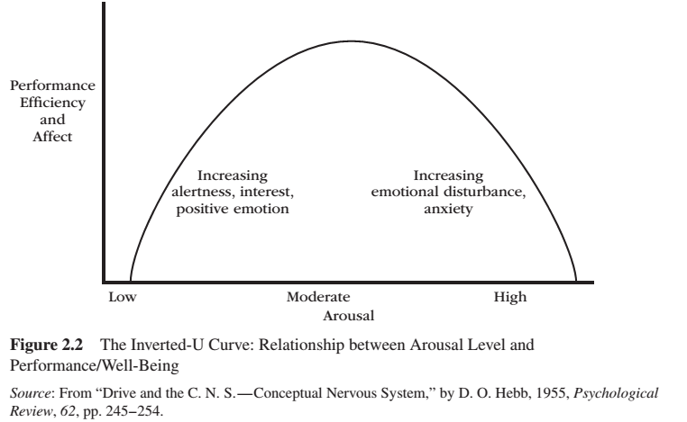
Arousal

Slide 15
Activity
In your group, devise a classroom style for PSYC 223 that will enhance performance, efficiency and affect according to the Inverted U Curve (Figure 2.2)

Slide 16
Bibliography
The information obtained to create this PowerPoint slide was obtained from:
Reeve, J. (2015) Understanding Motivation and Emotion, 6th ed. John Wiley and Sons

