Slide 1
Motivation and Emotion in Daily Life
Psychological needs
February 12th, 2018
Erik Chevrier

Slide 2
Benefits or Giving and Receiving Autonomy Support
The quality of the relationship between people is enhanced when autonomy, relatedness, and competence are supported.
Think of the names of five of your friends.

Slide 3
Benefits or Giving and Receiving Autonomy Support
The quality of the relationship between people is enhanced when autonomy, relatedness, and competence are supported.
Do you have a reciprocal relationship where you both try to foster a nurturing environment for each other? What would you answer to the questions below in regards to your interaction with the five people you listed?
My friend believes that I provide him/her with choices and options (giving autonomy support)
My friend tries to understand how I see things (receiving autonomy support)
When I am with my friend, I feel free to be who I am (autonomy)
When I am with my friend, I feel like a competent person (competence)
When I am with my friend, I feel loved and cared about (relatedness)

Slide 4
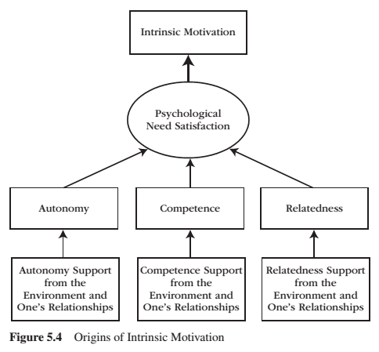
REVIEW: Intrinsic Motivation
Intrinsic motivation is the inherent propensity to seek out novelty and challenge, to extend and exercise one’s capacities, to explore, and to learn.
It is a natural inclination towards exploration, spontaneous interest, and environmental mastery that emerges from innate strivings for personal growth and from experiences of psychological needs satisfaction.

Slide 5
REVIEW - Person-Environment Dialectic

Slide 6
REVIEW – Person-Environment Synthesis vs Conflict
A person uses their inner motivational resources to interact with and change the environment, while the environment in turn changes and produces new forms of motivation for the person to internalize.
When an environment is supportive, the person’s inner motivational resources are vitalized, and autonomous forms of extrinsic motivation are internalized. The outcome is one of synthesis.
When environments are frustrating, the person’s inner motivational resources are deadened and controlled forms of extrinsic motivation are introjected (and external). The outcome is one of conflict.
Synthesis can be seen in people’s daily lives in four ways:
Engagement – how actively involved the person is in the activity at hand.
Developmental Growth – how agentic, mature, responsible, authentic, interpersonally connected, self-motivating, efficacious, and self-regulating a person is.
Health – functional efficiency of the mind and body and to the absence of illness, disease, and pathology.
Well-being – positive mental health and the presence of positive emotionality, absence of negative emotionality, having a sense of meaning or purpose, and being satisfied with one’s life.

Slide 7
REVIEW: Types of Extrinsic Motivation

Slide 8
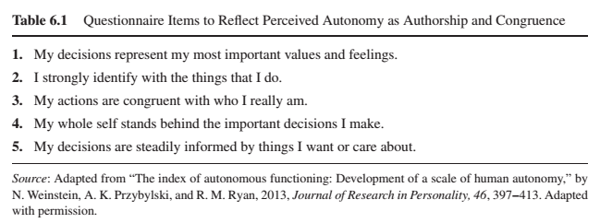
REVIEW – Autonomy
Autonomy is the psychological need to experience self-directed and personal endorsement in the initiation and regulation of one’s behaviour.
Behaviour is autonomous when our interests, preferences and wants guide our decision-making process to engage or not engage in a particular activity.
Perceived Autonomy - Trait

Slide 9
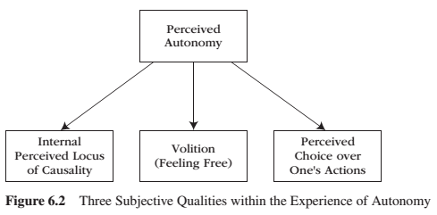
REVIEW – Autonomy
Autonomy is the psychological need to experience self-directed and personal endorsement in the initiation and regulation of one’s behaviour.
Behaviour is autonomous when our interests, preferences and wants guide our decision-making process to engage or not engage in a particular activity.
Perceived Autonomy - State

Slide 10
REVIEW – Autonomy vs Control

Slide 11
REVIEW – Encouraging Need for Autonomy
Nurture Inner Motivational Resources
Provide Explanatory Rationales
Listen Empathetically, Relying on Informational Language
Display Patience
Acknowledge and Accept Expressions of Negative Affect

Slide 12
Competence
Competence is the psychological need:
to be effective in interactions with the environment, and it reflects the desire to exercise and extend one’s capacities and skills and, in doing so, to seek out and master optimal and developmentally appropriate challenges.
that generates the willingness to seek out optimal challenges, take them on, and exert persistent effort and strategic thinking until we master them.
What kinds of activities can you perform competently?

Slide 13
The Pleasure of Optimal Challenge
When we engage in a task that offers a level of difficulty and complexity that is precisely right for our current skills and talents, we feel interest.
When we make progress on developing and extending our skills, our psychological need for competence is satisfied – we feel enjoyment.
People experience the greatest pleasure following the success of an optimal challenge.
People get feedback to inform them about their performance, then experience the psychological experience of being challenged.

Slide 14
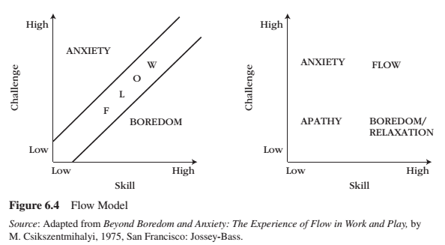
Flow
Flow is:
a state of concentration that involves a holistic absorption and deep involvement in an activity.
such a pleasurable experience that the person often repeats the activity with the hope of experiencing flow again.
when the challenges and skills are perfectly matched.

Slide 15
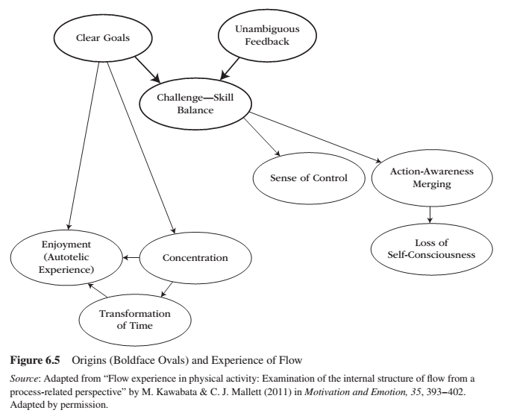
Flow
Challenge-Skill Balance—a sense that one is engaged in challenge commensurate with one’s current ability
Action-Awareness Merging—involvement is so deep that action feels spontaneous and almost automatic
Clear Goals—a feeling of certainty about what one is going to do
Unambiguous Feedback—immediate and clear feed-back about one’s action
Concentration on the Task at Hand—a feeling of being intensively focused on what one is doing in the present moment
Sense of Control—a sense that one can deal with the situation because one knows how to respond to whatever happens next
Loss of Self-Consciousness—lack of concern or worry about the self reflectively
Transformation of Time—a sense that the way time passes is distorted
Autotelic Experience—experience of the activity as intrinsically rewarding

Slide 16
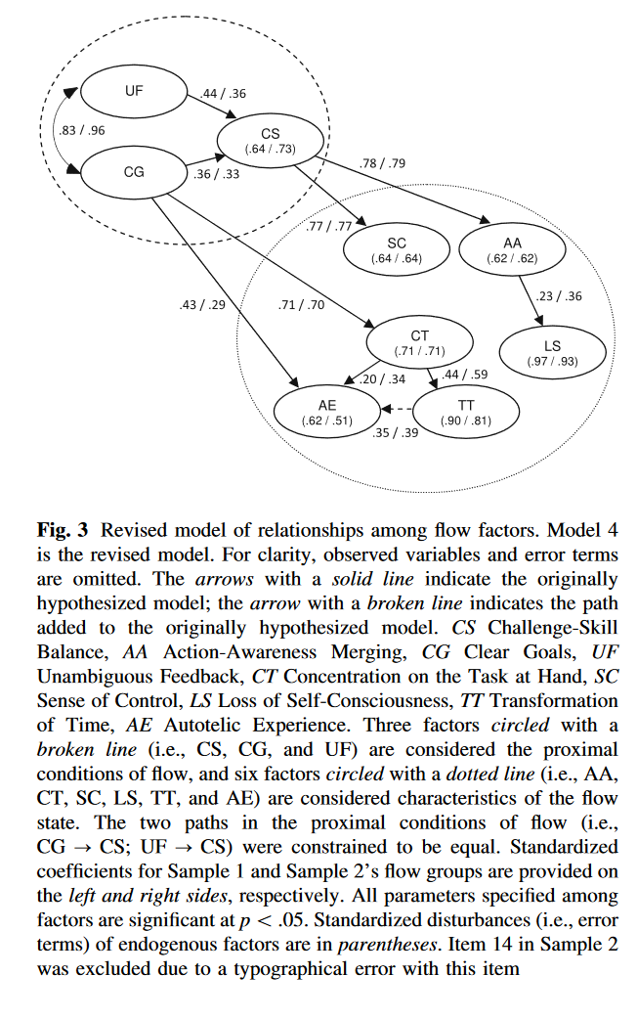
Flow
Challenge-Skill Balance—a sense that one is engaged in challenge commensurate with one’s current ability
Action-Awareness Merging—involvement is so deep that action feels spontaneous and almost automatic
Clear Goals—a feeling of certainty about what one is going to do
Unambiguous Feedback—immediate and clear feed-back about one’s action
Concentration on the Task at Hand—a feeling of being intensively focused on what one is doing in the present moment
Sense of Control—a sense that one can deal with the situation because one knows how to respond to whatever happens next
Loss of Self-Consciousness—lack of concern or worry about the self reflectively
Transformation of Time—a sense that the way time passes is distorted
Autotelic Experience—experience of the activity as intrinsically rewarding

Slide 17
Flow
Environments that provide structure are more likely to induce a flow state. The following factors provide structure:
clear goals, directions, and learning objectives
helpful guidance and monitoring
Clear, constructive, and skill-building feedback
Feedback comes from four sources:
The task itself
Comparisons of one’s current performance with one’s own past performances
Comparisons of one’s current performance with the performance of others
Evaluations of others
Failure tolerance:
People will experience failure and frustration from time to time
People must be failure tolerant
People prefer to seek optimal challenges when they find themselves in social environments that are autonomy-supportive and failure-tolerant, rather than controlling and failure-intolerant

Slide 18
Relatedness
Relatedness is the psychological need to:
establish close emotional bonds and attachments with other people, and it reflects the desire to be emotionally connected and interpersonally involved in warm relationships.
be to care and feel cared for, to love and reel loved.
engage in meaningful social interactions.
People tend to become close with people who look out for their well-being and who are trust worthy.
People tend to drift away from those who are not trust worthy and do not look out for their well-being.
To be satisfying, social bonds need to be characterized by the perceptions that the other person:
cares about my welfare
likes me

Slide 19
Relatedness
When someone can express their true self, they are more satisfied in the relationship.
Communal relationships (instead of exchange relationships) satisfy the need for relatedness.
Friendship can be established because of proximity and spending time together.
The fruits of relatedness need satisfaction are the fruits of any psychological need satisfaction – namely engagement, developmental growth health and well-being. Relatedness promotes positive functioning because it provides the social context for internalization to occur.
Internalization flourishes in relationships that provide a rich supply of:
relatedness need satisfaction
personally satisfying rationales that explain why others’ prescriptions and proscriptions will benefit the self

Slide 20
Satisfying Psychological Needs

Slide 21
Satisfying Psychological Needs

Slide 22
Discussion
You and your friend have made plans to eat well and begin exercising. Two weeks into the plan, your friend begins to show signs of ambivalence towards the plan. How can you create a nurturing environment to help your friend stay motivated?

Slide 23
Thank you!
Questions? Concerns?

Slide 24
Bibliography
The information obtained to create this PowerPoint slide was obtained from:
Reeve, J. (2015) Understanding Motivation and Emotion, 6th ed. John Wiley and Sons

