Slide 1
Motivation and Emotion in Daily Life
Implicit Motives
February 26th, 2018
Erik Chevrier

Slide 2
REVIEW – Implicit Motives
Implicit motives:
are enduring, nonconscious needs that motivate people’s behaviour towards the attainment of specific social incentives.
are psychological needs that is implied or inferred from the person’s characteristic thought, emotions, and behaviour.
arise from situational cues that cause emotional reactions that then predict, guide, and explain people's behaviour and lifestyle.
We are not always aware of psychological needs that exert a continual and enduring influence on what we think about, feel and do.
David McClelland believed that thoughts, feelings, and behaviours were guided by forces unknown to themselves. He suggested that:
Implicit motives are unconscious and cannot be measured by self-reports
Implicit motives predicted people’s behaviour and performance, whereas explicit motives predicted only people's attitudes and values
Explicit motives are:
People’s conscious, readily accessible, and verbally stated motivations.

Slide 3
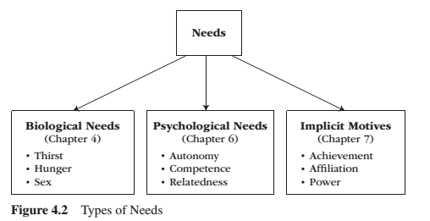
REVIEW – Acquired Needs
Achievement Affiliation Power
Implicit needs are not universal but are gained through experience and socialization.
Implicit needs develop within us as acquired individual differences – as acquired or a learned part of our personality.

Slide 4
REVIEW – Acquired Social Needs
We acquire implicit motives early in life by engaging with the environment and experiencing positive or negative affect.
In adulthood, people experience implicit needs as emotional and behavioral potentials that are achieved by particular situational incentives.

Slide 5
REVIEW – How Acquired Needs Motivate Behaviour
Most implicit motives are reactive in nature – they lie dormant within us until we encounter a potentially need-satisfying incentive that activates a particular pattern emotionally.
People also learn to anticipate the emergence of social incentives – people learn that particular occupations, organizations, and recreational events are opportunities to satisfy an implicit motive; i.e. for demonstrating personal competence, for pleasing/gaining approval from others, for having an impact on others.
High achievement strivings: Feel interest, joy, arousal, excitement, and a sense of opportunity when given a difficult challenge with immediate diagnostic feedback about your performance. Feel happy when you pursue goals such as winning, diagnosing personal competence, and improving the self, as often happens in sports and various domains of risk-taking.
High affiliation strivings: Feel calmness accompanied by warm, positive affect in situations that offer comfort and interpersonal security. Feel happy when pursuing activities such as cuddling or relaxing with a close friend.
High power strivings: Feel strong, sharp arousal spikes that generate a burst of epinephrine, testosterone, and increased blood pressure and muscle tone. Feel happy when you pursue activities such as riding a rollercoaster and making a persuasive speech in front of a large audience.
What kind of employment do you want to seek once you are finished your university degree?

Slide 6
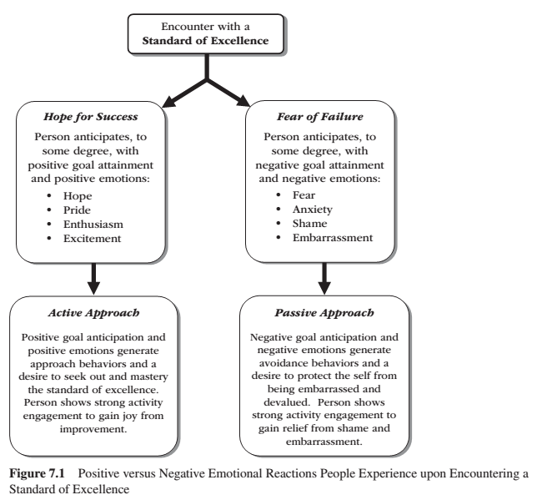
REVIEW – Achievement
Need for achievement:
is the desire to do well relative to a standard of excellence
is the individual’s unconscious, but frequently recurring, preference to feel positive affect upon improving his or her performance, making progress on a challenging task, and experiencing success in competition with a standard of excellence
Standard of excellence:
is any challenge to a person’s sense of competence that ends with an objective outcome of success versus failure, win versus lose, or right vs wrong.
are experienced by explicit feedback and subjective experiences.

Slide 7
REVIEW – Achievement
Strong and resilient achievement strivings arise, in part, from social surroundings. Children develop strong achievement strivings when parents provide:
Independence training
High performance aspersions
Realistic standards of excellence
High ability self-concepts
A positive valuing of achievement-related pursuits
Explicit standards of excellence
A home rich in stimulation potential
A wide scope of experiences
Achievement strivings can change from childhood to adulthood and from one decade to the next.

Slide 8
REVIEW – Atkinson's Model
Expectancy X Value Model – approach vs avoidance – episodic predictor
Achievement behaviour depends on the individuals dispositional, implicit achievement strivings and their task specific probability of success.
The model features four variables:
Achievement behaviour – Tendency to approach success (Ts)
Need for achievement – Strength of need for achievement – (Ms)
Probability of success – Perceived probability of success (Ps)
Incentive for success – Incentive value of success (Is)
Ts = Ms x Ps x Is
Ts = Ms x Ps x (1-Ps)

Slide 9
REVIEW – Atkinson's Model
The model features four variables:
Achievement behaviour – Tendency to approach success (Ts)
Need for achievement – Strength of need for achievement – (Ms)
Probability of success – Perceived probability of success (Ps)
Incentive for success – Incentive value of success (Is)
Ts = Ms x Ps x Is
Ts = Ms x Ps x (1-Ps)
2.50 = 10 x .5 x .5
.9 = 10 x .1 x .9
.9 = 10 x .9 x .1

Slide 10
Atkinson's Model
Tendency to Avoid Failure:
Tendency to avoid failure – motivates the individual to defend against the loss of self-esteem, the loss of social respect, and the fear of embarrassment (Taf)
Motive to avoid failure (Maf)
Probability of failure (Pf)
Negative incentive value for failure (If)
Taf = Maf x Pf x If
Taf = Maf x Pf (1-Pf)
2.50 = 10 x .5 x .5
.9 = 10 x .1 x .9
.9 = 10 x .9 x .1

Slide 11
Atkinson's Model
Combined approach
Tendency to achieve (Ta)
Ta = Ts – Taf = (Ms x Ps x Is) – (Maf x Pf x If)
Pf = (1-Ps)
If = (1-Pf)
Is = (1-Ps)
Ta is highest when Ts is greater than Taf and lowest when Taf is greater than Ts.
Ta is highest when Ps equals .5 and lowest when Ps is around .9
People who have Ts greater than Taf show greater persistence on tasks of moderate difficulty. They also tend to experience interest and satisfaction when attaining standards of excellence for its own sake, not for external prescriptions.

Slide 12
Let’s practice!
Ms = 6 Maf = 5 Ps = .4
Ta = Ts – Taf = (Ms x Ps x Is) – (Maf x Pf x If)

Slide 13
Let’s practice!
Ms = 6 Maf = 5 Ps = .4
Ta = Ts – Taf = (Ms x Ps x Is) – (Maf x Pf x If)
Pf = (1-.4) = .6
If = (1-Pf) = .4
Is = (1-Ps) = .6
Ta = Ts – Taf = (6 x .4 x .6) – (5 x .6 x .4)
Ts (1.44) – Taf (1.2)
Ta = 0.24

Slide 14
Dynamics-of-Action Model
Future achievement orientation refers to an individual’s psychological distance from a long-term achievement goal.
Achievement goals perceived far away in time receives less approach-versus-avoidance weight than does a goal in the near future.
Goals that are psychologically closer have more impact on Ta than those that are psychologically farther.
Future time perspective is the degree to which the individual anticipates and integrates the future into their psychological present.
Concentrating only on short term goals can have maladaptive consequences.

Slide 15
Dynamics-of-Action Model
The dynamics-of-action model extends Atkinson’s episodic model into predict changes in achievement behaviour over time.
Instigation causes a rise in approach tendencies and occurs by confronting environmental stimuli associated with past reward. Instigation is the amount of motivation to do something. Same as Ts from Atkinson’s model.
Inhibition causes a rise in avoidance tendencies and occurs by confronting environmental stimuli associated with past punishment. Inhibition is the amount of motivation not to do something. Taf from Atkinson’s model.
Consummation refers to the fact that performing an activity brings about its own cessation. The consummatory force decreases the motivation to continue to engage in an ongoing behaviour; it is the motivation to stop and take a rest.

Slide 16
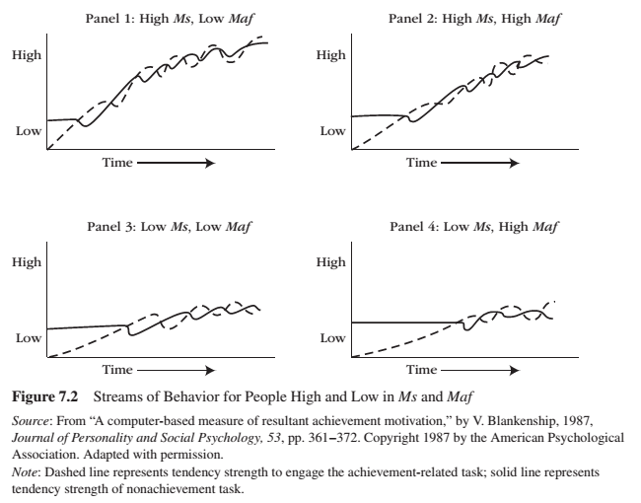
Dynamics-of-Action Model
Latency to begin an achievement task depends on motive strength (Ms vs Maf)
Persistence on an achievement task depends on motive strength (ms vs Maf)
Switching to a nonachievement task occurs with rising consumption.

Slide 17
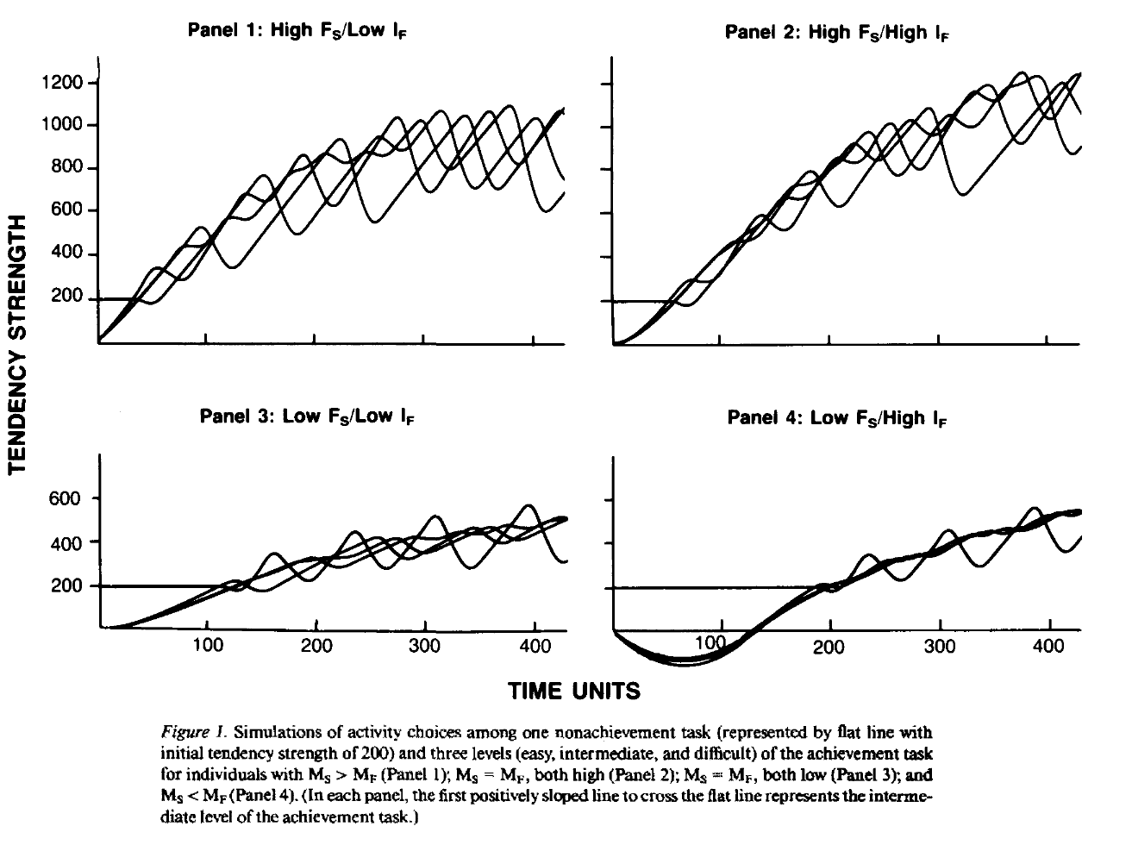
Dynamics-of-Action Model
Latency to begin an achievement task depends on motive strength (Ms vs Maf)
Persistence on an achievement task depends on motive strength (ms vs Maf)
Switching to a nonachievement task occurs with rising consumption.

Slide 18
Conditions that Satisfy the Need for Achievement
High need achievers perform better on moderately difficult tasks, not on easy or difficult tasks.
Interpersonal competition promotes positive emotions and improved performance for high need achievers. Low need achievers experience anxiety and avoidance.
High need achievers seek entrepreneurial activities.

Slide 19
Affiliation
Need for affiliation – establishing, maintaining, or restoring a positive, affective relationship with another person or persons.
Need for affiliation recognize two facets: approval and intimacy.
Approval:
Need for affiliation is rooted in a fear of interpersonal rejection.
People with a high need for affiliation are usually thought of as needy because they seek reassurance from others.
Deficiency motive
Intimacy:
Motive to engage in warm, close, positive interpersonal relations that hold little fear of rejection.
Strong intimacy strivings reflect the desire and need to share (to self-disclose) one’s inner life with a close other – to share one’s desires, feelings, goals, and so forth.
Growth-orientation motive
This duality suggests complex developmental antecedents.

Slide 20
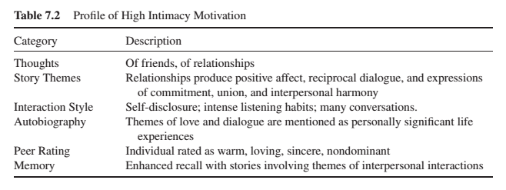
Affiliation

Slide 21
Affiliation
Fear and anxiety increase a person’s need to affiliate with others.
Coping strategies
Establishing interpersonal networks
People with a high need for intimacy typically spend time interacting with others, join social groups, and establish stable long-lasting relationships.
Maintaining interpersonal networks
People with a high need for affiliation strive to maintain those relationships by making more phone calls and paying more visits to their friends. Those with a high need for intimacy seek more dyadic friendship episodes, more self-disclosure, more listening, and more trust and concern for the well-being of their friends.
Conditions that satisfy the affiliation need
Satisfying affiliation brings about relief.
Social acceptance, approval, and reassurance constitute the need-satisfying conditions for people high in the need for affiliation.
People satisfy the need for intimacy by being close with others, and engaging in a warm relationship.

Slide 22
Power
Need for power is a desire to make the physical and social world conform to one’s personal image or plan for it.
People with a high need for power desire to have impact, control or influence over another person, group or the world at large.
Impact – allows power-needing individuals to establish power.
Control – allows power-needing individuals to maintain power.
Influence – allows power-needing individuals to expand their power.
Four social conditions are noteworthy in their capacity for involving and satisfying the need for power: leadership, aggressiveness, influential occupations, and prestige possessions.
Parents of future power-striving children impose very high developmental standards and are willing to sacrifice their parental affection to get their children to live up to these standards.
People with a high need for power were not the best leaders, not best liked, and fared poorly in dating relationships.

Slide 23
Power
Individuals with a high need for power more readily acquire the goals and outcomes they seek than do individuals with a low need for power. Power increases approach oriented tendencies.
Leadership motive pattern consists of the following threefold pattern:
High need for power
Low need for affiliation – they don’t care if they are liked.
High inhibition – they are self-disciplined.
Five variables that define presidential effectiveness: direct presidential actions, perceived greatness, performance on social issues, performance on economic issues, international relations. The leadership pattern is correlated with these five measures.

Slide 24
Additional Social Needs
Need for cognition
Need for closure
Need for structure
Uncertainty orientation

Slide 25
Learning Check
Please describe the Atkinson’s Model. How does the model work? What is the equation to calculate approach vs avoidance tendencies?
What is the dynamics-of-action model? What components make up this model? Compare and contract the dynamics-of-action model with Atkinson’s model.
What conditions satisfy the need for achievement?
What is the need for affiliation? What does it mean to say that affiliation has a growth and deficiency component? What conditions satisfy the need for affiliation?
What is the need for power? What is the leadership motive pattern? What conditions involve and satisfy the need for power?
What does an implicit motive refer to? What is an explicit motive? What is the difference between an implicit need and a psychological need?

Slide 26
Thank you!
Questions? Concerns?

Slide 27
Bibliography
The information obtained to create this PowerPoint slide was obtained from:
Reeve, J. (2015) Understanding Motivation and Emotion, 6th ed. John Wiley and Sons

