Slide 1
Motivation and Emotion in Daily Life
Personal Control Beliefs
March 19th, 2018
Erik Chevrier

Slide 2
Schedule For The Rest of This Course
March 19th – Personal Control Beliefs Chapter 10 – Personal Control Beliefs
March 21st – The Self and Its Strivings Chapter 11 – The Self and Its Strivings
March 26th – The Self and Its Strivings Chapter 11 – The Self and Its Strivings
March 28th – Nature of Emotions Chapter 12 – Nature of Emotions: Six Perennial Questions
April 4th – Nature of Emotions Chapter 12 – Nature of Emotions: Six Perennial Questions
April 9th – Aspects of Emotion Chapter 13 – Aspects of Emotion
April 11th – Aspects of Emotion Chapter 13 – Aspects of Emotion
April 16th – Individual Emotions Chapter 14 – Individual Emotions

Slide 3
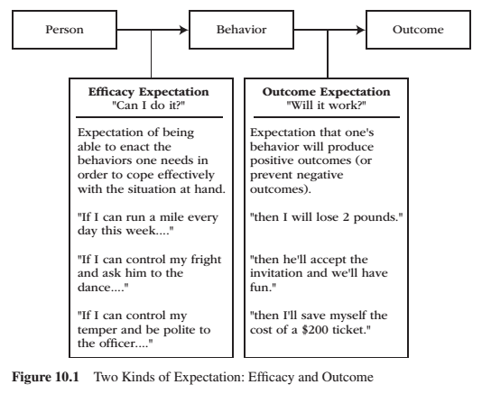
REVIEW – Expectancy
Expectancy is a subjective prediction of how likely is that event will occur.
Two kinds of expectancy
Efficacy expectations – judgement of one’s capacity to execute a particular act or course of action.
Outcome expectations – judgement that a given action, once performed, will cause a particular outcome.
Efficacy and outcome expectations are separate, causal determinants to the initiation and regulation of behaviour.
Both efficacy and outcome expectations must be reasonably high before behaviour becomes energized, goal directed, and sustained over time.

Slide 4
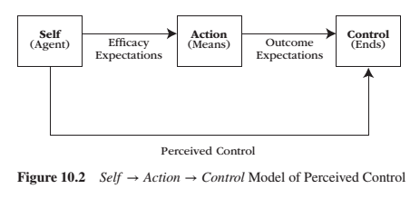
REVIEW – Perceived Self-Control

Slide 5
Self-Efficacy
Self-efficacy is:
a more generative capacity in which the individual organizes and orchestrates their skills to cope with the demands and circumstances they face – even under trying circumstances.
one’s judgment of how well or poorly one will cope with a situation, given the skills one possesses and the circumstances one faces.
not the same as ability because circumstances are taken into consideration.
the general capacity in which the performer improves ways to translate personal ability into effective performance.
Self-efficacy makes a potent contribution to the prediction of performance and outcomes.
The opposite of efficacy is doubt.

Slide 6
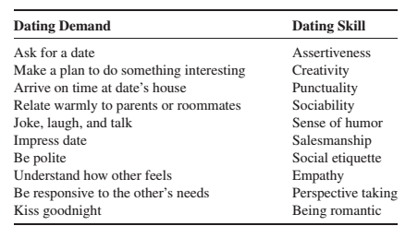
Activity
Think of an important activity you want to/must do in near future.
Write down the demands and skills necessary for this activity…(i.e. see below).
Please assess your self-efficacy and outcome expectations for these tasks.
The amount of self-doubt vs efficacy can be predicted by an analysis of perceived efficacy on the task-related demands.

Slide 7
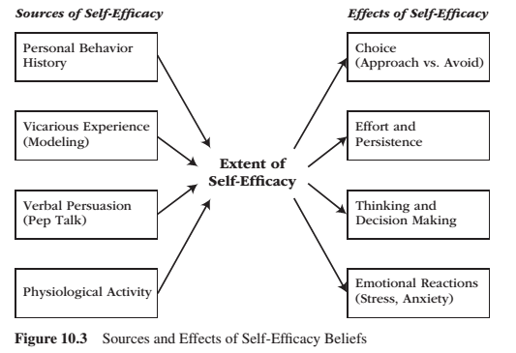
Sources of Self-Efficacy
Self-efficacy beliefs arise from:
One’s personal behavioral history in trying to execute that particular behaviour or way of coping**
Observations of similar others who also try to execute that behaviour**
Verbal persuasions from others
Physiological states
Self-efficacy affects
Choice
Effort and persistence
Thinking and decision making
Emotional Reactions
** stronger source of efficacy beliefs

Slide 8
Sources of Self-Efficacy
Personal behavioural history
The extent to which a person believes they can competently enact a particular course of action stems from their personal history of trying to enact that course of action in the past.
People learn their current self-efficacy from their interpretations and memories of past attempts to execute the same behaviour.
Previous competent attempts raise self-efficacy and previous incompetent past attempts lower self-efficacy
Strength of past experience is important.
Strong competent associations in the face of occasional incompetent situations do not lower self-efficacy much. The opposite also applies.
Experience is also important.
If someone is not experienced, competent and incompetent enactments will influence future expectancy of efficacy.

Slide 9
Vicarious Experience
Vicarious experience involves observing a model enact the same course of action the performer is about to enact.
Seeing others perform masterfully raises an observers sense of self-efficacy.
Seeing others perform and fail lowers our sense of self-efficacy
The extent to which a model’s enactment affects our own efficacy depends on:
The greater similarity between the model and observer
The less experienced observer is at the behaviour, the greater the impact of the vicarious experience.

Slide 10
Verbal Persuasion
Verbal persuasions:
shift a performer’s attention from sources of inefficacy to sources of efficacy.
does not work well if it contradicts actual experience – limited by the boundaries of the possible.
depend on the credibility, trustworthiness, and expertise of the persuader.
people can self-persuade to boost efficacy.
works to the extent that it provides the performer with enough of a temporary and provisional efficacy boost to generate the motivation necessary for another try.

Slide 11
Physiological State
An abnormal physiological state is a private, yet attention-getting, message that contributes to one’s sense of inefficacy.
The causal direction between efficacy and physiological activity is bidirectional – inefficacy heightens arousal and heightened arousal fuels perceived inefficacy.
Physiological information communicates efficiently information most when initial efficacy is uncertain.
When efficacy is relatedly assured, people sometimes interpret their physiological cues in a positive fashion.

Slide 12
Activity
Please use the same activity as before – when you assessed your efficacy and outcome expectations.
Please answer the following questions:
What is your personal behavioral history trying to execute that particular behaviour or way of coping?
What are your observations of similar people who have or will be executing that behaviour?
What do you expect in regards to verbal persuasions or self-persuasions?
What are your expected physiological states when performing, leading up to, and after the activity?

Slide 13
Self-Efficacy on Behaviour
Both skill and self-efficacy affect each other; although the effect that skilled performance has on self-efficacy is stronger than is the effect that self-efficacy has on skilled performance.
When people expect that they can perform an action, they are willing to put forth effort and persistence in the face of difficulties. In contrast, when people do not expect that they can perform the required task, they are not willing to engage in activities requiring such behaviour.
Self-efficacy beliefs affect:
Choice
Effort and persistence
Thinking and decision making
Emotionality
Learning and coping

Slide 14
Sources of Self-Efficacy
Self-efficacy beliefs arise from:
One’s personal behavioral history in trying to execute that particular behaviour or way of coping**
Observations of similar others who also try to execute that behaviour**
Verbal persuasions from others
Physiological states
Self-efficacy affects
Choice
Effort and persistence
Thinking and decision making
Emotional Reactions
** stronger source of efficacy beliefs

Slide 15
Choice
People seek out and approach activities/situations that they feel capable of adjusting or handling while they shun and avoid activities/situations that they see as likely to overwhelm, their coping capacities.
Doubt-plagued avoidance exert a profound and detrimental effect on a person’s long-term development – it arrests development potentials.
Avoiding activities makes self-doubt more entrenched because doubters never get to prove themselves wrong.

Slide 16
Effort and Persistence
Strong self-efficacy beliefs produce persistent coping efforts aimed at overcoming setbacks and difficulties.
Doubt leads to people to slacken their efforts when they encounter difficulties and perhaps give up or settle for mediocre solutions. Self-efficacy leads to a quick recovery of self-assurances following setbacks.

Slide 17
Thinking and Decision Making
People who believe strongly in their efficacy for solving problems:
remain remarkably efficient in their analytic thinking during stressful episodes
allows a performer to stay focused in the face of stressful situations
buffers the quality of a performers thinking and decision making
allows people to analyze feedback
People who doubt their problem-solving:
think erratically, show confusion and negative thinking
distracts decision makers away from such task-focused thinking
doubt deteriorates the quality of a performers thinking and decision making

Slide 18
Emotionality
Performers with a strong sense of efficacy:
Attend to the demands of the challenge
Visualize competent scenarios for forthcoming behaviour
Exude enthusiasm, optimism, and interest
Keep anxiety at bay
Performers with a weak sense of efficacy:
Dwell on personal deficiencies
Visualize formidable obstacles
Exude pessimism, anxiety, and depression
Quickly threatened by difficulties and react to setbacks with distress

Slide 19
Learning, Coping and Achieving
Self-efficacy beliefs:
Predict people’s learning, coping and performance, and achievement.
Facilitates the type of behaviour that is needed to increase and improve learning, coping, performance and achievement.
Makes people approach situations, exert greater effort, persist in the face of obstacles, think clearly on what needs to be done, experience constructive emotions, like hope.

Slide 20
Self-Efficacy vs Psychological Need for Competence
Self-efficacy and need for competence are similar constructs but not interchangeable.
Psychological need for competence is a developmental constant and self-efficacy beliefs are specific to certain tasks.

Slide 21
Empowerment
Two practical points about self-efficacy are important to highlight:
1 – Self-efficacy beliefs can be acquired and changed.
2 – The level of self-efficacy predicts ways of coping that can be called ‘competent functioning’ or ‘personal empowerment’.
Empowerment involves possessing the knowledge, skills, and beliefs that allow people to exert control over their lives (i.e. people defending one’s self against threats and/or abuse from others)
People need self-efficacy beliefs so that they can:
Translate their knowledge and skills into effective performance when threatened
Exert control over intrusive negative thoughts

Slide 22
Empowering People: Master Modeling Program
A formal program to empower people through self-efficacy training is to employ a mastery modeling program – which involves the following seven steps.
1 – Expert identifies component skills involved in effective coping and measures novices’ efficacy expectation on each component skill.
2 – Expert models each component skill, emphasizing the novices’ most worrisome skill areas.
3 – Novices emulate each modeled skill. Expert provides guidance and corrective feedback, as needed.
4 – Novices integrate the individual skills into an overall simulated performance. Expert introduces only mild obstacles and helps novices integrate the different skill components into a coherent overall performance.
5 – Novices participate in cooperative learning groups. One person gives a simulated performance while peers watch. As they watch, peers provide encouragement and tips. Each person takes a turn until everyone has performed multiple times.
6 – Novices perform individually in a realistic situation that features numerous difficulties, surprises, obstacles, and setbacks while the expert provides modeling and corrective feedback.
7 – Expert models confident demeanor and arousal-regulating techniques.

Slide 23
Learning Check
Please use the same activity as before.
How would you develop a master modeling program to empower someone to develop self-efficacy?
How do the master modeling steps relate to:
One’s personal behavioral history in trying to execute that particular behaviour or way of coping**
Observations of similar others who also try to execute that behaviour**
Verbal persuasions from others
Physiological states
How do the master modeling steps relate to:
Choice
Effort and persistence
Thinking and decision making
Emotional Reactions

Slide 24
Mastery Beliefs
Mastery beliefs reflects the extent of perceived control one has over attaining desirable outcomes and preventing aversive ones.
When control beliefs are strong and resilient, the individual perceives a strong causal link between actions and outcomes.
When personal control beliefs are weak and fragile, the individual perceives that personal initiatives and actions produce little effect on what happens.

Slide 25
Ways of Coping

Slide 26
Mastery vs Helplessness
Failure = the person was not able to gain control over a desired outcome, and people cope with failure in different ways.
Mastery motivational orientation:
responds to failure by remaining task-oriented and focused on achieving mastery in spite of difficulties and setbacks
hardy, resistant
Seize challenges and become energized by setbacks
Focus on how they can remedy failure
Failure is feedback that provides information on how to improve
Helpless motivational orientation:
the person responds to failure by giving up and withdrawing, acting as if the situation were out of their control
Shy away from challenges, fall apart in the face of setbacks, and begin to question and then outright doubt their ability
Focus on why they are failing
Focus on themselves as reasons for failure

Slide 27
Learned Helplessness

Slide 28
Learned Helplessness
Learned helplessness is:
The psychological state that results when an individual expects that life's outcomes are uncontrollable.
Efficacy expectancy building blocks of self-efficacy Outcome expectancies building blocks of learned helplessness
Controllable vs uncontrollable outcomes

Slide 29
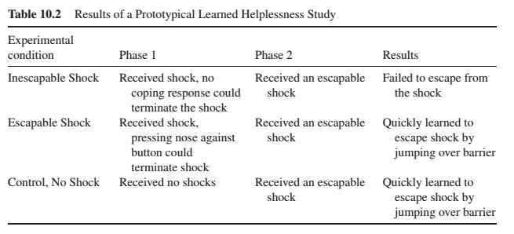
Learning Helplessness
Helplessness is learned

Slide 30
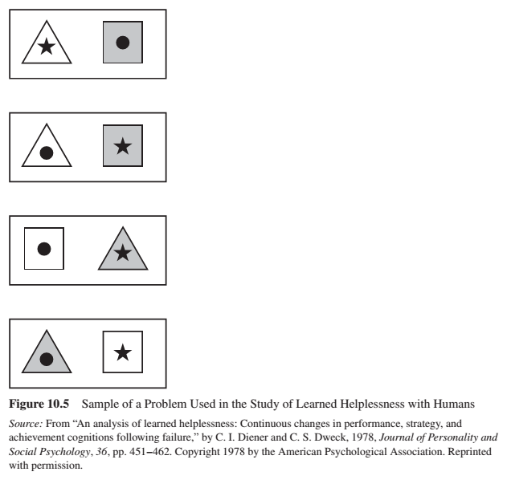
Learning Helplessness – Application to Humans
How do we ethically study learned helplessness?
Hiroto (1974) experiment with irritating noise constituted the aversive, traumatic event.
Diener & Dwek (1978) feature detection task.

Slide 31
Components of Learned Helplessness
Learned helplessness has 3 components:
Contingency
Objective relation between a person’s behaviour and the environment’s outcome.
Random vs influenced by voluntary behaviour
Cognition
Mental events distort the relationship between objective contingencies and subjective control, and these events therefore create some margin of error between objective truth and subjective understanding.
Biases, attributions, expectancies
Behaviour
Coping responses – passive, lethargic to active, assertive

Slide 32
Helplessness Effects
Learned helplessness occurs when people expect their voluntary behaviour will produce little or no effect on the outcomes they strive to attain or avoid. Learned helplessness contributes to three deficits:
Motivational deficit
Learning deficits
Emotional deficits

Slide 33
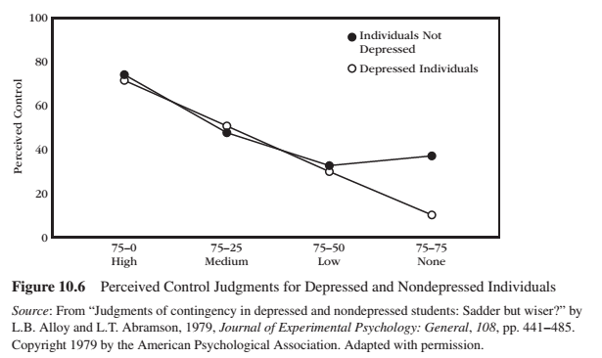
Helplessness and Depression
Depression (unipolar) and helplessness have similarities:
Individual expects that bad events will occur
Individual believes that there is nothing they can do to prevent bad events from occurring
They share symptoms and treatment strategies
These theories are supported and criticized
People with depression have a more realistic view of how much control they have over situations.

Slide 34
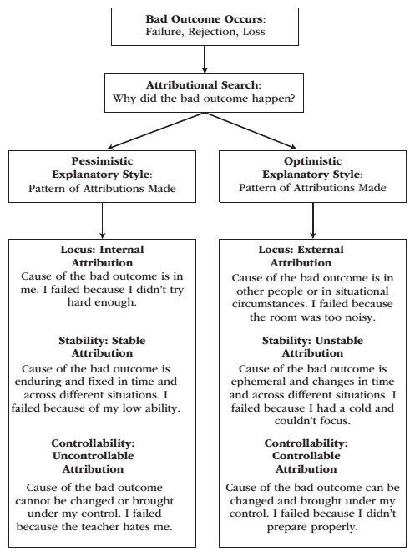
Attribution and Explanatory Style
Attribution is a causal explanation for why a particular success-failure outcome occurred.
Explanatory style is a relatively stable, cognitively based personality variable that reflects the way people explain the reasons why bad events happened to them.

Slide 35
Attribution and Explanatory Style
Optimistic explanatory style is associated with:
Delusional beliefs about controlling negative outcomes
Excuses
Denials
Self-deceptions
Narcissism
Pessimistic explanatory style is associated with:
Academic failure
Social distress
Physical illness
Impaired job performance
Depression
Electoral defeat

Slide 36
Alternative Explanations
1 - Helplessness may be caused by the trauma and not learning.
The learned expectation, not the trauma itself, that produces helplessness (Weiss, 1972)
2 – The expectation of failure, rather than the expectation of uncontrollability, induces helplessness.
Failure, produces positive motivation and that it is the expectation of uncontrollability, not the expectation of failure, that causes learned helplessness (Winefield, Barnett, Tiggemann, 1985)
3 – Uncontrollable events induce helplessness deficits not because they are uncontrollable but because they are unpredictable.
Perceived uncontrollability is a necessary but not sufficient condition – uncontrollability must coincide with unpredictability.
4 – Some people are motivated to remain passive.

Slide 37
Personal Control

Slide 38
Reactance Theory
Reactance refers to the psychological and behavioural attempt at reestablishing a threatened or eliminated freedom.
Integrative model:
Reactance
Show vigorous opposition to the uncontrollable environment
Active assertive coping efforts pay off to stablish control
Expectations of control
Learned helplessness
Over time, if the environment is uncontrollable, people learn that control attempts are futile
No expectations of control

Slide 39
Hope
Hope
Motivation to pursue goals – agentic
Ways to achieve goals – clear pathway
Mastery beliefs = optimism
High self-efficacy = confidence
High hope people…
1 – Establish specific and short-term, rather than vague and long-term, goals.
2 – Set mastery (learning), rather than performance, achievement goals.
3 – Rely on self-congruent goals, rather than on self-discordant goals.
4 – Engage goals with intrinsic, rather than extrinsic, motivation.
5 – Are less easily distracted by external obstacles or by task-irrelevant (distracting) thoughts and negative feelings.
6 – Generate multiple pathways and pursue other avenues when stumped rather than stick stubbornly with one approach.
7 – Have reservoirs of internally generated determination (“I will get this done”; “Keep going!”).

Slide 40
Expectancy-Value Model

Slide 41
Learning Check
What are optimistic and pessimistic explanatory styles? What are alternative explanations?
What is hope and how does it contribute to motivation?
What is reactance theory and how does it help explain motivation?
What is the expectancy-value model?
What is learned helplessness? What are the components of learned helplessness? How does it relate to…
Depression?
Mastery orientation?
What is self-efficacy? What predicts (sources) self-efficacy? What are the effects of self-efficacy?
What is empowerment? How do we empower people through the master modeling program?

Slide 42
Thank you!
Questions? Concerns?

Slide 43
Bibliography
The information obtained to create this PowerPoint slide was obtained from:
Reeve, J. (2015) Understanding Motivation and Emotion, 6th ed. John Wiley and Sons

