Slide 1
Motivation and Emotion in Daily Life
The Self and its strivings
March 26th, 2018
Erik Chevrier

Slide 2
Discussion
Who are you?
Please describe yourself to your group

Slide 3
Questions

Slide 4
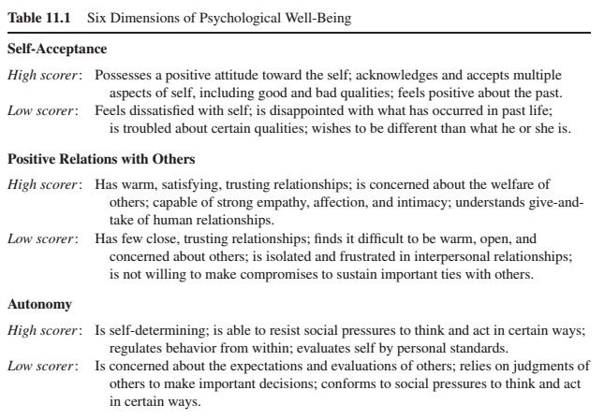
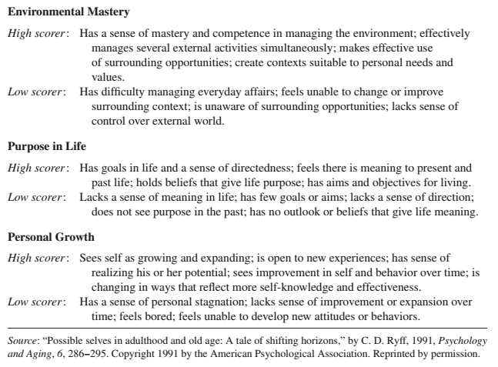
Six Dimensions of Psychological Well-Being

Slide 5
Self-Esteem
High self esteem is correlated with happiness
Self functioning is a cause → self esteem is an effect
Increases in self-esteem do not cause corresponding increases in achievement or productivity
Increases in achievement and productivity cause corresponding increases in self-esteem
Self esteem is a scorecard to report on how things are going in our lives
Self-esteem is not a source of motivation that allows people to make life go well
People with an inflated view of themselves are more prone to aggression and acts of violence when their favorable self-views are threatened

Slide 6
Self-Concept
Self-concepts are:
An individual’s mental representation of themselves
Constructed from experiences and reflections from those experiences
People get feedback about their personal attributes, characteristics, and preferences
People translate their multitude of specific experiences into a general representation of the self
A collection of domain specific schemas
The self-schemas that are involved in the definition of the self-concept are those that are most important to the person
Self-schemas are:
Cognitive generalizations about the self that are domain specific and learned from past experiences
Activity
With your group, please begin by defining your self concept by recounting the experiences and feedback in your life that led you to define yourself as you did in the first activity.
Please also think of domain specific generalizations about yourself and the experiences and feedback you received that led you to develop these self schemas

Slide 7
Motivational Properties of Self-Schemas
Self-schemas generate motivation in two ways:
Self-schemas, once formed, direct an individuals behaviour in ways that elicit feedback consistent with the established self-schema. Self-schemas direct behaviour in ways that confirm our established self-view. Inconsistent feedback produces motivational tension from the inconsistently and self-disconfirmation that leads to resistance and counter-argumentation.
Self-schemas generate motivation to move the present self toward a desired future self. Like the discrepancy creating process. Seeking possible selves is a goal-setting process that invites self-concept change and development, whereas seeking a consistent self-view is a verification process that preserves self-concept stability.
Activity
Please discuss aspects of your self schema that you are happy with.
Please discuss aspects of your self schema that you would like to improve (present vs ideal)

Slide 8
Consistent Self
Once someone establishes a particular self-schema it becomes increasingly resistant to change.
People preserve a consistent self by actively seeking out information that matches their self-concept and ignoring information that contradicts their self-view.
Inconsistency and contradiction generate an emotional discomfort that signals that consistency needs to be restored.
People adopt self-presentational signs and symbols that announce who we are.
We choose to interact with people who confirm our self-view and avoid people who contradict our self-view.
When faced with discrepant feedback, people defend by:
distorting the information
verifying if the information is valid, trustworthy, relevant or important
discounting with compensatory self-inflation, self-affirmation and other behaviours to maintain their self-view

Slide 9
Self-Verification and Self-Concept Change
Self-concept certainty:
Confidence that their self-schema is valid and true
High self-concept certainty anchors stable self-schemas
Low self-concept certainty can lead someone to self-schema change
Crisis of self-verification occurs when there is a conflict between an uncertain self-schema and discrepant feedback
People solve the self-verification crisis by seeking out additional domain-relevant feedback

Slide 10
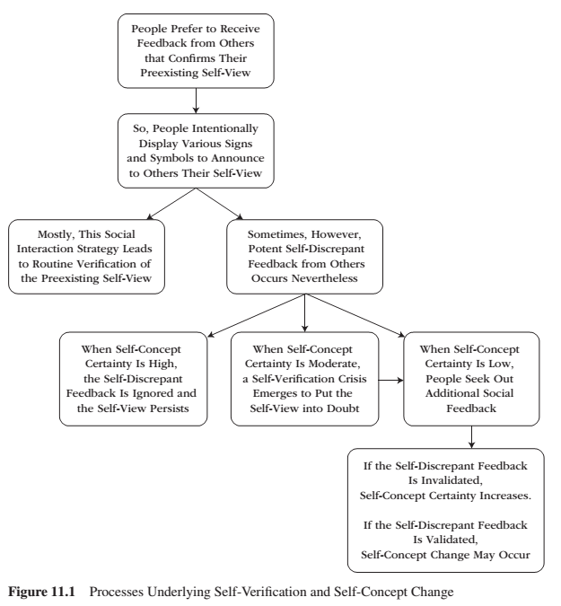
Process Underlying Self-Verification and Self-Concept Change

Slide 11
Self-Verification
People self-verify because of cognitive, epistemic and pragmatic reasons:
Cognitive – People seek to know themselves
Epistemic – Verifications of the self bolster perceptions that the world is predictable and coherent
Pragmatic – People avoid interactions that might be fraught with misunderstandings and unrealistic expectations and performance demands; they seek interactions with people who know what to expect from them

Slide 12
Possible Selves
Self-schemas change:
In response to social feedback
In a deliberate effort to advance the present self toward a desired future possible self
Possible selves:
Are mental representations of attributes, characteristics, and abilities that the self does not yet possess
Represent what people ideally want to become
Represent what they are afraid they might become
Represent the future self
Are social in origin – the individual observes the self modeled by others
Present self vs ideal self
When the self does not have the evidence or feedback to confirm the emerging possible self, one of two outcomes follow:
An absence of evidence (or contrary evidence) will lead the self to reject/abandon the possible self
The possible self can energize, and direct action so that the attributes, characteristics, and abilities of the self actually begin to materialize
Motivation becomes finding ways to become the ideal self (like goals)

Slide 13
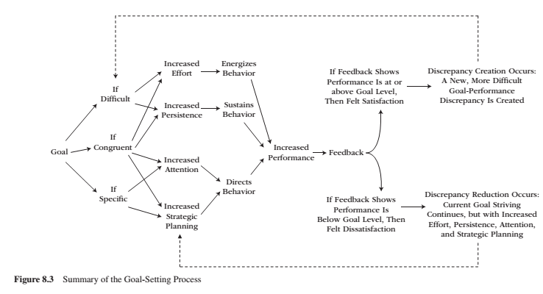
Goal Setting

Slide 14
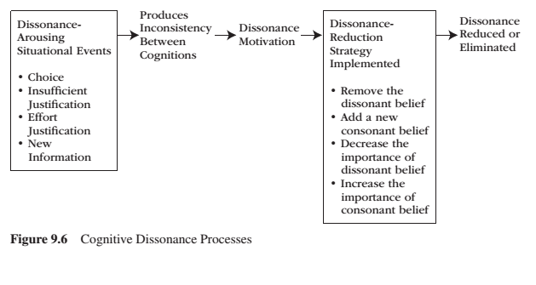
Motivational Processes Underlying Dissonance

Slide 15
Thank you!
Questions? Concerns?

Slide 16
Bibliography
The information obtained to create this PowerPoint slide was obtained from:
Reeve, J. (2015) Understanding Motivation and Emotion, 6th ed. John Wiley and Sons

