Slide 1
Motivation and Emotion in Daily Life
The Self and its strivings
March 28th, 2018
Erik Chevrier

Slide 2
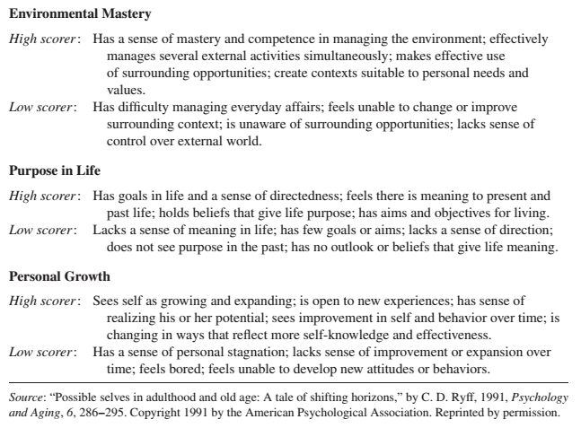
REVIEW – Six Dimensions of Psychological Well-Being

Slide 3
REVIEW – Self-Esteem
High self esteem is correlated with happiness
Self functioning is a cause → self esteem is an effect
Increases in self-esteem do not cause corresponding increases in achievement or productivity
Increases in achievement and productivity cause corresponding increases in self-esteem
Self esteem is a scorecard to report on how things are going in our lives
Self-esteem is not a source of motivation that allows people to make life go well
People with an inflated view of themselves are more prone to aggression and acts of violence when their favorable self-views are threatened

Slide 4
REVIEW – Self-Concept
Self-concepts are:
An individual’s mental representation of themselves
Constructed from experiences and reflections from those experiences
People get feedback about their personal attributes, characteristics, and preferences
People translate their multitude of specific experiences into a general representation of the self
A collection of domain specific schemas
The self-schemas that are involved in the definition of the self-concept are those that are most important to the person
Self-schemas are:
Cognitive generalizations about the self that are domain specific and learned from past experiences
Activity
With your group, please begin by defining your self concept by recounting the experiences and feedback in your life that led you to define yourself as you did in the first activity.
Please also think of domain specific generalizations about yourself and the experiences and feedback you received that led you to develop these self schemas

Slide 5
REVIEW – Motivational Properties of Self-Schemas
Self-schemas generate motivation in two ways:
Self-schemas, once formed, direct an individuals behaviour in ways that elicit feedback consistent with the established self-schema. Self-schemas direct behaviour in ways that confirm our established self-view. Inconsistent feedback produces motivational tension from the inconsistently and self-disconfirmation that leads to resistance and counter-argumentation.
Self-schemas generate motivation to move the present self toward a desired future self. Like the discrepancy creating process. Seeking possible selves is a goal-setting process that invites self-concept change and development, whereas seeking a consistent self-view is a verification process that preserves self-concept stability.
Activity
Please discuss aspects of your self schema that you are happy with.
Please discuss aspects of your self schema that you would like to improve (present vs ideal)

Slide 6
REVIEW – Consistent Self
Once someone establishes a particular self-schema it becomes increasingly resistant to change.
People preserve a consistent self by actively seeking out information that matches their self-concept and ignoring information that contradicts their self-view.
Inconsistency and contradiction generate an emotional discomfort that signals that consistency needs to be restored.
People adopt self-presentational signs and symbols that announce who we are.
We choose to interact with people who confirm our self-view and avoid people who contradict our self-view.
When faced with discrepant feedback, people defend by:
distorting the information
verifying if the information is valid, trustworthy, relevant or important
discounting with compensatory self-inflation, self-affirmation and other behaviours to maintain their self-view

Slide 7
REVIEW – Self-Verification and Self-Concept Change
Self-concept certainty:
Confidence that their self-schema is valid and true
High self-concept certainty anchors stable self-schemas
Low self-concept certainty can lead someone to self-schema change
Crisis of self-verification occurs when there is a conflict between an uncertain self-schema and discrepant feedback
People solve the self-verification crisis by seeking out additional domain-relevant feedback

Slide 8
REVIEW – Process Underlying Self-Verification and Self-Concept Change

Slide 9
REVIEW – Possible Selves
Self-schemas change:
In response to social feedback
In a deliberate effort to advance the present self toward a desired future possible self
Possible selves:
Are mental representations of attributes, characteristics, and abilities that the self does not yet possess
Represent what people ideally want to become
Represent what they are afraid they might become
Represent the future self
Are social in origin – the individual observes the self modeled by others
Present self vs ideal self
When the self does not have the evidence or feedback to confirm the emerging possible self, one of two outcomes follow:
An absence of evidence (or contrary evidence) will lead the self to reject/abandon the possible self
The possible self can energize, and direct action so that the attributes, characteristics, and abilities of the self actually begin to materialize
Motivation becomes finding ways to become the ideal self (like goals)

Slide 10
Agency
Agency:
Presents a view of self as action and development from within, as innate processes and motivations
Entails personal causation and action
Competence, autonomy and relatedness provide motivational forces that foster agency (see next slide)
Intrinsic Motivation:
Inseparably coordinated with the active nature of the developing self
Is the source of motivation that underlies agency because it spontaneously energizes people to pursue their interests, seek out environmental challenges, exercise their skills, and develop their talents.

Slide 11
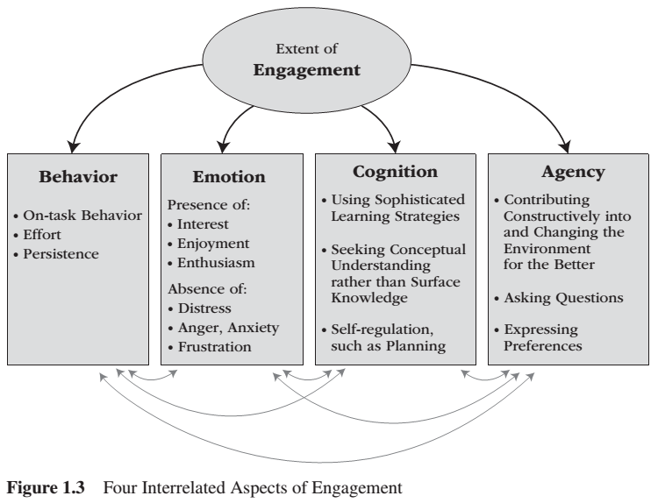
REVIEW – Satisfying Psychological Needs

Slide 12
Self as Action and Development From Within
Differentiation:
Expands and elaborates the self into an ever-increasing complexity
Proceeds as the individual exercises existing interests, preferences, and capacities in such a way that a relatively general and undifferentiated self becomes specialized into several life domains
Integration:
Synthesizes that emerging complexity into a coherent whole, thereby preserving a sense of a single, coherent self
An organizational process that brings the self’s differentiated parts together into a coherent whole

Slide 13
REVIEW - Person-Environment Dialectic

Slide 14
Internalization and the Integrating Self
Need for relatedness:
Supports the individual’s proactive motivation to internalize society’s rules, values and concerns – therefore behaviour, emotion and ways of thinking originate within the self and the social context
The process through which individuals take in, and accept as their own, an externally prescribed way of thinking, feeling or behaving is referred to as internalization.
Internalization:
Refers to the process through which an individual transforms a formerly externally prescribed way of behaving or valuing into an internal one.
Internalization occurs for two reasons:
From the individual’s desire to achieve meaningful relationships with family, friends, and others. Internalization is motivated by the need for relatedness.
From the individual’s desire to interact effectively with the social world. Internalization is motivated by the need for competence.
Agency:
The contribution of agency of the self as action and development from within is to recognize that:
Human beings possess a core self, one energized by innate motivation and directed by the inherent development processes of differentiation and integration
Not all self-structures are equally authentic, some reflect the core self and others reflect and reproduce the needs of society
Internal and societal self-structures may produce conflict – conflict is the opposite of integration

Slide 15
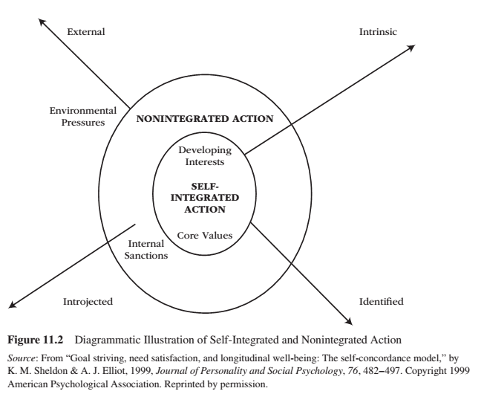
Self Integration vs Non-Integration

Slide 16
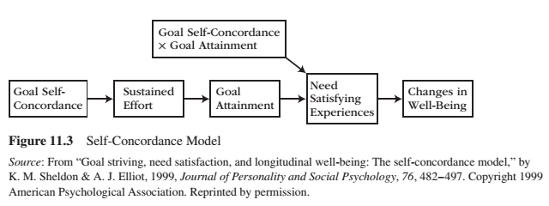
Self-Concordance

Slide 17
Self-Concordance

Slide 18
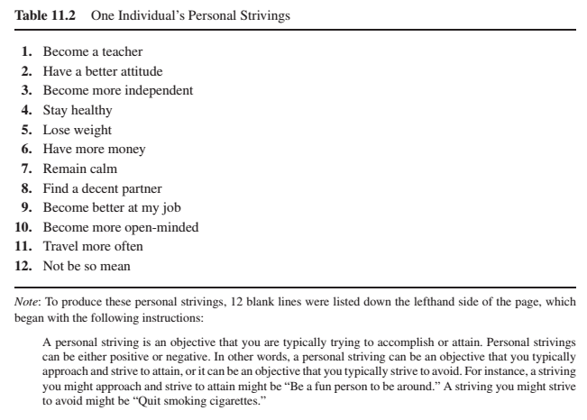
Personal Strivings
Personal Strivings:
Exist as superordinate aspects of the self that organize and integrate the many different goals a person seeks
Are NOT goals, per se
Might lead to many different daily goals
Are not equal
That generate from external pressures tend to generate conflict
That generate from the self contribute to personal growth and well-being
Subjective well-being comes from what one is striving for (psychological needs), not about what one obtains

Slide 19
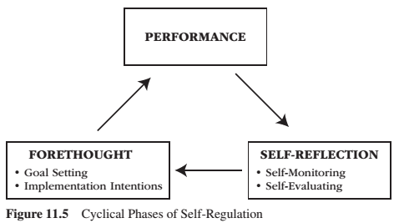
Self-Regulation
Self regulation:
Is the process of exerting and managing the self to accomplish a long-term goal
Is the metacognitive planning, implementing, monitoring, and evaluating one’s goal striving efforts
Involves:
Planning and strategic thinking
Implementing action and self-control
Monitoring and checking
Reflecting and adjusting

Slide 20
Developing More Competent Self-Regulation

Slide 21
REVIEW – Empowering People: Master Modeling Program
A formal program to empower people through self-efficacy training is to employ a mastery modeling program – which involves the following seven steps.
1 – Expert identifies component skills involved in effective coping and measures novices’ efficacy expectation on each component skill.
2 – Expert models each component skill, emphasizing the novices’ most worrisome skill areas.
3 – Novices emulate each modeled skill. Expert provides guidance and corrective feedback, as needed.
4 – Novices integrate the individual skills into an overall simulated performance. Expert introduces only mild obstacles and helps novices integrate the different skill components into a coherent overall performance.
5 – Novices participate in cooperative learning groups. One person gives a simulated performance while peers watch. As they watch, peers provide encouragement and tips. Each person takes a turn until everyone has performed multiple times.
6 – Novices perform individually in a realistic situation that features numerous difficulties, surprises, obstacles, and setbacks while the expert provides modeling and corrective feedback.
7 – Expert models confident demeanor and arousal-regulating techniques.

Slide 22
Self-Control
Self control is:
The capacity to suppress, restrain, and even override an impulsive desire, urge, behaviour, or tendency so to pursue a long-term goal.
Willpower
Long term goal pursuit is difficult because people are more attracted to the immediate gratification of short-term rewards than they are to delay the gratification necessary for longer-term rewards.
Researchers (in over 100 studies) have identified the following seven broad categories of self-control:
Suppressing impulses, urges, desires
Managing and suppressing emotions
Controlling and suppressing thoughts
Controlling and fixing attention
Making decisions and lots and lots of choices
Managing the impression one is making on others
Being kind to and dealing with difficult, demanding people

Slide 23
Self-Control (cont’d)
Self control:
Is an energy reserve that exists in a limited amount
Once depleted, people lose some of their capacity for future self control
Is enhanced through practice
Is limited in strength – Limited Strength Model of Self-Control
Amount or strength of willpower is critical to the success of self-control
The exertion of self-control depletes some of this resource, and hence…
Subsequent attempts at self-control are increasingly likely to fail
Glucose is converted into neurotransmitters in the brain, and when depleted, people become more impulsive and less able to exert self-control
Self-control depletes glucose only when self-control means suppressing an attractive short-term urge in order to pursue a less inherently attractive long-term goal - except when someone is in a good mood or when pursuing goals that satisfy psychological needs
Relaxation also buffers people from self-control depletion

Slide 24
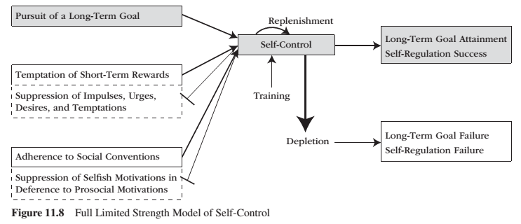
Limited Strength Model

Slide 25
Identity
Identity:
The means by which the self relates to society, as it captures the essence of who is within a cultural context
Once a person inhabits a role, that identity prescribes the person to display some behaviours (identity-confirming) while avoiding others (identity-disconfirming)
Roles:
Consist of cultural expectations for behaviour from persons who hold a particular social position
We all hold different social positions and the role we inhabit at any given time depends on the situation we are in and the people with whom we are interacting
People change how they act depending on the role they are assuming

Slide 26
Identity
Identity-establishing behaviour:
Individuals have many identifies, and they present to others the particular identity that is most appropriate for the situation.
Identity-confirming behaviours:
Humans possess a wide range of potential behaviours, but only a subset are appropriate and expected in any one particular setting.
Behaviours and emotions that are appropriate are determined by the identity of the person, situation and culture.
Identities direct behaviour, and behaviour feedback to maintain and confirm identity.
Identity-restoring behaviours:
If a person behaves in an inconsistent way, they can restore their original identity through restorative behaviours or restorative emotions.
The motivation and emotional implications are that, once the individual finds their place in society, society expects them to behave and emote in a way that is consistent with that identity.

Slide 27
Learning Check
Please compare and contrast the following terms. Also, please discuss how these concepts energize, sustain and/or direct motivational resources.
Self-concept
Self-Schema
Identity
Role
What is integration and differentiation? How do they relate to development and motivation?
What circumstances cause people to change their self-concept? What do people do to maintain a consistent self-concept?
What is the role of agency in relation to motivation?
How do self-concordant goals relate to well-being and motivation?
How does internalization affect motivation?
What are personal strivings? How do they relate to well-being and goal setting?
What is self-regulation? How do people self-regulate?
What is self-control? How does self control relate to motivation? What affects self-control? How does self-control relate to energy depletion?

Slide 28
Thank you!
Questions? Concerns?

Slide 29
Bibliography
The information obtained to create this PowerPoint slide was obtained from:
Reeve, J. (2015) Understanding Motivation and Emotion, 6th ed. John Wiley and Sons

