Slide 1
Food and Culture
Global Food Culture and International Trade Regulations
Erik Chevrier
November 14th, 2018

Slide 2
Group Discussion
Do people have the right to know what’s in their food?
What has prevented ‘right to know’ policies?
Why were these policies opposed?
Do people have the right to know where their food comes from?
What are barriers to country of origin labeling?

Slide 3
Building Alternative Food Systems
Food regimes based on food sovereignty
Spatial dimension – place of origin
Social dimension – methods of production and distribution
Cultural dimension – perceived qualities and reputation
How can we build a movement to re-localize food? What do we know about global food production and supply chain analysis?

Slide 4
World Trade Organization
GATT – General Agreement on Tariffs and Trade – 1947 - 1994
World Trade Organization – 1995
Trade negotiations – The WTO agreements cover goods, services and intellectual property. They spell out the principles of liberalization, and the permitted exceptions. They include individual countries’ commitments to lower customs tariffs and other trade barriers, and to open and keep open services markets. They set procedures for settling disputes. These agreements are not static; they are renegotiated from time to time and new agreements can be added to the package. Many are now being negotiated under the Doha Development Agenda, launched by WTO trade ministers in Doha, Qatar, in November 2001.
Implementation and monitoring – WTO agreements require governments to make their trade policies transparent by notifying the WTO about laws in force and measures adopted. Various WTO councils and committees seek to ensure that these requirements are being followed and that WTO agreements are being properly implemented. All WTO members must undergo periodic scrutiny of their trade policies and practices, each review containing reports by the country concerned and the WTO Secretariat.
Dispute settlement – The WTO’s procedure for resolving trade quarrels under the Dispute Settlement Understanding is vital for enforcing the rules and therefore for ensuring that trade flows smoothly. Countries bring disputes to the WTO if they think their rights under the agreements are being infringed. Judgements by specially appointed independent experts are based on interpretations of the agreements and individual countries’ commitments.
Building trade capacity – WTO agreements contain special provision for developing countries, including longer time periods to implement agreements and commitments, measures to increase their trading opportunities, and support to help them build their trade capacity, to handle disputes and to implement technical standards. The WTO organizes hundreds of technical cooperation missions to developing countries annually. It also holds numerous courses each year in Geneva for government officials. Aid for Trade aims to help developing countries develop the skills and infrastructure needed to expand their trade.
Outreach – The WTO maintains regular dialogue with non-governmental organizations, parliamentarians, other international organizations, the media and the general public on various aspects of the WTO and the ongoing Doha negotiations, with the aim of enhancing cooperation and increasing awareness of WTO activities

Slide 5
World Trade Organization
Sanitary and Phytosanitary Measures (SPS)
The SPS Agreement sets out rules for food safety and requirements for animal and plant health. It recognizes the right of governments to adopt and enforce measures necessary to protect human, animal or plant life or health. While the need to constrain trade may arise, any measures taken to do so should not be applied in an arbitrary or discriminatory manner or act as a disguised restriction on international trade.
Technical Barriers to Trade (TBT)
Under the TBT Agreement, members are free to choose how to regulate products to achieve those objectives but must do so in a way that does not discriminate between trading partners or that does not unnecessarily restrict trade in these products. The TBT Agreement covers trade in all goods – agricultural and industrial alike – and applies to three categories of measures: technical regulations, standards and conformity assessment procedures.
On 9 November 2016 the TBT Committee held a thematic session on regulatory cooperation between Members in the area of food labelling

Slide 6
World Trade Organization
Sanitary and Phytosanitary Measures (SPS)
The SPS Agreement explicitly recognizes three international standard-setting bodies, covering the three main areas in which SPS measures are applied:
• the FAO/WHO Codex Alimentarius Commission, for food safety standards;
• the World Organization for Animal Health (OIE), for animal health standards and diseases that can be transmitted from animals to humans (zoonoses); and
• the International Plant Protection Convention (IPPC), for plant-health standards.

Slide 7
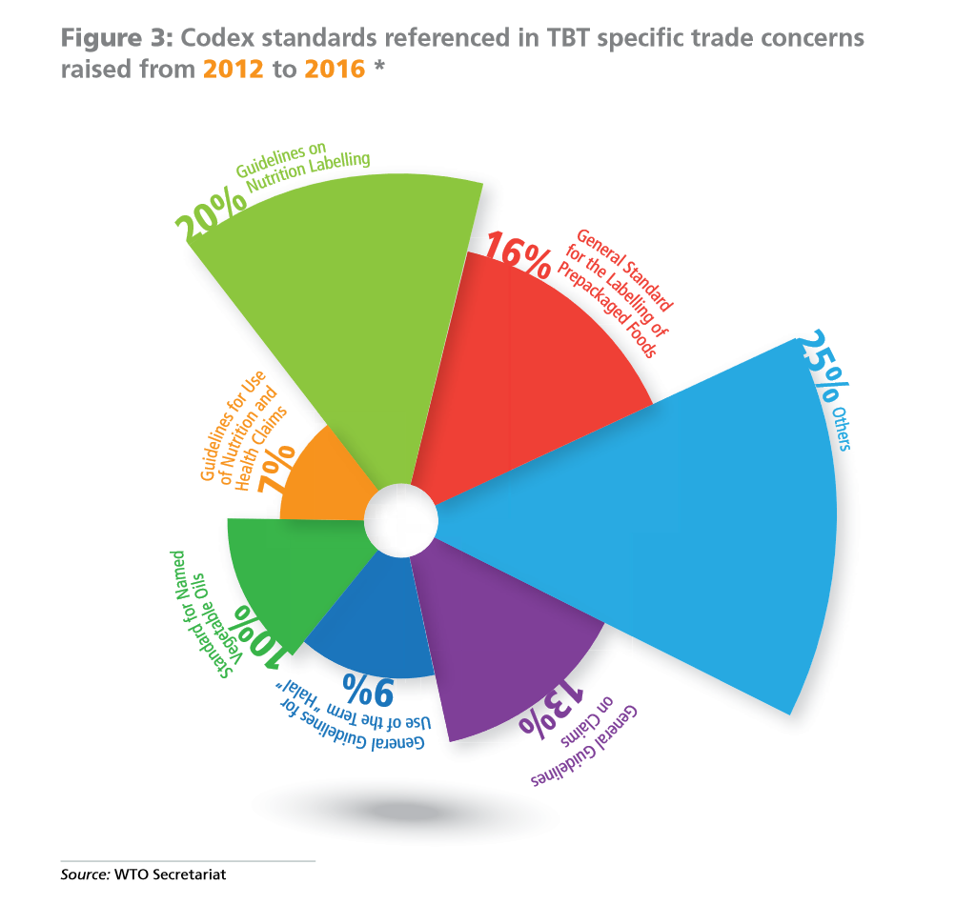

Slide 8
Codex Alimentarius
Codex Alimentarius
The Codex Alimentarius Commission was established by FAO and the WHO in 1963 as part of the Joint FAO/WHO International Food Standards Programme. It is the single most important international reference point for food standards.
Codex Alimentarius is a compilation of harmonized international food standards, guidelines and codes of practice.
Codex standards, guidelines and codes of practice are advisory in nature: to become legally enforceable, countries must voluntarily translate them into national legislation or regulations.
The annual meeting of the Codex Alimentarius Commission brings together an average of more than 130 member states and nearly 50 international observers, including representatives from the private sector, academia, civil society and other stakeholder groups.
Besides the annual plenary session of the Commission, Codex has 17 committees, six regional coordinating committees and further ad hoc task forces In any given year, there can be as many as 100 working groups in Codex operating electronically between sessions on work assigned by a committee.
Trade and Food Standards Document 2017

Slide 9
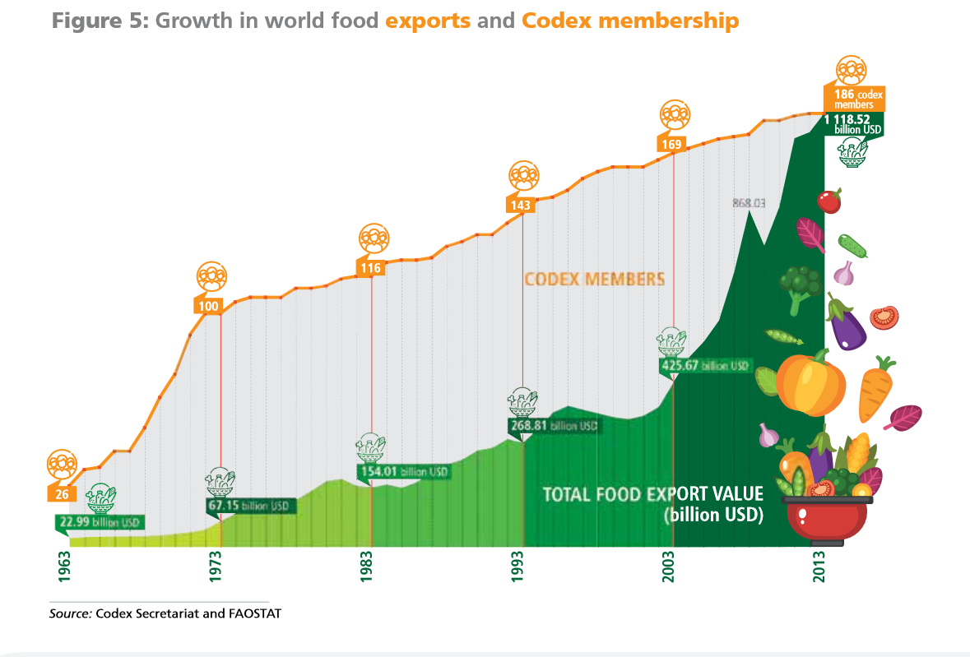
Codex Alimentarius

Slide 10
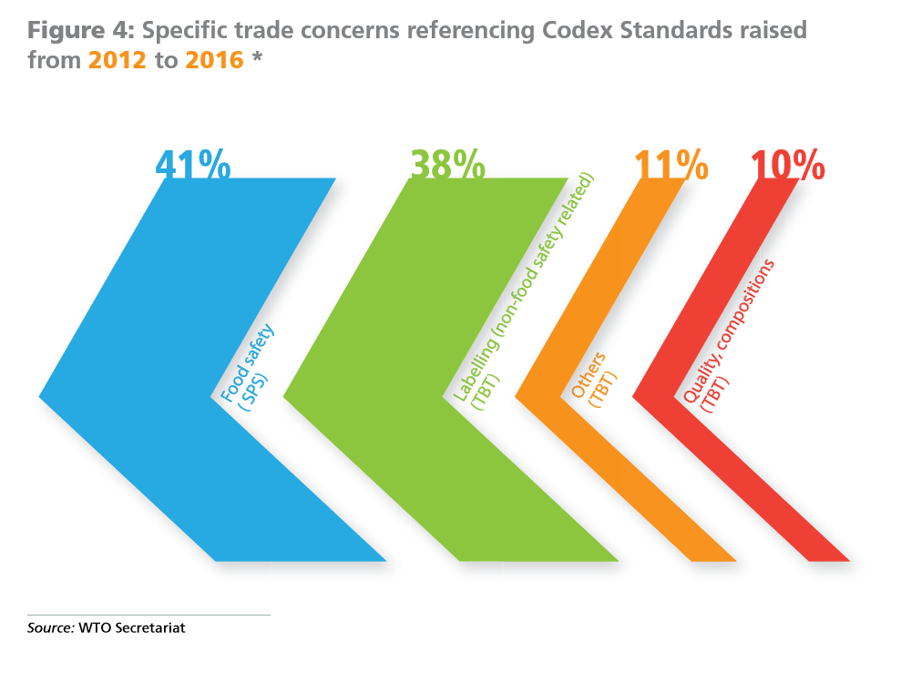

Slide 11
Food Labeling in Canada
Canada Food Labelling
Health Canada is responsible, under the Food and Drugs Act (FDA), for the establishment of policies and standards relating to the health, safety, and nutritional quality of food sold in Canada.
The Canadian Food Inspection Agency (CFIA) is responsible for the administration of food labelling policies related to misrepresentation and fraud in respect to food labelling, packaging and advertising (FDA), and the general agri-food and fish labelling provisions respecting grade, quality and composition specified in the Canada Agricultural Products Act (CAPA), the Meat Inspection Act (MIA) and the Fish Inspection Act (FIA). In addition, the CFIA has responsibility for the administration of the food-related provisions of the Consumer Packaging and Labelling Act (CPLA), including basic food label information, net quantity, metrication and bilingual labelling.
The CFIA is responsible for the enforcement of all of the above requirements.

Slide 12
Group Activity
What are Canada’s regulations regarding country of origin labeling? Country of origin labelling
What are Canada’s regulations regarding date marking? Date Marking
What are Canada’s regulations regarding reporting a safety and/or labeling concern? Report a food safety or labelling concern

Slide 13
Food Labelling in Canada
Canada Food Labelling
Country of Origin Labelling in Canada
In Canada, there are mandatory requirements for certain food products to indicate the country of origin on their labels. Companies may also make origin claims to highlight the origins of a product or ingredient in a product.
Country of origin labelling does not provide information on the safety of a food product. All food products sold in Canada, whether produced in Canada or abroad, must meet the same food safety standards.
Mandatory labelling
All prepackaged food products sold in Canada are required to be labelled with the identity and principal place of business of the company responsible for the product, such as the importer or manufacturer.
When a food product is wholly manufactured outside of Canada, the label must show that the product is imported. This information can be provided in one of three ways:
the identity and principal place of business of the foreign manufacturer, or
the statement "imported for" or "imported by" followed by the identity and principal place of business of the Canadian company;
the identity and principal place of business of the Canadian company with the country of origin of the product.

Slide 14
Food Sovereignty (Patel)
Read the 2007 Nyéléni Declaration on Food Sovereignty
What does the declaration state?
Who formulated the declaration?
What are they fighting for?
What are they fighting against?
What can and will they do about it?
How does the definition of food sovereignty compare to other definitions provided this class?
Can we apply a food sovereignty approach to university food services? If so, how?
Concordia Food Groups Discussion About Campus Food Sovereignty

Slide 15
Thanks!
Questions or concerns?

