Slide 1
Fundamentals of Lifespan Development
September 12, 2014 – Prenatal Development, Birth, and the Newborn Baby

Slide 2
Video
Video – 9 Months in the Womb
Footage of Baby in the Womb
3D Video of Conception to Birth
Life’s Greatest Miracle – PBS NOVA

Slide 3
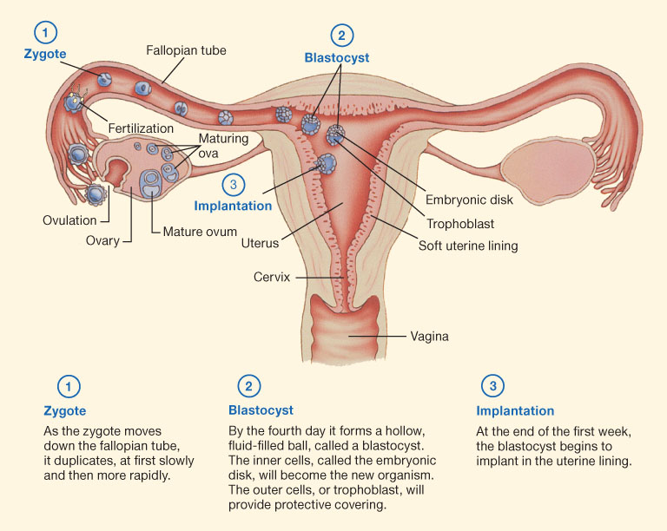
Conception and Implantation
Implantation:
  Trophoblast – Outer layer
  Amniotic Fluid – Fluid for temperature & protection
  Yolk Sac – Produces blood cells
  Chorion – Surrounds the amnion
  Placenta – Food & oxygen & waste
  Umbilical Cord – Delivers blood & removes waste

Slide 4
Milestones of Prenatal Development
Trimester | Period | Weeks | Length and Weight | Major Events
First | Zygote | 1 |  | One cell multiplies & forms blastocyst
 | Zygote | 2 |  | Blastocyst begins implantation
 | Embryo | 3-4 | 6 mm | Primitive brain & spinal cord. Organs begin to grow
 | Embryo | 5-8 | 2.5 cm 4 g | External body parts grow. Embryo can move.
 | Fetus | 9-12 | 7.6 cm 28 g | Rapid increase in size. Internal organs become organized. Genitals grow.
Second | Fetus | 13-24 | 30 cm 820 g | Fetus enlarges. Fetal movements felt by mother. Sensitive to light & sound.
Third | Fetus | 25-38 | 50 cm 3400 g | Size increases. Organs mature. Fat is added. Antibodies are transmitted.

Slide 5
Key Terms
Period of the Embryo
  Ectoderm – Nervous system & skin
  Mesoderm – Muscles, skeleton, circulatory system & some internal organs
  Endoderm – Digestive system, lungs, urinary tract, and glands
Period of the Fetus
  Vernix – Cheese likes substance that protects skin from chapping
  Lanugo – White, downy hair. Helps vernix stuck to skin.

Slide 6
  Teratogens – Any environmental agent that causes damage during the prenatal period. Depend on: Dose, heredity, age, and other negative influences.
        Illegal Drugs
        Alcohol
        Tobacco
        Radiation
        Pollution
        Infectious disease
        Nutrition (maternal factor)
        Stress (maternal factor)
        Maternal Age
        Rh factor incompatibility

Slide 7
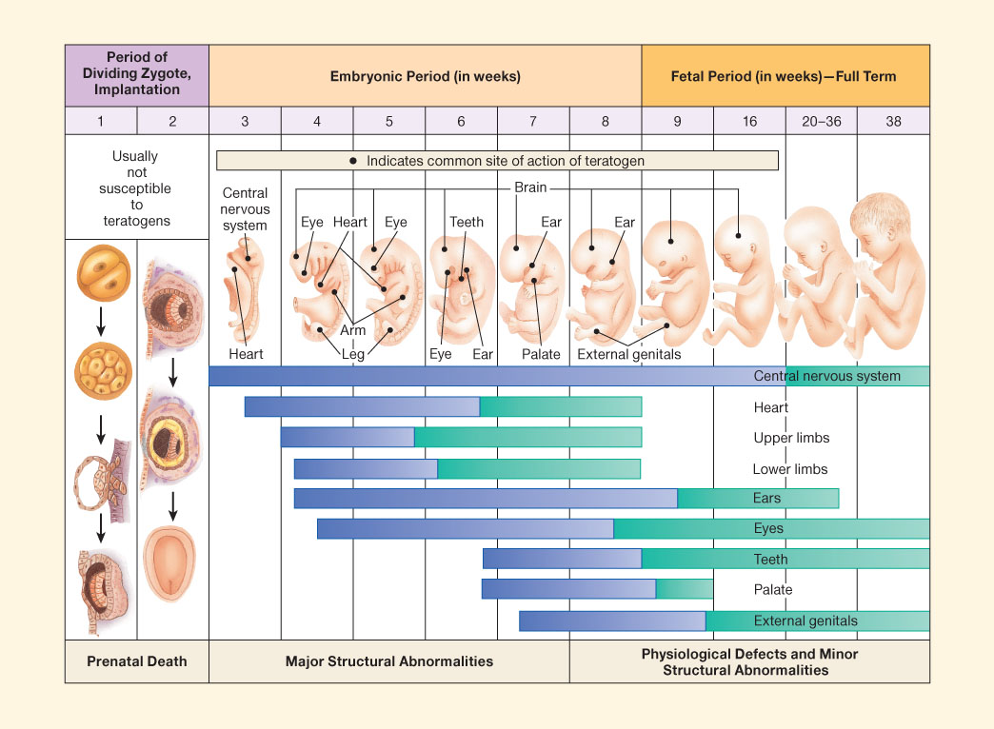
Teratogens

Slide 8
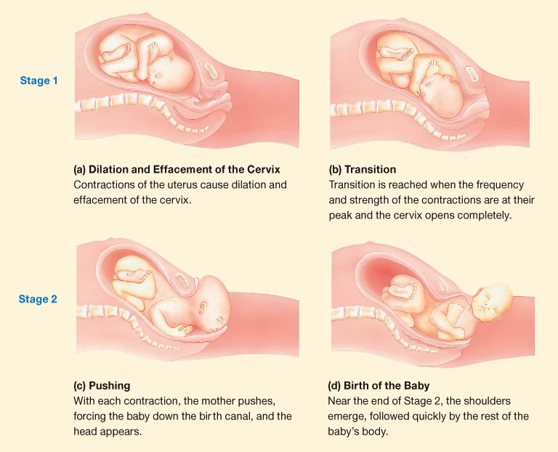
Childbirth
Stages of childbirth:
  Dilation and effacement of the cervix
    First birth = 12 – 14 hours
    Second + = 4-6 hours
  Delivery of the baby
    First birth = 50 min
    Second + = 20 min
  Delivery of the placenta
    5-10 min

Slide 9
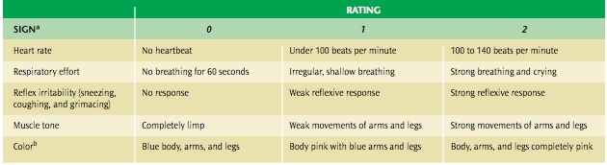
The Apgar Scale

Slide 10
Childbirth Key Terms
Breech position – When a baby is turned so that the buttocks or feet would be delivered first
Anoxia – Inadequate oxygen supply during labour and delivery
Isolette – Plexiglas-enclosure to protect preterm babies
Cesarean – A surgical birth where a doctor makes an incision in the mother’s abdomen and lifts the baby out of the uterus

Slide 11
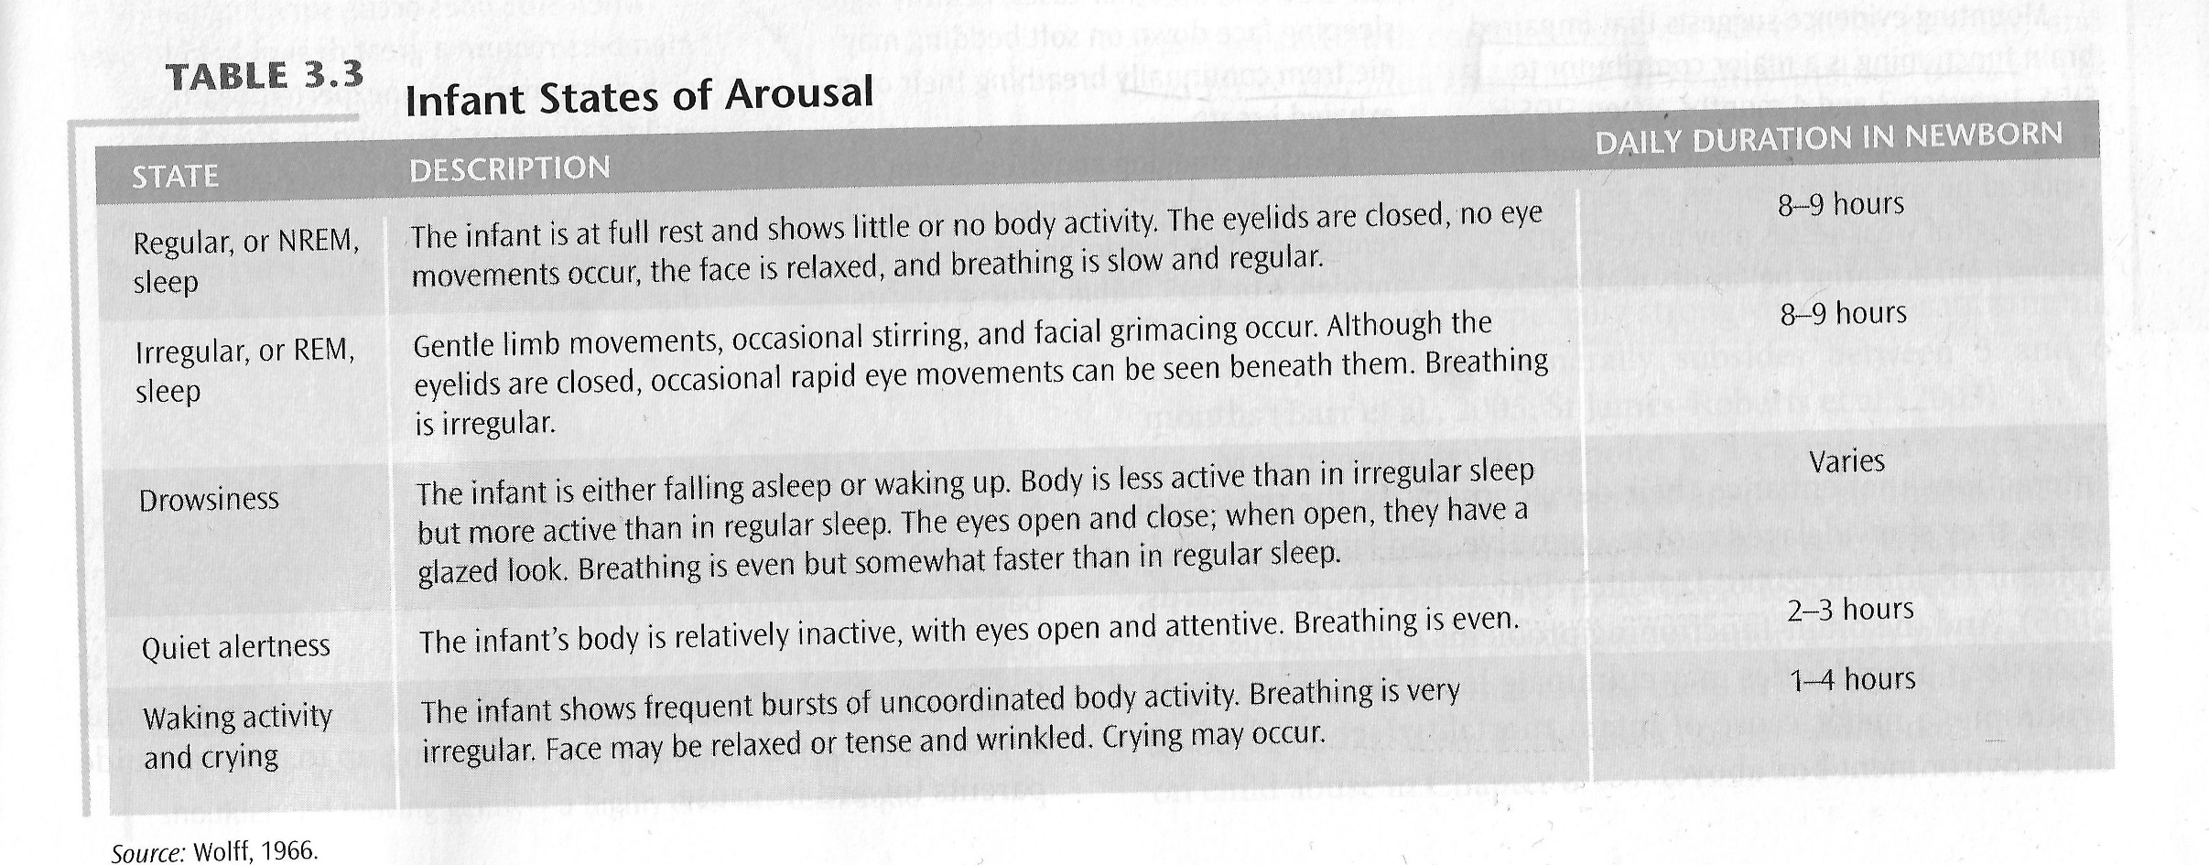
Infant States of Arousal

Slide 12
Discussion
If you (or a partner) want to have a baby, how would you have the baby?
1 – In a hospital
2 – In a birthing center
3 – At home
4 – Other
Why?
What are the pros and cons of each choice?

