Slide 1
Fundamentals of Lifespan Development
September 17 – physical development in infancy and toddlerhood

Slide 2
Videos
Developmental Milestones
PBS – The Secret Life of the Brain: The Baby’s Brain

Slide 3
Changes in Body Size and Muscle-Fat Makeup
Height increases 50% by age 1, 75% by age 2
Weight doubles by 5 months, triples by 1 year
Individual and group differences in size and rate of growth
First phase:
Cephalocaudal trend – “Head to Tail”. During the prenatal period, the head develops more rapidly than the lower part of the body.
Second Phase:
Proximodistal trend – “Near to Far”. The body grows from the center outward.

Slide 4
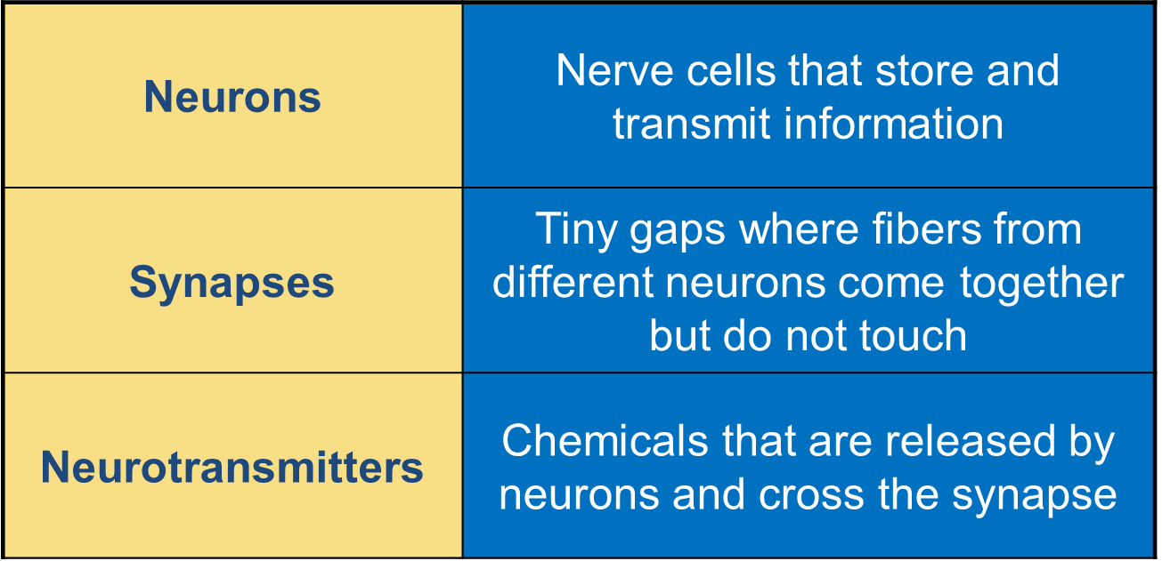
Brain Development
Video about Neurology
How a Neuron Fires

Slide 5
Methods for Measuring Brain Functioning
Electroencephalogram (EEG)
Event-related potentials (ERPs)
Functional magnetic resonance imaging (fMRI)
Positron emission tomography (PET)
Near-infrared spectroscopy (NIRS)

Slide 6
Development of the Cerebral Cortex
Two Hemispheres
Left – Verbal, positive emotions, sequential, analytic processing
Right – Spatial, negative emotions , holistic, integrative processing
Brain Lateralization
Brain Lateralization is a complex and ongoing process by which differing regions of the brain “take over” the functioning of specific behaviors and cognitive skills. Lateralization literally means that certain functions are located (in part or total) on one side of the brain.
Brain Plasticity
Before the hemispheres lateralize their functioning, the brain can adapt easier if damaged
Sensitive Period
Sensory deprivation causes brain damage. Environmental stimulation leads to overall brain growth.

Slide 7
Appropriate Stimulation
Experience-expected brain growth – refers to the young brain’s rapidly developing organization, which depends on ordinary experiences – opportunities to explore the environment, interact with people, and hear language.
Sensitive period
Experience-dependent brain growth – occurs throughout our lives. It consists of additional growth and refinement of established brain structures as a result of specific learning experiences that vary widely across individuals and cultures.
No sensitive period
Rushing these experiences may overwhelm the brain reducing the brain’s experience expected brain growth

Slide 8
Influences on Early Physical Growth
Heredity
Nutrition
Malnutrition

Slide 9
Learning Capacities

Slide 10
Learning - Key Terms
Habituation – refers to a gradual reduction in the strength of a response due to repetitive stimulation.
Recovery – A once habituated stimuli now causes a response again.
Imitation – Copying the behaviour of another person.
Mirror neuron

Slide 11
Motor Development
Gross-motor development: crawling, standing, walking
Fine-motor development: reaching, grasping
Sequence is fairly uniform
Large individual differences in rate of motor progress
Mastery involves acquiring increasingly complex systems of action with each skill
Dynamic System
Each new skill is joint product of:
central nervous system development
the body’s movement capacity
the child’s goals
environmental supports for the skill

Slide 12
Hearing

Slide 13
Seeing

Slide 14
Seeing

Slide 15
Intermodal Perception

Slide 16
Differentiation Theory
Infants
- actively search for invariant features of the environment
- notice stable relationships among features of a stimulus, detecting patterns such as individual faces
- gradually detect finer and finer features

Slide 17
Discussion
What were some of your developmental milestones?
How do they compare to the developmental milestones listed on page 106?
What were your first words?
What toys do you remember from your toddlerhood?
What memories do you have from that period of your life?
They can be based on pictures and what you were told.

