Slide 1
Fundamentals of Lifespan Development
September 24 – Emotional and social development in infancy and toddlerhood

Slide 2
Video
Erik Erikson – 5:40
Harry Harlow

Slide 3
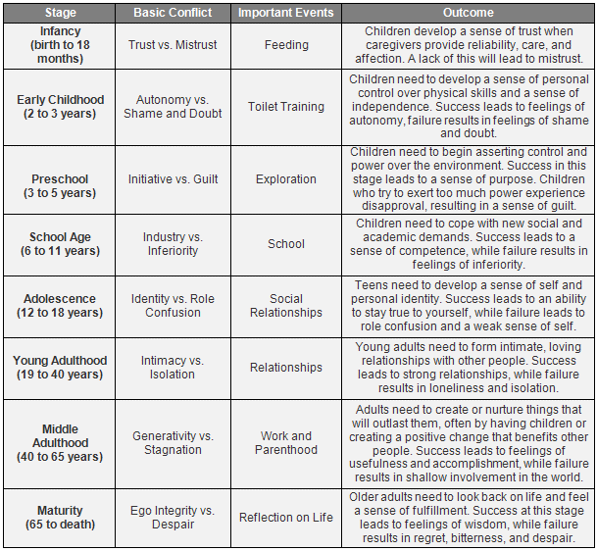
Erikson’s Psychosocial Stages

Slide 4
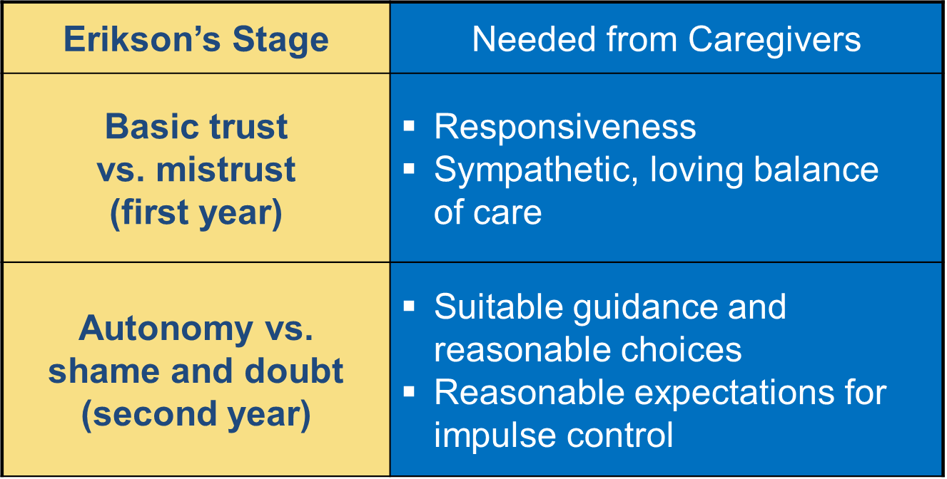
Erikson’s Psychosocial Stages

Slide 5
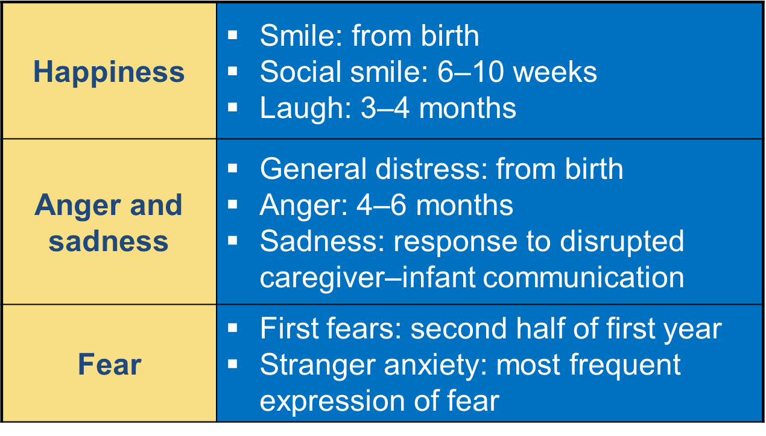
Development of Basic Emotions

Slide 6
Understanding and Responding to Emotions of Others
Birth – Matching feeling tone of caregiver
3–4 months – Sensitivity to structure and timing of face-to-face interactions
8–10 months – Social referencing
  Reliance on a trusted person’s emotional reactions to appraise an uncertain situation
  Used by caregivers to teach children how to react to everyday events

Slide 7
Self-Conscious Emotions & Emotional Regulation
Self-Conscious Emotions
  Shame
  Embarrassment
  Guilt
  Pride
  Envy
  Awareness of self as a separate unique individual
  Adult instruction
  Appear between ages 1½ and 3 years
Emotional Regulation
  Prefrontal cortex development
  Assistance of caregivers

Slide 8
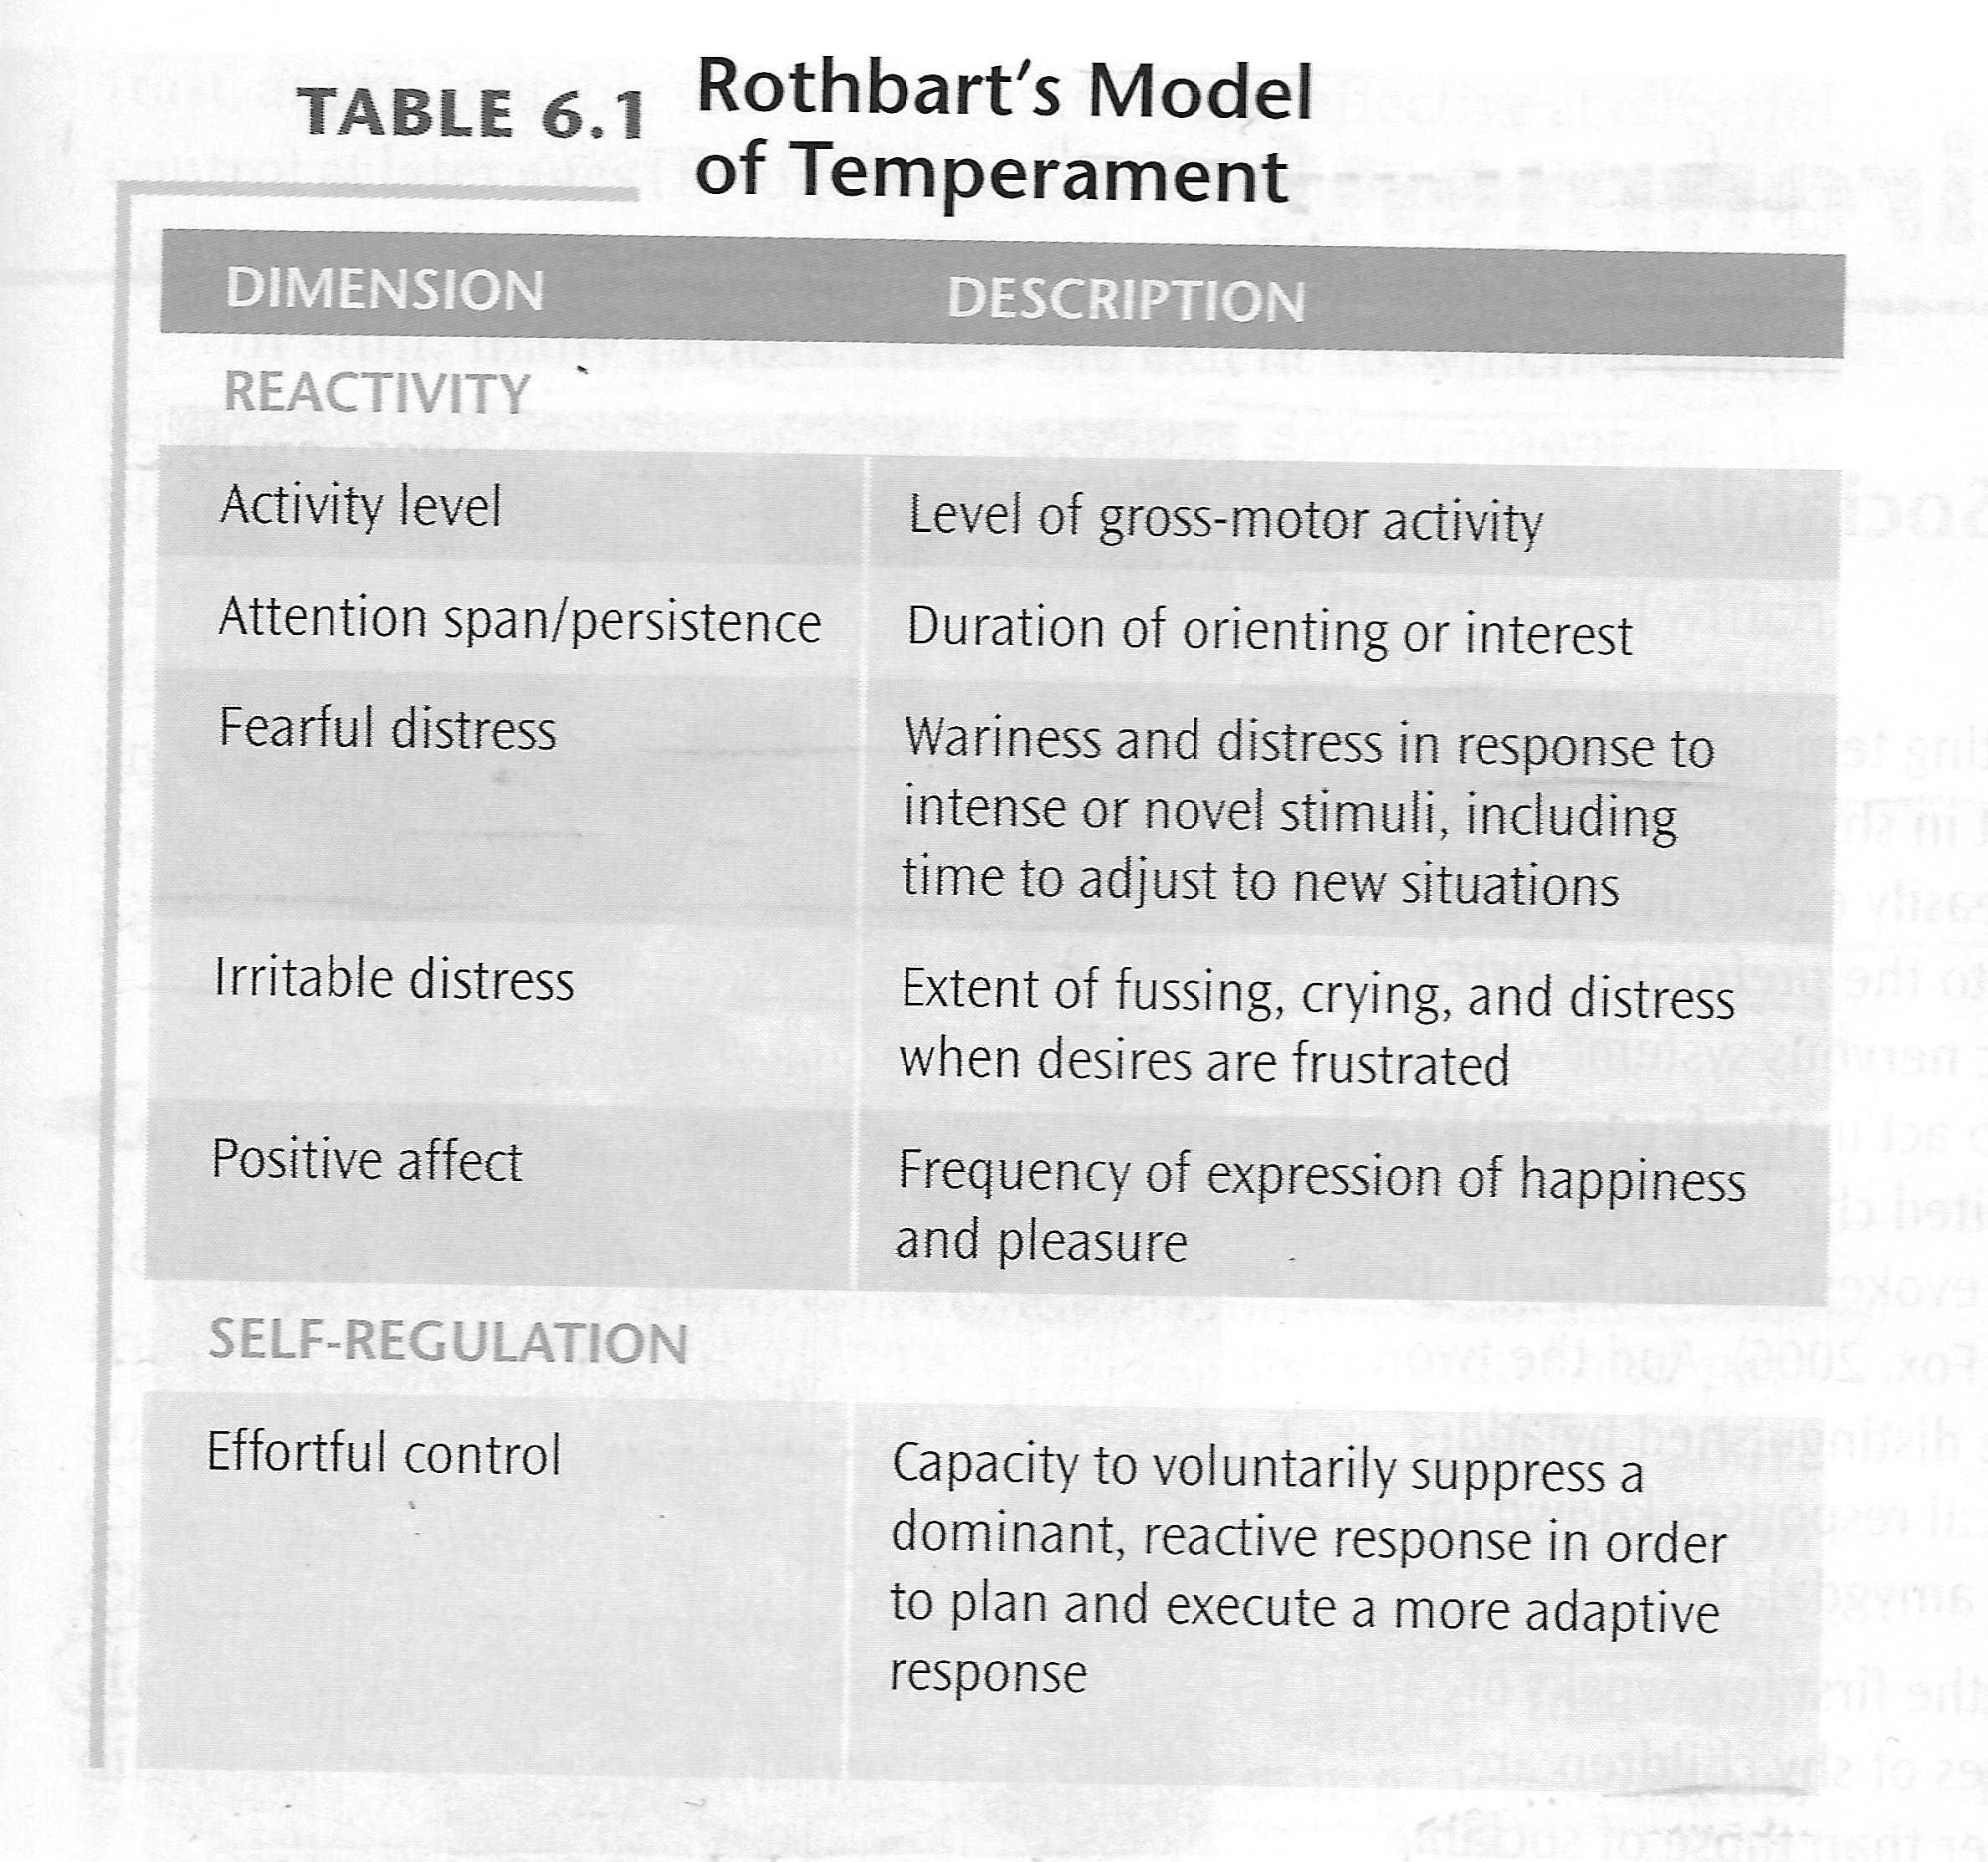
Structure of Temperament
Thomas & Chess
  Easy child (40%)
  Difficult child (10%)
  Slow to warm up (15%)
  Not in a category (35%)

Slide 9
Stability of Temperament
Stability is
  low in infancy and toddlerhood
  moderate from preschool years on
Temperament develops with age, becoming more stable after age 3 years

Slide 10
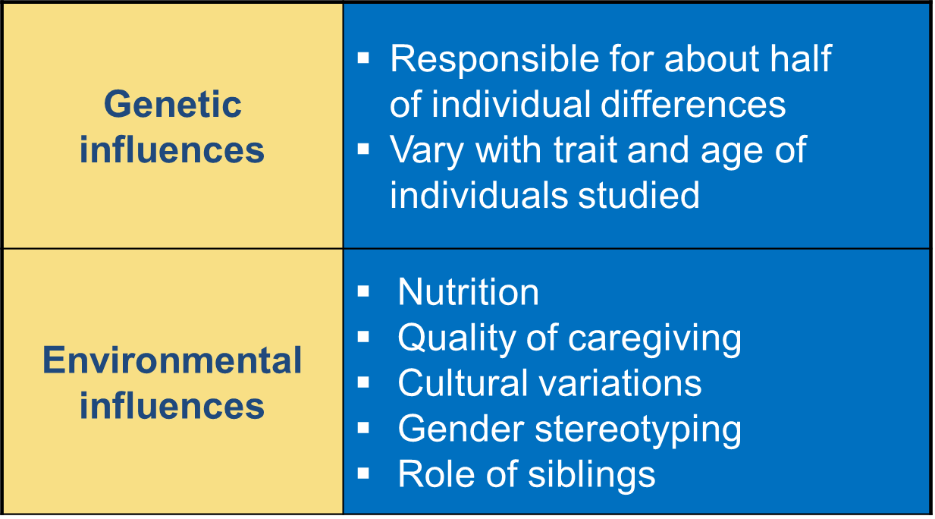
Genetic and Environmental Influences
Child Rearing: The Goodness-of-Fit-Model
  Interaction between temperament and child-rearing style
  Effective child rearing: good fit with child’s temperament

Slide 11
Bowlby’s Ethological Theory of Attachment
Pre-attachment phase (Birth to 6 weeks) – Grasping, crying, smiling, gazing
Attachment-in-the-making phase (6 weeks to 6-8 months) – Begin to develop a sense of trust to caregiver over stranger
Clear-cut attachment phase (6-8 months to 18 months-2 years) – Separation anxiety may occur depending on temperament
Reciprocal relationship with caregiver (18 months-2years and on) – The development of language permits discussion of coming and going

Slide 12
Ainsworth Attachment Styles
Strange Situation Paradigm
Secure attachment (60%)
Avoidant attachment (15%)
Resistant attachment (10%)
Disorganized/disoriented attachment (15%)
Cultural Variations
Factors that affect attachment
  Early availability of consistent caregiver
  Quality of caregiving: parental sensitivity
  Infant characteristics
  Parents’ internal working models
Multiple Attachments to:
  Mothers
  Fathers
  Siblings
  Grandparents
  Professional caregivers

Slide 13
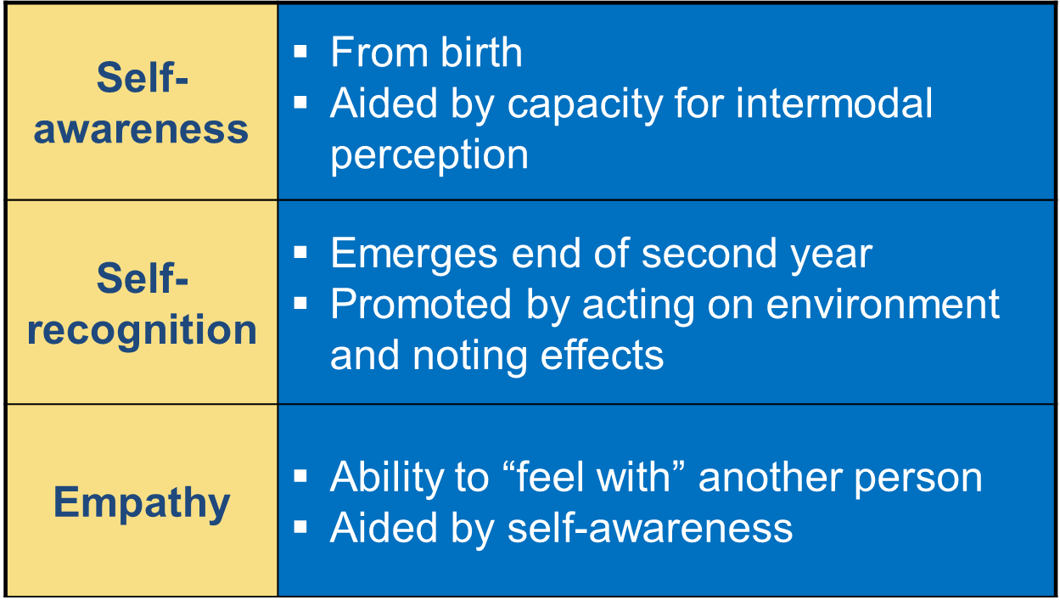
Self-Development
Self-categorization (2nd year) – Develops along with language
Self-control
  inhibit impulses
  manage negative emotions
  behave in socially acceptable ways
  Self-control depends on:
  awareness of self as separate, autonomous being
  confidence in directing own actions
  memory for caregiver’s directives

Slide 14
Discussion
How can adults encourage toddlers to comply with their requests?

Slide 15
Helping Toddlers Develop Compliance and Self-Control
Respond with sensitivity and support
Give advance notice of change in activities
Offer many prompts and reminders
Reinforce self-controlled behavior
Encourage sustained attention
Support language development
Increase rules gradually

