Slide 1
Fundamentals of Lifespan Development
September 26 – Physical and cognitive development in early childhood

Slide 2
Video
Vygotsky Short Video
Ted Talk – What Kindergarten Should Be
Ted Talk – Looking to Montessori to Guide Education Reform

Slide 3
Physical Development – Brain & Skeleton
Skeletal growth:
  new epiphyses emerge
  lose baby teeth
Brain development:
  rapid growth of the prefrontal cortex
  hemispheres continue to lateralize
Reflects dominant cerebral hemisphere:
  right-handed (90%) — left hemisphere
  left-handed (10%) — both hemispheres
  Jointly influenced by nature and nurture:
    position in uterus
    practice

Slide 4
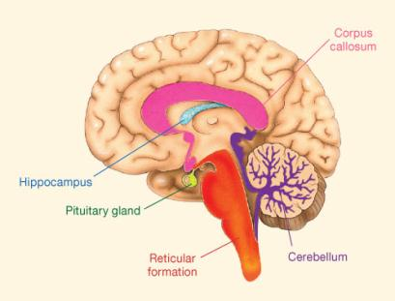
Brain Development
Cerebellum – Aids in balance and control of body movement
Reticular Formation – Maintains alertness and consciousness
Hippocampus – Memory, image of space
Corpus callosum – Large bundle of fibers that connect the two cerebral hemispheres, perception, attention, memory, language, problem solving
Pituitary gland – Critical role in releasing:
  Growth hormone
  Thyroid-stimulating hormone

Slide 5
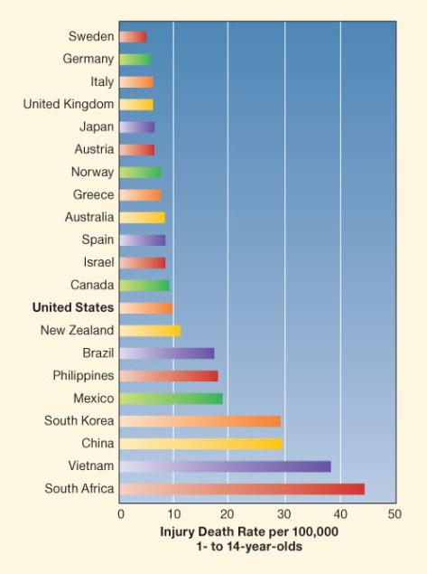
Influences on Physical Development Growth and Health
Heredity and hormones
Nutrition
Infectious disease
Childhood injuries

Slide 6
Motor Development in Early Childhood
Gross-motor skills:
  balance improves
  gait smooth and rhythmic by age 2
  upper- and lower-body skills combine into more refined actions by age 5
  greater speed and endurance
Fine-motor skills:
  self-help: dressing, eating
  drawing and printing

Slide 7
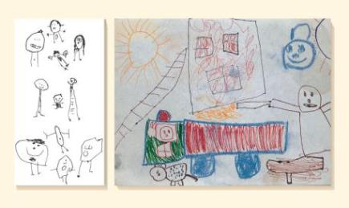
Progression of Drawing Skills
Scribbles
First representational forms:
  draws first recognizable
  pictures: 3 years
  draws boundaries and tadpole people: 3–4 years
More complex drawings: 5–6 years
Early printing: 4–6 years

Slide 8
Individual Differences in Motor Skills
Gender
  Boys excel in skills using force and power
  Girls excel in skills using balance and agility
Practice
Adult encouragement

Slide 9
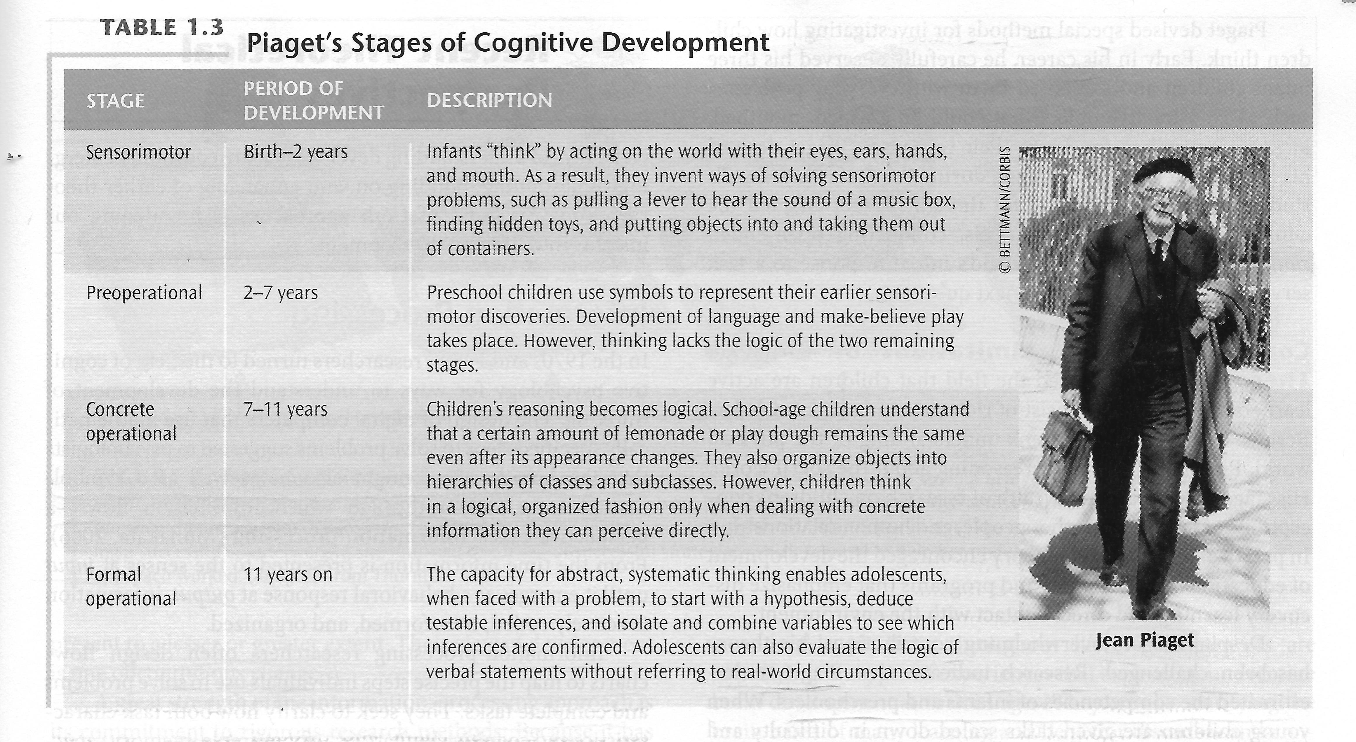
Piaget – Preoperational Stage
Ages 2 to 7
Gains in mental representation:
  make-believe play
  symbol–real-world relations
Limitations in thinking:
  egocentrism
  lack of conservation
  lack of hierarchical classification

Slide 10
Make-Believe Play
With age, make-believe gradually
  detaches from real-life conditions
  becomes less self-centered
  becomes more complex
  Sociodramatic play develops
Benefits of Make-Believe Play
  Contributes to cognitive and social skills
  Strengthens mental abilities:
    sustained attention
    memory
    language and literacy
    creativity
    regulation of emotion
    perspective taking

Slide 11
Symbol-Real-World Relations
Dual Representation – Viewing a symbolic object as both an object and a symbol. Strengthens around age 3.
Egocentrism – Failure to distinguish others’ viewpoints from one’s own
Animistic Thinking – Belief that inanimate objects have lifelike qualities
Conservation – Understanding that physical characteristics remain the same when appearance changes:
Centration: focus on one aspect to
neglect of others
  Irreversibility: inability to mentally
  reverse a series of steps

Slide 12
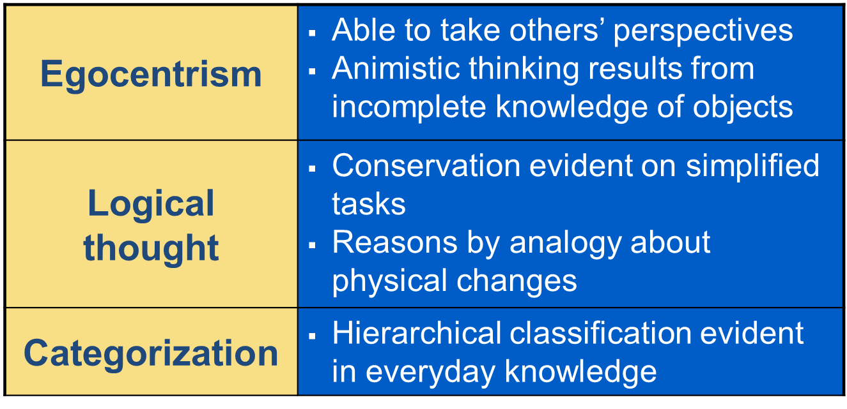
Follow-up on Piaget’s Preoperational Theories

Slide 13
Vygotsky’s Sociocultural Theory
Private speech
Zone of proximal development
Scaffolding: support of an “expert” to fit the child's current level of performance
Helps us understand cultural variation in cognition
Focuses on language, deemphasizes other routes to cognitive development
Says little about how basic elementary capacities (motor, perceptual, attention, memory, and problem-solving skills) contribute to higher cognitive processes

Slide 14
Gains in Information Processing
Attention: inhibition, planning
Memory: recognition, recall, episodic memory
Theory of mind: Metacognition, beliefs & false belief
Emergent literacy
Mathematical reasoning – ordinality (14 -16 months), cardinality 3.5 – 4 years)

Slide 15
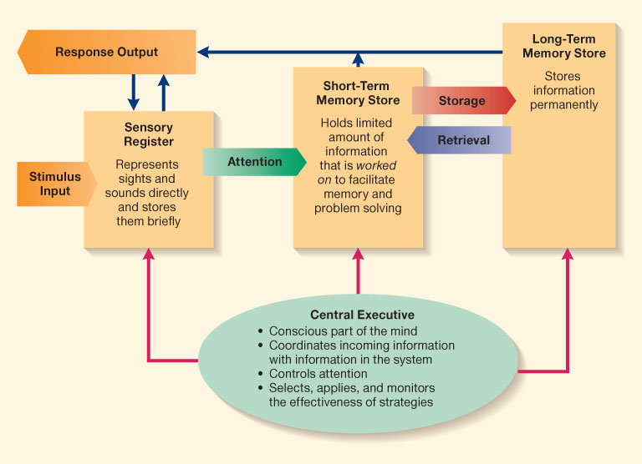
Information Processing Model

Slide 16
Individual Differences in Mental Development
Factors contributing to individual differences:
  home environment
  quality of child care, preschool, or kindergarten
    child-centered vs. academic
    early intervention programs
  Educational media

Slide 17
Language Development in Early Childhood
Vocabulary: fast-mapping
Grammar: overregularization
Conversation: pragmatics
Supporting language development:
  recasts
  expansions

Slide 18
Vocabulary Development
Fast-mapping:
  object names
  verbs
  modifiers
Coins new words
Uses metaphors
  Strategies for word learning
  Mutual exclusivity bias
  Shape bias
  Cues in sentence structure
  Rich social information

Slide 19
Grammar Development
Basic rules:
  subject–verb–object structure between ages 2 and 3
  small additions to sentences to express meaning: “-s,” variations of “to be”
Overregularization
Complex structures: question-asking, passive voice, embedded sentences, indirect objects

Slide 20
Pragmatics
2-year-olds can engage in effective conversation
By age 4, adjusts speech to fit listener’s age, sex, social status
Challenging situations, such as telephone conversations

Slide 21
Supporting Early Childhood Language
Conversation with adults
Recasts: restructuring inaccurate speech to correct form
  Expansions: elaborating on children’s speech

