Slide 1
Fundamentals of Lifespan Development
October 1 – emotional and social development in early childhood

Slide 2
Video
Social Learning – Bobo Doll – BBC
Ted Talk – Looking to Montessori to Guide Education Reform

Slide 3
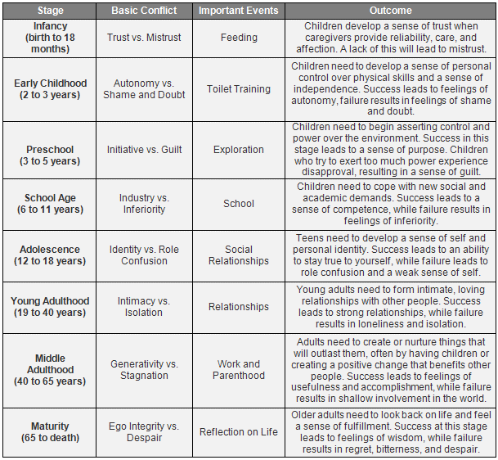
Erik Erikson – Psychosocial Stages
Initiative
New sense of purposefulness
Eagerness to try new tasks, join activities
Play permits trying out new skills
Strides in conscience development
Guilt
Overly strict superego, or conscience, causing too much guilt
Related to parental
threats
criticism
punishment

Slide 4
Self-Understanding
Self-Concept – The set of attributes, abilities, attitudes, and values that an individual believes defines who he or she is.
Consists largely of:
observable characteristics (appearance, possessions, behavior)
typical emotions and attitudes (“I like/don’t like …”)
Does not yet reference personality traits (“I’m shy”)
Self-Esteem – The judgment we make about our own worth and feelings associated with those judgments. It influences:
Future Behaviour
Emotional Experiences
Future psychological adjustment

Slide 5
Emotional Development
Gains in Emotional Competence
Improvements in:
emotional understanding
emotional self-regulation
Increase in self-conscious emotions (shame, guilt) and empathy
Preschoolers correctly judge:
causes of emotions
consequences of emotions
behavioral signs of emotions
Parents, siblings, peers, and make-believe play contribute to understanding

Slide 6
Emotional Self-Regulation & Self-Conscious Emotions
By age 3–4, aware of strategies for adjusting emotional arousal
Affected by
temperament: effortful control
warm parents who use verbal guidance
Self-Conscious Emotions
Examples:
Shame
Embarrassment
Guilt
Pride
Depend on adult feedback
Vary across cultures

Slide 7
Empathy and Sympathy
Empathy
Feeling same or similar emotions as another person
Sympathy
Feeling concern or sorrow for another’s plight
Factors that encourage empathy, sympathy, and prosocial behavior:
Temperament:
sociable
assertive
good at emotional self-regulation
Parenting: warm, sensitive parents who
show empathic concern
encourage emotional expressiveness

Slide 8
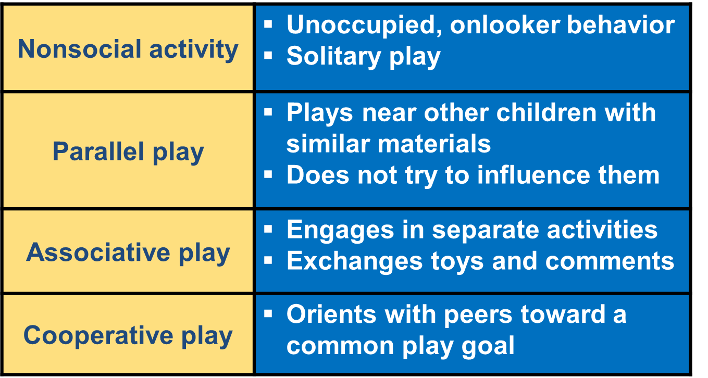
Peer Sociability in Play

Slide 9
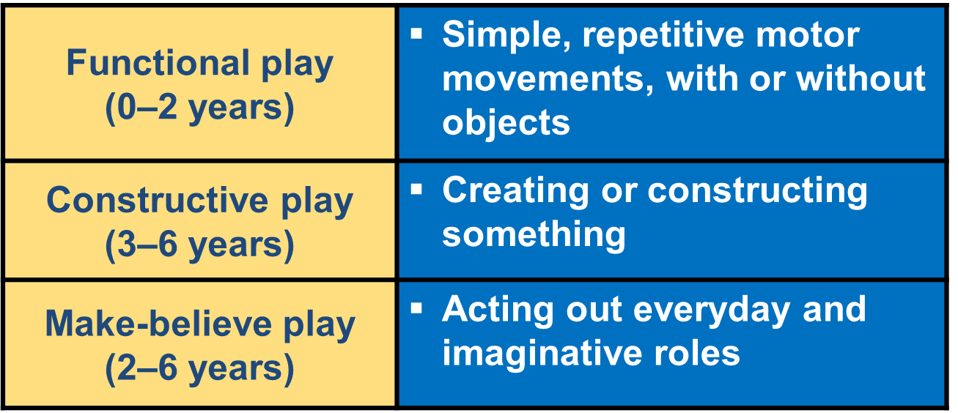
Cognitive Play Categories

Slide 10
First Friendships
Someone who “likes you,” plays with you, shares toys
Friendships change frequently
Benefits of friendships:
social support: cooperation and emotional expressiveness
favorable school adjustment
Parents can directly and indirectly influence peer relations

Slide 11
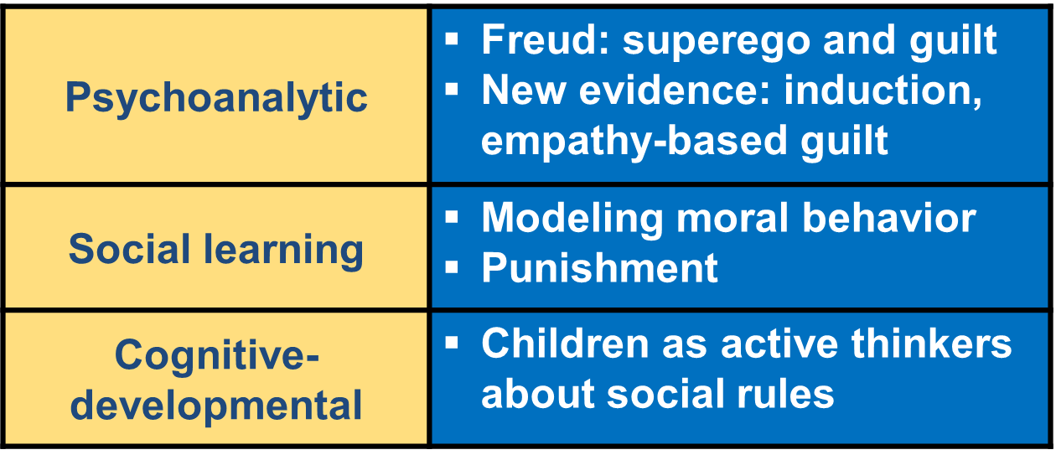
Foundations on Morality

Slide 12
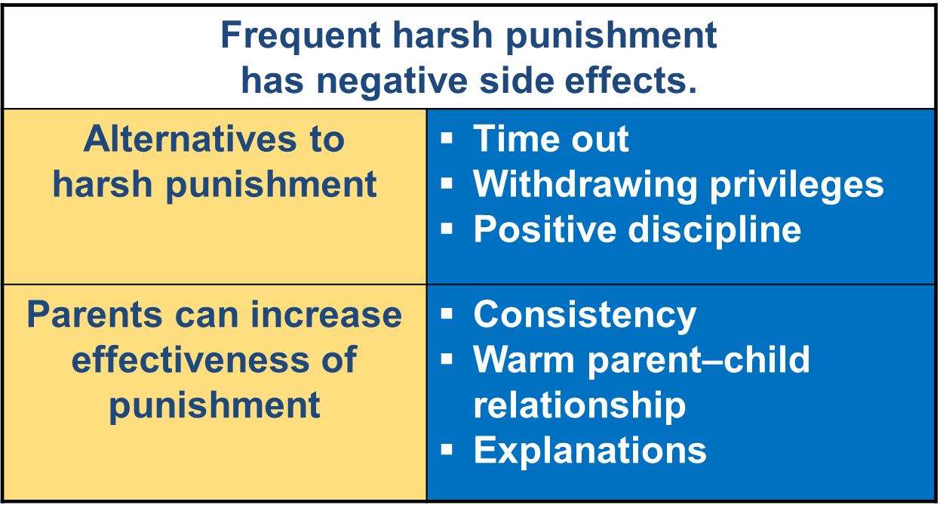
Effects of Punishment
Positive Discipline
Use transgressions as opportunities to teach.
Reduce opportunities for misbehavior.
Provide reasons for rules.
Have children participate in family duties and routines.
Try compromising and problem solving.
Encourage mature behavior.

Slide 13
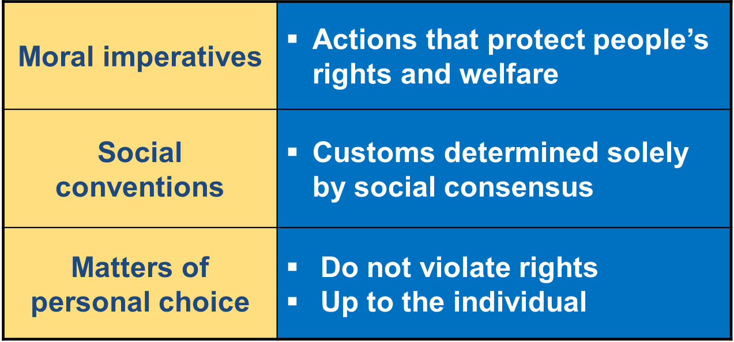
Cognitive-Developmental Perspective

Slide 14
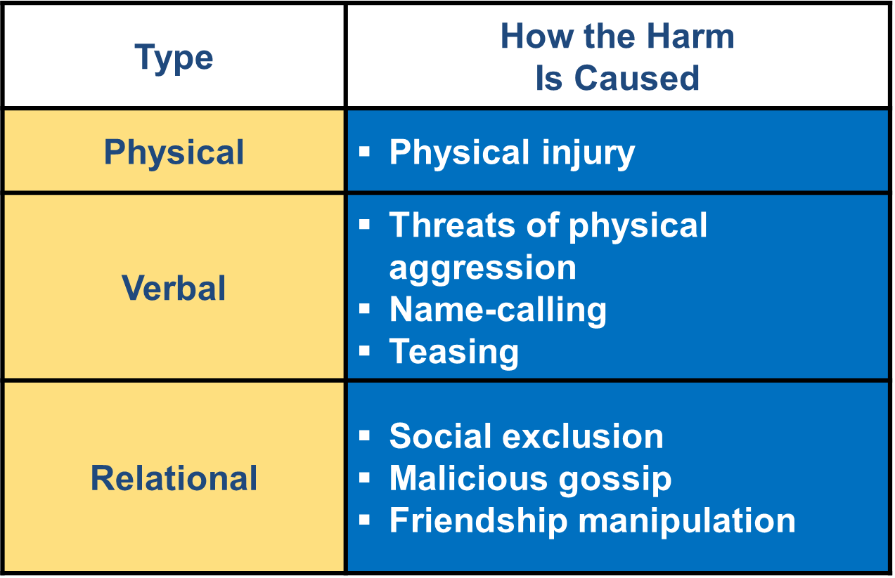
Types of Aggression
Proactive – Children need to fulfill a need or desire
Reactive – An angry defense response to provocation or a blocked goal and is meant to hurt another
Sources of Aggression
Individual differences:
gender
temperament
Family:
harsh, inconsistent discipline
cycles of such discipline, whining/giving in
Media violence

Slide 15
Gender Typing
Strengthen and operate as blanket rules in early childhood
Preschoolers associate toys, clothing, household items, occupations, behavior, and more with gender
Young children’s rigid gender stereotypes are a joint product of
gender stereotyping in the environment
cognitive limitations
Factors that influence gender typing:
Genetic:
evolutionary adaptiveness
hormones
Environmental:
family
teachers
peers
broader social environment
Judith Butler on Gender Performativity

Slide 16
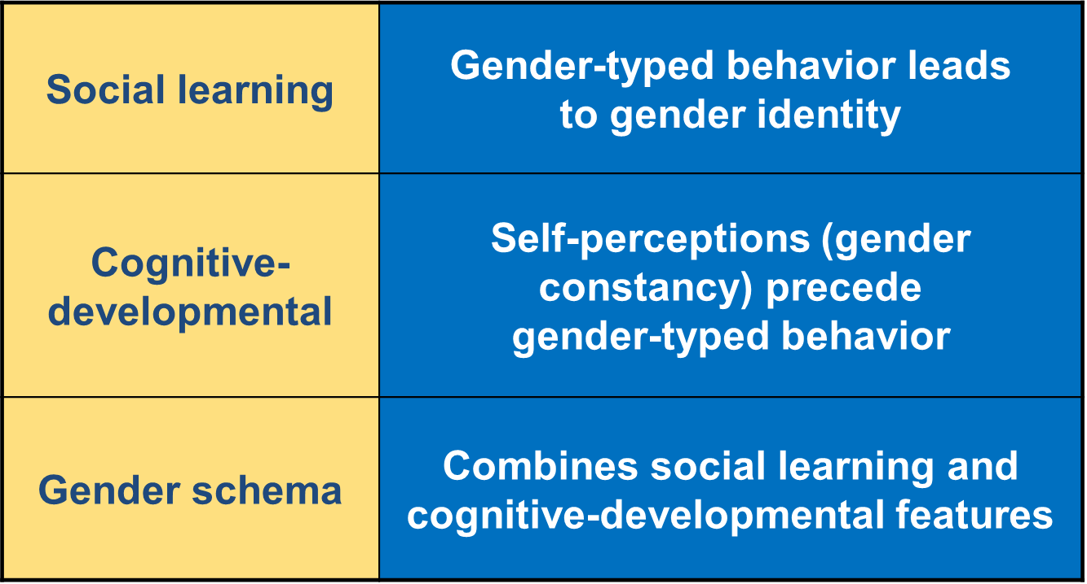
Theories of Gender Identity

Slide 17
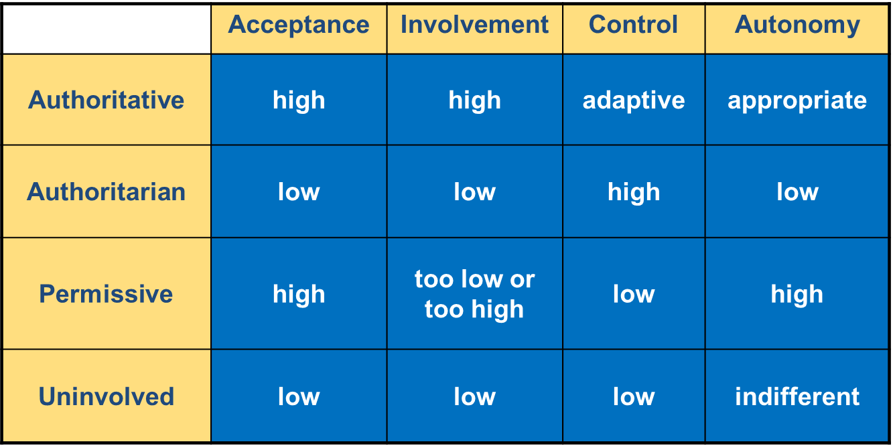
Child Rearing Styles
Authoritative
self-control, moral maturity, high self-esteem
Authoritarian
anxiety, unhappiness, low self-esteem, anger, defiance
Permissive
impulsivity, poor school achievement
Uninvolved
depression, anger, poor school achievement

Slide 18
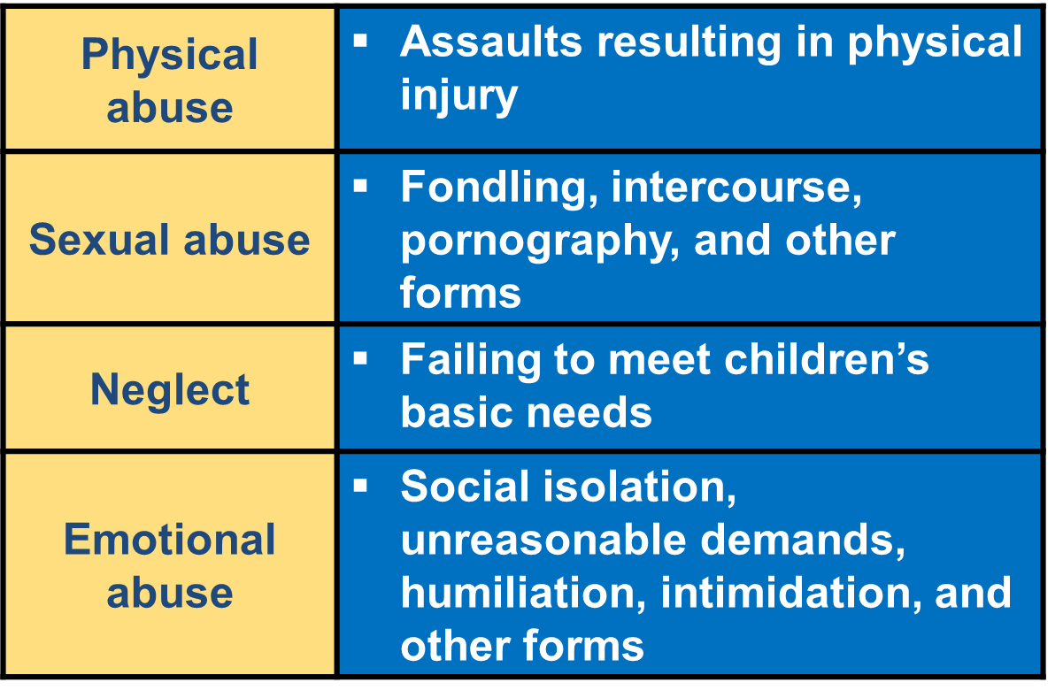
Child Maltreatment
Emotional:
poor emotional self-regulation
impaired empathy/sympathy
depression
Adjustment:
substance abuse
violent crime
Learning:
impaired working memory and executive function
low academic motivation

