Slide 1
Fundamentals of Lifespan Development
October 10, 2014 – Emotional and Social development in middle childhood

Slide 2
Video
Creative Video Day Camp
Co-op Collective Vision

Slide 3
Who were you as a child?
With a partner, please describe yourself as a middle child
Self-Understanding – Ideal vs Real Self
Social Comparisons
Self-Esteem
Social
Academic
Physical/Athletic
Physical Appearance
Attributions
Mastery oriented attribution
Learned Helplessness
Emotional Regulation and Understanding
Moral Values
Peer Relations
Family Life

Slide 4
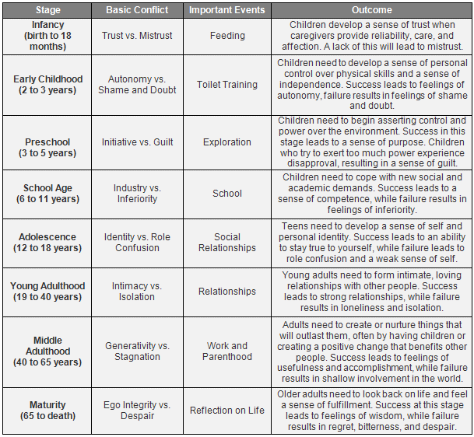
Erikson – Industry vs Inferiority

Slide 5
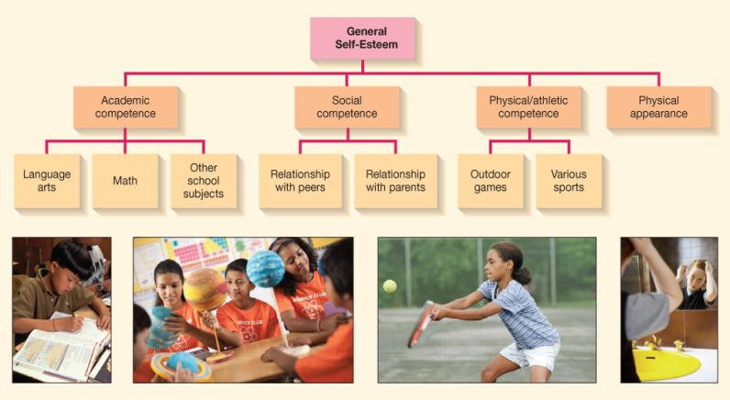
Self-Esteem

Slide 6
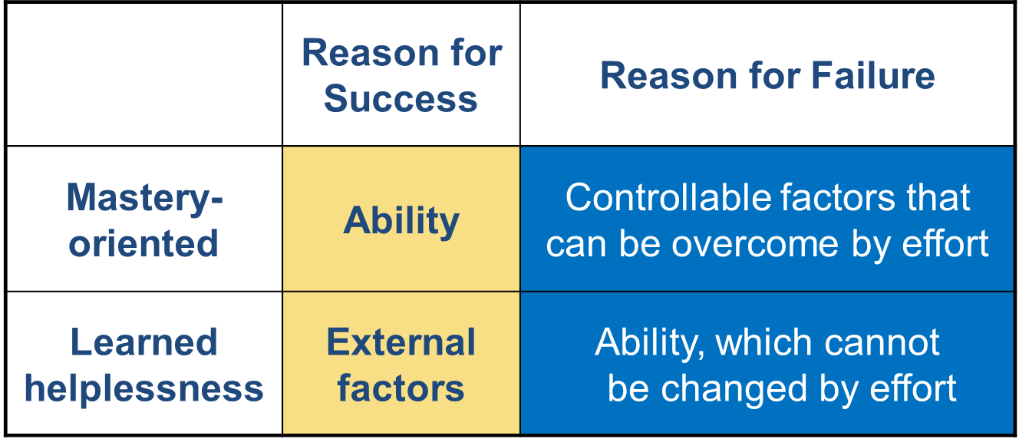
Achievement-Related Attributions

Slide 7
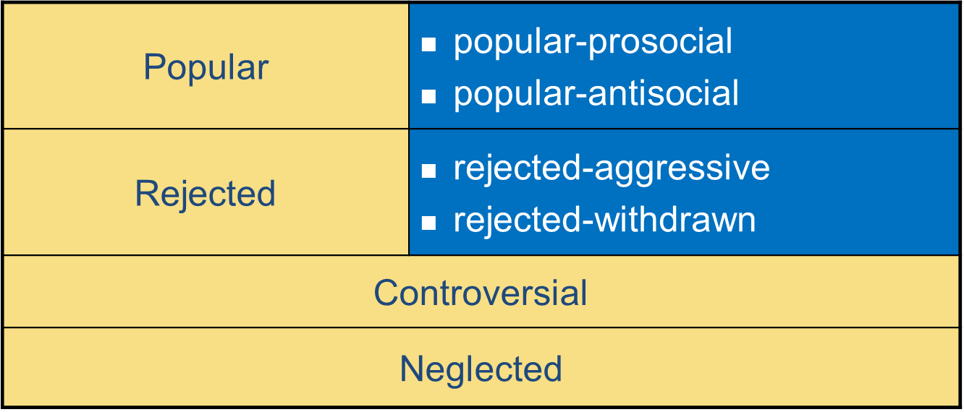
Categories of Peer Acceptance

