Slide 1
Fundamentals of Lifespan Development
October 24, 2014 – Physical and cognitive development in adolescence

Slide 2
Video
The Teenage Brain – Ted Talk
Mysterious Workings of the Adolescent Brain – Ted Talk

Slide 3
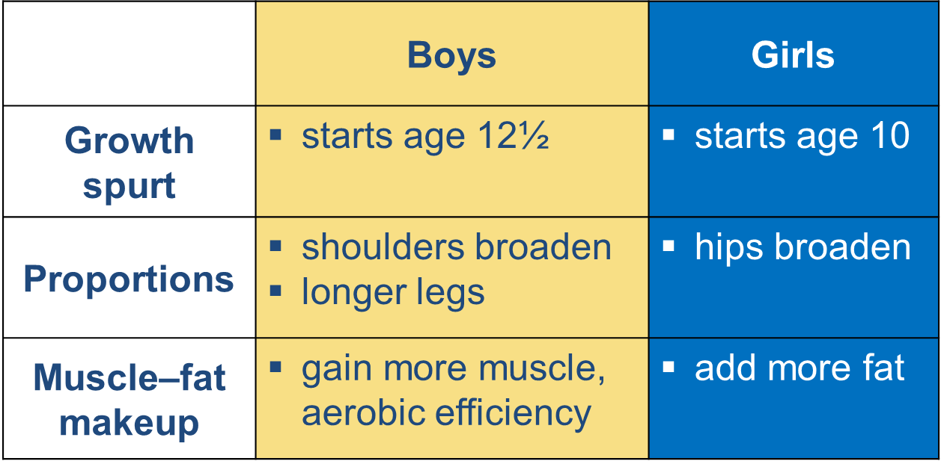
Puberty – Physical Changes
Growth hormone and thyroxine
Boys:
  androgens: testosterone
  Small amounts of estrogens
  Spermarchy
Girls:
  estrogens
  adrenal androgens
  Menarchy

Slide 4
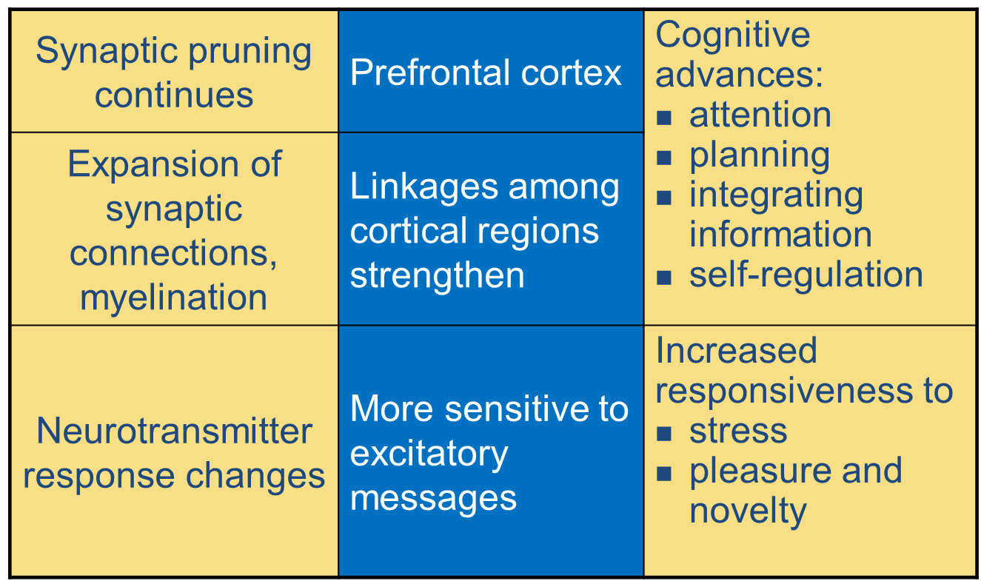
Puberty – Brain Development

Slide 5
Changes in Puberty
Reactions to changes
Mood
Parent-child relationship
Timing
Importance of physical attractiveness – Body Image
Importance in fitting in with peers
Dietary independence – Nutrition
Sexuality
Substance use and abuse

Slide 6
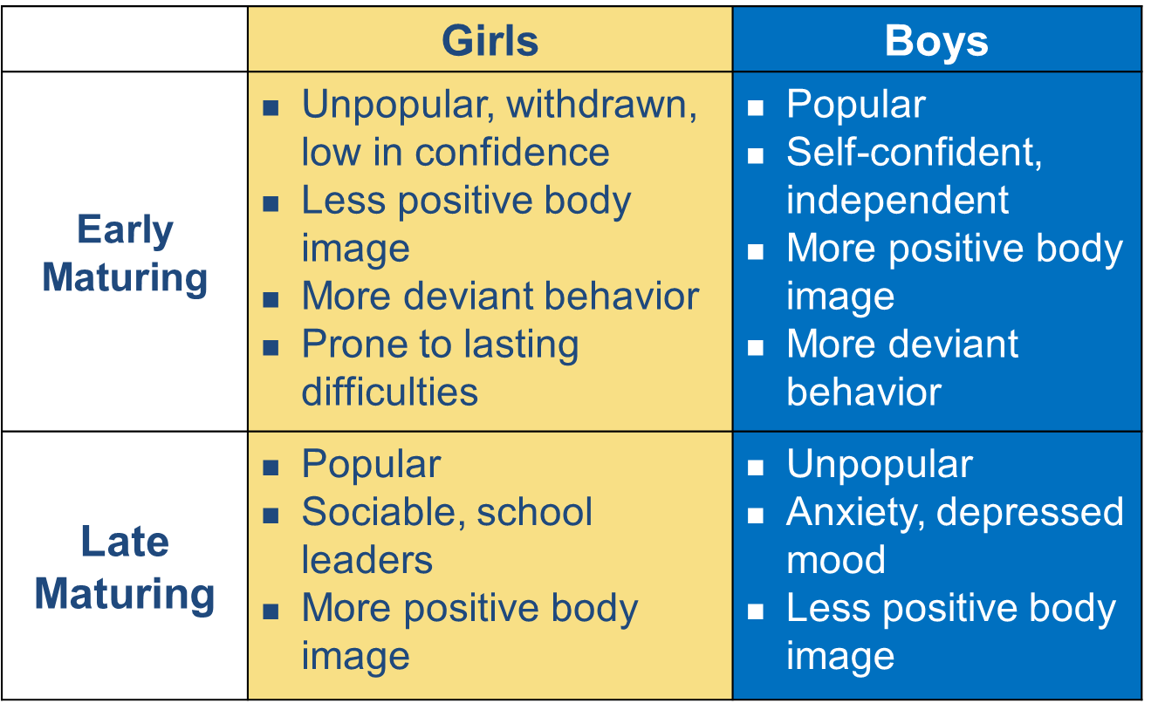
Onset of Puberty

Slide 7
Advertising and Teens
Compare and contrast ads!
Dove Evolution
http://www.youtube.com/watch?v=hibyAJOSW8U
Axe Body Spray
http://www.youtube.com/watch?v=7DpoavYXMK4&feature=related

Slide 8
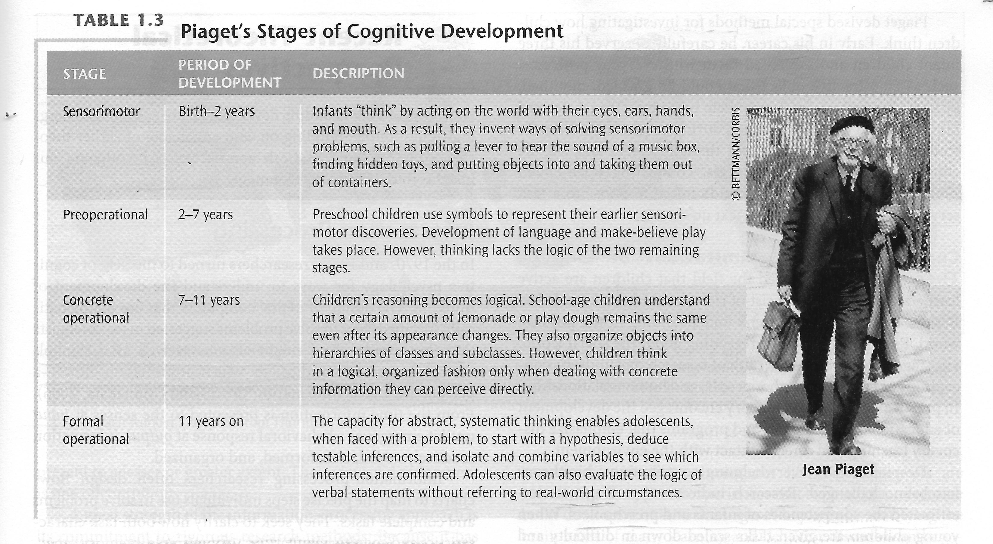
Piaget – Formal Operational Stage

Slide 9
Piaget – Formal Operational Stage
Hypothetico-deductive reasoning:
  problem solving based on a hypothesis, deducing logical, testable inferences
Propositional thought:
  evaluating the logic of verbal propositions without using real-world circumstances
Video
Follow-Up
School-age children show beginnings of formal operational thought
Adolescents are considerably more competent:
  reason about more variables simultaneously
  grasp logical necessity
Formal operations may not be universal:
  training and context contribute
  schooling is powerfully influential

Slide 10
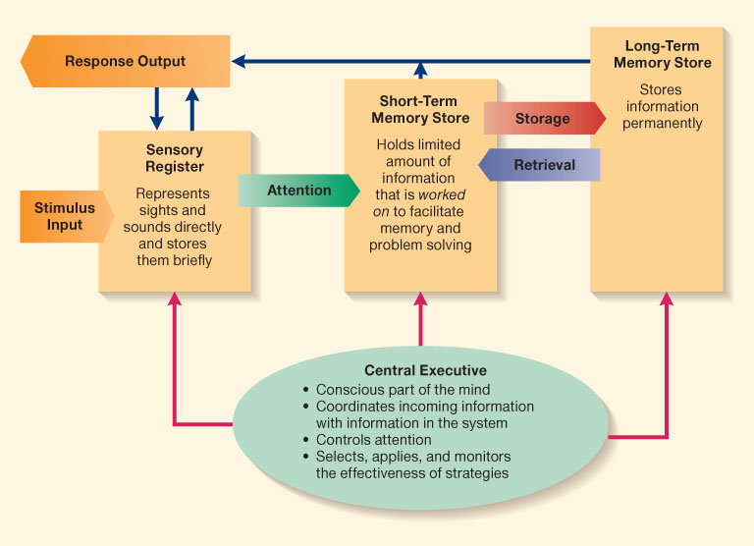
Cognitive Processing
Attention
Inhibition
Strategies
Knowledge
Metacognition
Cognitive self-regulation
Speed of thinking
Processing capacity
Coordinating theory with evidence
Contributing factors:
  working memory capacity
  exposure to complex problems
  metacognitive understanding
  open-mindedness
Adolescents and adults vary widely

Slide 11
Scientific Reasoning
Self-consciousness and self-focusing:
  imaginary audience – focus of concern
  personal fable – others are observing and thinking about them (inflated opinion)
Idealism and criticism
Decision making:
  influenced by immediate reward
  fall back on well-learned, intuitive judgments

Slide 12
What about you?
What were you like as a teen?

