Slide 1
Fundamentals of Lifespan Development
October 31, 2014 – Emotional and social development in adolescence

Slide 2
Video
Identity in the 21st century – Ted Talk
Defining your Identity – Ted Talk

Slide 3
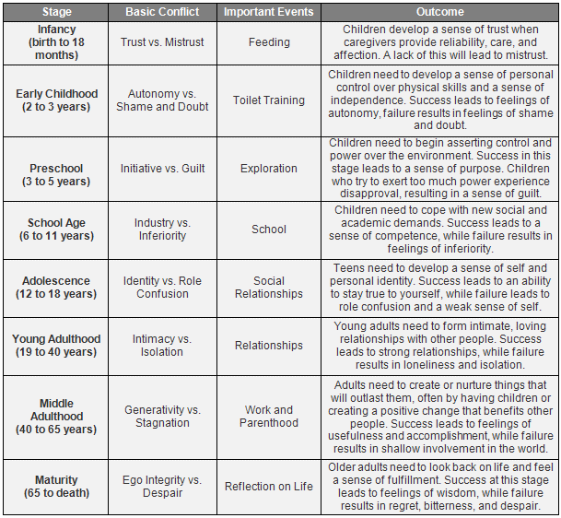
Erikson – Identity vs Role Confusion
Identity
Defining who you are, what you value, and your direction in life
Commitments to vocation, relationships, sexual orientation, ethnic group, ideals
Exploration, resolution of “identity crisis”
Role Confusion
Lack of direction and self-definition
Earlier psychosocial conflicts not resolved
Society restricts choices
Unprepared for challenges of adulthood

Slide 4
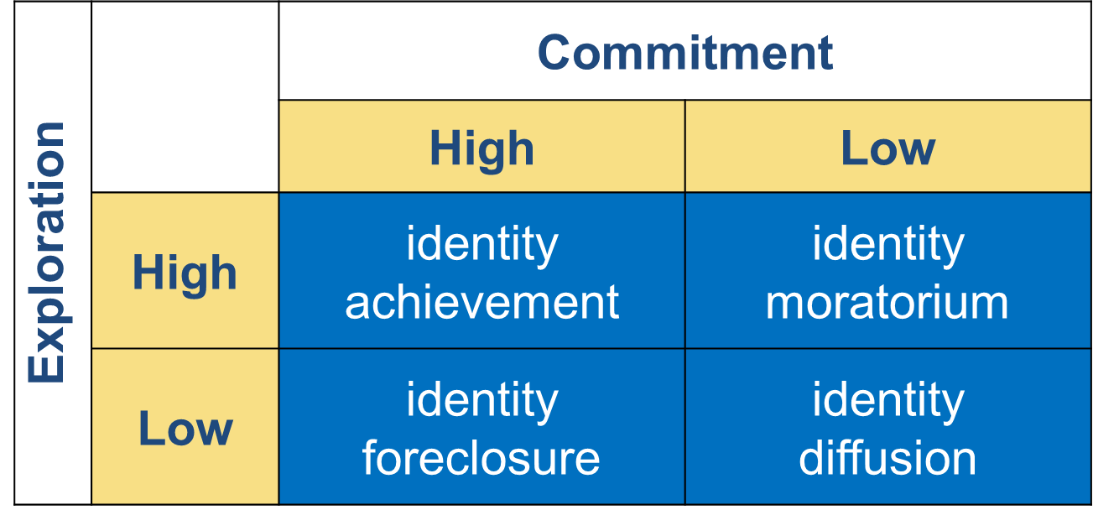
Paths to Identity

Slide 5
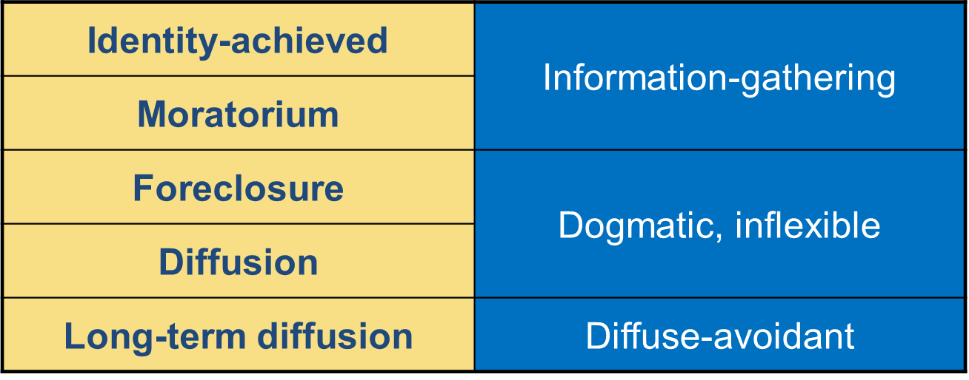
Identity Status and Cognitive Style

Slide 6
Factors Affecting Identity
Personality
Child-rearing practices:
attachment
Peers, friends
Schools, communities
Culture
Societal forces

Slide 7
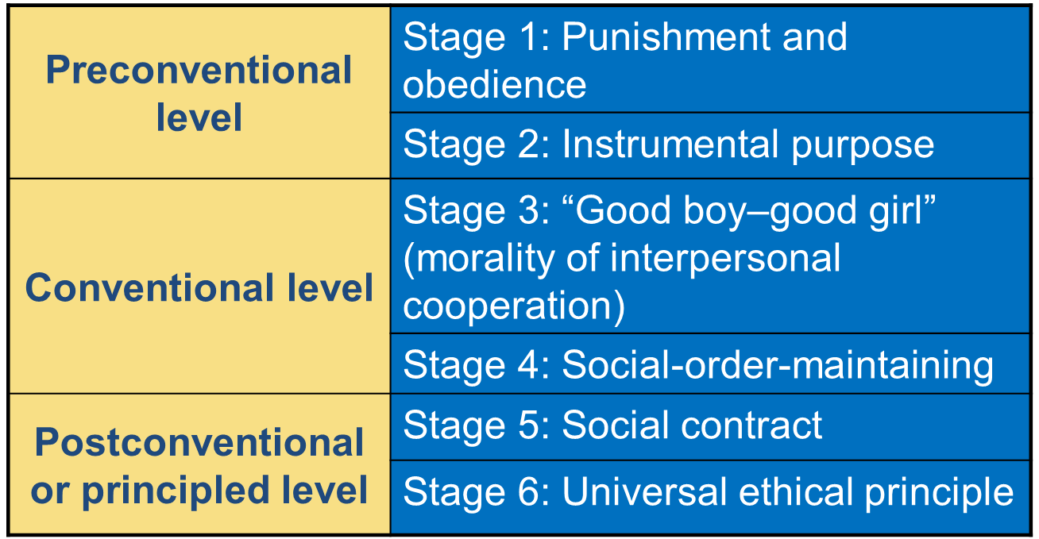
Kohlberg’s Theory of Moral Development

Slide 8
Kohlberg’s Theory of Moral Development
Preconventional Level
Stage 1 – The punishment and obedience orientation
Difficult to consider two points of view. Overlook people’s intentions.
Stage 2 – The instrumental purpose orientation
People can have different perspectives. Right action follows from self interest. Reciprocity as equal exchange.

Slide 9
Kohlberg’s Theory of Moral Development
Conventional Level
Stage 3 – Good boy-good girl orientation
Desire to obey rules because they promote social harmony. Seeks approval.
Stage 4 – The social order maintaining orientation
Individuals take into consideration larger perspective of societal laws.

Slide 10
Kohlberg’s Theory of Moral Development
Postconventional Level
Stage 5 – The social contract orientation
Rules and laws are flexible instruments for furthering human purpose. Can imagine alternative forms of social order. Emphasize fair procedures for interpreting and changing laws.
Stage 6 – The universal ethical principal orientation
Self-chosen ethical principles of conscience that are valid for all people regardless of laws and social agreement.

Slide 11
Morality
Research on Kohlberg’s Theory
Few people reach postconventional morality
Stages 3 and 4 reflect morally mature reasoning
In real life, people often reason below actual capacity
Influences on Moral Reasoning
Child-rearing practices:
caring, supportive
discussions of moral concerns
Schooling: higher education
Peer interaction
Culture

Slide 12
Critique on Kohlberg’s Theory
Kohlberg’s stages inadequately account for behavior in everyday life
Moral judgments are practical tools that
depend on current context and motivation
are frequently directed at self-serving goals
Critics: People often rise above self-interest to defend others’ rights

Slide 13
Relationship with Family and Peers
Parent-Child Relationship
Sibling Relationship
Friendships
Cliques and Crowds
Dating

Slide 14
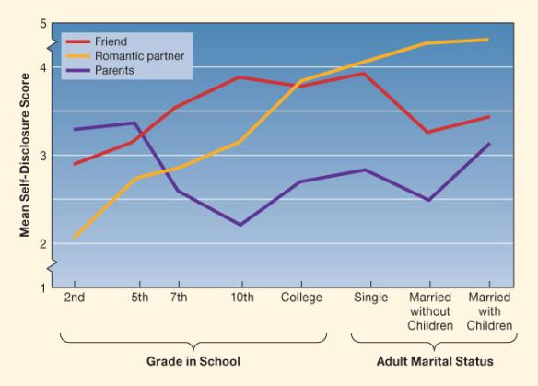
Self-Disclosure

Slide 15
Problems with Development
Depression
Most common psychological problem: 15–20% have had one or more major episodes
Twice as many girls as boys:
early-maturing girls
gender intensification
Influential factors:
heredity
parental depression
gender-typed coping styles

Slide 16
Problems with Development
Suicide
Suicide rate jumps sharply at adolescence
Related factors:
gender
ethnicity
family environment, high life stress
sexual orientation
personality:
intelligent, withdrawn
antisocial
triggering negative events

Slide 17
Problems with Development
Delinquency
Early-onset: behavior begins in childhood:
biological risks and inept parenting combine
linked to serious antisocial activity
Late-onset: behavior begins around puberty
peer influences

Slide 18
Pathway to Chronic Delinquency

Slide 19
The Moral Question – Discussion
Canada’s Environmental Ratings

