Slide 1
Fundamentals of Lifespan Development
October 8, 2014 – Physical and Cognitive Development in Middle childhood

Slide 2
IMPORTANT
  I will NOT cover new material on October 15th
  Instead, I will lead an activity that will help you review for the midterm exam
  We will begin chapter 11 after the midterm exam

Slide 3
Videos
Changing Education Paradigms

Slide 4
Learning in School
What is the role of educational institutions?
How are schools presently structured?
What are your educational philosophies?
  Constructivist
  Traditional
  Social Constructivist/Cooperative
  Other
  What is the role of the teacher in a school?
  How would you structure this course?
Key Terms:
  Self-Fulfilling Prophecies
  Inclusive classroom
  Cooperative learning
  Gifted
  Creativity
  Convergent thinking
  Divergent thinking
  Talent

Slide 5
Physical Growth
Slow, regular pace
Girls shorter and lighter until about age 9, when trend reverses
Lower portion of body grows fastest
Bones lengthen, broaden
Muscles very flexible
All permanent teeth appear

Slide 6
Motor Development
Gross-motor skill gains:
  flexibility
  balance
  agility
  force
Fine-motor skill gains:
  writing
  drawing

Slide 7
Play
Games with rules
Rough and Tumble Play
Newly Invented Games/Rules

Slide 8
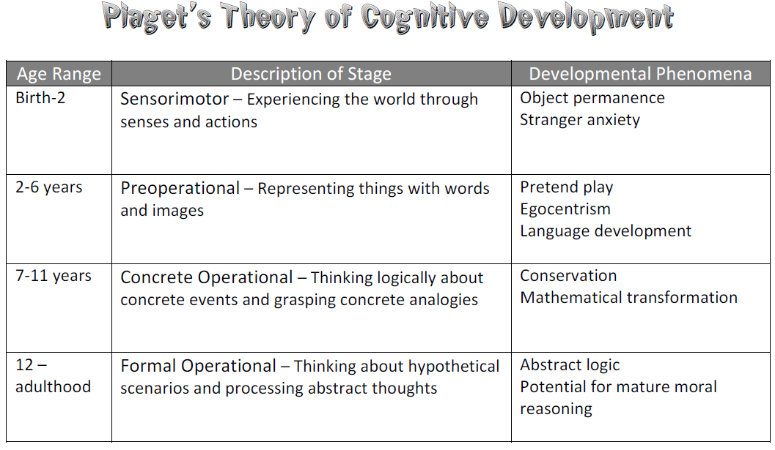
Piaget’s Concrete Operational Stage
Thought is more logical, flexible, and organized
  Gains:
  Conservation/Reversibility
  Classification
  Seriation/Transitive Abilities
  Spatial Reasoning
  Limits – Abstract thinking not yet fully developed

Slide 9
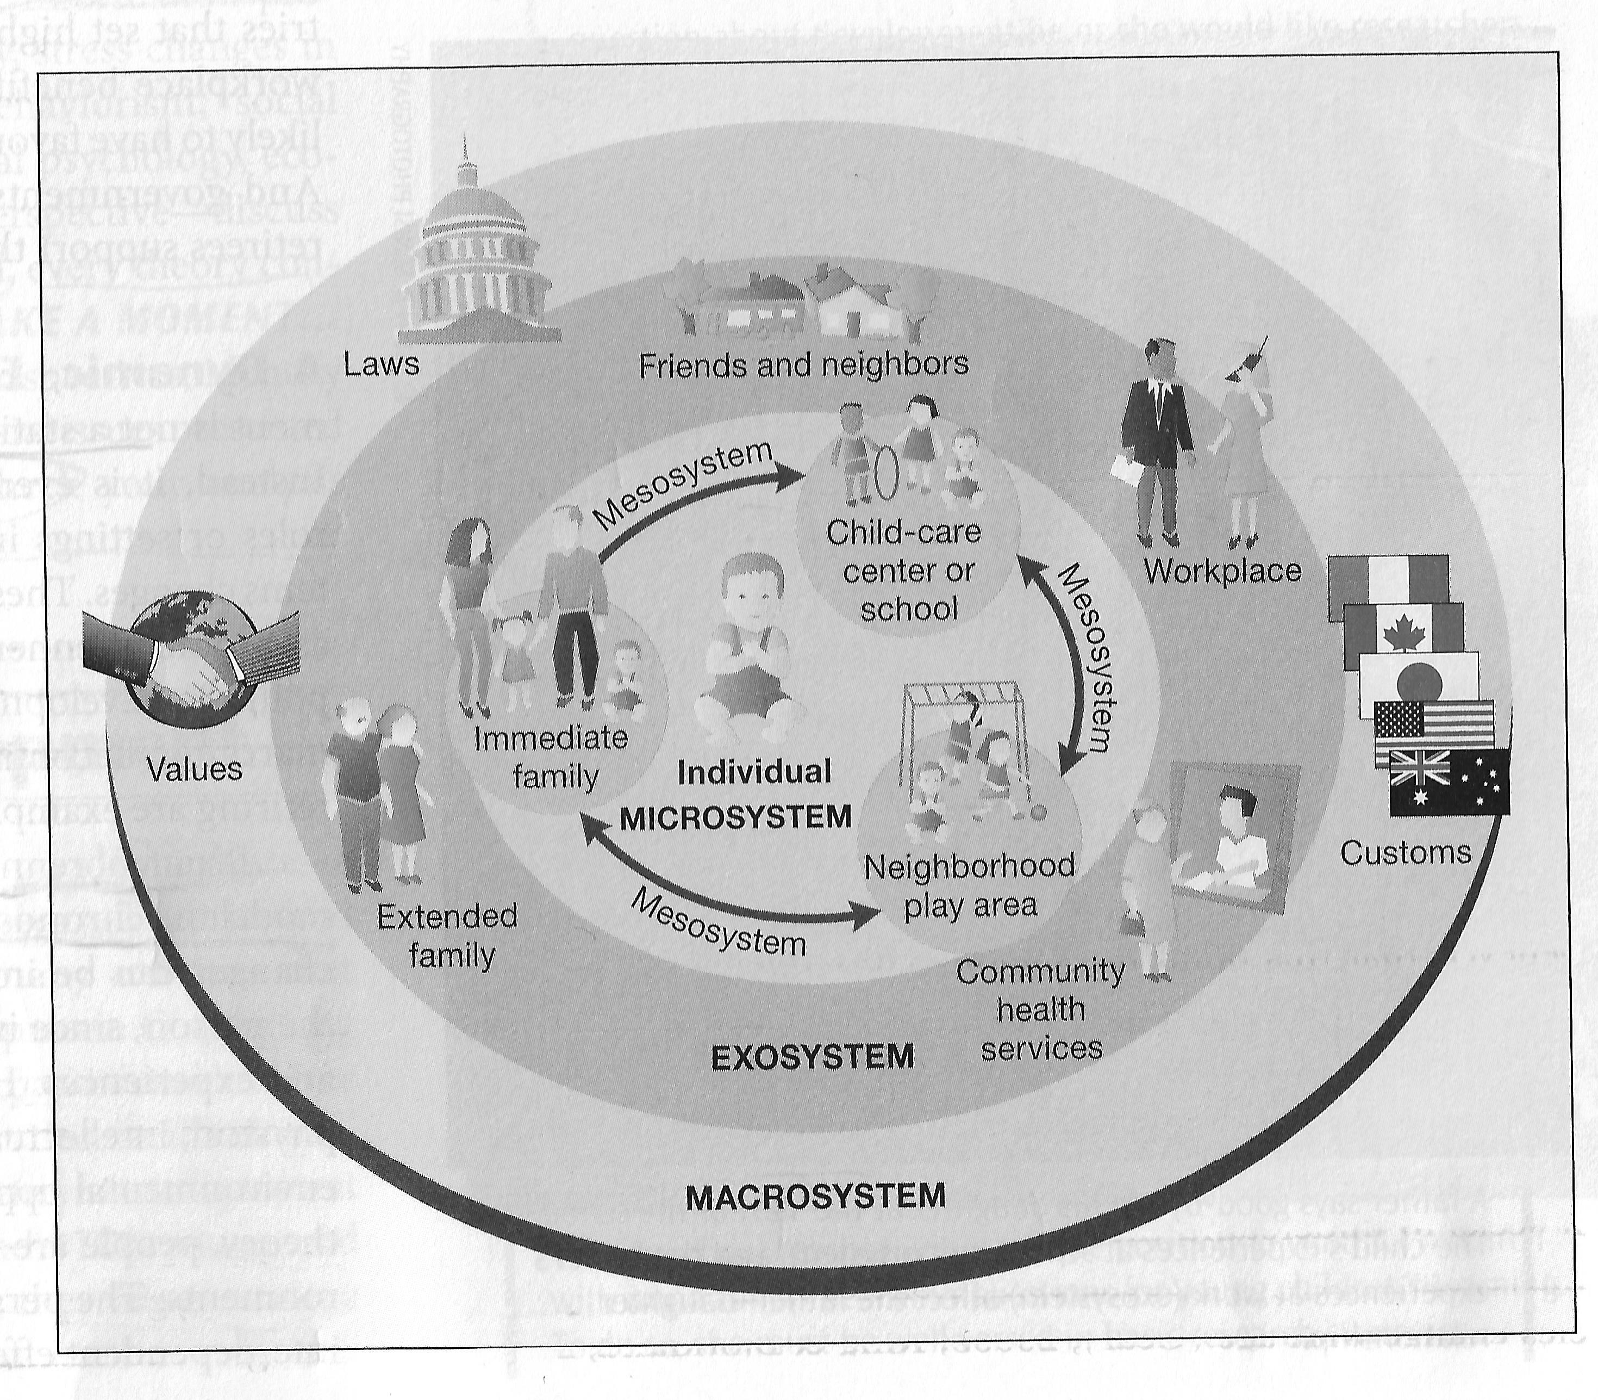
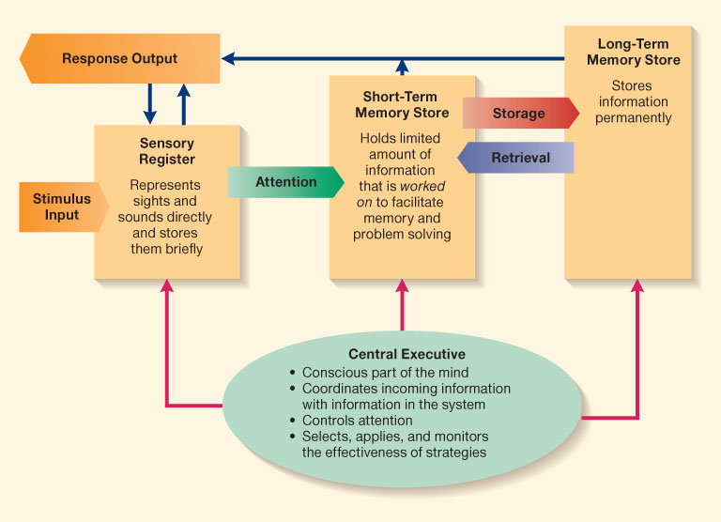
Information Processing

Slide 10
Intelligence Tests
What factors should define intelligence?
What is the role of intelligence testing?
How do you assess learning?
How would you test students in this class?

Slide 11
Intelligence Testing
  Stanford-Binet Intelligence Test
  Knowledge
  Quantitative
  Visual Spatial Ability
  Working Memory
  Information Processing
  Wechsler Intelligence Scale for Children
  Verbal Reasoning
  Perceptual Reasoning
  Working Memory
  Processing Speed
Sternberg Triarchic Theory
  Analytical Intelligence – Information Processing
  Creative Intelligence – Solve Novel Problems
  Practical Intelligence – Application in Everyday Life
  Gardner Multiple Intelligence
  Linguistic
  Logico-Mathmatical
  Musical
  Spatial
  Bodily-Kinesthetic
  Naturalist
  Interpersonal
  Intrapersonal

