Slide 1
Fundamentals of Lifespan Development
November 7th, 2014 – Physical and Cognitive Development in Early Adulthood

Slide 2
Video
Ted Talk – Rejuvenation Biotechnology

Slide 3
Senescence
Influences:
genetic
lifestyle
environment
historical period
Multidimensional and multidirectional
Average life expectancy has increased 25–30 years over past century

Slide 4
Biological Aging
DNA-Cellular Level
Programmed effects of specific genes:
“aging genes”
telomere shortening
Random events:
mutations and cancer
free radicals
Organ/Tissue Level
Cross-linkage theory
Gradual failure of endocrine system
Declines in immune system functioning

Slide 5
Cardiovascular and Respiratory Changes
Heart:
few resting changes but reduced performance under stress, exercise
hypertension, atherosclerosis
disease declining due to better lifestyle
Lungs:
maximum vital capacity declines after age 25
stiffness makes breathing harder with age

Slide 6
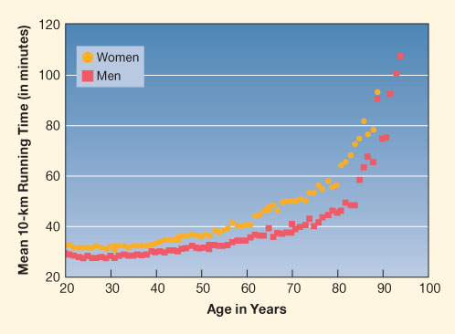
Motor Skills in Adulthood
Athletic skills
peak from the early twenties to early thirties
decline gradually until sixties or seventies, then more rapidly
Continued training
slows loss
retains vital capacity, muscle, response speed

Slide 7
Immune System
Declines after age 20:
shrinking thymus: reduced maturity and differentiation of T cells
B cells rely on T cells to function
Stress weakens immune response:
psychological stressors
physical stressors

Slide 8
Reproductive Capacity
Fertility risks for women:
problems jump sharply at 35–44 years
reduced number, quality of ova
Fertility risks for men:
problems gradual, starting age 35
decreased sperm volume, motility
increased percentage abnormal sperm

Slide 9
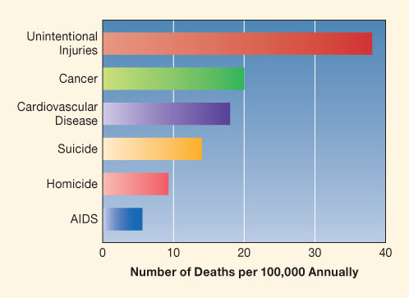
Health and Fitness
Nutrition
Substance Abuse
Sexuality
Psychological Stress

Slide 10
Changes in the Structure of Thought
Postformal thought – Cognitive development beyond Piaget’s formal operations stage.
Epistemic Cognition – Perry’s theory referring to our reflections on how we arrived at facts, beliefs and ideas.
Pragmatic Thought – Labouvie-Vief’s theory referring to a structural advance in which logic becomes a tool for real-world problem solving.

Slide 11
Epistemic Cognition - Perry
Dualistic thinking – Dividing information, values and authority into right and wrong.
Relativistic thinking – Viewing all knowledge as embedded into frames of thought. Awareness of a diversity of options on many topics. No absolute truth, instead there are multiple truths that are context dependent.
Commitment within relativistic thinking – Formulation of a personally satisfying perspective that synthesizes contradictions.
Contributing factors:
opportunities to tackle challenging problems
peer interaction
metacognition

Slide 12
Pragmatic Thought – Labouvie-Vief
Adulthood brings
increased experience with real-world problems
new ways of thinking that thrive on contradiction and compromise
Increase in cognitive-affective complexity:
greater awareness of one’s own and others’ perspectives
improved emotion regulation

Slide 13
Expertise and Creativity
Expertise:
acquisition of extensive knowledge in a field
takes many years
enhances information processing
Essential for creativity:
move to problem finding
rise in creative productivity in early adulthood

Slide 14
College/University and Vocations
College/university experience
Vocation
Fantasy period
Tentative period
Realistic period:
exploration
crystallization

