Slide 1
Fundamentals of Lifespan Development
September 15 – Theories of development

Slide 2
Video
Epigenetics and the influence of our genes: Courtney Griffins

Slide 3
Genetics – Key Terms
Phenotype – Direct observable characteristics
Genotype – Blend of genetic information that influences all our unique characteristics
Chromosomes – Store and transmit genetic information
Deoxyribonucleic Acid (DNA) - A nucleic acid that carries the genetic information in the cell and is capable of self-replication and synthesis of RNA. DNA consists of two long chains of nucleotides twisted into a double helix and joined by hydrogen bonds between the complementary bases adenine and thymine or cytosine and guanine. The sequence of nucleotides determines individual hereditary characteristics.
Gene – Segment of DNA along the length of the chromosome
Autosomes – Chromosomes that are not sex chromosomes

Slide 4
Key Terms – Genetics
Allele – The form of gene that occurs in pairs at the same place on the chromosome, one inherited by the mother and one from the father.
Homozygous – Displays inherited trait because the alleles from both parents are alike
Heterozygous – The relationship between dominant and recessive relationships determine the phenotype
Incomplete Dominance – A pattern of inheritance in which both alleles are expressed in the phenotype, resulting in a combined trait, or one that is intermediate between the two
Polygenetic inheritance – Many genes influence the characteristic in question
Mutation – A sudden permanent change to a segment of DNA
Germline mutation – Takes place in the cells that give rise to gametes
Somatic mutation – Takes place in cells over the course of one’s lifetime
Epigenesis –Development resulting from ongoing, bidirectional exchanges between heredity and all levels of the environment

Slide 5
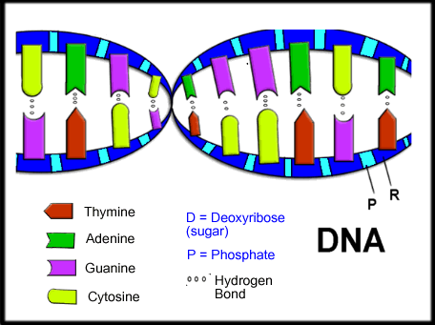
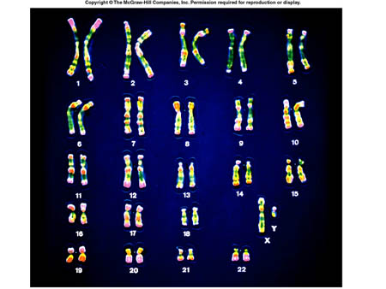
Genetic Code

Slide 6
Mitosis vs Meiosis
Mitosis
meiosis

Slide 7
Patterns of Inheritance

Slide 8
Evolutionary Theory
Ethology – Look at genetically determined survival behaviours presumed to have evolved through natural selection
Behavioural Genetics – Focus on effects of heredity on individual differences
Sociobiology – Study society using methods and concepts from biology and evolutionary theory
Evolutionary Psychology – Emphasize genetically inherited cognitive and social characteristics evolved through natural selection
Evolutionary Developmental Psychology – View that genetically inherited cognitive and social characteristics that promote survival appear at different times across the lifespan
Evolutionary Prenatal Programming – Prenatal information about the current environment is passed from mother to child. The child develops predictive-adaptive responses
Applied Uses
Disease Control
Early Intervention
Genetic Engineering

Slide 9
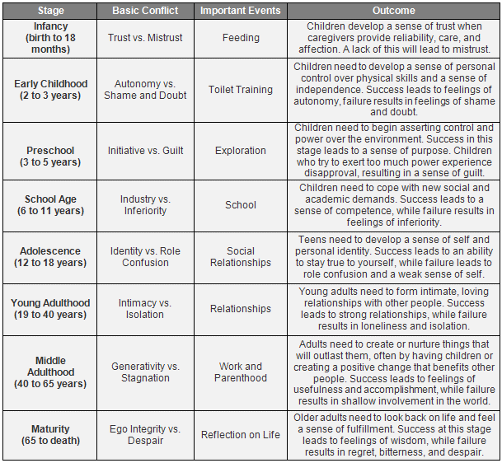
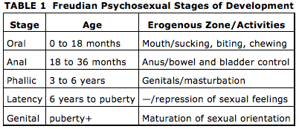
Theories
Psychoanalytic Perspective – People move through a series of stages in which they confront conflicts between biological drives and social expectations. How these conflicts are resolved determines the person’s ability to learn, to get along with others, and cope with anxiety.

Slide 10
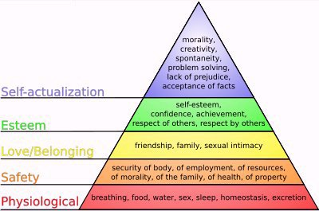
Theories
Humanistic Theories
Maslow’s Hierarchy of Needs

Slide 11
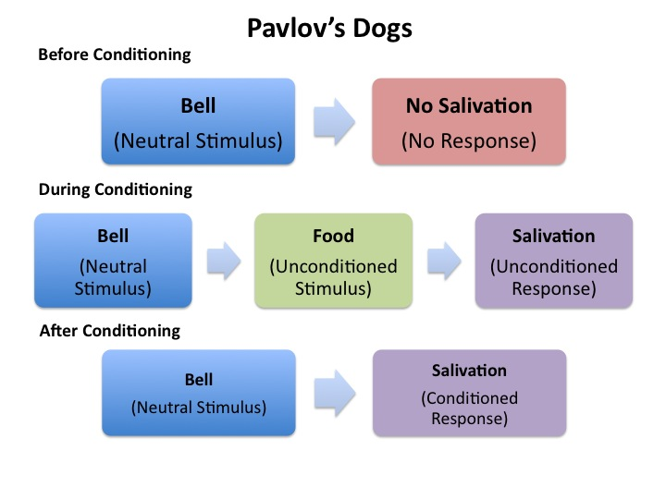
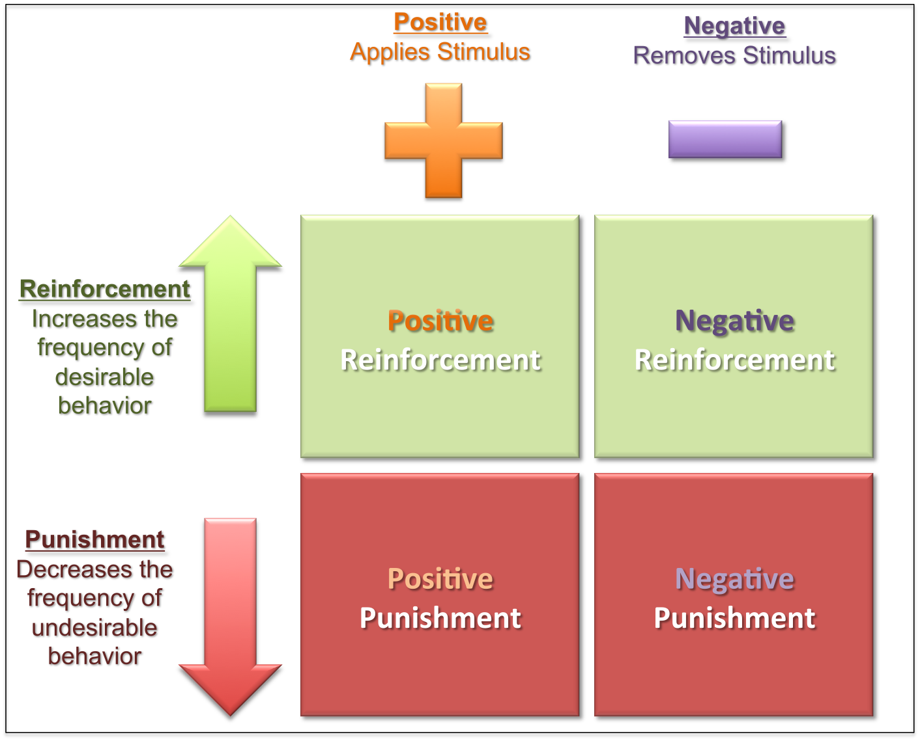
Theories
Behaviourism and Social Learning Theory
Directly observable events – stimuli and response – are the appropriate focus of study.
Pavlov – Classical Conditioning
Watson – School of Behaviourism
Skinner – Operant Conditioning
Bandura – Social Learning Theory

Slide 12
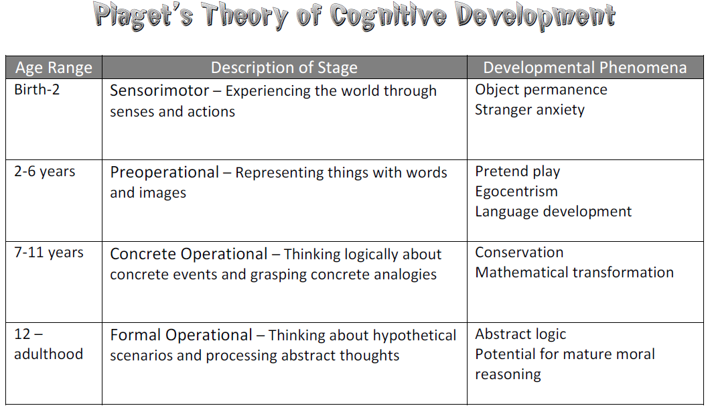
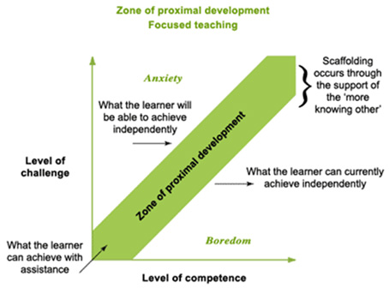
Theories
Cognitive Development Theory (Middle 1900)
Children actively construct knowledge as they manipulate and explore the external world.
Piaget & Vygotsky

Slide 13
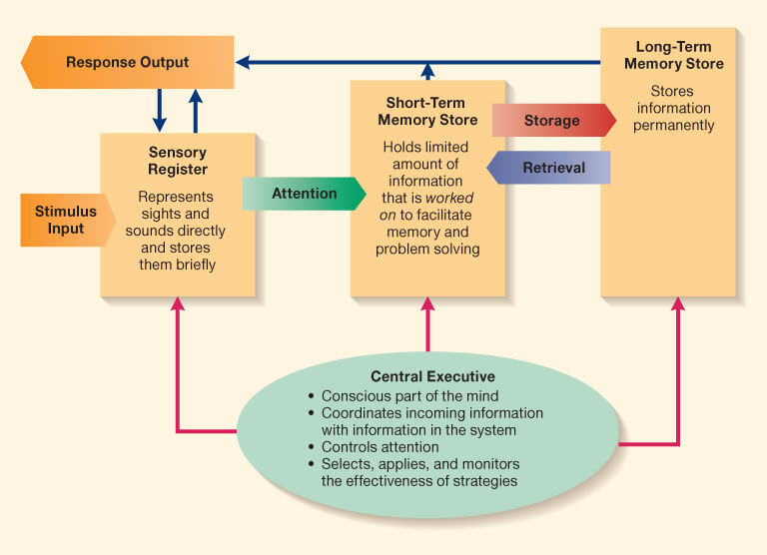
Theories
Information Processing Model

Slide 14
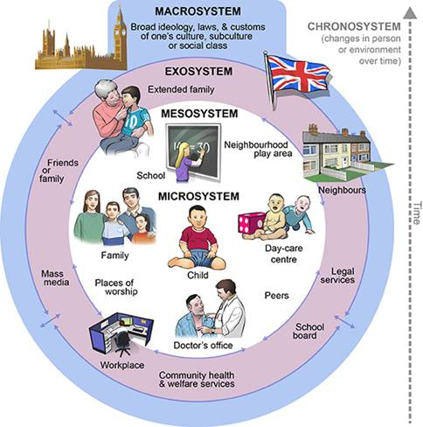
Theories
Bronfenbrenner’s
Bio-ecological Systems Theory

