Slide 1
Fundamentals of Lifespan Development
January 22 – Physical, sensory and perceptual development in infancy

Slide 2
Videos
Developmental Milestones
PBS – The Secret Life of the Brain: The Baby’s Brain

Slide 3
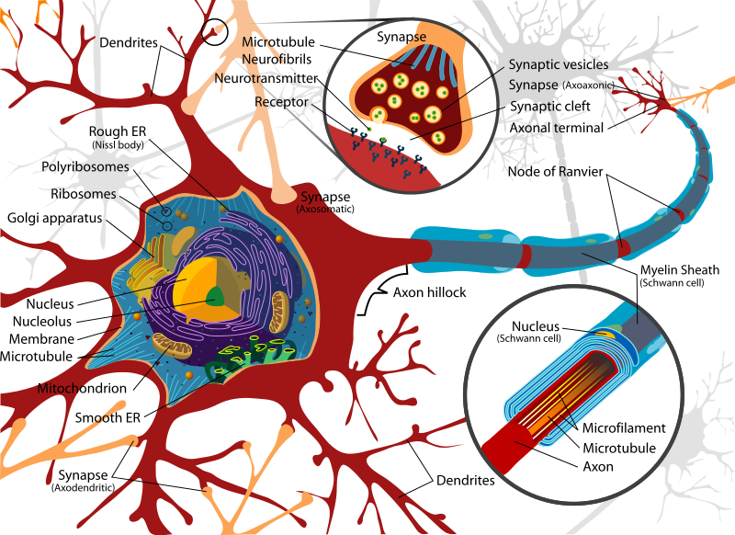
Brain Development
Key Terms
Synapses
Synaptogenesis
Synaptic Pruning
Neuroplasticity
Myelination
Video about Neurology

Slide 4
Brain Development
Cortex – Two Hemispheres
Left – Verbal, positive emotions, sequential, analytic processing
Right – Spatial, negative emotions , holistic, integrative processing
Brain Lateralization
Brain Lateralization is a complex and ongoing process by which differing regions of the brain “take over” the functioning of specific behaviors and cognitive skills. Lateralization literally means that certain functions are located (in part or total) on one side of the brain.
Brain Plasticity
Before the hemispheres lateralize their functioning, the brain can adapt easier if damaged
Sensitive Period
Sensory deprivation causes brain damage. Environmental stimulation leads to overall brain growth.

Slide 5
States of Arousal

Slide 6
Body Systems
First phase:
Cephalocaudal Pattern – “Head to Tail”. During the prenatal period, the head develops more rapidly than the lower part of the body
Second Phase:
Proximodistal Pattern – “Near to Far”. The body grows from the center outward
Key Terms
Ossification – Bones harden
Adaptive Reflexes – Help people survive
Rooting Reflex – Turning head when cheek is touched
Sucking Reflex – Newborn babies suck when they feel something in their mothes

Slide 7
Motor Development

Slide 8
Influences on Early Physical Growth
Nutrition/Malnutrition
Health Care/Immunizations
Illness in the First Two Years
Pre/Post Term Babies
Heredity

Slide 9
Sensation Overview
Vision not well developed at birth
Evidence for taste and smell at birth
Touch well developed from at birth
Infants make remarkable discriminations in sound

Slide 10
Looking

Slide 11
Looking

Slide 12
Listening

Slide 13
Intermodal Perception

Slide 14
Discussion
What were your physical milestones as an infant?

