Slide 1
Fundamentals of Lifespan Development
January 27th – Cognitive development in infancy

Slide 2
Video
Piaget on Piaget Part 1
Piaget on Piaget Part 2
Piaget on Piaget Part 3
Piaget on Piaget Part 4
I didn’t eat the doughnut
Kid wants doughnuts

Slide 3
Schemes
Assimilation and accommodation are in states of equilibrium and disequilibrium
Key Terms
Schemes – Psychological structures, organized ways of making sense of experience
Schematic Learning – Organizing experiences into expectancies which enable infants to distinguish between familiar and unfamiliar objects

Slide 5
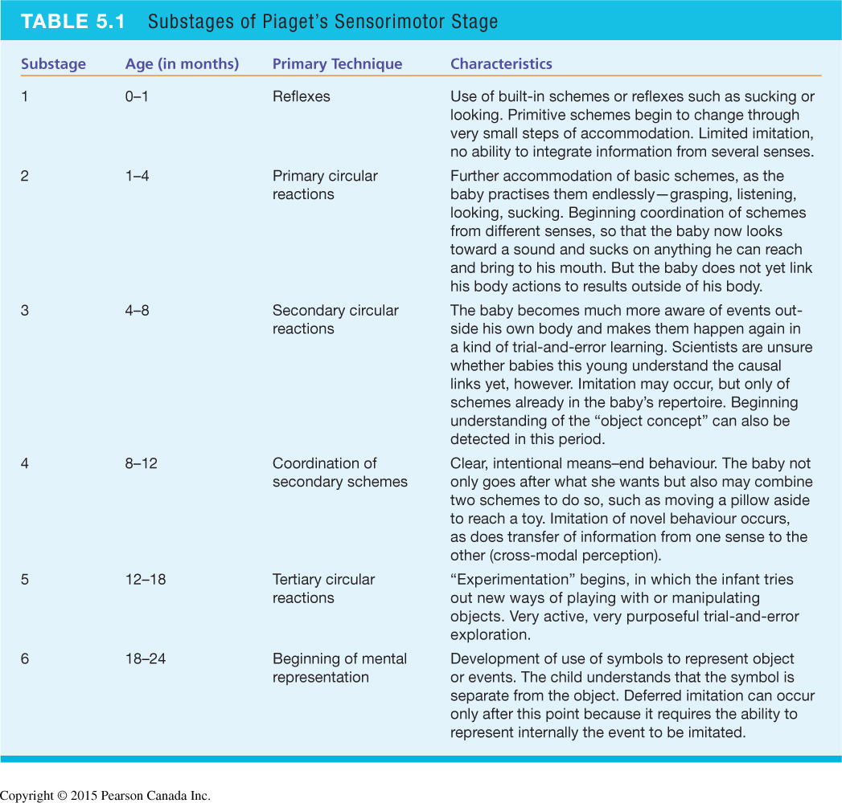

Slide 6
Piaget’s Sensorimotor Stage

Slide 7
Piaget vs Follow-Up Research
Research Lab Testing Cognition in Infants
Object Permanence
May start as young as 2 months
Imitation
6 weeks: imitates facial expressions
Deferred Imitation

Slide 8
Object Individuation
4 Months = Spatiotemporal
10 Months = Property
9 – 12 Months = Kind

Slide 9
Information Processing Model

Slide 10
Cognitive Gains in Infancy and Toddlerhood
Attention
improved efficiency, ability to shift focus
less attraction to novelty, improved sustained attention
Memory
longer retention intervals
development of recall by second half of first year
Categorization
gradual shift from perceptual to conceptual categorization in toddlerhood

Slide 11
Infant Toddler Intelligence Tests
Bayley Scales:
Poor predictor of later intelligence
Largely used for screening

Slide 13
Language Development
1 – 2 Months: Cooing
6 – 7 Months: Babbling
9 – 10 Months:
More refined babbling
Receptive language - understands 20 – 30 words
Gestures
12 - 13 Months:
Understands 300 words
Expressive language - first words
12 - 18 Months:
Holophrases – action & word pair
16 – 24 Months:
Naming explosion
Expresses 50 words
18 – 24 Months:
Expresses 200 - 320 words
Telegraphic speech – first sentences (two word)

Slide 14
Discussion
What were your first words?

