Slide 1
Fundamentals of Lifespan Development
February 17– Social and personality development in early childhood

Slide 2
Video
Rethinking Gender Development – Judith Butler
Terms from Textbook
Cognitive Developmental Explanation
Gender Identity
Gender Stability
Gender Consistency
Information Processing Approach
Gender Schema Theory
Gender Consistency Theory
Biological Approach
Sex Role Knowledge
Sex-Typed Behaviour
Cross-Gender Behaviour For discussion only, you will not be tested on this!

Slide 3
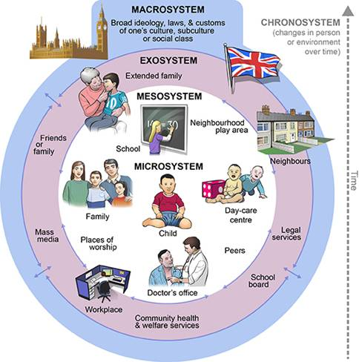
Bronfenbrenner’s Bio-Ecological Systems Theory

Slide 4
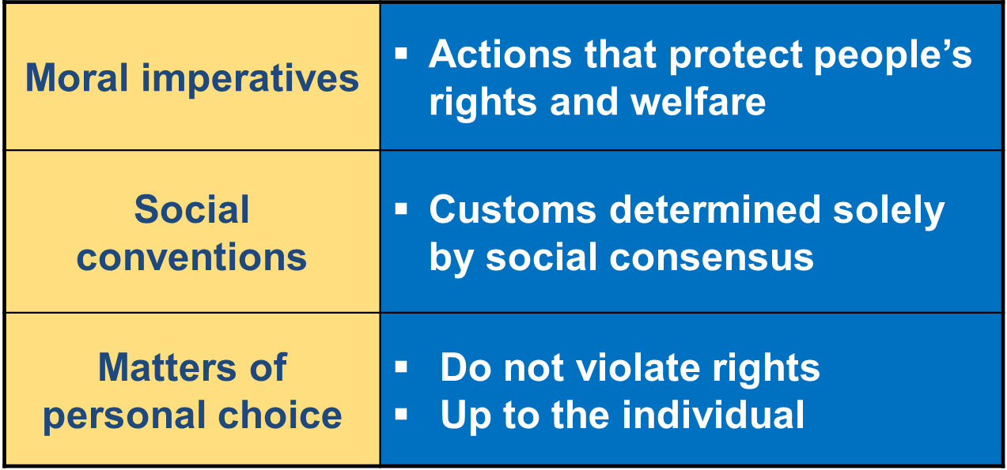
Social-Cognitive Perspective
Person Perception – Classify others
Understanding Rules
Understanding Others’ Intentions

Slide 5
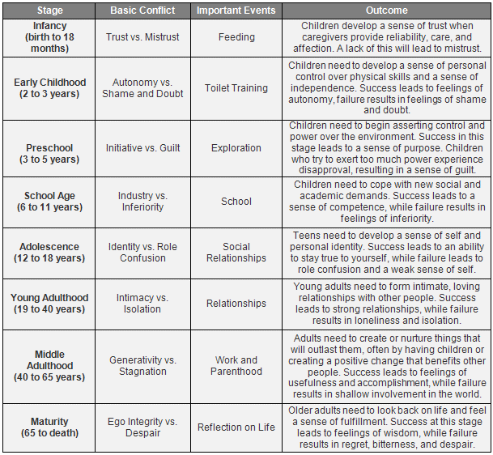
Erik Erikson – Psychosocial Stages

Slide 6
Erik Erikson – Psychosocial Stages

Slide 7
Bowlby’s Ethological Theory of Attachment
Non-focused orienting and signaling (Birth to 3 months) – Babies want attention from anyone whom they come in contact. Grasping, crying, smiling, gazing, etc..
Focus on one or more figures (3 to 6 months) – Direct attention from less people.
Secure base behavior (6 – 24 months) – Proximity seeking from ‘safe bases’. Primary caregiver (or multiple ‘primary care givers”).
Internal model (24 months +) – Reciprocal exchanges in developing bonds with caregivers.
NEW CATEGORY (4 years of Age)
Goal-Corrected Partnership
People continue to exist when we are not there (object permanence)
A relationship continues to exist when people are not around (Goal-Corrected Partnership)
Internal model begins to focus less on individual relationships and more about general social relationships

Slide 8
Parenting Styles (Baumrind)
Diana Baumrind four aspects of family functioning
Warm/nurturing
Clarity and consistency of rules
Level of expectation
Communication
Patterns of parenting style
Permissive
Authoritative
Authoritarian
Maccoby and Martin add ‘Uninvolved Parenting Style’ following Baumrind

Slide 9
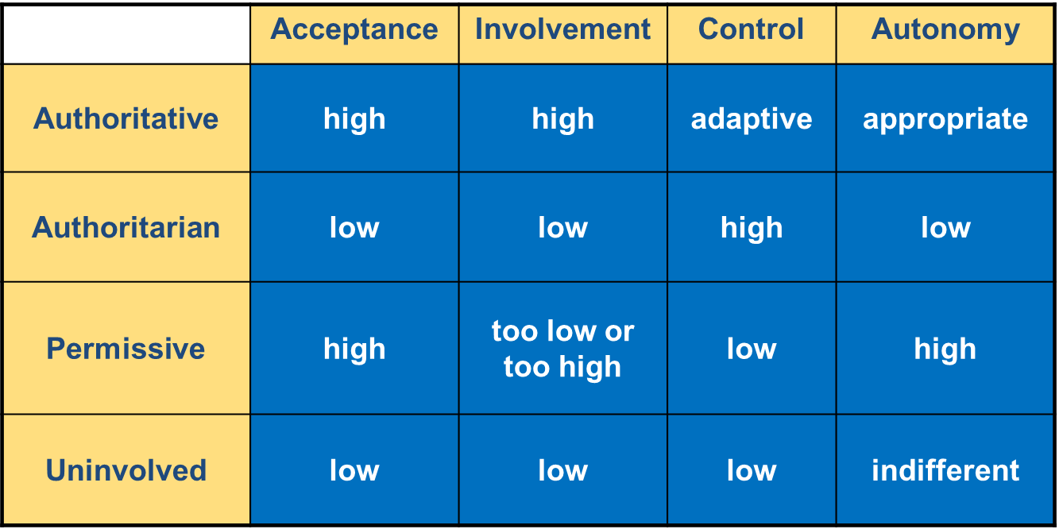
Parenting Styles

Slide 10
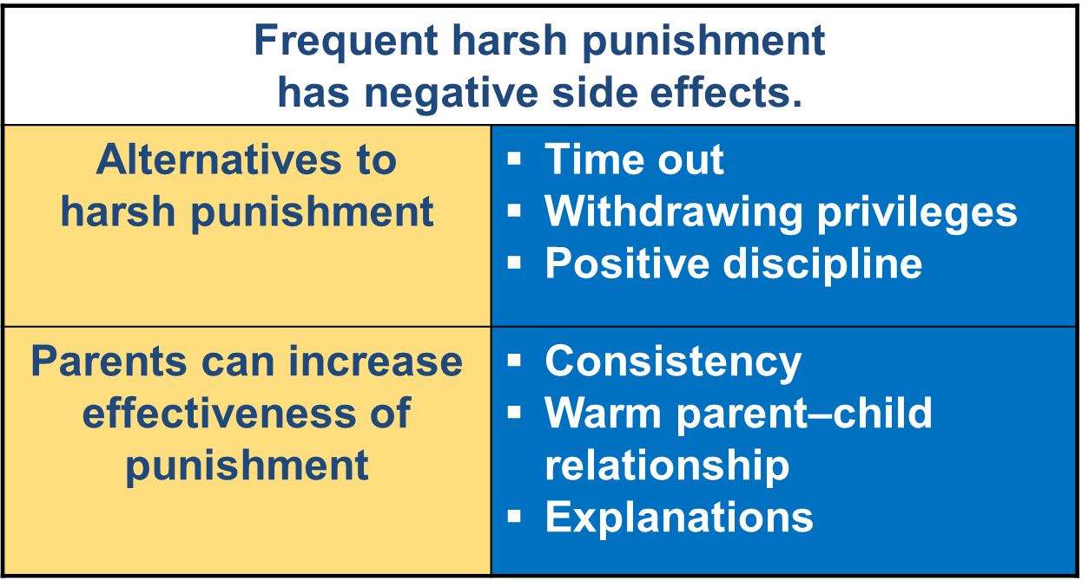
Parenting and Discipline
Positive/Inductive Discipline
Use transgressions as opportunities to teach.
Reduce opportunities for misbehavior.
Provide reasons for rules.
Have children participate in family duties and routines.
Try compromising and problem solving.
Encourage mature behavior.

Slide 11
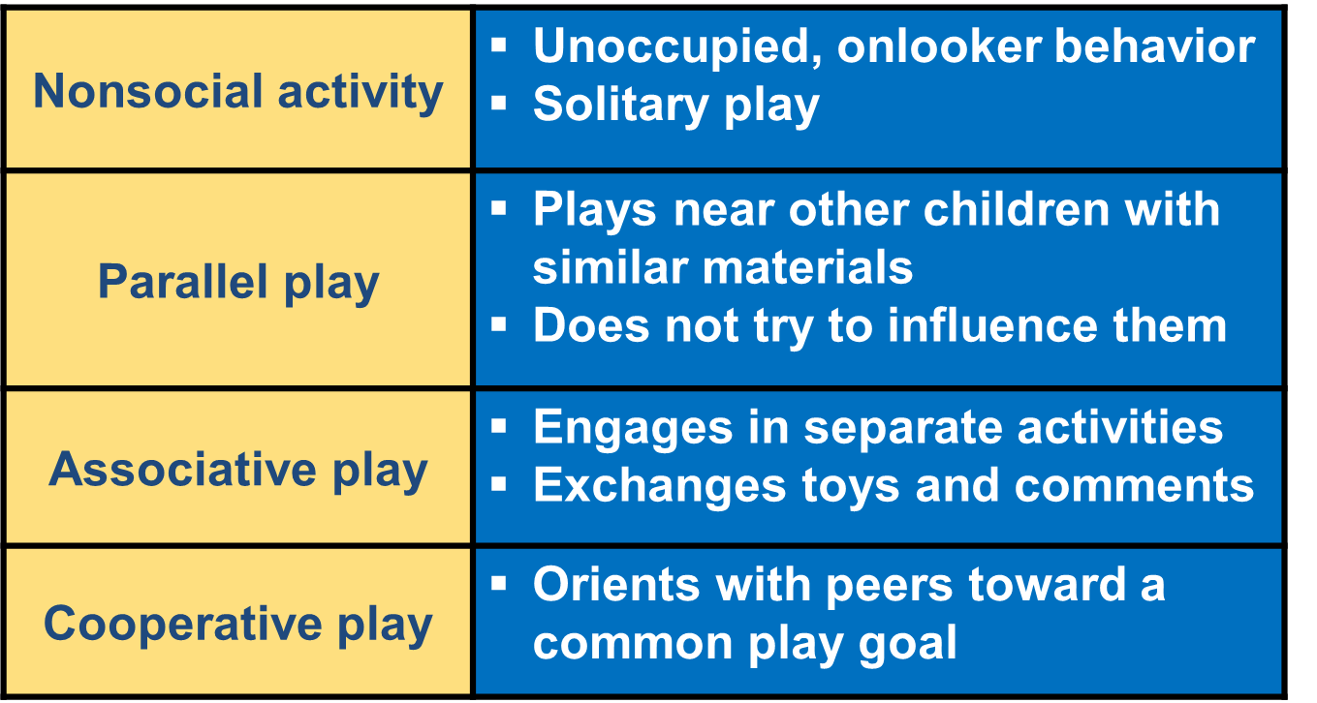
Peer Relationships
6 Months
14 Months
18 Months
3 – 4 Years

Slide 12
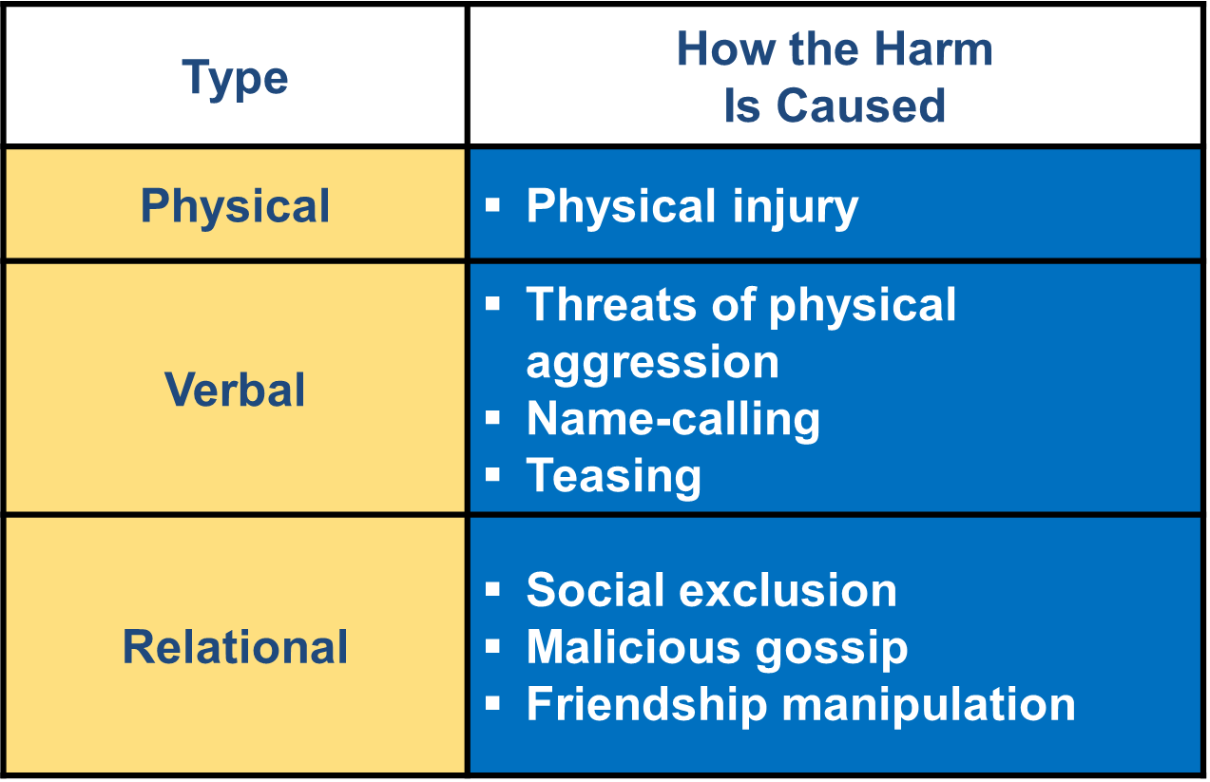
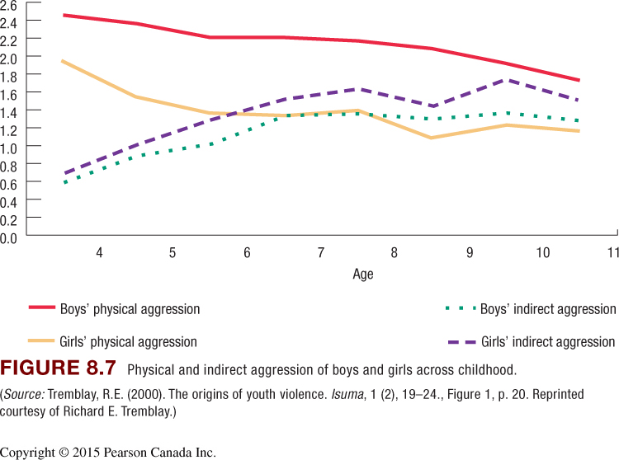
Types of Aggression
Proactive – Children need to fulfill a need or desire
Reactive – An angry defense response to provocation or a blocked goal and is meant to hurt another

Slide 13
First Friendships – Prosocial Behaviour
Someone who “likes you,” plays with you, shares toys
Friendships change frequently
Benefits of friendships:
social support: cooperation and emotional expressiveness
favorable school adjustment
Parents can directly and indirectly influence peer relations

Slide 14
Personality and Self-Concept
From temperament to personality
Self-Concept – The set of attributes, abilities, attitudes, and values that an individual believes defines who he or she is.
Categorical Self
observable characteristics (appearance, possessions, behavior)
Emotional Self
typical emotions and attitudes (“I like/don’t like …”)
Emotional regulation

Slide 15
Emotional Development
Gains in Emotional Competence
Improvements in:
emotional understanding
emotional self-regulation
Increase in self-conscious emotions and moral emotions (i.e. shame, guilt, pride and empathy)
Preschoolers correctly judge:
causes of emotions
consequences of emotions
behavioral signs of emotions
Parents, siblings, peers, and make-believe play contribute to understanding

Slide 16
Feedback from Preliminary Report

