Slide 1
Fundamentals of Lifespan Development
February 19 – Physical and Cognitive Development in Middle childhood

Slide 2
Videos
Changing Education Paradigms

Slide 3
Learning in School
What is the role of educational institutions?
How are schools presently structured?
What are your educational philosophies?
What is the role of the teacher in a school?
How would you structure this course?
Key Terms:
Literacy (reading, writing, other media)
Systematic and explicit phonics
Achievement tests/assessment/evaluation
Analytical (steps)/relational (big picture)
ADHD
Inclusive classroom
Cooperative learning
Creativity
Convergent thinking
Divergent thinking

Slide 4
Physical Growth & Motor Development
Slow, regular pace
Lower portion of body grows fastest
Bones lengthen, broaden
Muscles very flexible
All permanent teeth appear
Gross-motor skill gains:
flexibility
balance
agility
force
Fine-motor skill gains:
writing
drawing

Slide 5
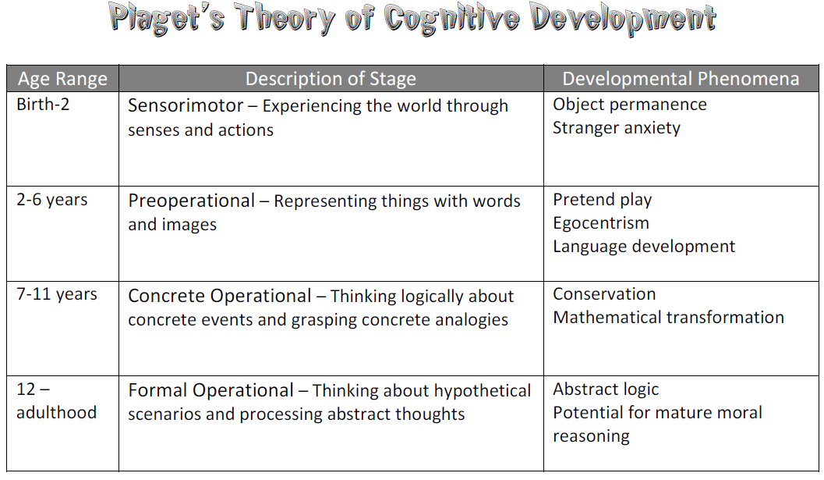
Piaget’s Concrete Operational Stage
Thought is more logical, flexible, and organized
Gains:
Conservation
Reversibility
Inductive Logic
De-centration/Classification
Spatial Perception
Limits – Abstract thinking and deductive logic not yet fully developed

Slide 6
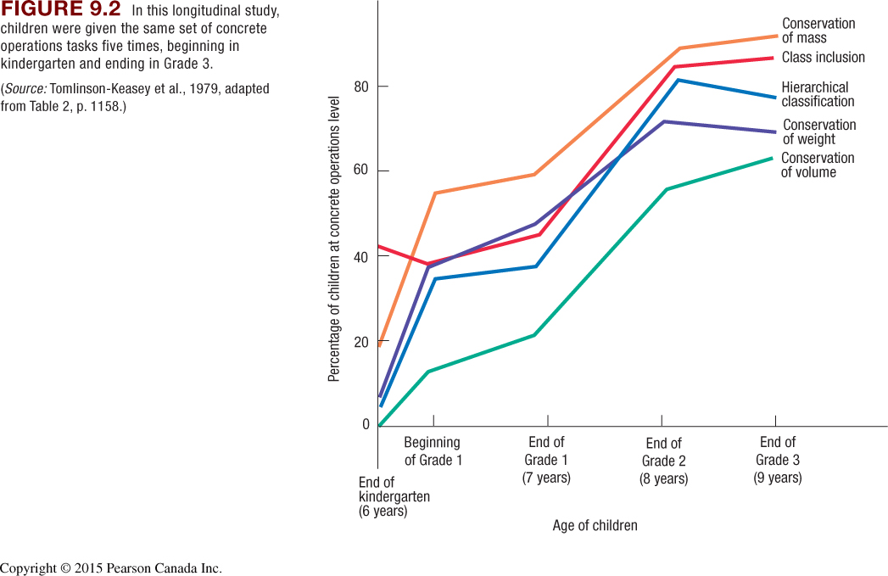
Piaget’s Concrete Operational Stage
Problem Solving (Siegler)
Rule 1 – Preoperational
one dimension (number)
Rule 2 – Transitional
Number then distance
Rule 3 – Concrete operational
Distance and weight then guess
Rule 4 – Understand formula

Slide 7
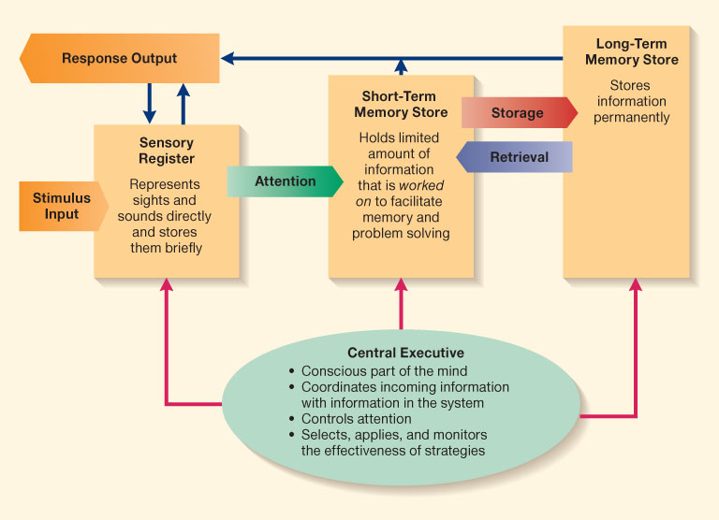
Information Processing
Key Words
Automaticity
Memory strategies
Executive process
Expertise
Selective Attention

Slide 8
Intelligence Testing
Stanford-Binet Intelligence Test
Knowledge
Quantitative
Visual Spatial Ability
Working Memory
Information Processing
Wechsler Intelligence Scale for Children
Verbal Reasoning
Perceptual Reasoning
Working Memory
Processing Speed
Goldman Emotional Intelligence
Awareness of one’s emotions
Ability to express emotions appropriately
Channel emotions in pursuit of worthwhile goals
Sternberg Triarchic Theory
Experimental Intelligence – Information Processing
Componential Intelligence – Solve Problems
Contextual Intelligence – Application in Everyday Life
Gardner Multiple Intelligence
Linguistic
Logico-Mathmatical
Musical
Spatial
Bodily-Kinesthetic
Naturalist
Interpersonal
Intrapersonal

Slide 9
Intelligence Tests
What factors should define intelligence?
What is the role of intelligence testing?
How do you assess learning?
How would you test students in this class?

