Slide 1
Fundamentals of Lifespan Development
February 5– Physical and cognitive development in early childhood

Slide 2
Video
Vygotsky Short Video
Ted Talk – What Kindergarten Should Be
Ted Talk – Looking to Montessori to Guide Education Reform

Slide 3
Physical Development – Brain & Skeleton
Skeletal growth:
  new epiphyses emerge
  grow and lose one set of teeth
Brain development:
  rapid growth of the prefrontal cortex
  hemispheres continue to lateralize
Reflects dominant cerebral hemisphere:
  right-handed (83%)
  left-handed (14%)
  ambidextrous (3%)

Slide 4
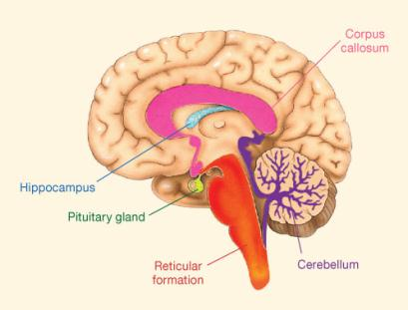
Brain Development
Cerebellum – Aids in balance and control of body movement
Reticular Formation – Maintains alertness and consciousness & attention
Hippocampus – Memory storage
Corpus callosum – Large bundle of fibers that connect the two cerebral hemispheres, perception, attention, memory, language, problem solving

Slide 5
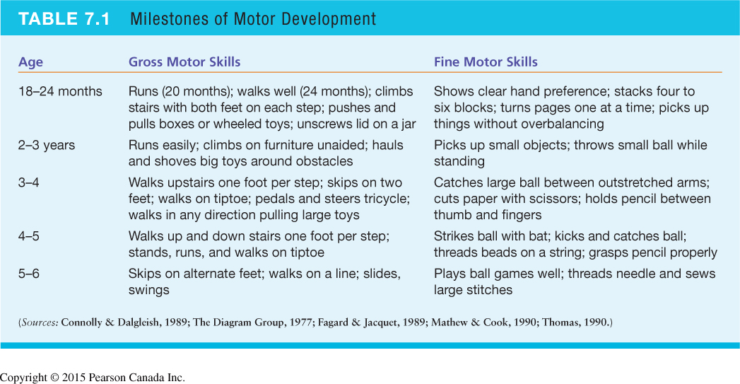
Milestones of Motor Development

Slide 6
Influences on Physical Development Growth and Health
Heredity and hormones
Nutrition
Childhood injuries
Maltreatment
A little game to learn about nutrition
  Look up:
  Castoreum
  Natural favouring
  Products that contain natural flavoring
  Understanding health and nutrition goes far beyond calorie counting!

Slide 7
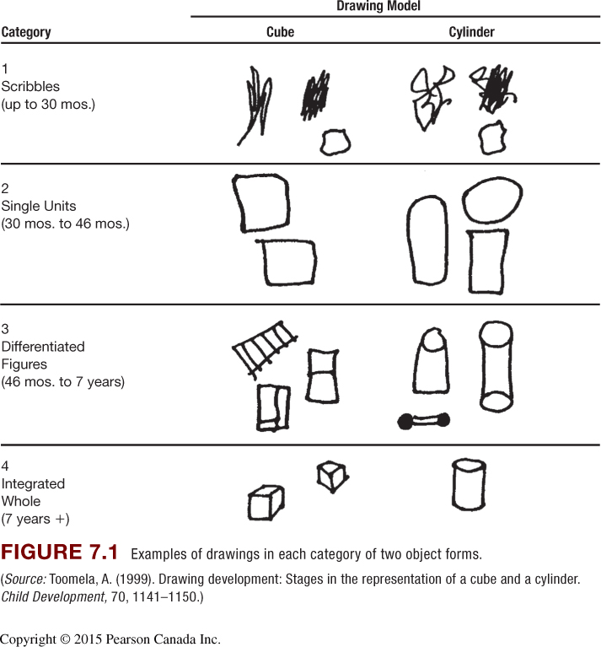
Progression of Drawing Skills
Scribbles
First representational forms:
  draws first recognizable
  pictures: 3 years
  draws boundaries: 3–4 years
More complex drawings: 5–6 years
Early printing: 4–6 years

Slide 8
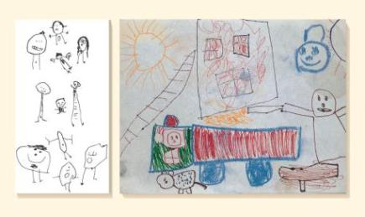
Drawings

Slide 9
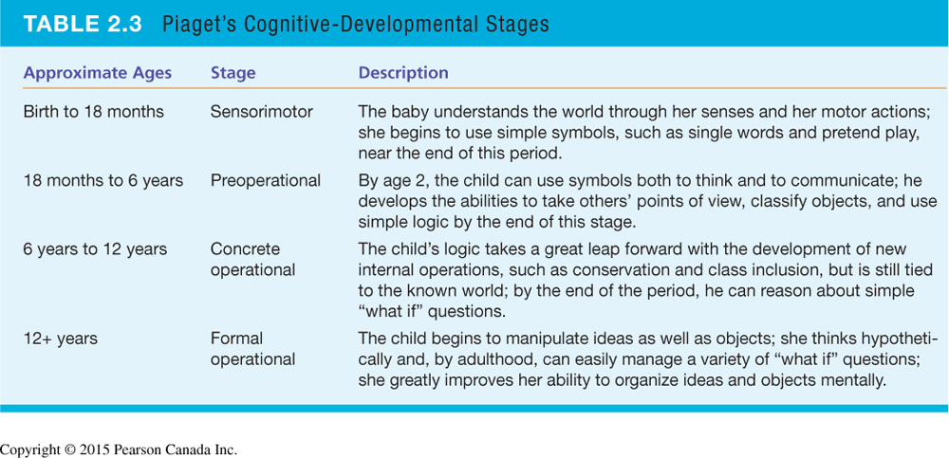
Piaget – Preoperational Stage
Gains in mental representation:
  make-believe play
  symbol–real-world relations
Limitations in thinking:
  Egocentrism
  centration
  lack of conservation

Slide 10
Make-Believe Play
With age, make-believe gradually
  detaches from real-life conditions
  becomes less self-centered
  becomes more complex
  Sociodramatic play develops
Benefits of Make-Believe Play
  Contributes to cognitive and social skills
  Strengthens mental abilities:
    sustained attention
    memory
    language and literacy
    creativity
    regulation of emotion
    perspective taking

Slide 11
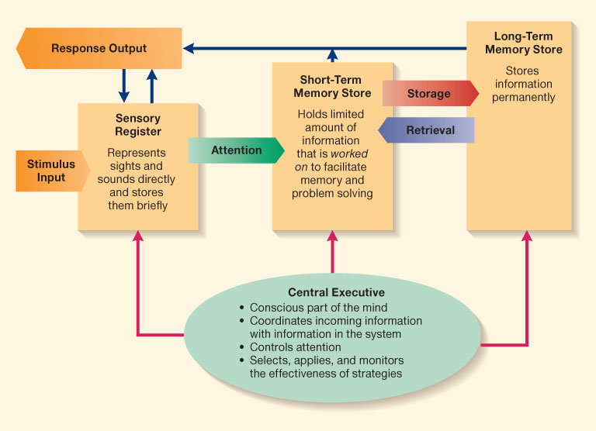
Information Processing Model

Slide 12
Gains in Information Processing
Attention: inhibition, planning
Memory: recognition, recall, episodic memory
Theory of mind: Metacognition, metamemory, beliefs & false belief
Emergent literacy
Mathematical reasoning – ordinality (14 -16 months), cardinality 3.5 – 4 years)

Slide 13
Vygotsky’s Sociocultural Theory
Zone of proximal development
Scaffolding: support of an “expert” to fit the child's current level of performance
Private speech
Primitive stage
Naïve psychological stage
Egocentric speech
Ingrowth stage

Slide 14
Language Development in Early Childhood
Vocabulary: fast-mapping
  Grammar explosion
  Receptive
  Expressive
Grammar:
  Basic rules
  Overregularization (ex. wented)
  Inflections (ex. ing)
  Complex sentences
  Numeracy
  Writing
Improving Language Development
Conversation with adults
  Recasts: restructuring inaccurate speech to correct form
  Expansions: elaborating on children’s speech

Slide 15
Discussion
Should children be given standardized tests?

