Slide 1
Building a Better Food System at Concordia University
The Concordia student-run food groups documentary project
By: Erik Chevrier

Slide 2
Where are we now?
Multinational food corporations control the current food service contracts
Pepsi
Chartwells
These contracts are currently being renegotiated
Request for Proposal Process (RFP)
The Concordia community is not satisfied with the food services from the multinational corporations
Student-run food groups can provide better food services at Concordia
Subsidized food that is free for students – Loyola Luncheon & People’s Potato
Cooperative economic models
Produce, process and distribute food on campus

Slide 3
Problems with the Current System
Problems with multinational food corporations on campus
Exclusivity agreements
Monopoly over food services
Unhealthy food
Waste
Serving times
Price
Resident meal plan
Rob Green on Concordia’s History with Multinational Food Corporations
Two main ways of addressing these problems
Administrative route (work with administration to bring about change)
Student organizing route (a movement led by the students)

Slide 4
Administrative Route
Concordia University Governance
Working within the administrative structures at Concordia
Committees
Request for Proposal Process
Food Advisory Working Group
Board of Governors
Laura Beach on the Environmental Advisory Committee Recommendations
Laura Beach on the Request for Proposal Process
Laura Beach on Alternatives to Multinational Beverage Contracts

Slide 5
Student Organizing Route
Oppose Problematic Practices
Hold referendum votes to ban products like bottled water
Let administrators know your position
Talk with the press
Laura Beach on Tap Thirst
Organize a Better Food System!
Concordia students currently:
Grow food on campus
Process food on campus
Distribute and sell food on campus
Use cooperative and non-profit economic models

Slide 6
Successful Food Activism Involves
Organizing with the help of the student groups and unions on campus
Targeting issues that students are concerned about:
May start with a small group of passionate people
Informing other students about these issues:
Education campaigns
Developing student run organizations that:
Have sustainable funding structures
Have become (semi-)autonomous from student groups and organizations
Involve many stakeholders including students at the community at large
Passing motions or referendum questions to secure funding or oppose certain practices
Getting involved with university committees

Slide 7
Student-Run Initiatives’ Economic Models
How should students organize food groups?
Karl Polanyi
Market – Market pattern
Redistribution – Centralization
Reciprocity – Symmetry
Household – Autarchy

Slide 8
Multidimensional System
Redistribution
People’s Potato
Loyola Luncheon
Food baskets
Reciprocity
Volunteer labour
Workshops
In kind donations
Market Based
Chartwells
Pepsi
Hive
Café X
Concordia Farmers Market
CUSACORP
Household
Dorm food preparation
Students bring their own lunch

Slide 9
Multidimensional System – Positive and Negative Consequences
Redistribution
Funded via student fee
Gives access to food to all students
Reciprocity
Sharing economy
Hard to institutionalize
Can be a highly productive force (open source)
Can be rewarding
Market Based
Can cause negative or positive effects depending on the types of market practices
Success may vary depending on the type of organization or business
Does not guarantee food security
Household
University does not provide sufficient infrastructure in the dorms
Could reduce waste
Learn life skills

Slide 10
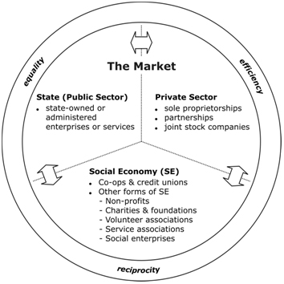
Social Economy Models
Karl Polanyi Nancy Neamtan
Market – Market pattern
Redistribution – Centralization
Reciprocity – Symmetry
Household – Autarchy

Slide 11
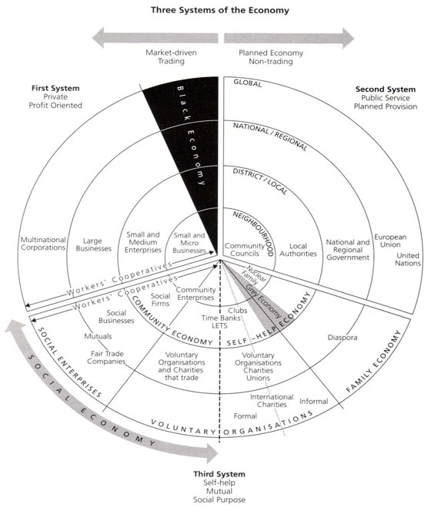
John Pearce

Slide 12
Types of Social Economy Businesses
Cooperatives
Workers – Worker members are also owners of the business
Producer – An assortment of production based businesses working in tandem
Consumer – Provide goods and services to members
Solidarity – Members may be from different categories (i.e. consumer/worker/shareholder)
Shareholder-Worker – Workers and shareholders own the business
Non-profit Organization

Slide 13
Student-Run Food System
Recommendations
Should encompass each of Polanyi’s four economic systems
Should be autonomous from the Concordia administration
Should be (semi) autonomous from the student unions
Should work in concert with the other student-run food groups
Should engage with the community at large
Should be organized under the principles of social economy
Democratic
Socially responsible
Ethical labour practices
Environmental sustainability

Slide 14
What Other Types of Food Practices Can We Create
Redistribution
Reciprocity
Market Based
Household

Slide 15
Get Involved
Be part of the research team
You can become an intern for credit
You can do assignments for courses and add to the content of our archive
You can come to our research meetings
Visit our Website – concordiafoodgroups.ca
Like our Facebook Page
Share our Youtube videos
Help us fund the project
More importantly, get involved in the food movement at Concordia

Slide 16
Thanks You!
Funding provided by:

