Slide 1
Fundamentals of Lifespan Development
March 10 – Social and personality development in middle childhood

Slide 2
Video
Creative Video Day Camp
  Murder Mystery Madness
  The Ghost of the Past
  Haunted Memories

Slide 3
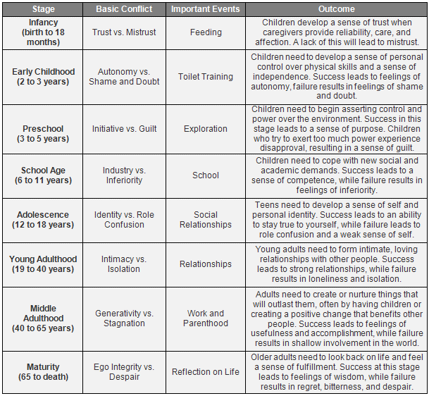
Erikson – Industry vs Inferiority

Slide 4
Erikson – Industry vs Inferiority

Slide 5
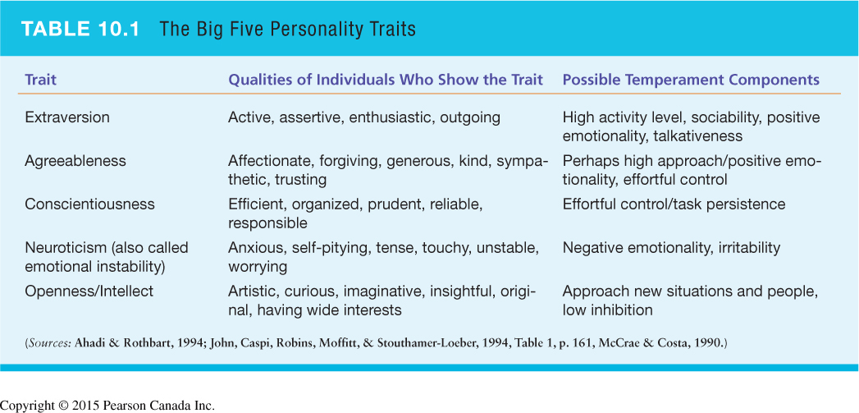
Trait Theorists

Slide 6
Social-Cognitive Perspective
Albert Bandura – Bobo Doll Experiment
Albert Bandura – Bobo Doll BBC DOC
Reciprocal Determinism
  Personal Factor – emotional/cognitive
  Behavioural Responses
  Environmental Influences
  Self-Efficacy – self-perceived competence
  Comparison with peers

Slide 7
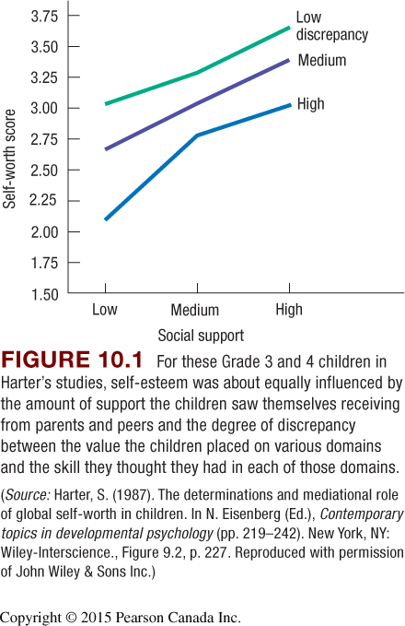
Self-Concept
Psychological self – A person’s understanding of his or her enduring psychological characteristics
  Begins with basic descriptions but becomes increasingly complex by middle
Self esteem – A global evaluation of one’s self worth
  Influenced by mental comparisons of children’s ideal selves and their actual experiences – is the discrepancy large or small?
  Also influenced by the overall support a child thinks they are receiving from important people around them

Slide 8
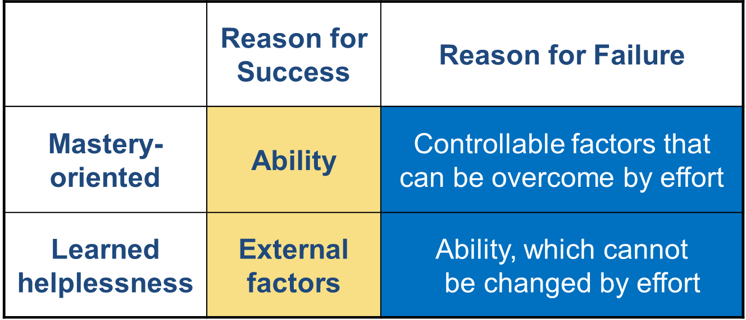
Achievement-Related Attributions

Slide 9
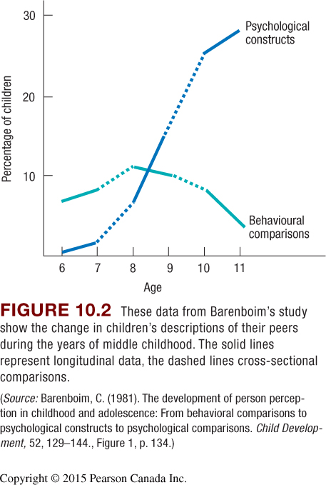
Child as a Psychologist

Slide 10
Moral Reasoning
The process of making judgements about right or wrong of specific acts.
Piaget
  Moral realism stage – (beginning of middle childhood) rules are inflexible
  Moral relativism stage – (8 and up) rules can be changed through social agreement

Slide 11
Social Relationships
Independence from parents
  Self-regulation – ability to conform to parental standards without direct supervision
Friendships
  Increasing relations with peers
  Best friends
  Reciprocal trust
  Gender segregation
Aggression
  Increasing relations with peers
  Best friends
  Reciprocal trust
  Gender segregation

Slide 12
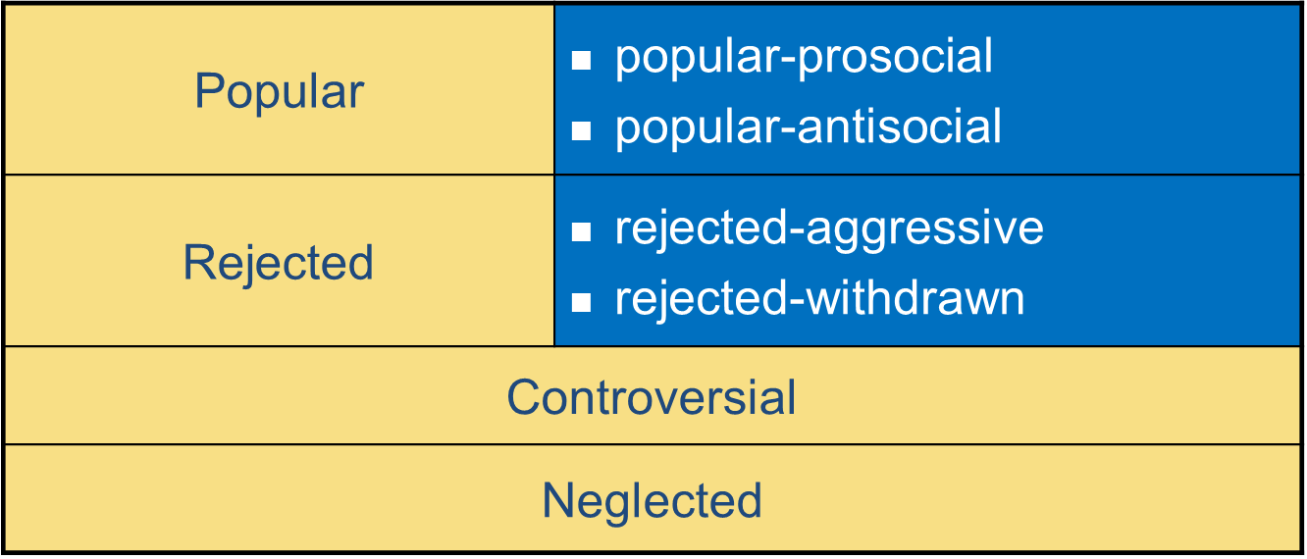
Social Status

Slide 13
Aggression
Physical aggression becomes less common from early childhood to middle childhood
Two main forms of aggression in middle childhood
  1 – Relational aggression
  2 – Retaliatory aggression

Slide 14
Advertising and Teens
Compare and contrast ads!
Dove Evolution
http://www.youtube.com/watch?v=hibyAJOSW8U
Axe Body Spray
http://www.youtube.com/watch?v=7DpoavYXMK4&feature=related

