Slide 1
Fundamentals of Lifespan Development
March 17 – Physical and cognitive development in adolescence

Slide 2
Video
The Teenage Brain – Ted Talk
Mysterious Workings of the Adolescent Brain – Ted Talk

Slide 3
Puberty – Physical Changes
Boys:
androgens: testosterone
Small amounts of estrogens
Spermarchy
Girls:
estrogens
adrenal androgens
Menarchy
Reverse cephalocaudal and proximodistal trends

Slide 4
Onset of Puberty
According to Berk (2008)
Other studies show conflicting results
Girls did not show negative effects as early developers
They smoked, drank and did drugs less than other teens
They did hang around with older people
According to Japal, Tremblay, McDuff, & Willms (2002)

Slide 5
Hormones

Slide 6
Sex Characteristics
Primary
Secondary
Growth of reproductive organs
Penis
Testes
Ovaries
Uterus
Vagina
Growth of characteristics that serve as additional signs of maturity and are usually visible outside the body
Breasts
Beard
Voice change
Hair Growth

Slide 7
Puberty – Brain Development

Slide 8
Changes in Puberty
Reactions to changes
Mood
Parent-child relationship
Importance of physical attractiveness – Body Image
Importance in fitting in with peers
Dietary independence – Nutrition
Sexuality
Substance use and abuse

Slide 9
Advertising and Teens
Compare and contrast ads!
Dove Evolution
http://www.youtube.com/watch?v=hibyAJOSW8U
Axe Body Spray
http://www.youtube.com/watch?v=7DpoavYXMK4&feature=related

Slide 10
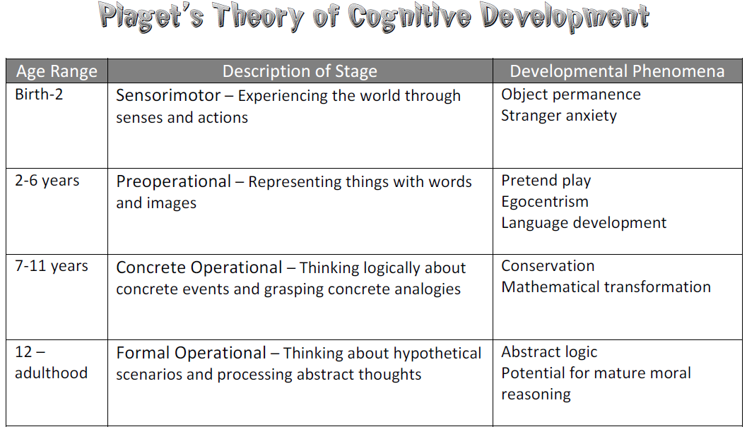
Piaget – Formal Operational Stage

Slide 11
Piaget – Formal Operational Stage
Hypothetico-deductive reasoning:
problem solving based on a hypothesis, deducing logical, testable inferences
May lead to ‘naïve idealism’ – When adolescents use formal operations to mentally construct an ideal world and then compare the real world within it.
Propositional thought:
evaluating the logic of verbal propositions without using real-world circumstances
Follow-Up
School-age children show beginnings of formal operational thought
Adolescents are considerably more competent:
reason about more variables simultaneously
grasp logical necessity
Formal operations may not be universal:
training and context contribute
schooling is powerfully influential

Slide 12
Cognitive Processing
Attention
Inhibition
Memory strategies
Knowledge
Metacognition
Cognitive self-regulation
Speed of thinking
Processing capacity
Coordinating theory with evidence
Contributing factors:
working memory capacity
exposure to complex problems
metacognitive understanding
open-mindedness
Adolescents and adults vary widely

Slide 13
Self-Consciousness and Self-Focusing
Imaginary audience – A internalized set of behavioral standards usually derive from a teenager’s peer group
Personal fable – The belief that the events of one’s life are controlled by a mentally constructed autobiography
Types of goals:
Task goals: Are goals based on personal standards and a desire to become more competent at something
Ability goals: Defines success in competitive terms, being better than another person at something

Slide 14
What about you?
What were you like as a teen?

