Slide 1
Fundamentals of Lifespan Development
March 24 – Physical and Cognitive Development in Early Adulthood

Slide 2
Video
Ted Talk – Rejuvenation Biotechnology

Slide 3
Aging
Primary Aging – Age related physical changes that have a biological basis and are universally shared and inevitable
Senescence
Secondary Aging – The product of socioeconomic and environmental influences health habits, or disease and is neither inevitable nor experienced by all adults.
Average life expectancy has increased 25–30 years over past century

Slide 4
Determinants of Health
Biological embedding – epigenetic factors in first few years of life (Clyde Hertzman)
Social determinants – a variety of socioeconomic and environmental factors that determine health
GINI coefficient – a measure of equality in a country where 1 represents perfect inequality and 0 represents perfect equality

Slide 5
Aggregate Health Indicators
Disability-Adjusted Life Years (DALY) – A measure of the gap between a populations ideal and actual levels of health. It is derived from the number of life-years lost to premature death, illness, or injury and the number of years living with a disability. It assumes a potential life limit of 82.5 years for women and 80 for men.
Health-Adjusted Life Expectancy (HALE) – An estimate of the life expectancy at birth. It is the number of years that a newborn can expect to live in full health given the current rates of morbidity and mortality.
Quality-Adjusted Life Years (QALY) – A measure of how much benefit is gained, and at what cost, for any particular physical or mental intervention. It provides an estimate of time a person will live at levels of health over his or her remaining years of life.

Slide 7
Biological Aging
DNA-Cellular Level
Programmed effects of specific genes:
“aging genes”
telomere shortening
Random events:
mutations and cancer
free radicals
Organ/Tissue Level
Cross-linkage theory
Gradual failure of endocrine system
Declines in immune system functioning

Slide 8
Immune System
Declines after age 20:
shrinking thymus: reduced maturity and differentiation of T cells
B cells rely on T cells to function
Stress weakens immune response:
psychological stressors
physical stressors

Slide 9
Aging and Body
Brain and Nervous System
New synapses forming
Myelination occurring
Synaptic pruning
Functions have been localized in specific parts of the brain
Prefrontal lobe maturation
Response inhibition
Better control of limbic system

Slide 10
Cardiovascular and Respiratory Changes
Heart:
few resting changes but reduced performance under stress, exercise
hypertension, atherosclerosis
Lungs:
VO2 MAX – Maximum oxygen uptake
At rest there is little change
During exercise VO2 max declines around 35-40

Slide 11
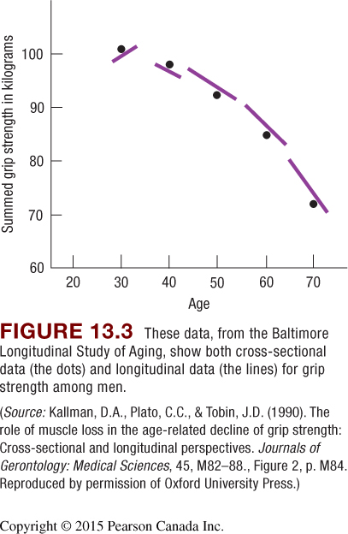
Motor Skills and Strength
Athletic skills
peak from the early twenties to early thirties
decline gradually until sixties or seventies, then more rapidly

Slide 12
Reproductive Capacity
Fertility risks for women:
problems jump sharply at 35–44 years
reduced number, quality of ova
Fertility risks for men:
problems gradual, starting age 35
decreased sperm volume, motility
increased percentage abnormal sperm

Slide 13
Health
Alameda Study
1965 – 1974 – 1983
Good health is:
Exercise
Not smoking
Not drinking
Not over/under eating
No Snacking
Eating breakfast
Regular sleep
Strong Social Support
Internal (vs external) Locus of Control
Self-Efficacy
Optimism

Slide 14
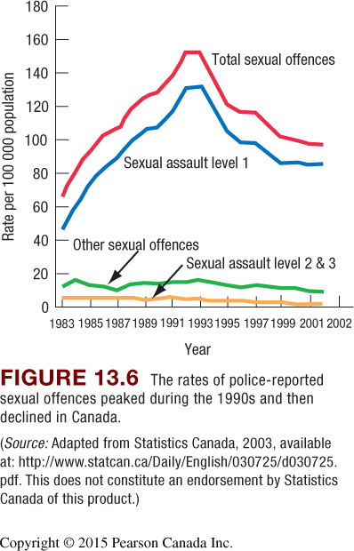
What Else Can Affect Health
Sexually Transmitted Diseases
Domestic Abuse (intimate partner violence)
Mental Disorders
Personality disorder
Anxiety and mood disorders
Schizophrenia
Alcohol and substance disorders
Sexual Assault
Level 1 – Sexual Assault
Level 2 – Sexual Assault with a weapon
Level 3 – Aggravated Sexual Assault

Slide 15
Changes in the Structure of Thought
Postformal thought – Cognitive development beyond Piaget’s formal operations stage.
Epistemic Cognition – Perry’s theory referring to our reflections on how we arrived at facts, beliefs and ideas.
Pragmatic Thought – Labouvie-Vief’s theory referring to a structural advance in which logic becomes a tool for real-world problem solving.
Dialectical Thought – Basseches theory that thought involving the recognition and acceptance of paradox and uncertainty
Reflective Judgement – King and Kitcherners theory referring to people’s ability to identify the underlying assumptions of differing perspectives on controversial issues
Has seven stages

Slide 16
Epistemic Cognition - Perry
Dualistic thinking – Dividing information, values and authority into right and wrong.
Relativistic thinking – Viewing all knowledge as embedded into frames of thought. Awareness of a diversity of options on many topics. No absolute truth, instead there are multiple truths that are context dependent.
Commitment within relativistic thinking – Formulation of a personally satisfying perspective that synthesizes contradictions.
Contributing factors:
opportunities to tackle challenging problems
peer interaction
metacognition

Slide 17
Pragmatic Thought – Labouvie-Vief
Adulthood brings
increased experience with real-world problems
new ways of thinking that thrive on contradiction and compromise
Increase in cognitive-affective complexity:
greater awareness of one’s own and others’ perspectives
improved emotion regulation

Slide 18
Intelligence
Crystalized Intelligence – Knowledge and judgement acquired through education
Fluid Intelligence – The aspects of intelligence that reflects a fundamental biological processes and does not depend on specific experiences
Fluid Intelligence reduces in old age.

