Slide 1
Fundamentals of Lifespan Development
March 26 –social and personality development in early adulthood

Slide 2
Video
Why 30 is not the New 20 – Ted Talk

Slide 3
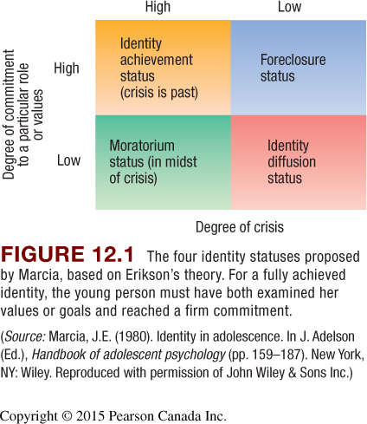
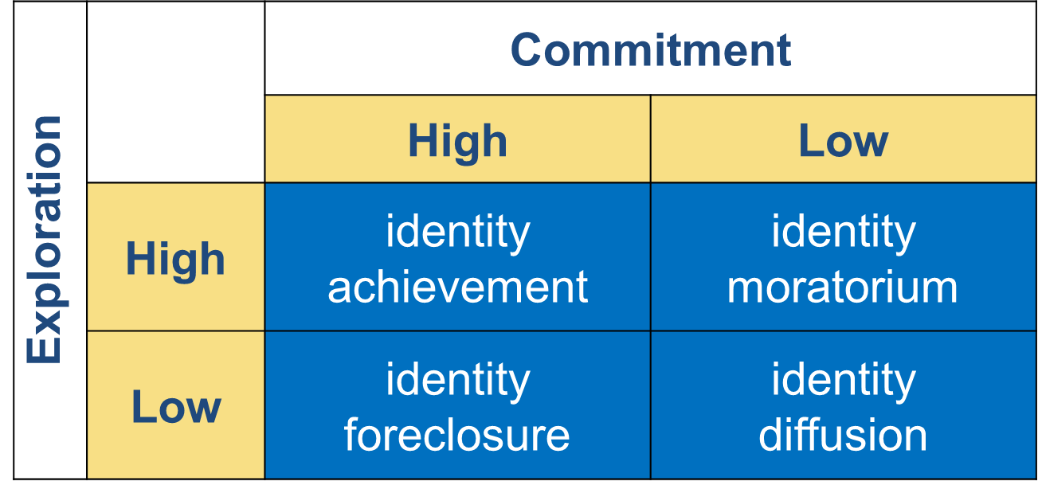
Paths to Identity

Slide 4
Emerging Adulthood
Explore alternatives in:
Education
Economic activities
Social surroundings
Impulsivity and risky decision making may carry over from adolescence to early adulthood
Routes to adult responsibility vary in:
Timing
Order

Slide 5
Cultural Change, Cultural Variation and Emerging Adulthood
Cultural change
Entry-level positions require more education
Wealth, longevity free young people from immediate entry to work force
Emerging adulthood largely limited to:
Middle- and high SES in industrialized nations
Wealthy, privileged few in developing countries
Some researchers question whether emerging adulthood is a distinct period

Slide 6
Levinson’s Life Structure
Novice Phase
Adjustment to new life circumstances
Mid-Era Phase
More competent at meeting the new challenges through reassessment and reorganization of the life structure from novice phase
Culmination Phase
Stability returns
Manage new challenges more effectively
More confidence, less distress
The underlying pattern or design of a person’s life at a given time, which includes, roles, relationships, and behavior patterns

Slide 7
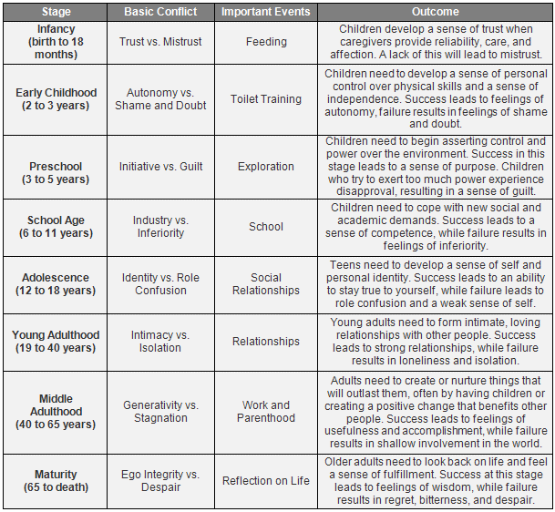
Erik Erikson – Intimacy vs Isolation
Intimacy
Making a permanent commitment to intimate partner
Redefining identity
Secure identity associated with fidelity
Isolation
Loneliness, self-absorption
State of searching

Slide 8
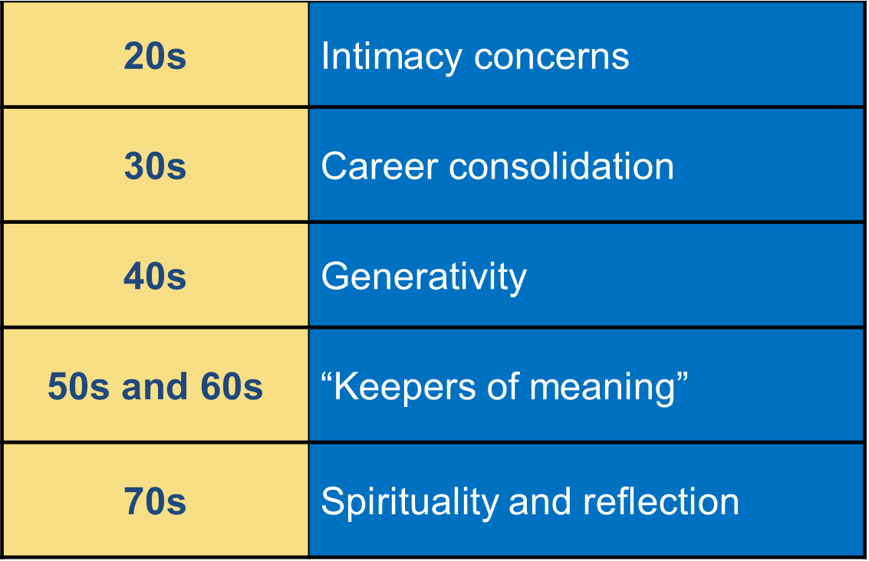
Vaillant’s Adaptation to Life

Slide 9
Theories of Mate Selection
Evolutionary
Parental Investment Theory – Sex differences in mate preferences and mating behavior are based on the different amounts of time and effort men and women must invest in child-rearing
Social
Social role theory – Sex differences in mate preference and mating behavior are adaptations to gender roles
Assertive Mating, or Homogamy
Sociology term for the tendency to mate with someone who has similar traits to one’s own
What else?

Slide 10
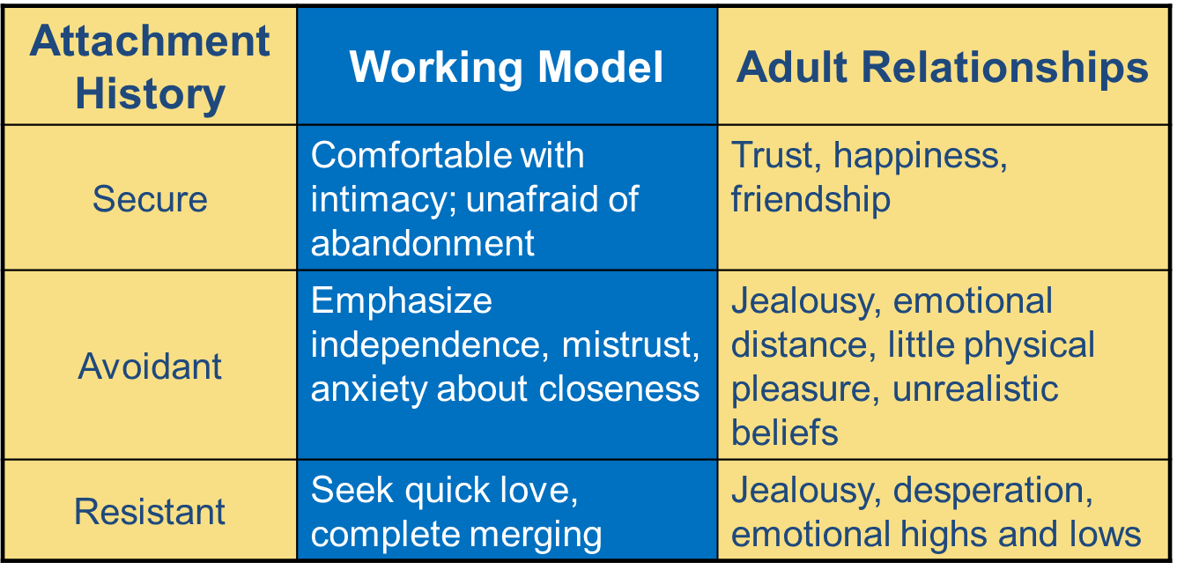
Attachment Patterns and Adult Relationships

Slide 11
Triangular Theory of Love
Intimacy: warm, tender concern
Passionate love: sexual attraction
Companionate love: affection and caregiving
Passionate love early, companionate love later
Passion gradually fades, while intimacy and commitment strengthen

Slide 12
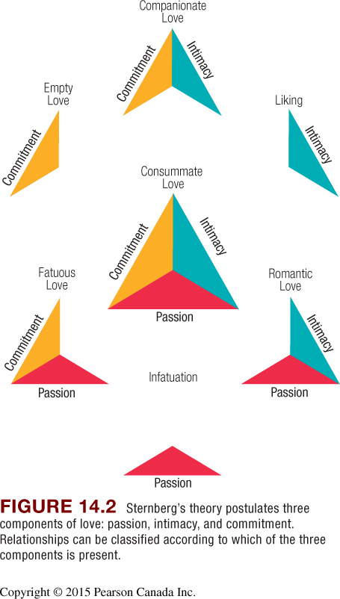

Slide 13
Conflict Management
Successful partnerships
Validating couples – Partners who express mutual respect, even in disagreements, and are good listeners
Volatile couples – Partners who argue a lot and don’t listen well, but still have more positive than negative interactions
Avoidant couples – Partners who agree to disagree and who minimize conflict by avoiding each other.
Unsuccessful partnerships
Hostile/engaged couples – Partners who have frequent arguments and lack the balancing effect of humour and affection
Hostile/detached couples – Partners who fight regularly, rarely look at each other, and lack affection and support

Slide 14
The Rest of Chapter 14
The rest of the chapter (page 419 to 434) will NOT be included on the exam

