Slide 1
Fundamentals of Sensation and Perception
Erik Chevrier
September 8th, 2015

Slide 2
Who am I?
Erik Chevrier
Part time professor in Sociology and Psychology
PhD student in Humanities (Sociology & Social Economics)
Masters in Psychology and Communications
B.A Honours in Psychology
Taught sensation and perception to youth
Experienced musician
Videographer
Former Magician

Slide 3
What about you?
Who are you?

Slide 4
Course Information
Lectures: Tuesday: 6 PM – 8:30 PM
Classroom: CC – 111
Office: H – 1125.12
Office Hours: by appointment
Email: professor@erikchevrier.ca
Course web address: www.erikchevrier.ca

Slide 5
Course Description
This course gives you insights into the complexity and the beauty of the physiological and psychological mechanisms of your sensory systems. We explore the age-old question of how information about the world is acquired by the visual and auditory systems (and others) and used together with stored information to create an ongoing representation of the world.
We begin the course with an overview of the methodologies, theories and overriding assumptions within the field of sensation and perception. We then look at the way attention and awareness guide what we experience and understand about our environment. We also learn about sound by exploring sound waves, the anatomy of ears and by discovering how our brain perceives auditory signals. Finally, we look at how the visual system functions, the anatomy of the eyes and how our optic nerve and brain communicate.
In this course, we focus primarily on a biological perspective, although we also explore other fields like philosophy, communications studies and social psychology to contextualize the way people sense and understand the world. Furthermore, we use hands on examples, especially magic and illusions, to introduce topics throughout the course.

Slide 6
Schedule
PART 1
September 8th Course overview / Introduction to Perception
September 15th NO CLASS! Erik Presentation 7th floor of Hall Building
September 22nd Foundations of Sensation and Perception Chapter 1
September 29th Attention and Awareness Chapter 8
October 6th Sound and the Ears Chapter 9
October 13th The Auditory Brain Chapter 10
October 20th Perceiving Speech and Music Chapter 11
October 27 Midterm Exam

Slide 7
Schedule
PART 2
November 3rd Light and the Eyes Chapter 2
November 10th Visual Brain Chapter 3
November 17th Recognizing Visual Objects Chapter 4
November 24th Perceiving Colour Chapter 5
December 1st Class Presentations
FINAL EXAM

Slide 8
Materials
REQUIRED TEXT
Yantis, S. (2013). Sensation and Perception. Worth Publishers.
Book Companion website: http://bcs.worthpublishers.com/yantis1e
PsychPortal for Sensation and Perception by Yantis, S (use activation code bundled with textbook) http://courses.bfwpub.com/yantis.php
Additional materials (lecture notes and readings) will be posted on the class website.

Slide 9
Assessment
Exam 1 40%
Exam 2 40%
Group Project 10%
Class Participation 10%

Slide 10
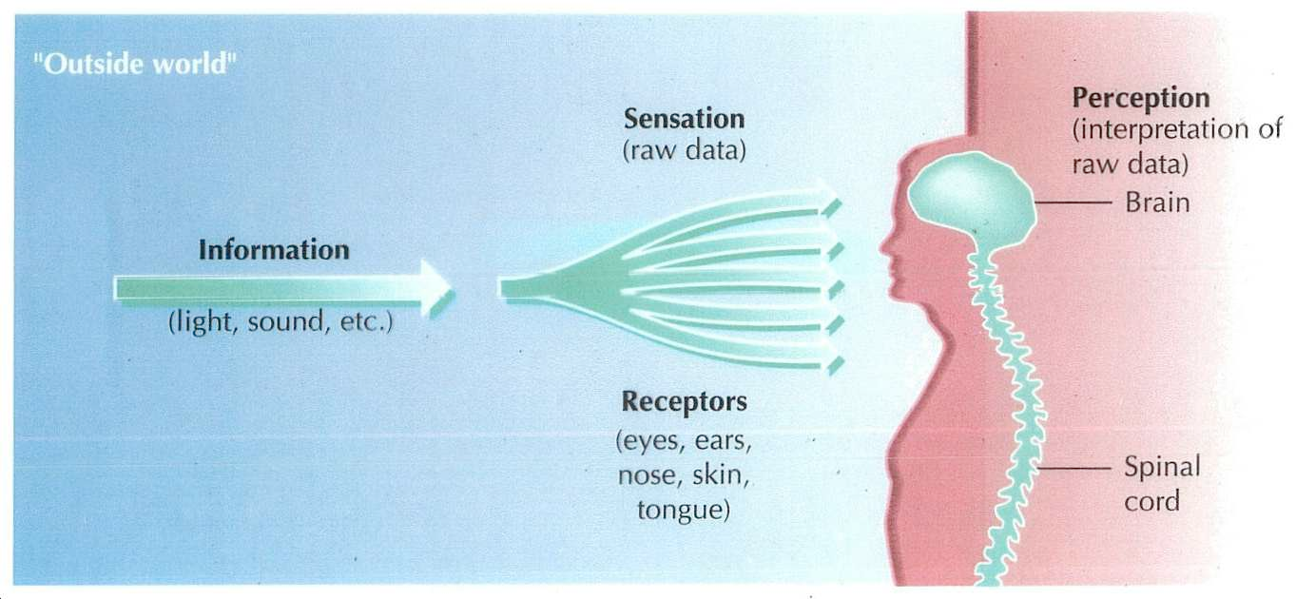
Sensation and Perception

Slide 11
Sensation and Perception

Slide 12
Sensation and Perception
Sensation – The initial steps in the perceptual process, whereby physical features of the environment are converted into electrochemical signals that are sent to the brain for processing.
Perception – The later steps in the perceptual process, whereby the initial sensory signals are used to represent objects and events so they can be identified, stores in memory, and used in thought and action.
Sensation and perception are the primary mechanisms for all psychological principles!

Slide 13
Information Processing Model

Slide 14
Senses
The Five Senses
Vision Hearing Touch Smell Taste
Are there any other senses?

Slide 15
Senses
The Five Senses
Vision Hearing Touch Smell Taste
Sense limb and body position Pain Skin temperature Balance Body Movement

Slide 16
Dimensions of Senses
Vision
Brightness, colour, shape, texture
Audition
Loudness, pitch, location
Gustation
Sweet, salty, bitter, sour, texture, spiciness,
Body Senses
Pain, limb and body position, temperature, balance, body movement
Olfaction
Odor
Body States
Hunger, thirst, muscle fatigue

Slide 17
Optical Illusions - Video
Optical Illusion Show how we See

Slide 18
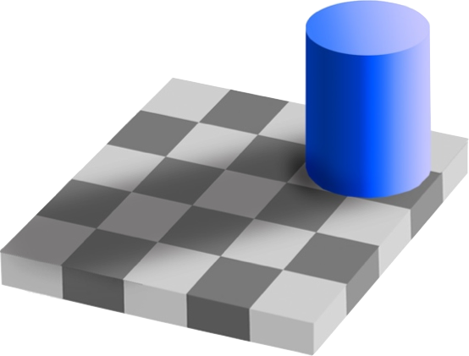
Optical Illusions

Slide 19
Optical Illusions

Slide 20
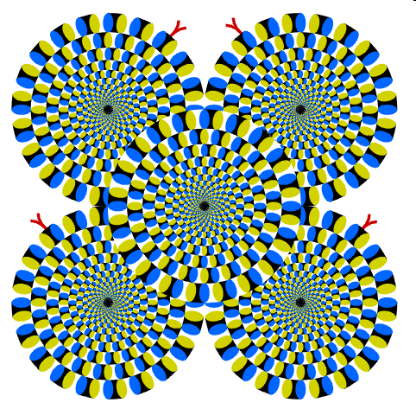
Optical Illusions

Slide 21
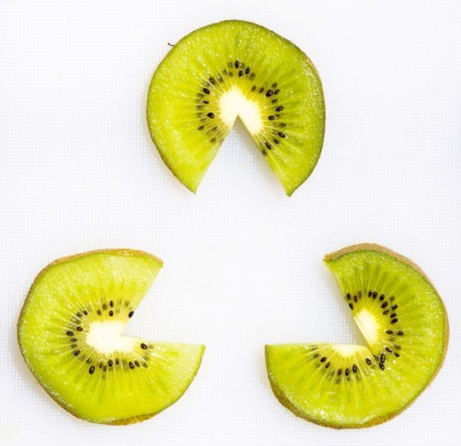
Perception is Subjective

Slide 22
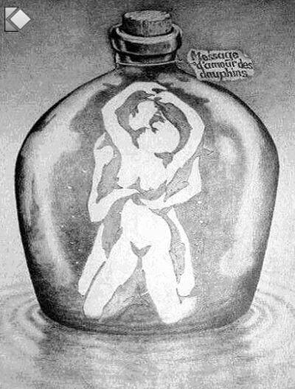
Perception is Subjective

Slide 23
Perception is Subjective

Slide 24
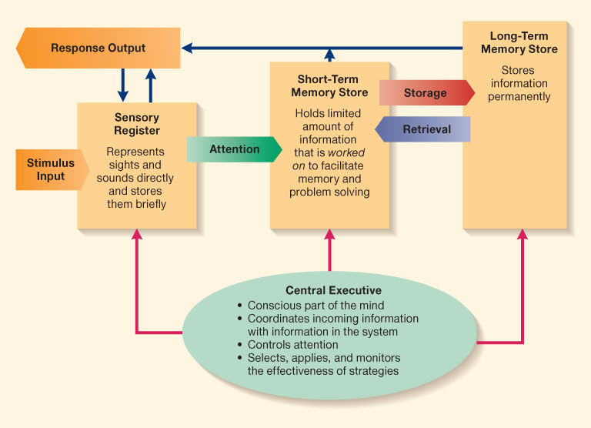
Attention and Awareness are Important
Seeing the world that isn’t
The Art of Misdirection

Slide 25
Music and Mood
Experiment 1
Experiment 2
Experiment 3
Experiment 4
Mental and Emotional Effects of Music

Slide 26
Images, Sound and Mood
Experiment 1
Experiment 2
Experiment 3

Slide 27
A Little Test!

Slide 28
Reality & Representations
How do you know if the things we sense and perceive are real?
Do we see reality as it is?

