Slide 1
Fundamentals of Sensation and Perception
Attention and awareness
Erik Chevrier
September 21th, 2015

Slide 2
Videos
Attention, Distraction and the War in our Brain
Test Your Awareness

Slide 3
Information Processing Model
Awareness
Attention
Selective Attention
Cocktail Problem

Slide 4
How Attention Works
Attention is selective
An ‘attentional spotlight’ guides our attentional resources towards fixation points
We are more aware of stimuli that we are cued to pay attention to (attentional cuing)
Attention is derived from top-down and bottom-up processes
We perform visual searches by attending to key features (feature vs conjunction searches)
We sometimes discriminate visual stimuli that we are not aware of (blindsight)
We understand the general gist of an event/situation very rapidly
We have limits to our awareness
We are not aware of unattended stimuli (inattentional bias)
We fail to quickly detect small changes in complex scenes (change blindness)
There is a limit to the amount of things we can attend to at once (filter theory of attention)
Task switching and multitasking impairs our cognitive abilities

Slide 5
An Example of Change Blindness
Spot the Difference

Slide 6
Spot the Difference

Slide 7
Spot the Difference

Slide 8
People Rely on Visual Cues for Attention

Slide 9
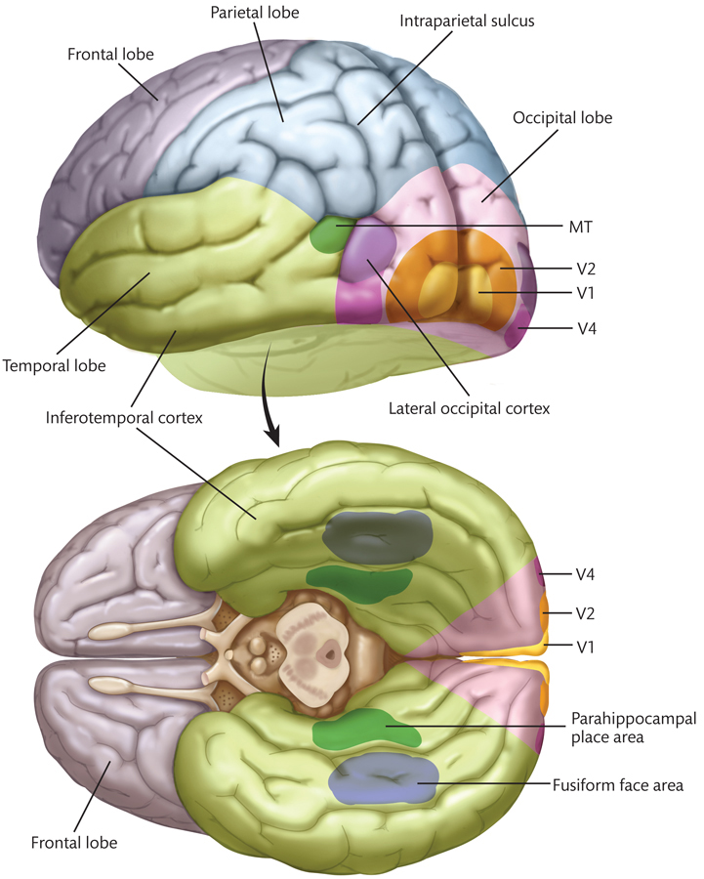
Visual Pathways - Basics

Slide 10
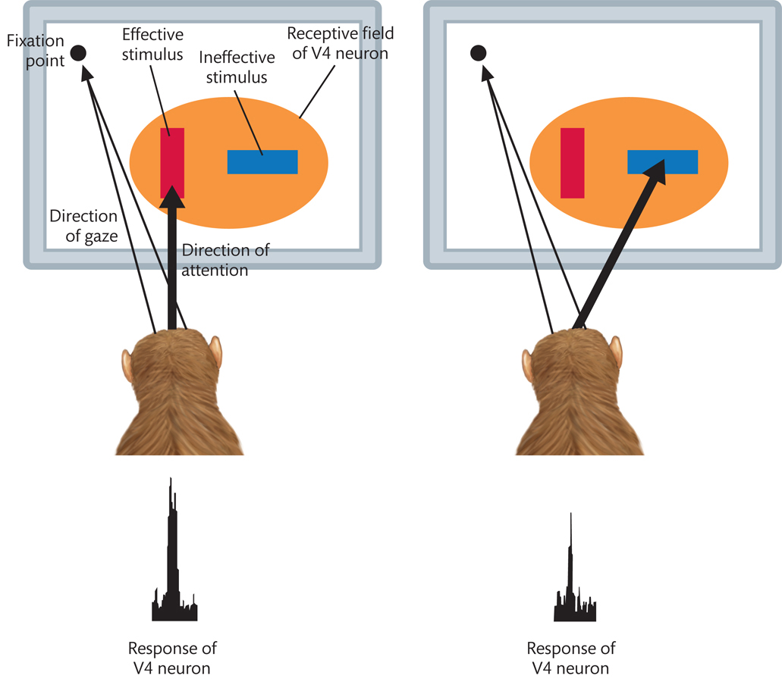
Visual Pathways – V4 Neuron

Slide 11
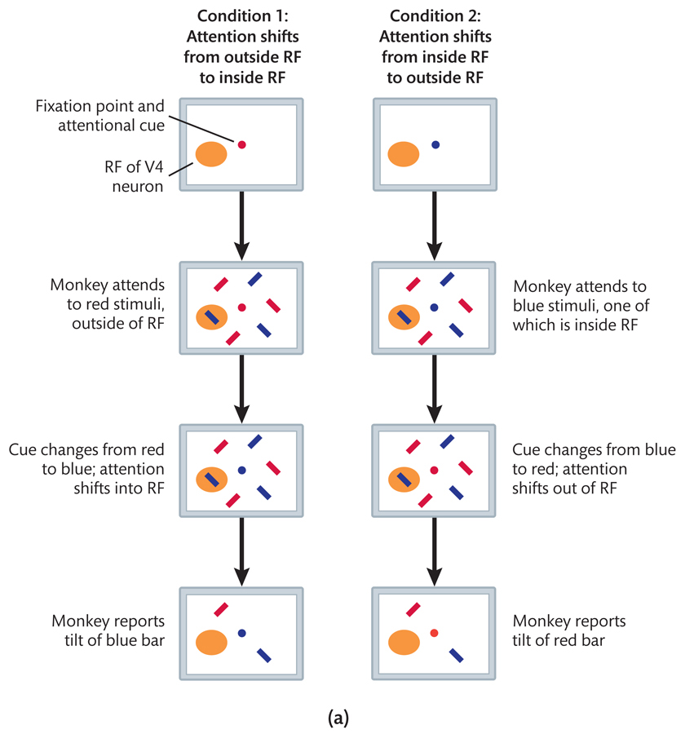
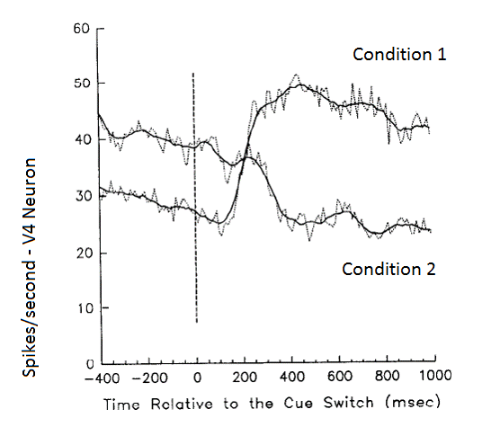
Neural Reponses – V4 Area

Slide 12
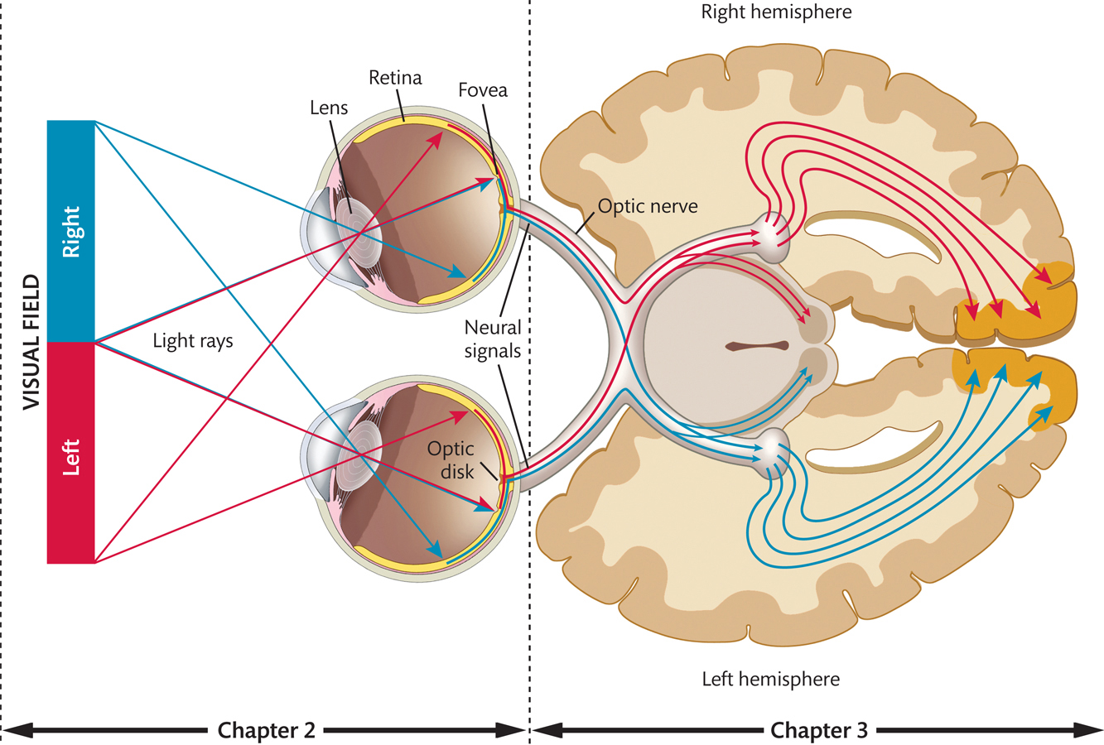
Attention, Vision and Brain Activity

Slide 13
Feature Detection
Find the Green #5

Slide 14
Feature Detection

Slide 15
Feature Detection
Find the Red #5

Slide 16
Feature Detection

Slide 17
Conjunction Search
Find the Green #5

Slide 18
Conjunction Search

Slide 19
Conjunction Search
Find Waldo!

Slide 21
Conjunction Search & Selective Attention
Binding Problem
The problem faced by the visual system of perceiving which visual features belong to the same object
Feature Integration Theory (FIT)
The brain solves the binding problem by selectively attending to one object and ignoring any others
Biased Competition Theory
The brain resolves competition for neural representation by selectively attending to one object and representing the features of just that object

Slide 22
Biased Competition Theory
Biased Competition Theory
The brain resolves competition for neural representation by selectively attending to one object and representing the features of just that object

Slide 23
Motion Centers and Feature Detection

Slide 24
Types of Features

Slide 25
Types of Features

Slide 26
Top-Down vs Bottom-Up

Slide 27
Awareness and Neural Correlates of Consciousness
The difference between neural activity and conscious awareness
Third vs First Person Data
Discussion! Can neural activity fully describe conscious experience?
Perceptual Bistability

