Slide 1
Fundamentals of Sensation and Perception
Foundations - The world, mind and brain
Erik Chevrier
September 22th, 2015

Slide 2
Reality & Representations
How do you know if the things we sense and perceive are real?
Do we see reality as it is?

Slide 4
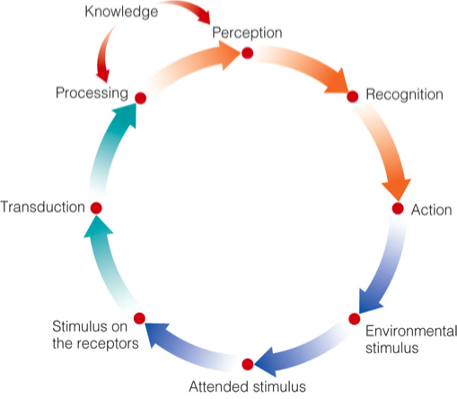
Sensation and Perception

Slide 5
Neurons and Neural Signals

Slide 6
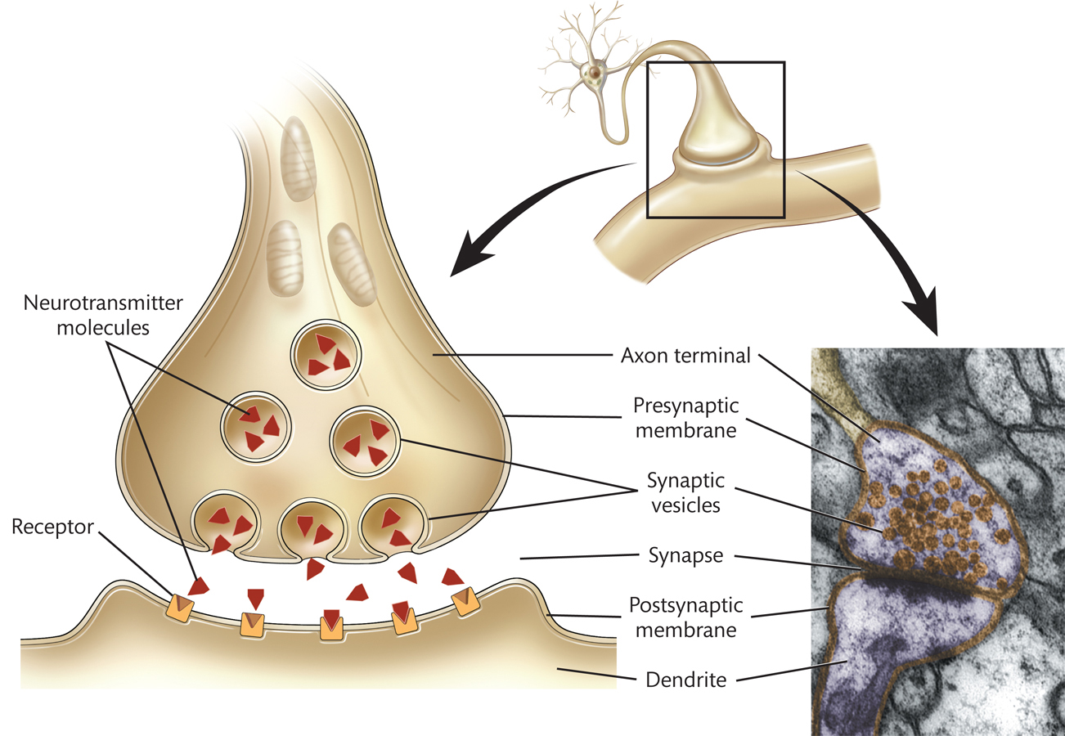
Neurotransmitters

Slide 7
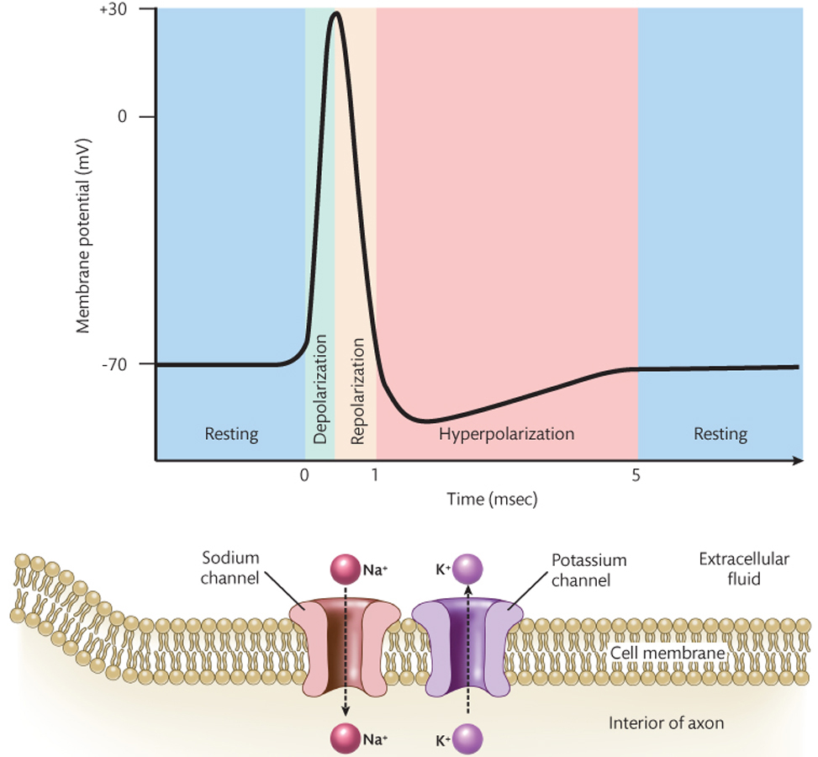
Action Potential

Slide 8
Transmitting Signals Between Neurons
Excitatory Neurotransmitters – Have excitatory effect on post-synaptic neuron, increasing probability of action potential. (EPSP; excitatory postsynaptic potential)
Inhibitory Neurotransmitters – Have inhibitory effect on post-synaptic neuron, decreasing the probability of action potential. (IPSP; inhibitory post synaptic potential)

Slide 9
The Brain
Cerebral Cortex – Outer most layer of cerebral hemispheres
Grey – Mainly cell bodies of neurons, makes up cerebral cortex
White matter – Myelin covered axons of cortical neurons
Corpus callosum – Major connection between the two hemispheres
Gyrus – Elongated bump on the surface of the cerebral hemispheres
Sulcus – Indentation between two giri on the surface of the cerebral cortex

Slide 10
The Brain
Amygdala – Important for Emotion
Hippocampus – Important for Memory
Thalamus – Most neural signals from sensory organs pass through

Slide 11
Cognitive Neuropsychology
Cognitive Neuropsychology – The investigation of perceptual and cognitive deficits in individuals with brain damage in order to discover how perception and cognition are carried out in the normal, undamaged brain.
Modularity – The idea that the human brain consists of distinct modules, each of which carries out one or more specific functions.
Dissociation – In cognitive neuropsychology, a pattern of brain damage and impaired function in which damage to some specific brain region is associated with impairment of some specific function but not impairment of another function.
Double Dissociation – In cognitive neuropsychology, a pattern of brain damage and impaired functioning in which damage to some specific brain region is associated with impairment of some function A but not with impairment of another function B, along with a pattern (in a different patient) in which damage to a different region is associated with impairment of function B but not with impairment of function A.
Assumption of Cognitive Uniformity – The assumption that the functional organization of human cognition and of the brain is essentially the same in everyone.

Slide 12
Functional Neuroimaging
Electroencephalography (EEG) – Measurement of electrical fields associated with brain activity.
Magnetoencephalography (MEG) – Measurement of magnetic fields associated with brain activity.
Positron Emission Tomography (PET) – Measurement of changes in blood flow associated with brain activity.
Functional Magnetic Resonance Imaging – Measurement of the changes in blood oxygenation associated with brain activity.

Slide 13
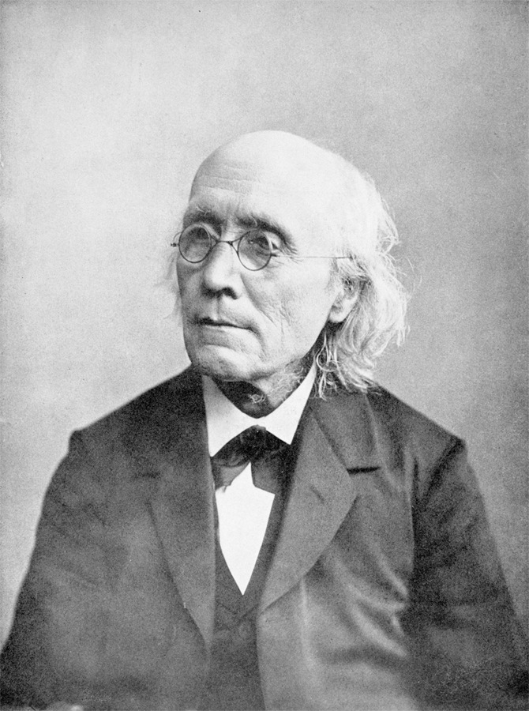
Gustav Fechner (1801–1887) invented “psychophysics” and is often considered to be the true founder of experimental psychology
Psychophysics: The science of defining quantitative relationships between physical and psychological (subjective) events

Slide 14
How Can we Study Sensation and Perception?
Psychologists look at behavioural responses
Absolute threshold – Minimum intensity of a physical stimulus that can just be detected by an observer
Difference threshold – The minimum difference between two stimuli that allows an observer to perceive the two stimuli are different.
Noise in neural activity – The minimum difference between two stimuli that allows an observer to perceive the two stimuli are different.

Slide 15
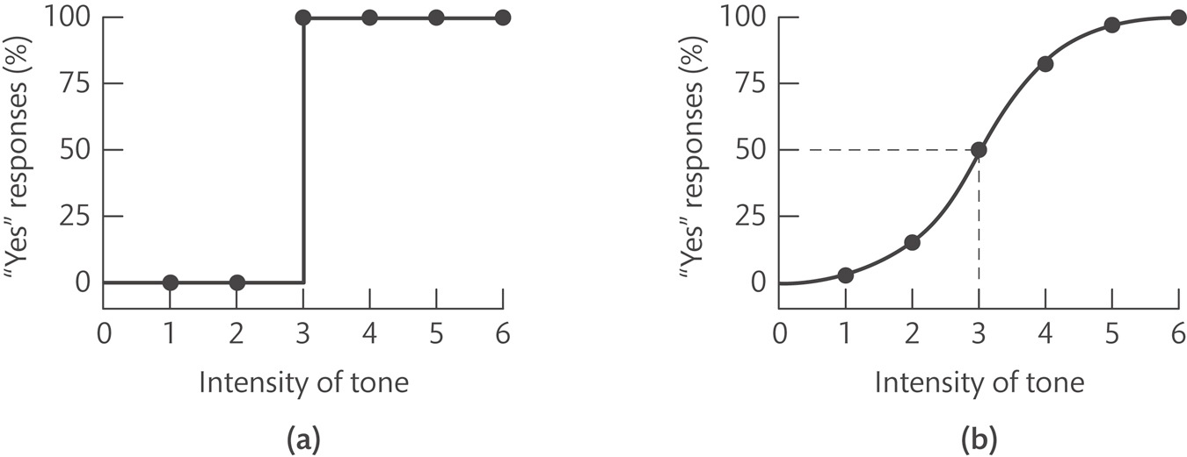
Absolute Threshold
Method of Adjustment – Participant observes a stimulus and adjusts a knob that directly controls the intensity of the stimulus. Average is the final estimate.
Method of Constant Stimuli – Participant is presented with a fixed set of stimuli covering a range of intensities that are presented repeatedly in random order, and the participant must indicate whether or not each stimulus was detected.
Psychometric Function

Slide 16
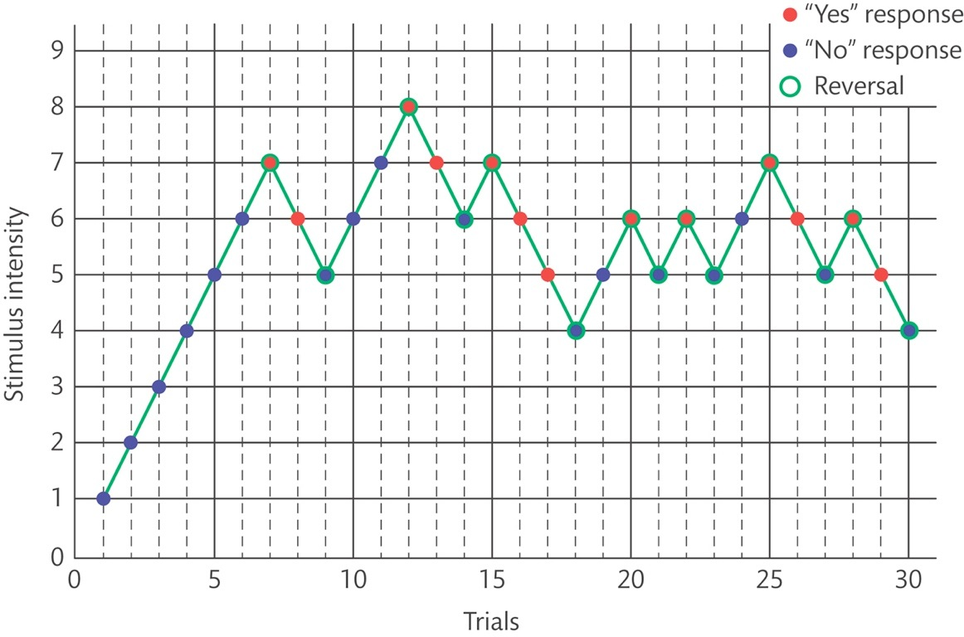
Absolute Threshold
Staircase Method – The participant is presented with a stimulus and indicates whether it was detected, and based on that response, the next stimulus is either one step up or one step down in intensity.

Slide 17
Difference Threshold
Just Noticeable Difference – The minimum difference between two stimuli that allow an observer to perceive that the two stimuli are different.
Standard stimulus / comparison stimulus

Slide 18
Difference Threshold
Method of Adjustment
Participant observes two stimuli, a standard and comparison, and adjusts a knob that directly controls the intensity of the comparison stimulus, in order to determine the threshold of difference between the comparison and standard stimulus. The average is the final estimate.
Staircase Method
The participant is presented with two stimuli and indicates whether they were the same or different, and based on that response, the next stimulus is either one step up or one step down in intensity from the standard stimulus.

Slide 19
Difference Threshold
Method of Constant Stimuli
Participant is presented with a fixed set of stimuli covering a range of intensities that are presented repeatedly in random order, and the participant must indicate whether or not each stimulus was detected.
JND = (75% score – 25% score) / 2

Slide 20
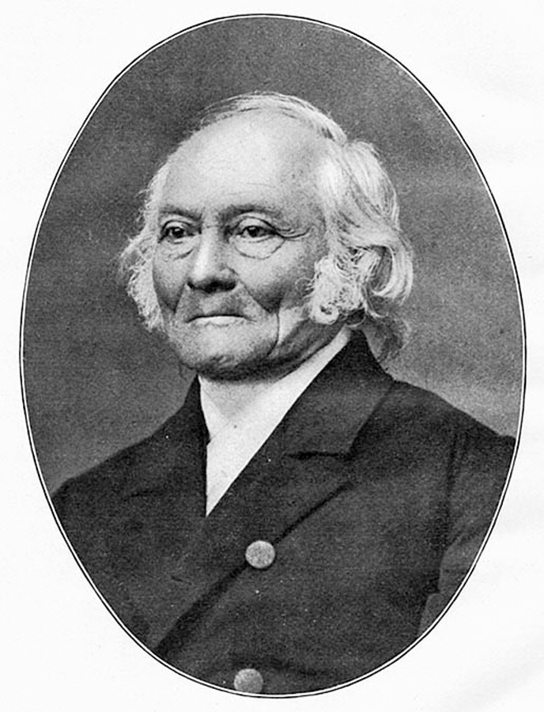
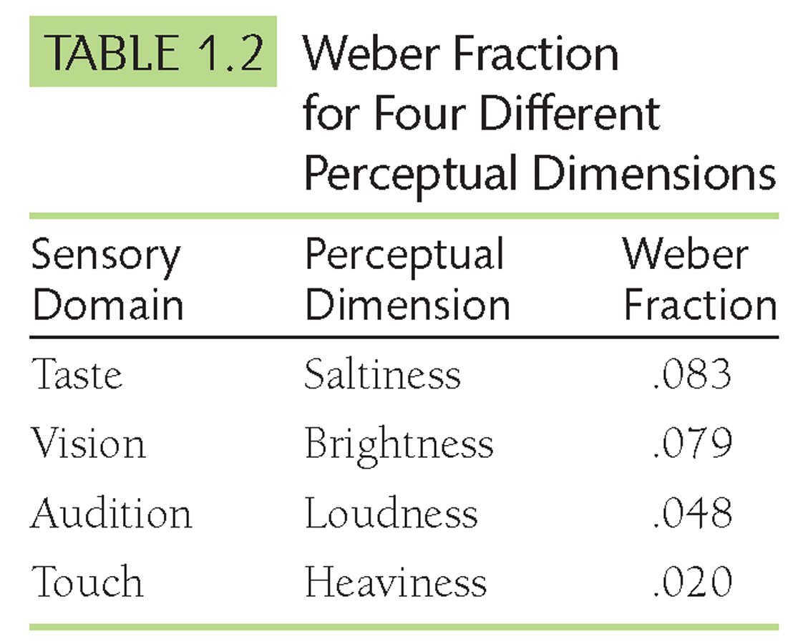
Ernest Weber (1795 – 1878)
Weber’s Law
The smallest change in a stimulus (e.g., the weight of an object) that can be detected is a constant proportion of 2% of the stimulus level.
For 100g, JND is 2g (or 2%)
For 1000g, JND is 20g (or 2%).
Weber’s law: The principle describing the relationship between stimulus and resulting sensation intensity (l) that says the JND is a constant fraction (k) of the comparison stimulus.
JND=kl
JND=k (weber fraction) l(Intensity)

Slide 21
Psychophysical Scaling
The process of measuring how changes in stimulus intensity relates to changes in perceived intensity.
Fechner’s law
Variant of Weber’s law, a principle describing the relationship between the perceived intensity (S) of a stimulus as it changes in comparison to the natural log ratio between the physical intensity (I) and the intensity at absolute threshold (Io).
S = k ln I/Io
S (perceived stimulus intensity =
k (weber fraction)
ln I/Io (natural logarithm of the ratio of the stimulus intensity)

Slide 22
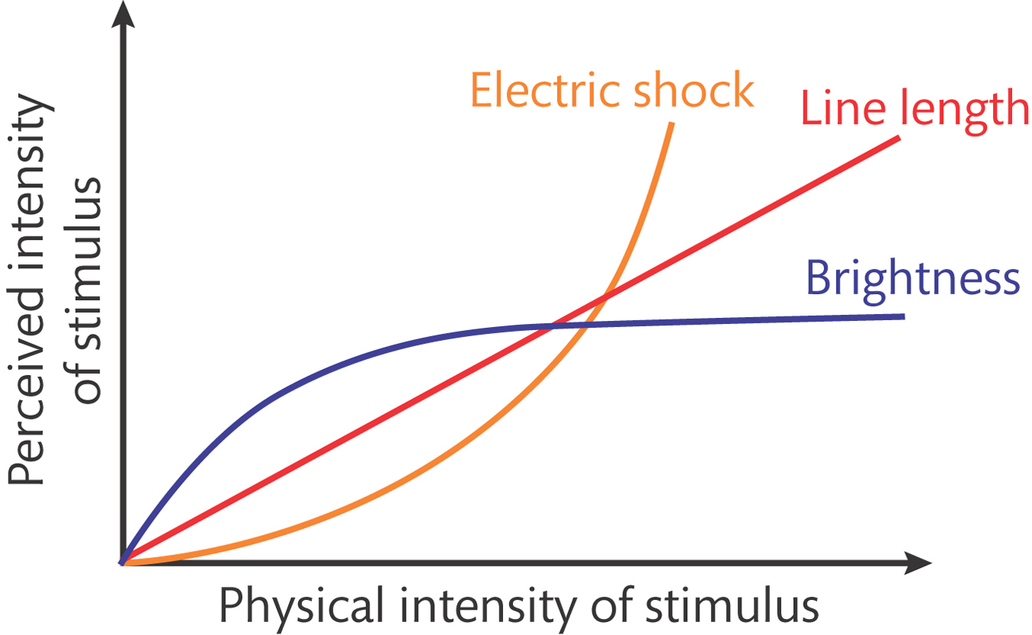
Psychophysical Scaling
The process of measuring how changes in stimulus intensity relates to changes in perceived intensity.
Stevens Law
Relationship between the perceived intensity of a stimulus (S), its physical intensity (I), the exponent n is different for each perceptual dimension, and c is the constant that depends on which units are being used for S and I.
S = cl^{n}
S (perceived stimulus intensity) =
I (physical intensity)
C (constant)
n (exponent)

Slide 23
Action Potentials - Recap

Slide 24
Noise in Neural Activity

Slide 26
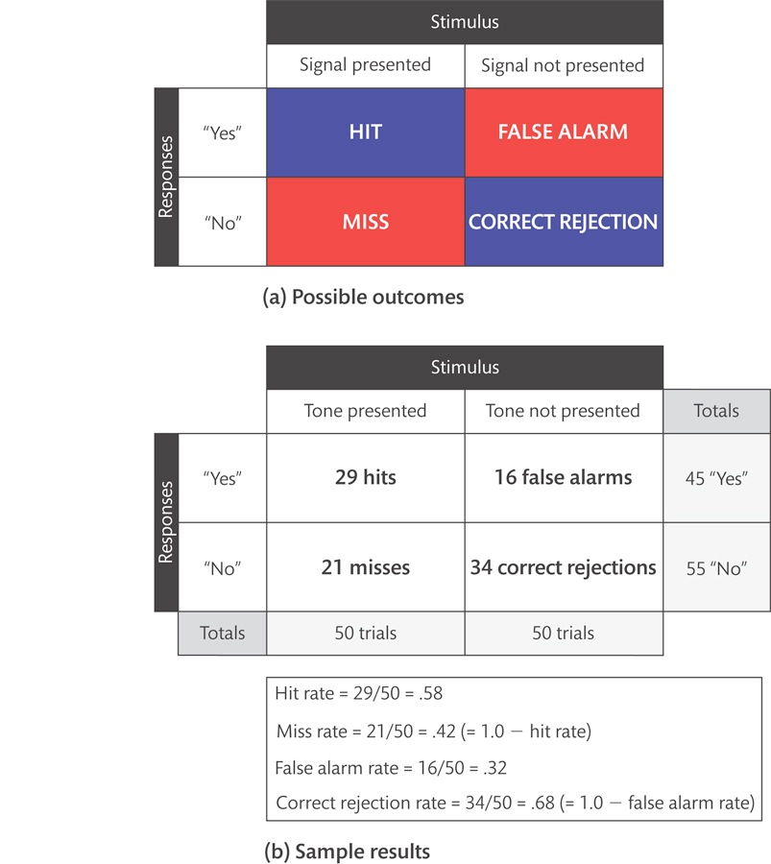
Signal Detection Theory
Signal Detection Theory – A framework for measuring how people make decisions based on noisy perceptual evidence. It provides a way to measure perceptual sensitivity apart from decision making style.

Slide 27
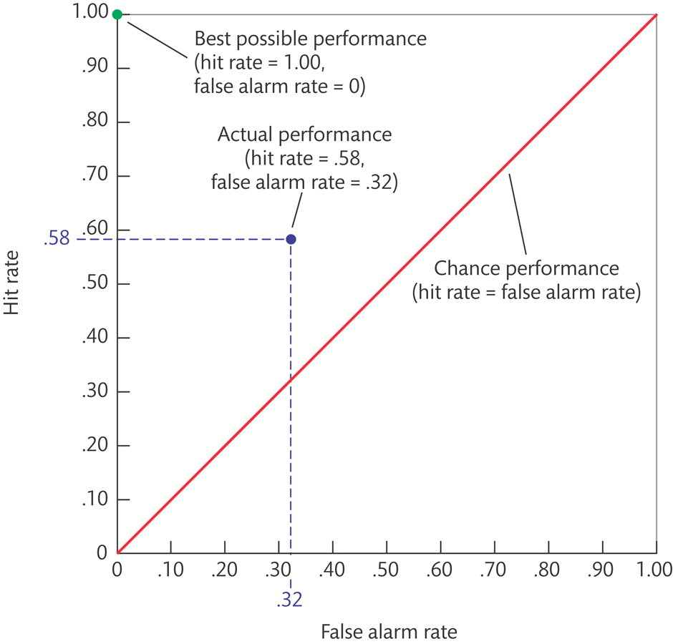
Receiver Operating Characteristic Plot
In a signal detection experiment, it is a curve representing the quality of a participant’s performance.

Slide 28
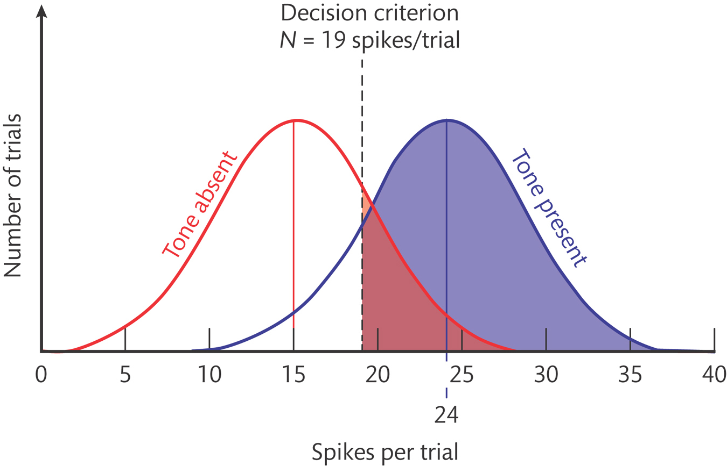
Sensitivity and Bias
Decision-making bias
In a signal detection experiment, a participant’s tendency to be liberal or conservative in deciding whether a signal was detected; indicated by the value of the participant’s decision criteria.
d’ (d-prime)
Difference between means

Slide 30
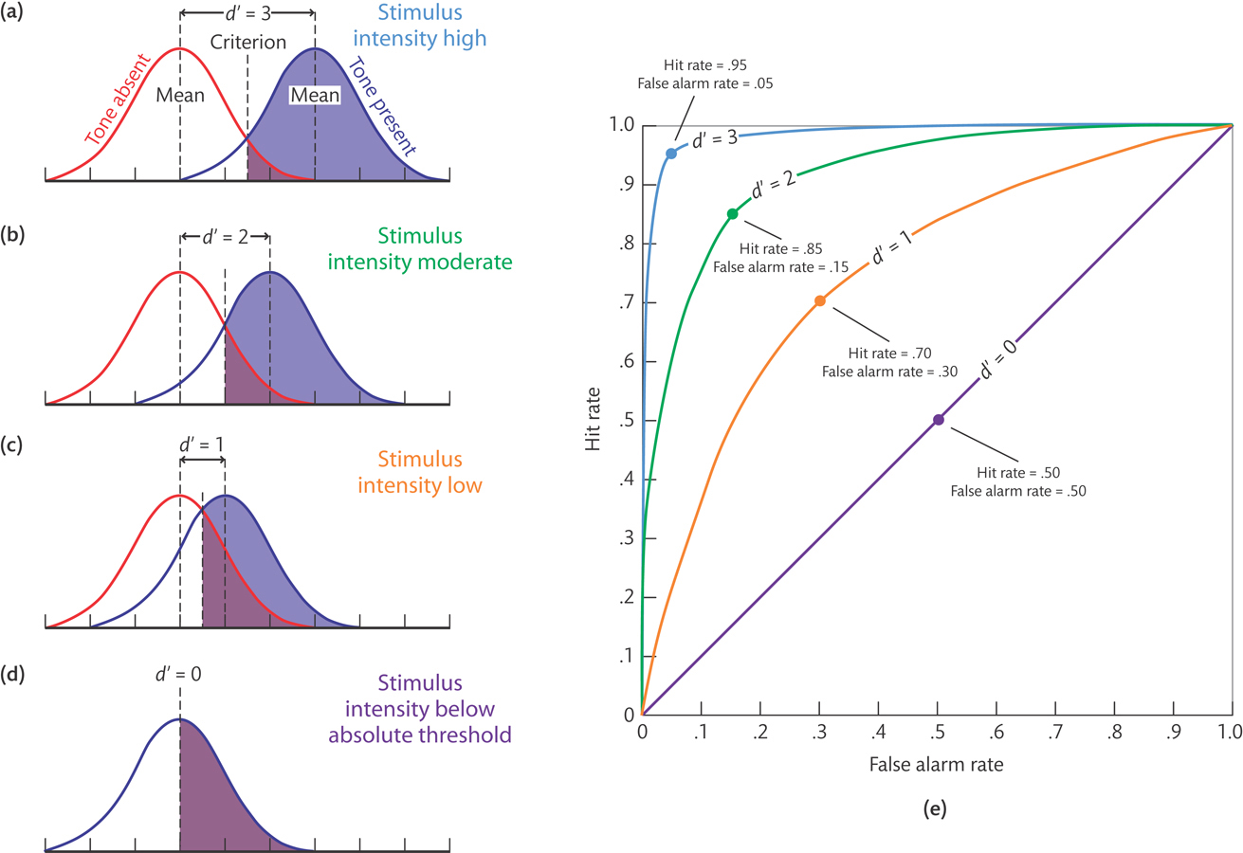

Slide 31
Videos
Mapping the Brain
Neurons – Function of and Types if Neurons
Bittersweet Biology – Action Potentials
Hearing test
Signal Detection Test

Slide 32
Questions?

