Slide 1
Fundamentals of Sensation and Perception
Attention and awareness
Erik Chevrier
September 29th, 2015

Slide 2
Videos
Attention, Distraction and the War in our Brain
Test Your Awareness
Awareness Test

Slide 3
Information Processing Model
Awareness
Attention
Selective Attention
Cocktail Problem

Slide 4
How Attention Works – General Overlook
Attention is selective
An ‘attentional spotlight’ guides our attentional resources towards fixation points
We are more aware of stimuli that we are cued to pay attention to (attentional cuing)
Attention is derived from top-down and bottom-up processes
We perform visual searches by attending to key features (feature vs conjunction searches)
We sometimes discriminate visual stimuli that we are not aware of (blindsight)
We understand the general gist of an event/situation very rapidly
We are attracted to pay attention to things that stand out
We have limits to our awareness
We are not aware of unattended stimuli (inattentional bias)
We fail to quickly detect small changes in complex scenes (change blindness)
There is a limit to the amount of things we can attend to at once (filter theory of attention)
Task switching and multitasking impairs our cognitive abilities

Slide 5
Selective Attention and the Limits of Awareness
Cocktail Party
Inattentional Blindness
Change Blindness
Gist awareness – Details need attention

Slide 6
An Example of Change Blindness
Spot the Difference

Slide 7
Spot the Difference

Slide 8
Spot the Difference

Slide 9
Attention to Locations
Filter theory of attention
Sensory information is registered as physical signals but that attention selects only some of those signals to be interpreted for meaning, with the rest being filtered out.
Attentional Cuing
Spotlight
Attention affects the rate of firing of V4 neurons

Slide 10
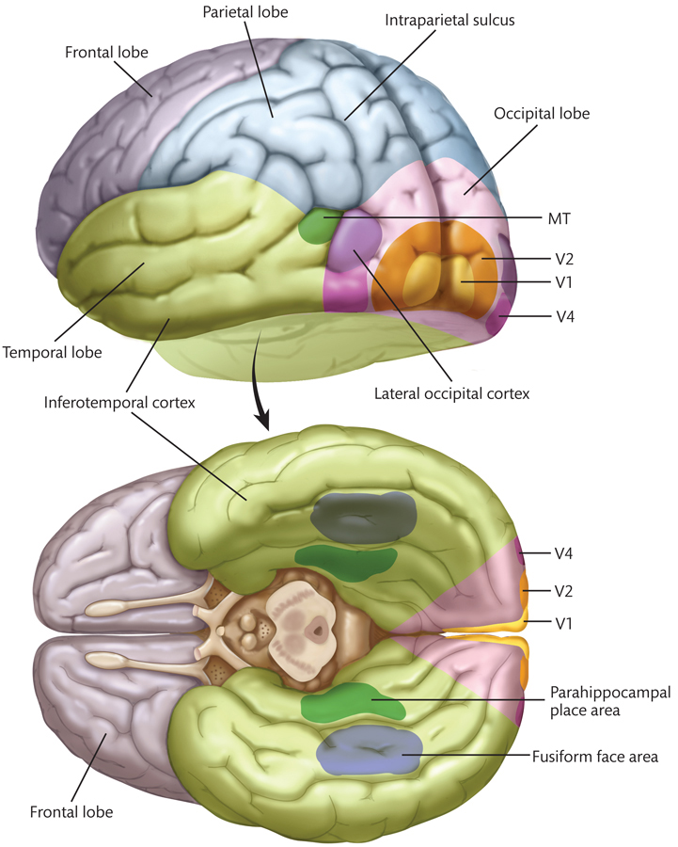
Visual Pathways - Basics

Slide 11
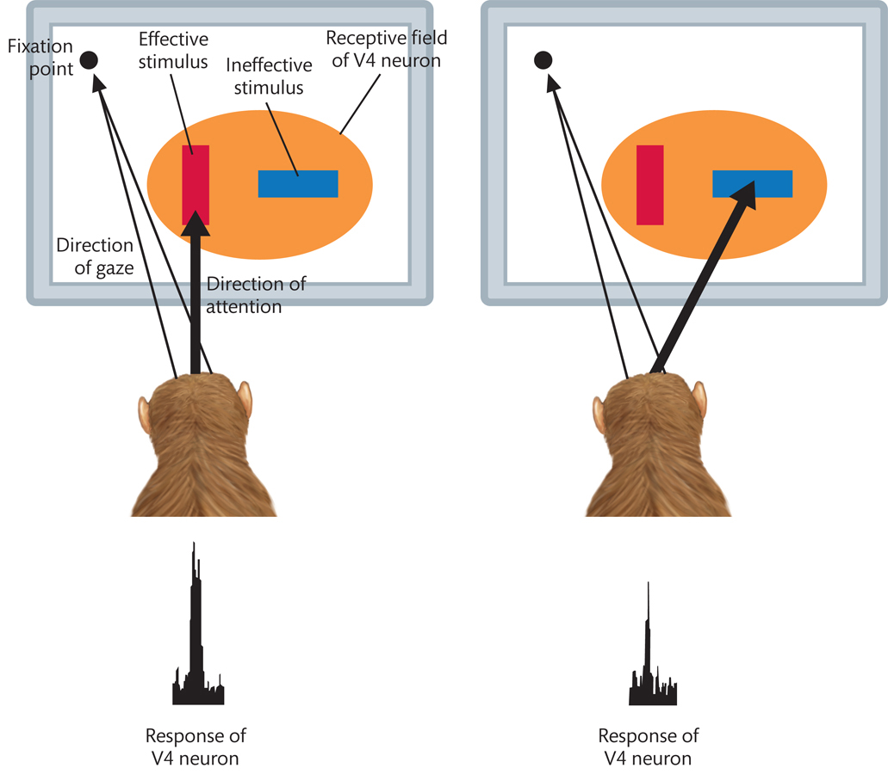
Visual Pathways – V4 Neuron

Slide 12
People Rely on Visual Cues for Attention

Slide 13
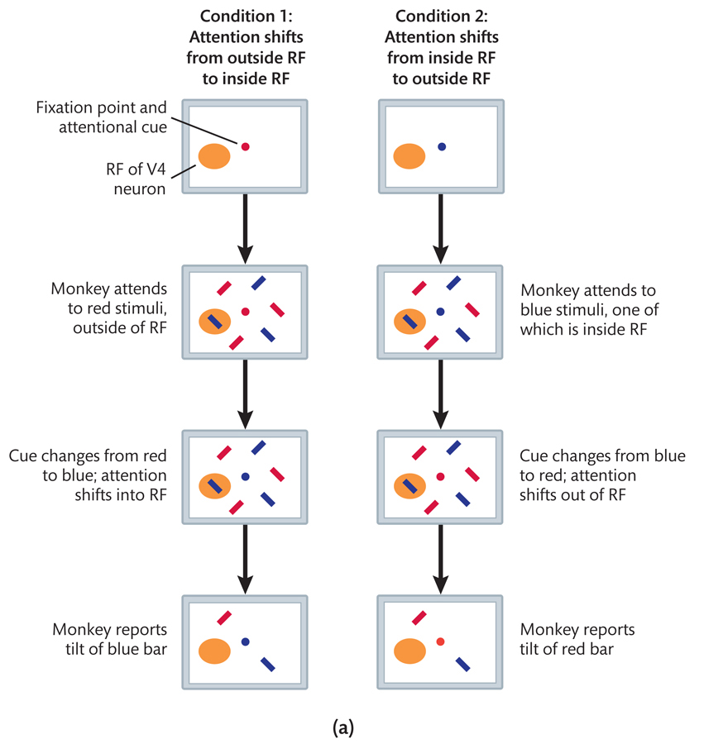
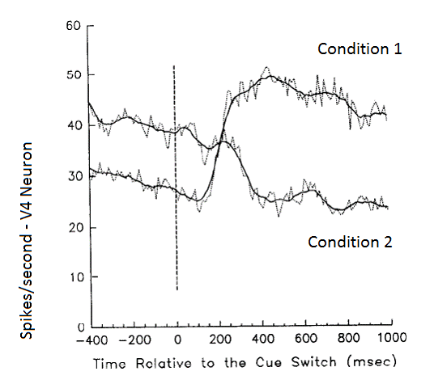
Neural Reponses to Attentional Cuing

Slide 14
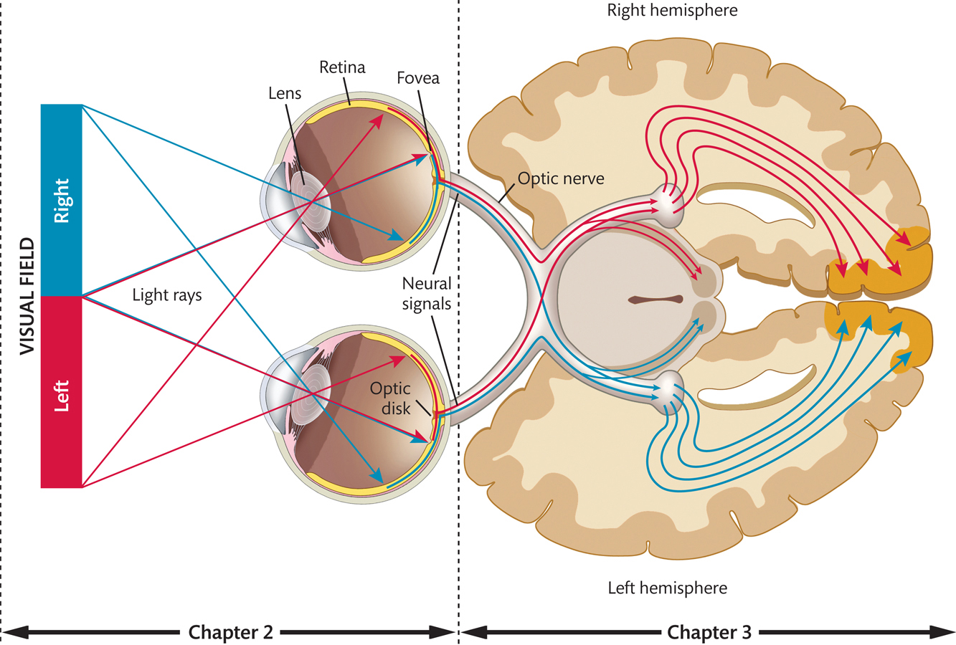
Attention, Vision and Brain Activity

Slide 15
Feature Detection
Find the Green #5

Slide 16
Feature Detection

Slide 17
Feature Detection
Find the Red #5

Slide 18
Feature Detection

Slide 19
Conjunction Search
Find the Green #5

Slide 20
Conjunction Search

Slide 21
Conjunction Search
Find Waldo!

Slide 24
Types of Features

Slide 25
Types of Features

Slide 26
Visual Pathways - Basics

Slide 27
Motion Centers and Feature Detection

Slide 28
Attention to Features & Selective Attention
Binding Problem
The problem faced by the visual system of perceiving which visual features belong to the same object
Feature Integration Theory (FIT)
The brain solves the binding problem by selectively attending to one object and ignoring any others
Biased Competition Theory
The brain resolves competition for neural representation by selectively attending to one object and representing the features of just that object

Slide 29
Biased Competition Theory
Biased Competition Theory
The brain resolves competition for neural representation by selectively attending to one object and representing the features of just that object

Slide 30
Top-Down vs Bottom-Up

Slide 31
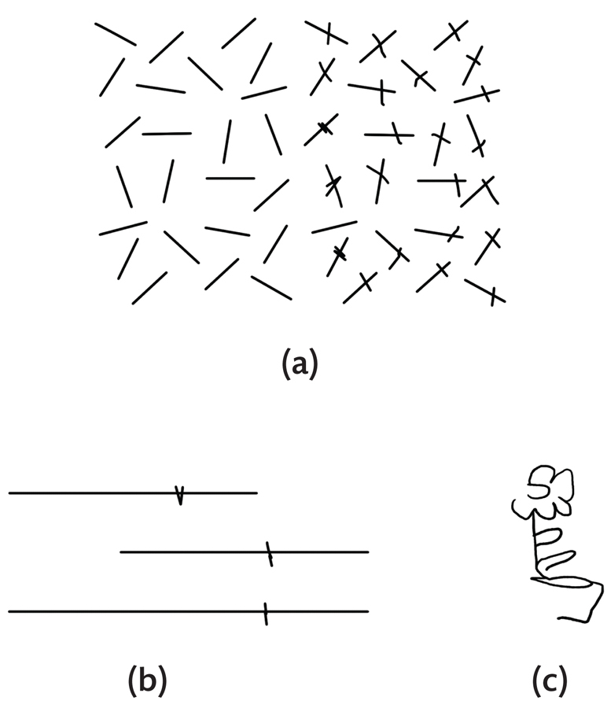
Sources of Attentional Control in the Brain
Unilateral Visual Neglect
A condition in which a person has difficulty attending to stimuli in one half of the visual field (almost always the left half), as a result of damage to the contralateral posterior parietal cortex (PPC).
Patients are not blind on the left suggesting that it is attention and not vision responsible for the problem

Slide 32
PCC Neurons
Moreover!
fMRI evidence for FEF and PPC in attentional control

Slide 33
Awareness and Neural Correlates of Consciousness
The difference between neural activity and conscious awareness
Third vs First Person Data
Perceptual Bistability
Perceptual Bistability

Slide 34
Seeking NCC in Perceptual Bistability
Binocular Rivalry
Fusiform Face Area FFA – Faces
Parahippocampal Place Area (PPA) – Houses

Slide 35
Task Switching

Slide 36
Rapid Serial Visual Presentation

Slide 37
Rapid Serial Visual Presentation - Slowed

Slide 38
Attention and Magic

Slide 39
Perception of the World Via Media

Slide 40
Advertising and Attention
Compare and contrast ads!
Dove Evolution
http://www.youtube.com/watch?v=hibyAJOSW8U
Axe Body Spray
http://www.youtube.com/watch?v=7DpoavYXMK4&feature=related

Slide 41
Questions?

