Slide 1
Fundamentals of Sensation and Perception
The auditory brain and perceiving auditory scene
Erik Chevrier
October 13th, 2015

Slide 2
Videos
Teaching the Blind to Navigate the World Using Tongue Clicks
Daniel Kish “Batman”

Slide 3
Sound Scenes & Sound Tests
City Sounds Rain in the City Nature Sounds
Guessing Game Guessing Game 2 Race Car Sound Effects Race Car Sound Effects 2
McGurk Effect BBC McGurk Effect 2 McGurk Effect 3 Hearing Test

Slide 4
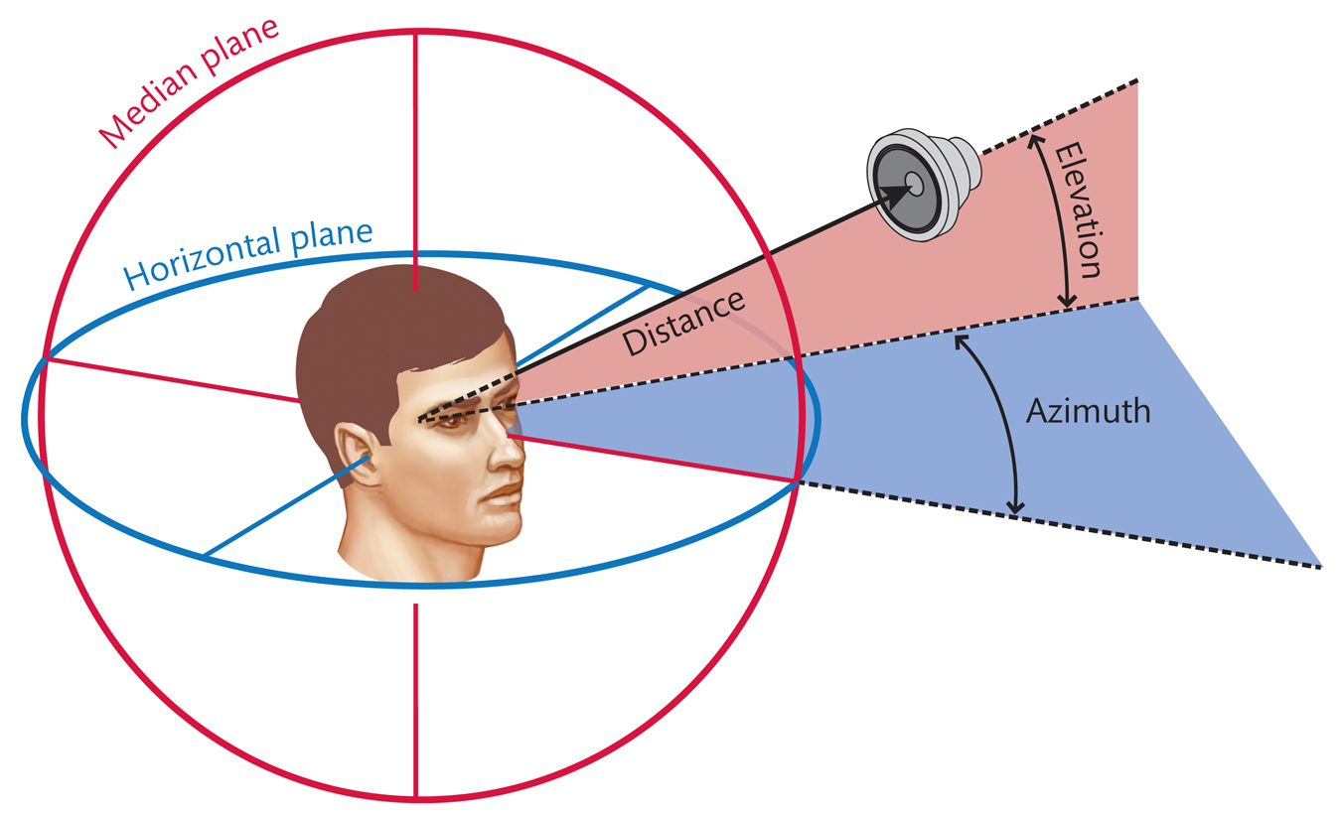
Localizing Sounds
Azimuth
Side to side dimension
Elevation
Up and down
Distance
Distance from observer

Slide 5
Localizing Sounds
Minimum audible angle
The minimum angular separation between a reference sound source and a different sound source emitting a tone of the same frequency that yields 75% correct judgements about the relative horizontal positions of the two sources
Interaural level differences (ILD)
The difference in sound level of the same two ears
Interaural time differences (ITD)
The difference in arrival time of the same sound in two ears
Acoustic shadow
An area on the other side of the head from a sound source in which the loudness of the sound is reduced because the sound waves are partially blocked by the head

Slide 6
Localizing Sounds

Slide 7
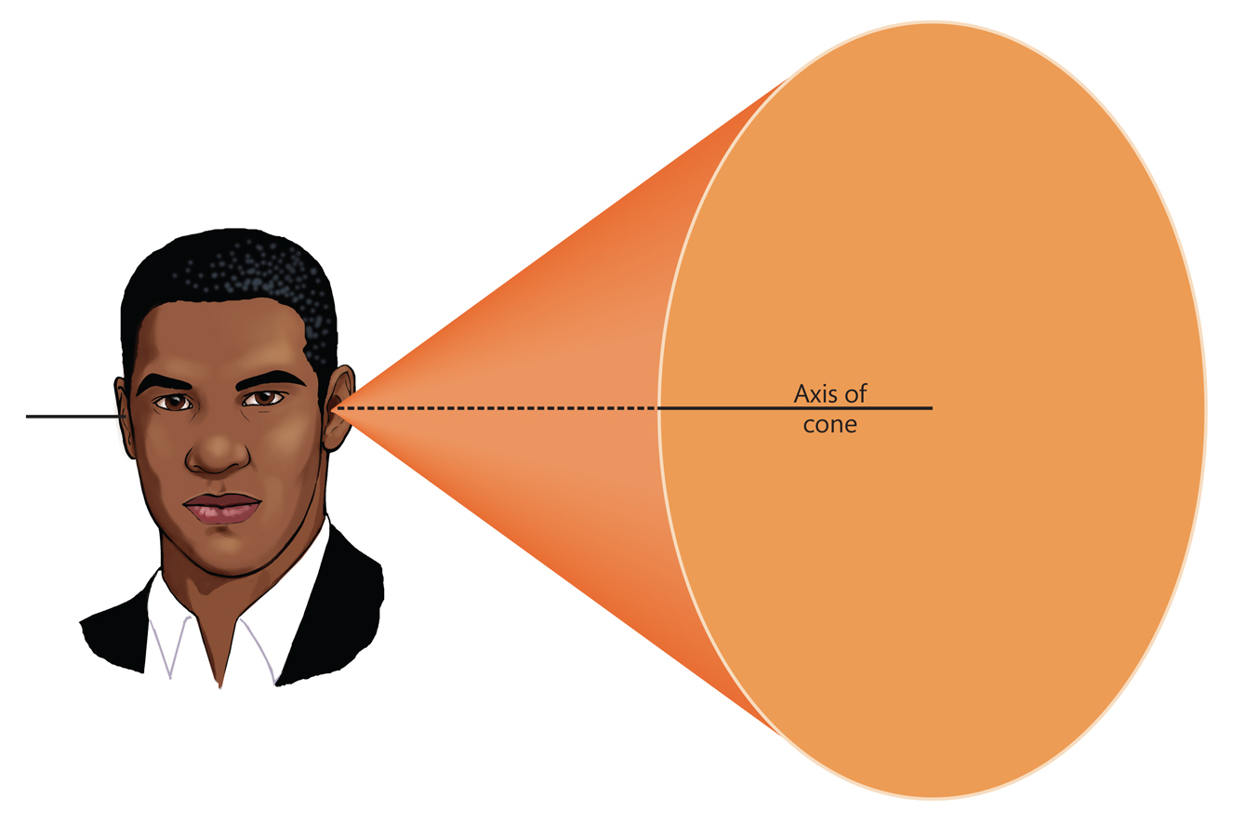
Head Motion and the Cone of Confusion
Cone of confusion
A hypothetical cone-shaped surface in auditory space; when two equally distant sound sources are located on a cone of confusion, their locations are confusable because they have highly similar ILD and ITD

Slide 8
Perceiving Elevation
Pinna
Helps funnel sound waves into the auditory canal
Spectral shape cue
A pinna-induced modification in a sound’s frequency spectrum; it provides information about the elevation of the sound source

Slide 9
Perceiving Distance
Doppler effect
The frequency of a sound emitted by a moving sound source is higher in front of the sound source than behind it; the frequency rapidly decreases as the sound source passes the listener
Distance cues
Perceived loudness (amplitude)
Perceived tone (frequency)
Echoes
Inverse Square Law

Slide 10
Vision and Sound Localization
Ventriloquism effect
The tendency to localize sound on the basis of visual cues when visual and auditory information provide conflicting cues
Vision bias influenced by:
Events must be close together in time
Events must be plausibly linked
Events must be close together in space

Slide 11
Auditory Scene Analysis
Auditory scene
All the sounds entering the ears during the current interval of time
Auditory scene analysis
The process of extracting and grouping together the frequencies emitted by specific sound sources from among the complex mixture of frequencies emitted by multiple sound sources within the auditory scene
Auditory stream
An assortment of frequencies occurring over time that were all emitted by the same sound source or related sound sources

Slide 12
Auditory Scene Analysis
Simultaneous Grouping
Grouping by harmonic coherence
Grouping by synchrony or asynchrony
Sequential Grouping
Grouping by frequency similarity
Grouping by temporal proximity

Slide 13
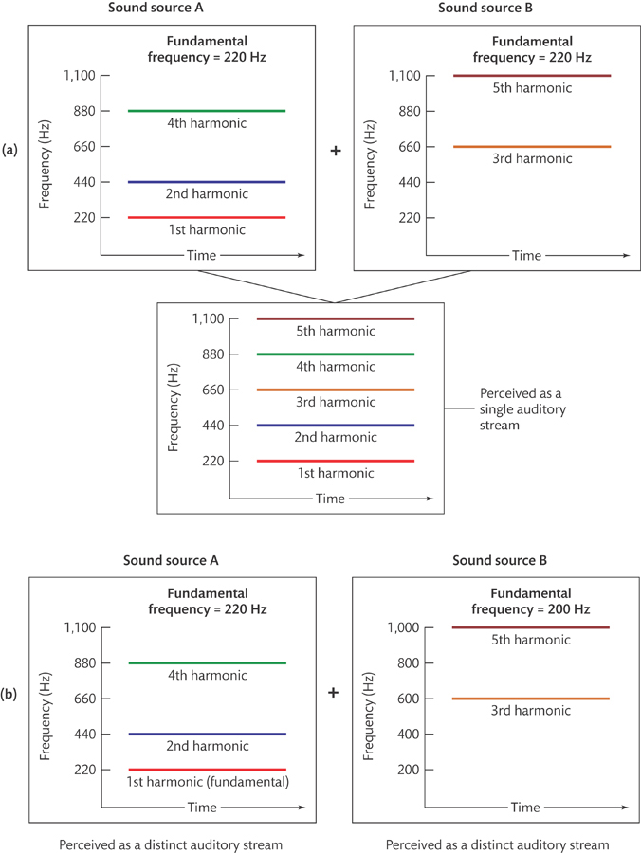
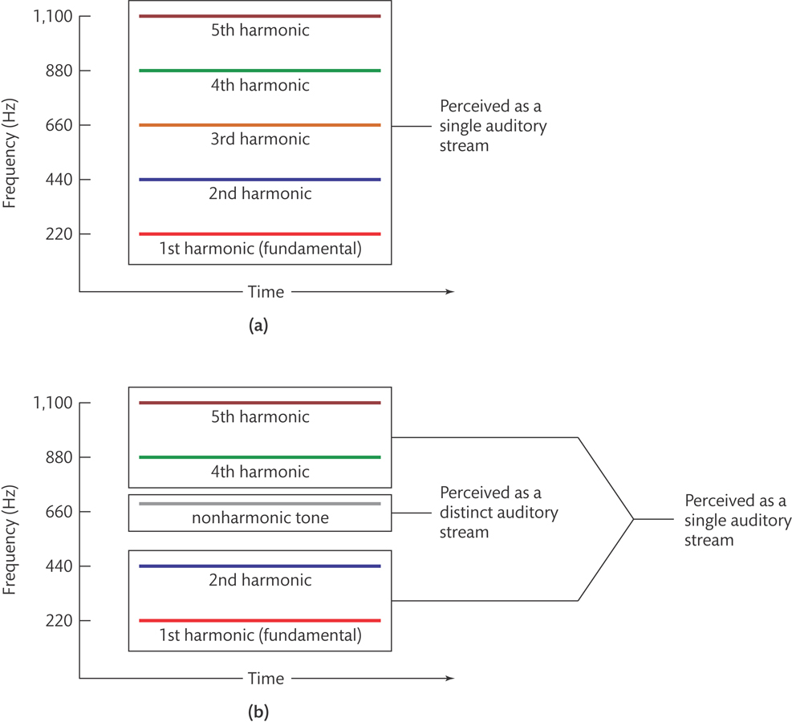
Simultaneous Grouping
Grouping by harmonic coherence

Slide 14
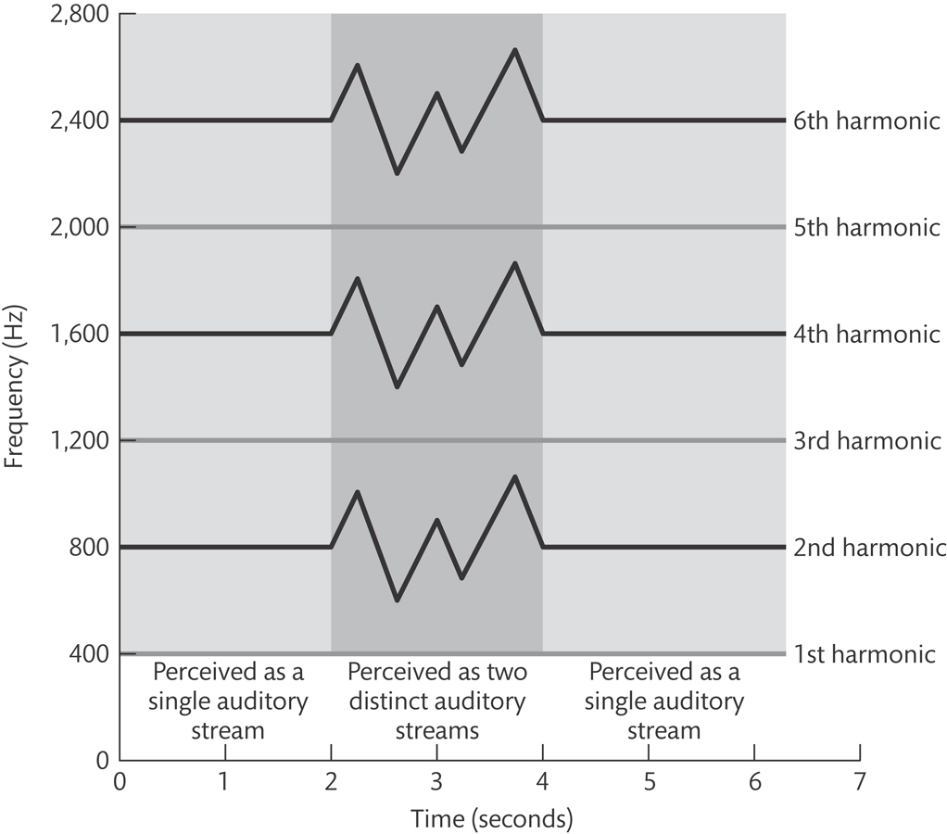
Simultaneous Grouping
Grouping by synchrony or asynchrony

Slide 15
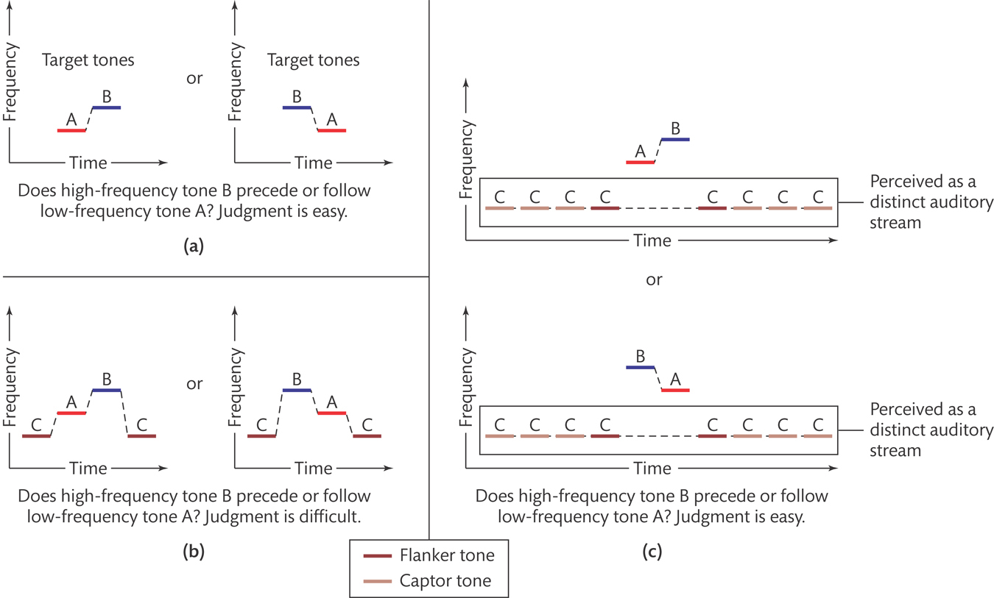
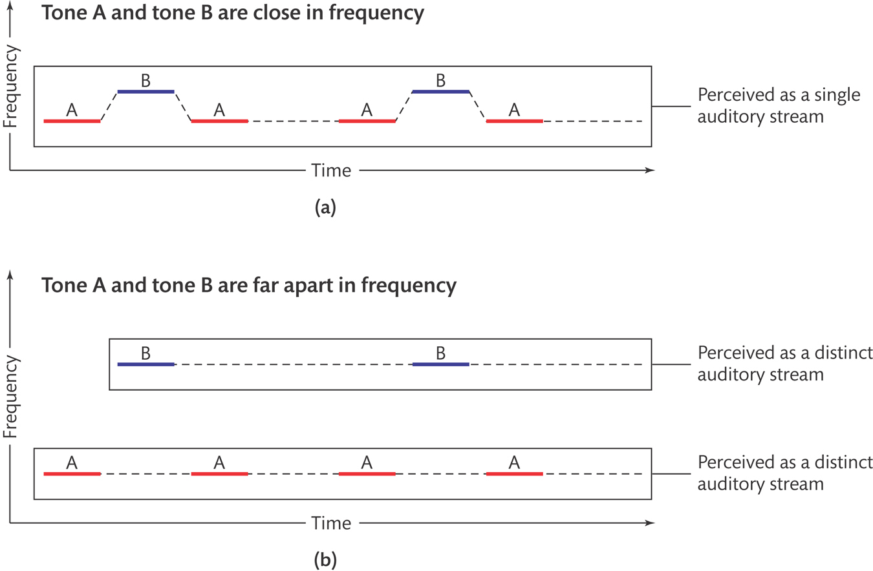
Sequential Grouping
Grouping by frequency similarity

Slide 16
Sequential Grouping
Grouping by temporal proximity

Slide 17
Perceptual Completion of Occluded Sounds

Slide 18
Video Resources
The Auditory Pathway Song
From Ear to Primary Cortex

Slide 19
Recap - The Ear

Slide 20
Recap - Middle Ear

Slide 21
Recap - Cochlea
Perilymph
A fluid that fills the tympanic and vestibular canals
Round Window
Relief valve at the base of the tympanic canal

Slide 22
Recap - Basilar Membrane

Slide 23
Recap - Organ of Corti
Each hair cell has about 50 – 150 stereocilia
Inner Hair Cells
3 500 inner hair cells
Pear shaped
Stereocilia not attached to tectorial membrane
Most important for transduction
Outer Hair Cells
3 rows of about 12 000 outer hair cells
Cylindrical
Stereocilia attached to tectorial membrane
Amplify and sharpen responses of inner hair cells
Auditory Nerve
Type 1 – 95% - Thick myelinated
Type 2 – 5% - Thinner unmylenated

Slide 24
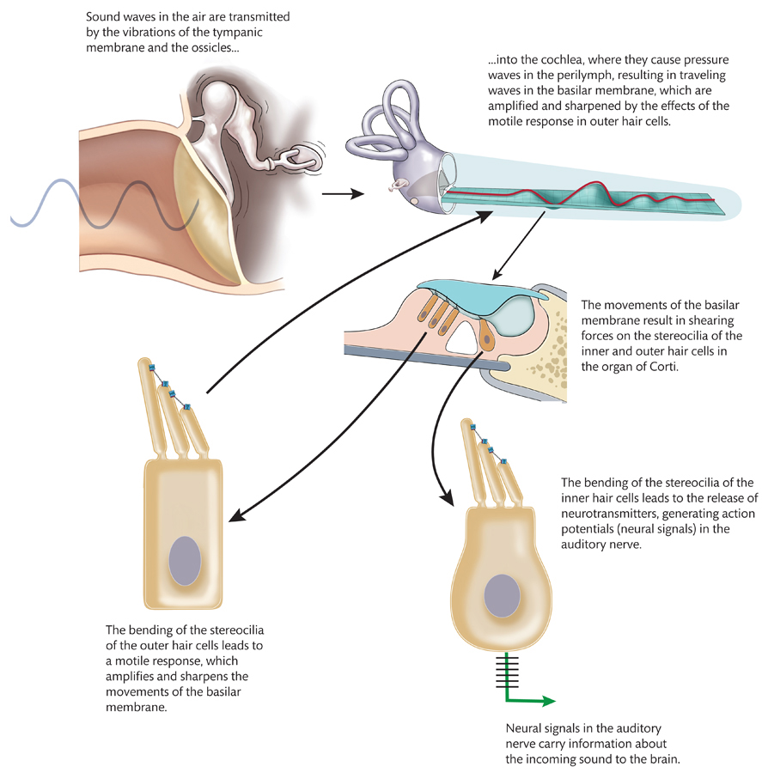
Recap - Stereocilia

Slide 25
Recap - Place Code For Frequency

Slide 26
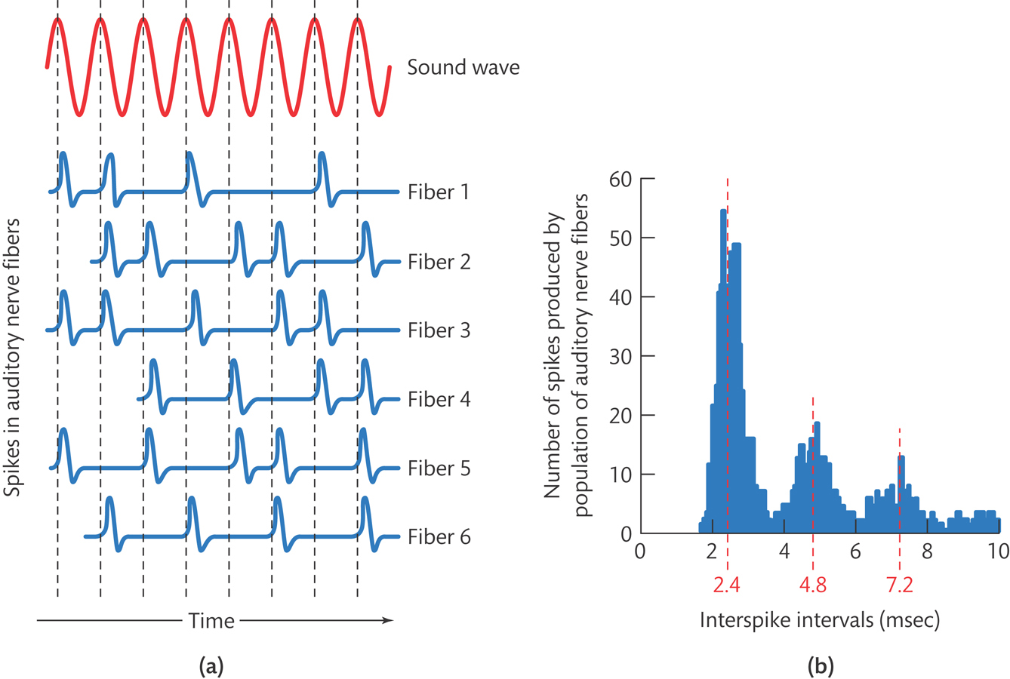
Recap - Temporal Code

Slide 27
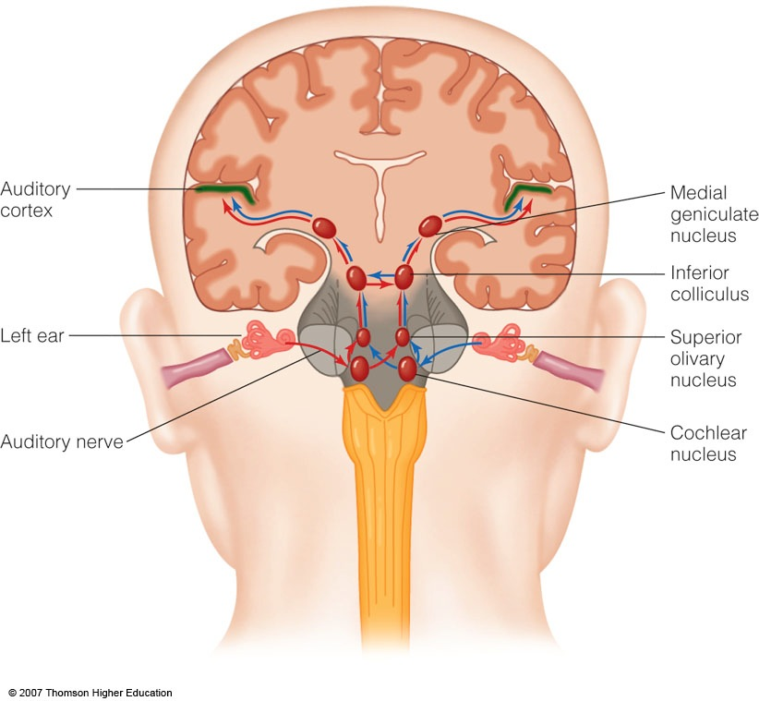
The Auditory Brain
Cochlear nucleus: The first brain stem nucleus at which afferent auditory nerve fibers synapse
Superior olive: An early brain stem region in the auditory pathway where inputs from both ears converge
Inferior colliculus: A midbrain nucleus in the auditory pathway
Medial geniculate nucleus: The part of the thalamus that relays auditory signals to the temporal cortex and receives input from the auditory cortex
Ascending & Descending Pathways

Slide 29
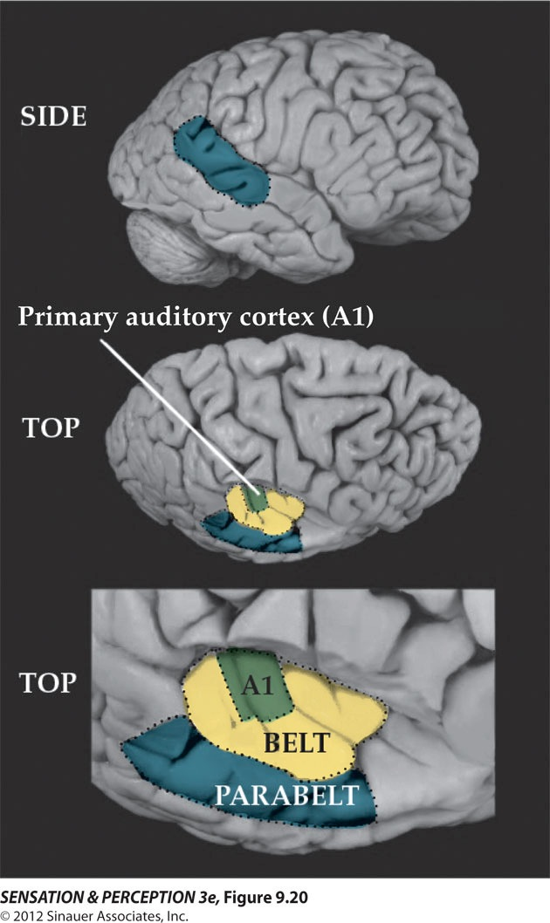
Auditory Cortex
Primary auditory cortex (A1): The first area within the temporal lobes of the brain responsible for processing acoustic organization
Belt area: A region of cortex, directly adjacent to A1, with inputs from A1, where neurons respond to more complex characteristics of sounds
Parabelt area: A region of cortex, lateral and adjacent to the belt area, where neurons respond to more complex characteristics of sounds, as well as to input from other senses

Slide 30
Auditory Cortex
Auditory core region
Rostral core
Rostrotemporal core
Tonotopic map
An arrangement of neurons within the auditory brain regions such that the characteristic frequencies of the neurons gradually shift from lower at one end of the region to higher at the other end

Slide 31
Auditory Cortex
Ventral pathway
What?
Dorsal pathway
Where?

Slide 32
Neural Basis for Sound Localization
Medial Superior Olive (MSO)
Thought to contain neurons that function as a mechanism for detecting specific ITD, thus representing sound sources.

Slide 33
Questions?

