Slide 1
Fundamentals of Sensation and Perception
Speech
Erik Chevrier
October 28th, 2015

Slide 2
Video
Tom Thum: Orchestra in my Mouth
Michael Tilson Thomas: Music and Emotion Through Time
Victor Wooten: Music as a Language

Slide 3
Revised Course Schedule
October 26 & 28 Perceiving Speech and Music Chapter 11
November 2 Group Project – Preliminary Assessment Due
November 4 & 9 Light and the Eyes Chapter 2
November 11 & 16 Visual Brain Chapter 3
November 18 & 23 Recognizing Visual Objects Chapter 4
November 25 Group Project & Revision for Exam
November 30 Final Exam
Dec 2,7 & 8 Class Presentations

Slide 4
The Sound of Speech
Phonemes
Basic sounds of a language
International Phonetic Alphabet (IPA)
Each symbol stands for a different speech sound

Slide 5
Production of Speech

Slide 6
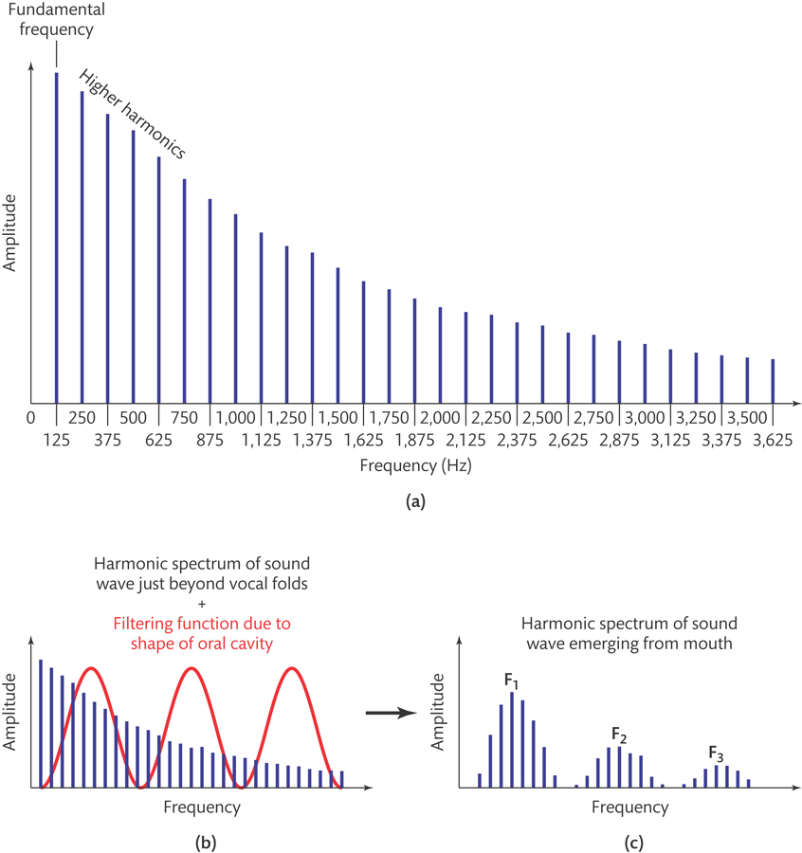
Production of Speech - Producing Vowels
Relatively unrestricted airflow
Formant

Slide 7
Production of Speech - Producing Consonants
Place of articulation – place of restriction
Manner of articulation – nature of restriction
Voicing – voice or voiceless

Slide 8
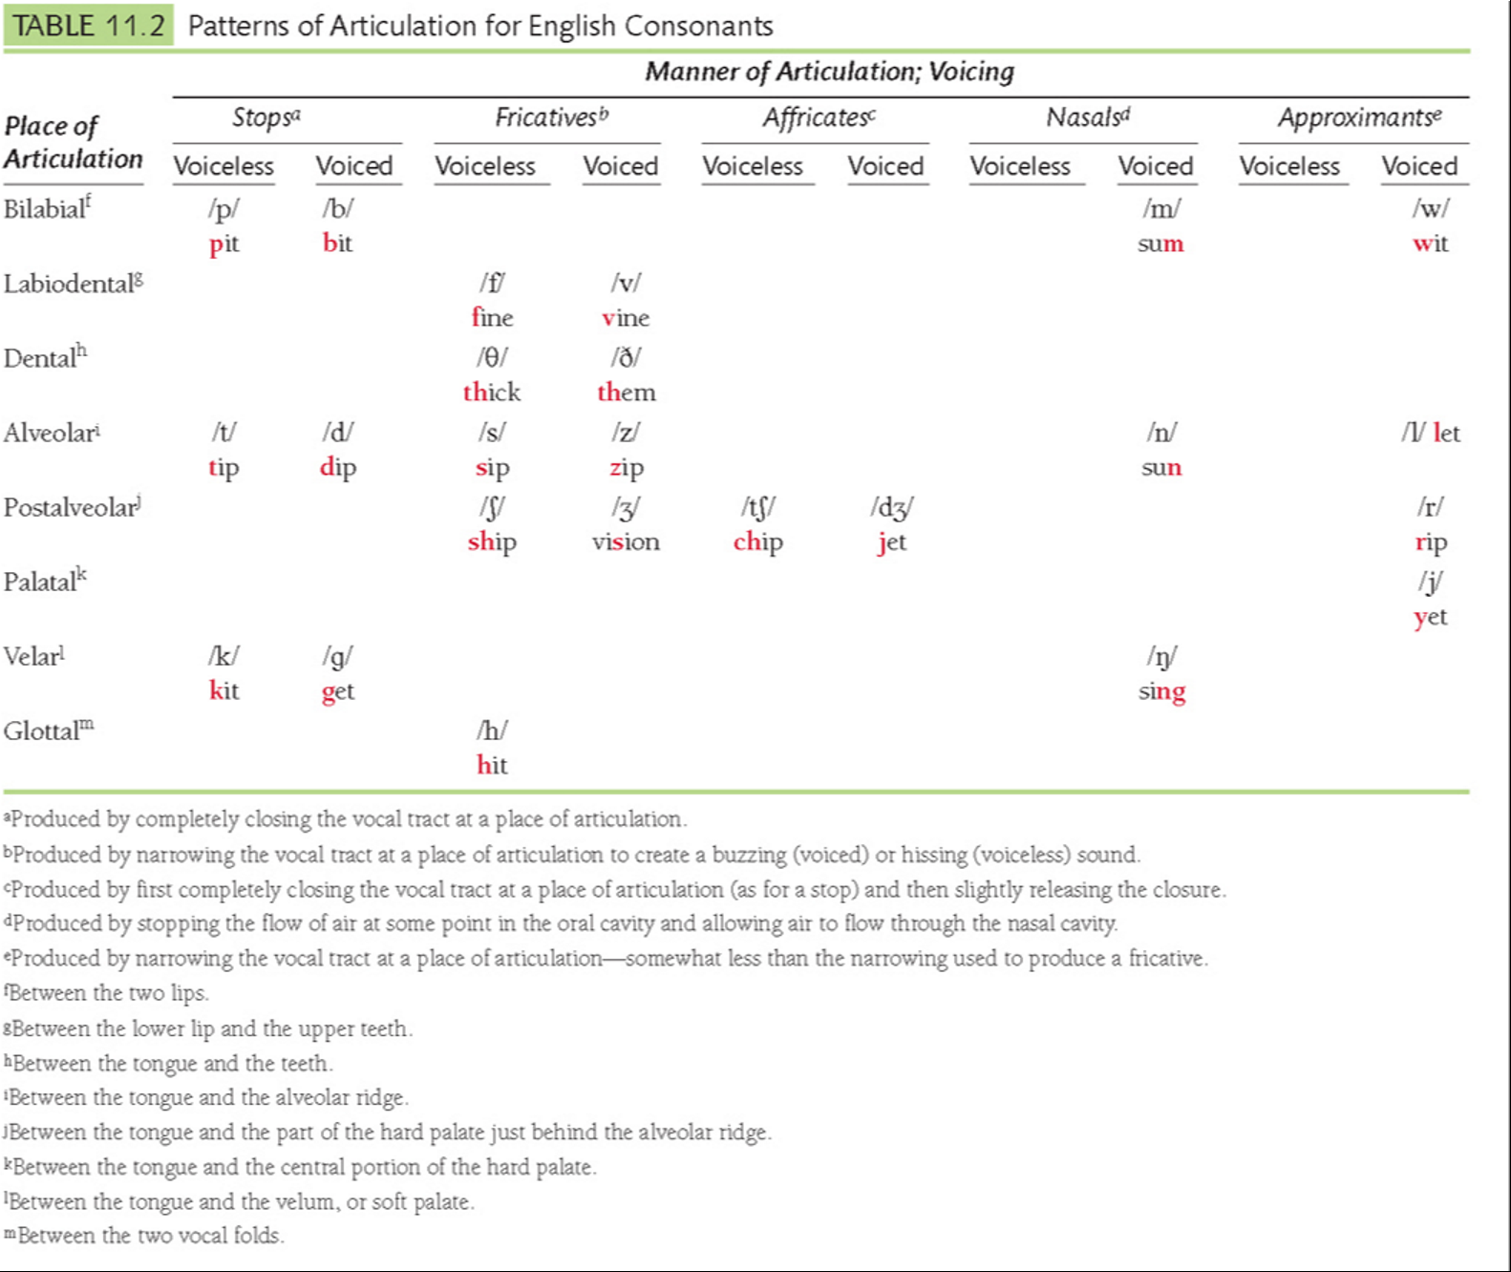
Pit
Bit
Tip
Dip
Fine
Vine
Sip
Zip
Kit
Get
Ship
Vision
Thick
Them

Slide 9
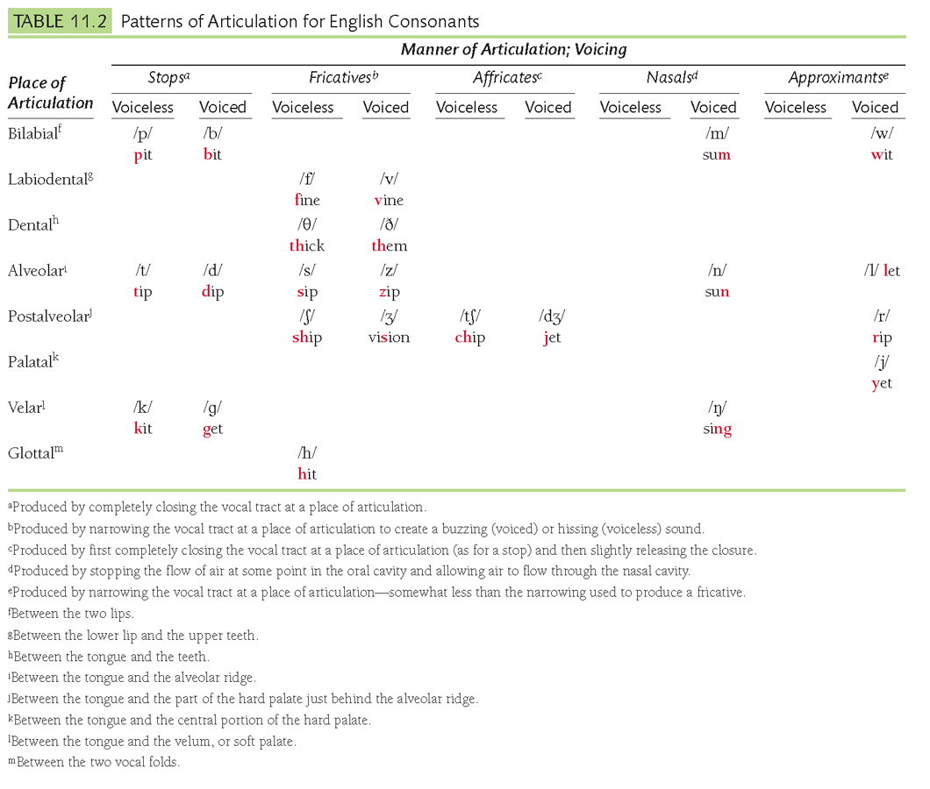

Slide 10
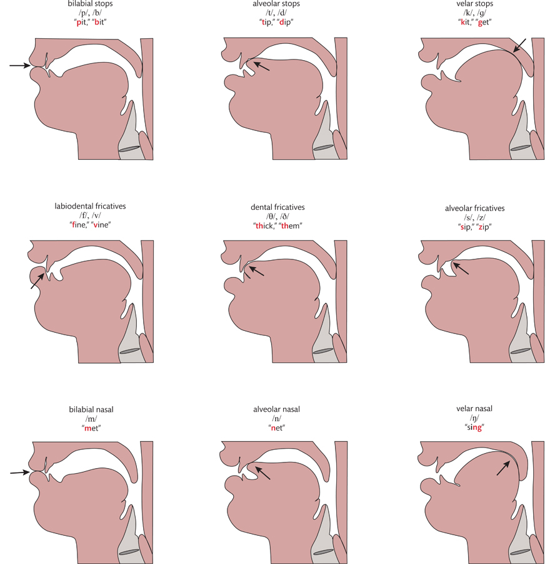

Slide 11
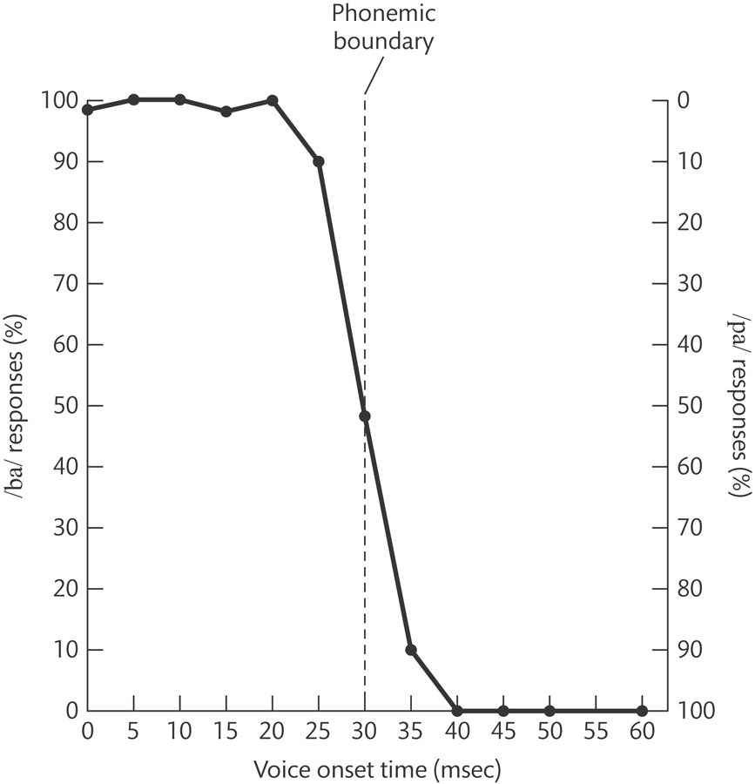
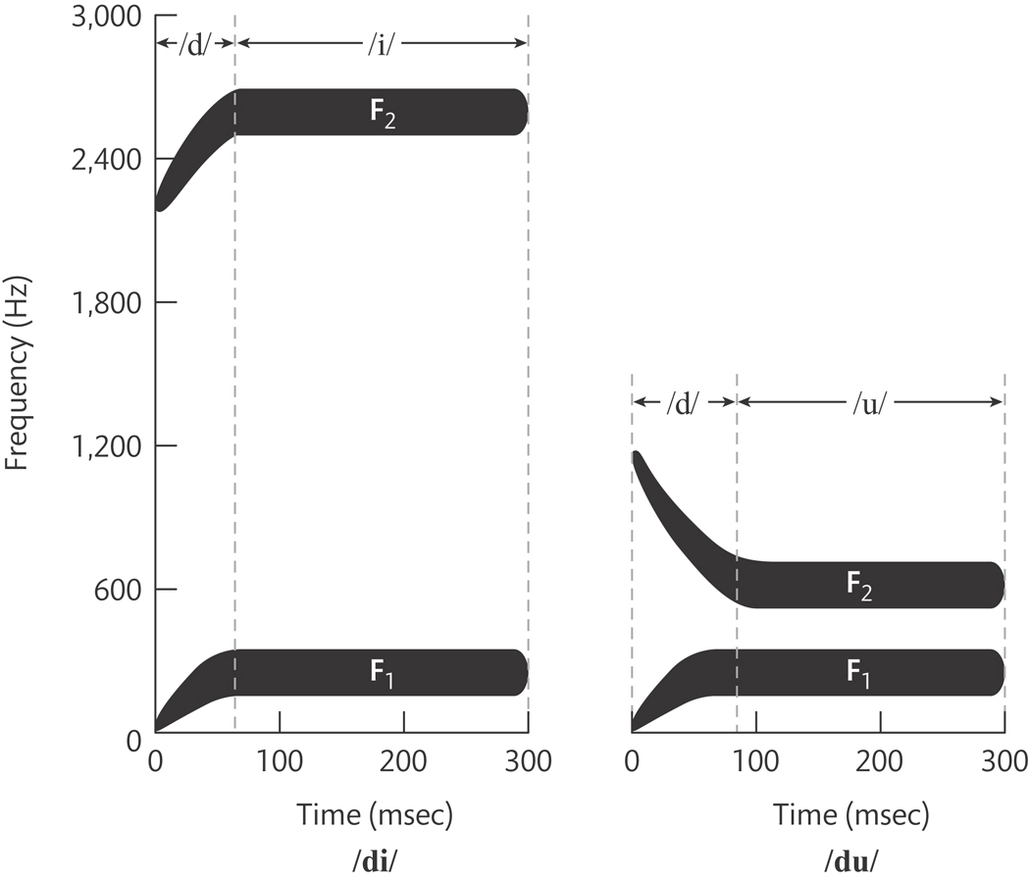
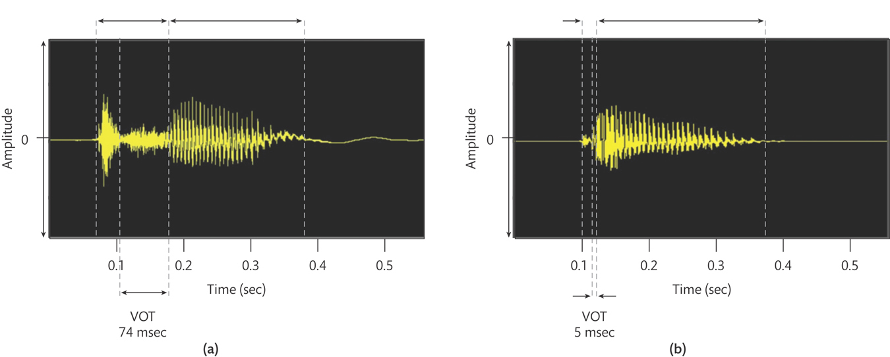
Perceiving the Sound of Speech
Coarticulation and Perceptual Consistency
Categorical Perception of Phonemes
Phonemic boundary
Vision and Speech Perception
McGurk Effect
Knowledge and Speech Perception
Probability of sequences & context
Word segmentation & Perceptual completion

Slide 12
Neural Basis of Speech Perception and Production

Slide 13
Questions?

