Slide 1
Fundamentals of Sensation and Perception
Sound and the ears
Erik Chevrier
October 6th, 2015

Slide 2
Videos
The Four Ways Sound Affects Us
The Mad Scientist of Music
Orchestra in my Mouth
Unlocking Music With Neuroscience
Music on the Brain

Slide 3
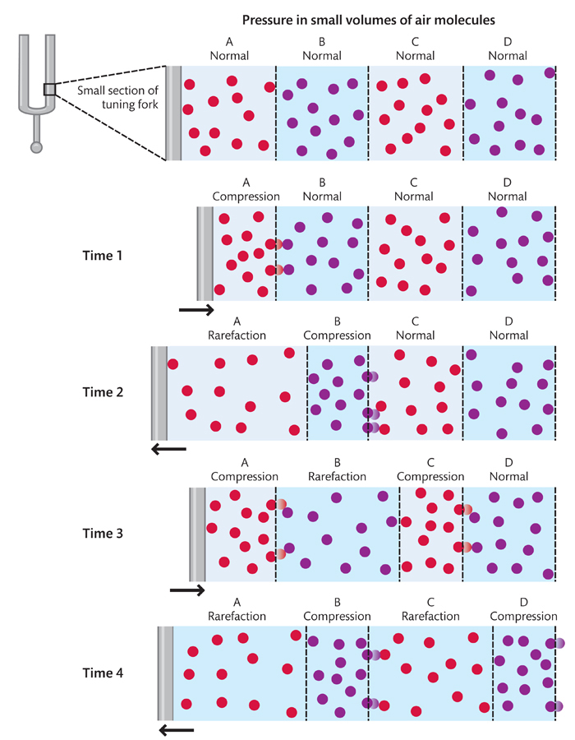
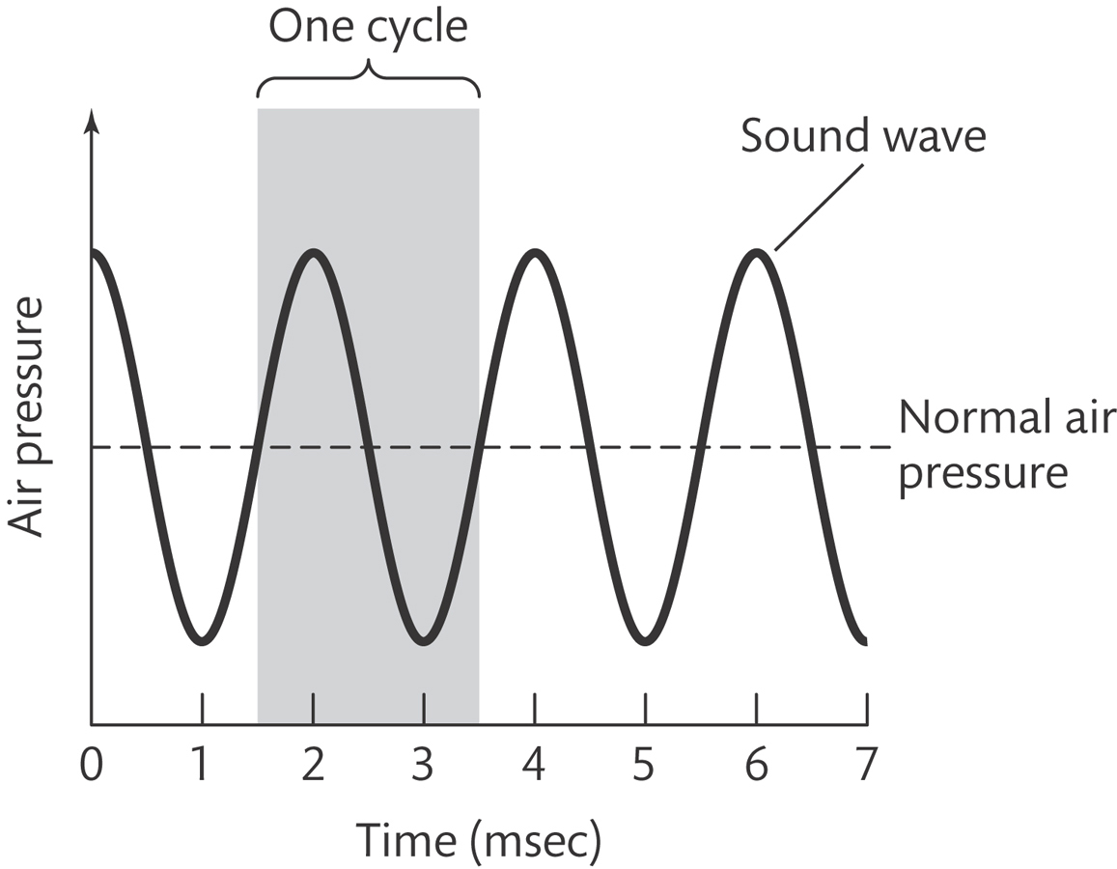
What is Sound?
Physical definition
Sound is pressure changes in the air (or other medium)
Perceptual definition
The experience we have when we hear

Slide 4
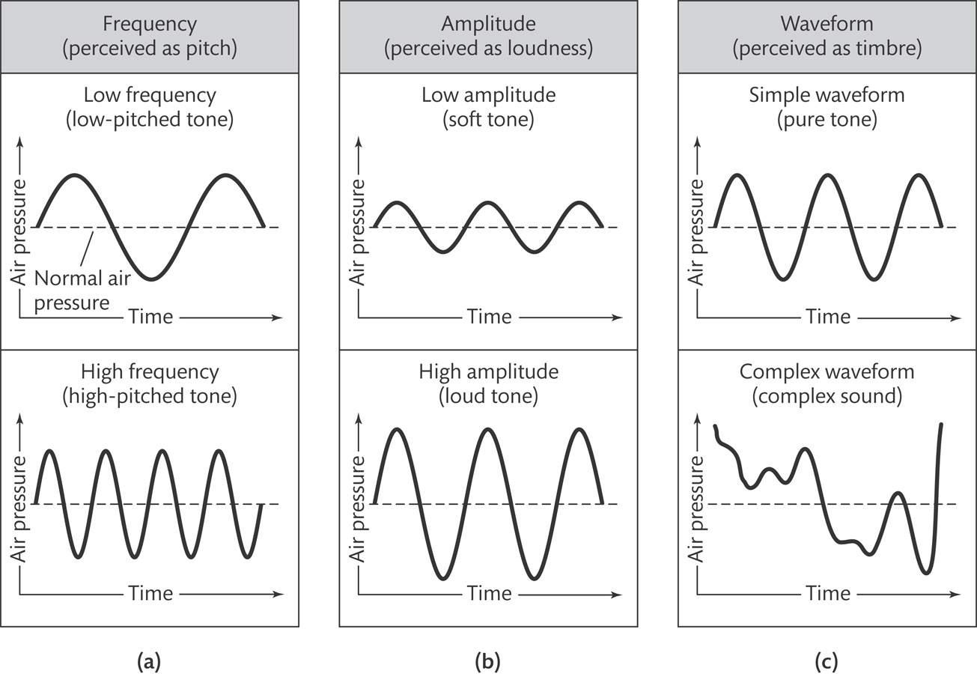
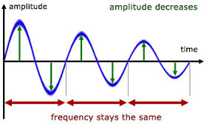
Physical and Perceptual Dimensions of Sound
Physical
Perceptual
Frequency Amplitude Waveform
Pitch Loudness Timbre

Slide 5
Physical and Perceptual Dimensions of Sound
Periodic sound waves
Cycles of compression and rarefaction repeat in a regular, or periodic, fashion
Pure tone
Simplest periodic soundwave (sine wave or sinusoid)

Slide 6
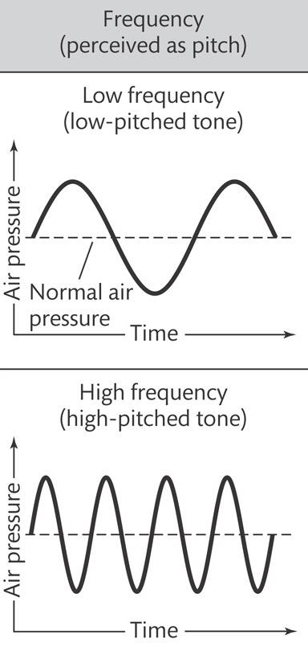
Frequency and Pitch
Related to pitch
High frequency = High pitch
Expressed in units called Hz
Number of cycles/second
1 000 Hz = 1 000 cycles/second
Range of young adult hearing
20Hz – 20 000Hz

Slide 7
Amplitude and Loudness
Amplitude of a pure tone is the difference between the maximum and minimum sound pressure in the wave
Amplitude is related to loudness
Expressed in:
Decibels (dB)
(Micro) Pascals
Watts per square metre

Slide 8
Amplitude and Loudness
dB SPL = 20log(p/po)
P = Micropascals
Po = 20uPa = Pressure of 1 000 Hz tone at threshold
Example
20 000 Micropascals
dB = 20 log(20 000/20)
dB = 20 log (1000)
dB = 20 X 3
dB= 60

Slide 9
Audibility Curve

Slide 10
Equal Loudness Contours
Equal Loudness Contour
A curve showing the amplitude of tines at different frequencies that sound equally loud
Phon
The numerically equal to the amplitude of a
1 000 Hz
1 000Hz tone at 10 dB = 10 Phons
1 000Hz tone at 20 dB = 20 Phons

Slide 11
Waveform and Timbre
Fourier analysis
A mathematical procedure for decomposing a complex waveform into a collection of sine waves with various frequencies and amplitudes
Fundamental frequency
The frequency of the lowest-frequency component of a complex waveform; determines the perceived pitch of the sound

Slide 12
Waveform and Timbre
Harmonic
Each component of frequency of a complex waveform that is an integer multiple of the fundamental frequency
Fundamental frequency = 1st harmonic Twice the fundamental frequency = 2nd harmonic Three times the fundamental frequency = 3rd harmonic
Overtones = second + harmonics
Timbre
Difference between the quality of two sounds with the same pitch and loudness

Slide 13
Timbre
Attack and decay also play a factor in timbre
Illusion of the missing fundamental

Slide 14
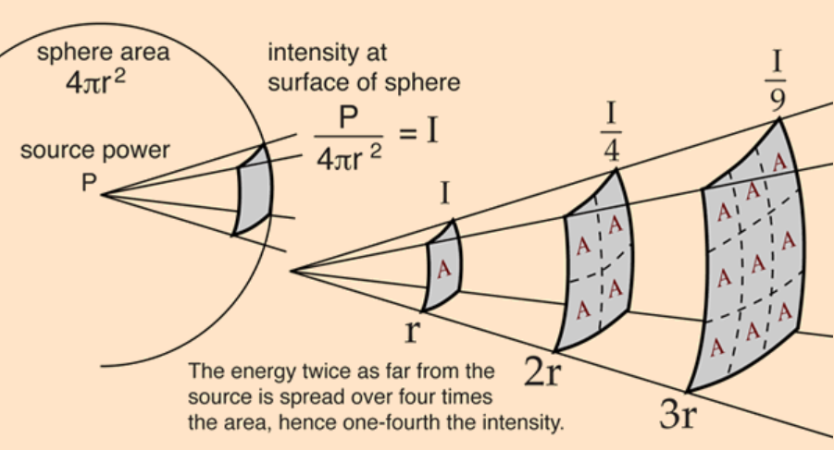
Inverse Square Law
The energy of sound decreases in proportion to the square of the distance from the source

Slide 15
The Ear

Slide 16
Middle Ear

Slide 17
Cochlea
Perilymph
A fluid that fills the tympanic and vestibular canals
Round Window
Relief valve at the base of the tympanic canal

Slide 18
Basilar Membrane

Slide 19
Organ of Corti
Each hair cell has about 50 – 150 stereocilia
Inner Hair Cells
3 500 inner hair cells
Pear shaped
Stereocilia not attached to tectorial membrane
Most important for transduction
Outer Hair Cells
3 rows of about 12 000 outer hair cells
Cylindrical
Stereocilia attached to tectorial membrane
Amplify and sharpen responses of inner hair cells
Auditory Nerve
Type 1 – 95% - Thick myelinated
Type 2 – 5% - Thinner unmylenated

Slide 20
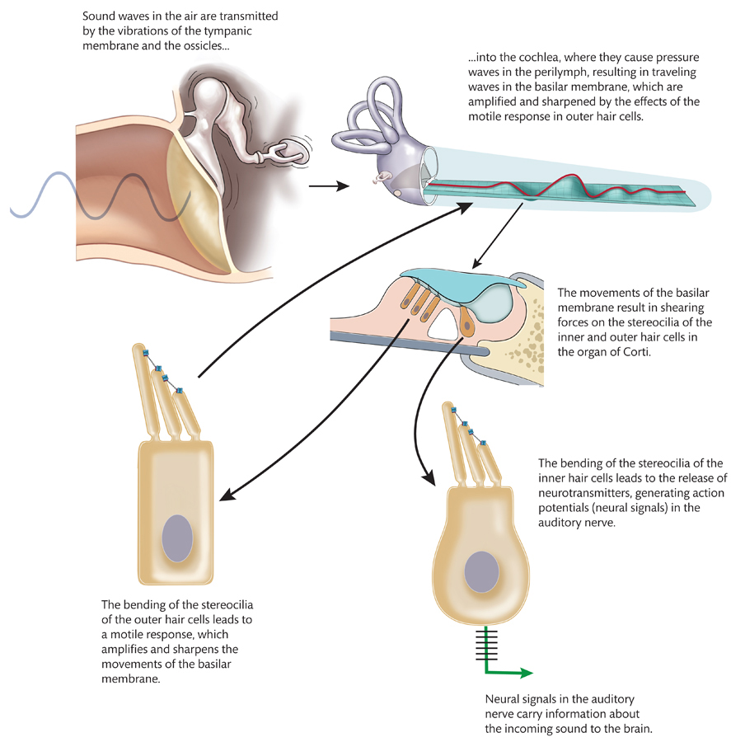
Stereocilia

Slide 21
Videos
Cymatics
Orchestra in my Mouth
Unlocking Music With Neuroscience
Music on the Brain
Transmission of Sound – Animated Video
The Human Cochlea – Animated Video
Organ of Corti – Animated
Auditory Transmission – Animated Video

Slide 22
Video Lessons
Auditory Structure
Auditory Processing
How Sound is Transferred to the Inner Ear

Slide 23
Discussion
Describe the patterns of complex waveforms that could be heard at:
A dance club A sporting event On a beach At a construction site

Slide 24
Neural Representation of Frequency and Amplitude
Place code for frequency
Temporal code for frequency

Slide 25
Place Code For Frequency

Slide 26
Place Code For Frequency - Evidence

Slide 27
Place Code For Frequency - Evidence

Slide 28
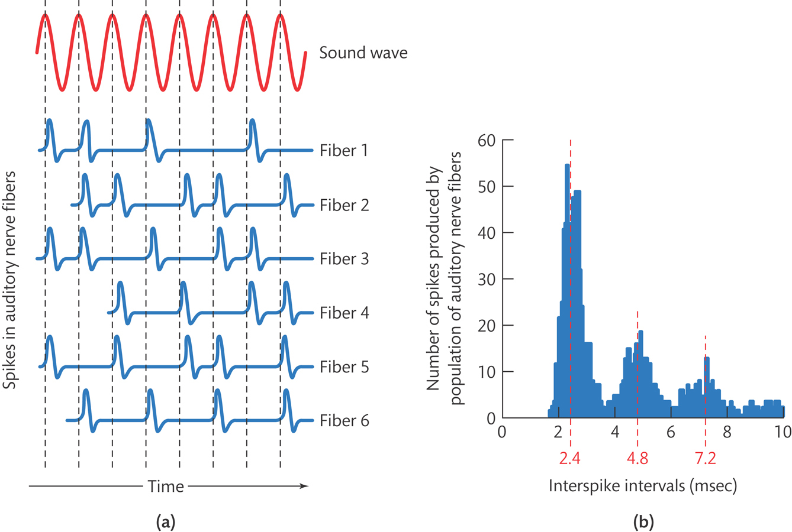
Temporal Code

Slide 29
Amplitude Representation

Slide 30
Disorders of Audition
Tinnitus
A persistent perception of sound (ringing or buzzing) not caused by actual sound.
Conductive Hearing Impairments
Loss of sound conduction to the cochlea as a result of problems in the outer or middle ear
Sensorineural Hearing Impairments
Hearing impairments caused by damage to the cochlea, the auditory nerve, or the auditory pathways of the brain
Aging
Noise induced

Slide 31
Age related Sensorineural impairments

Slide 32
Effects of Hair Cell Death and Hearing Level

Slide 33
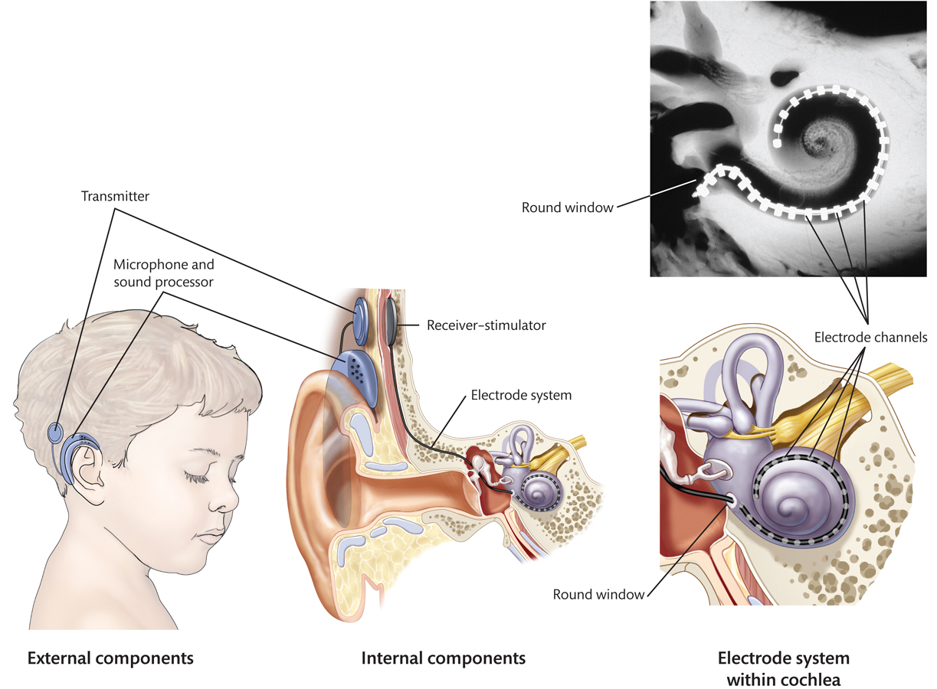
Cochlear Implants
Cochlear Implants

Slide 34
Questions?

