Slide 1
Fundamentals of Sensation and Perception
Disorders of vision
Erik Chevrier
November 17, 2015

Slide 2
Strabismus and Amblyopia
Strabismus
A disorder of the extracellular muscles in which the two eyes are not aligned with one another, resulting in a double image, which impairs binocular depth perception.
Eyeglasses, extraocular surgery.
Amblyopia
A condition in which both eyes develop normally but the neural signals from one eye aren’t processed properly.
Patching stronger eye early in life (before 5)

Slide 3
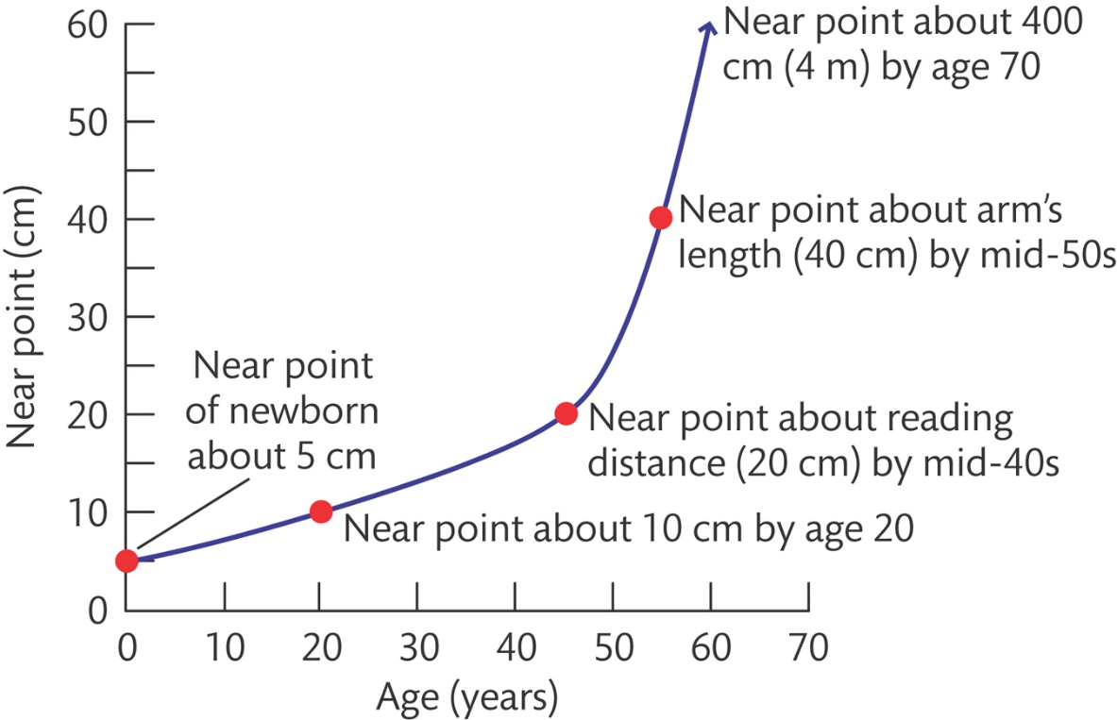
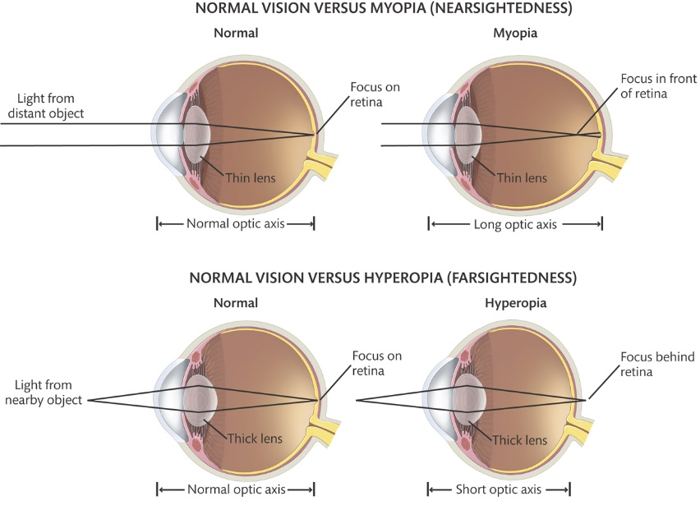
Disorders of Accommodation
Myopia
Hyperopia
Presbyopia
Astigmatism

Slide 4
Retinal Disease
Retinitis Pigmentosa – an inherited condition which there is gradual degeneration of the photoreceptors over many years.
Causes tunnel vision
No treatment
Macular Degeneration – Damage to photo receptors in the macula.
Dry – Cells degenerate in the pigment epithelium which cause the loss of photo receptors overlaying those cells.
Wet – New blood vesicles grow under the retina, leak fluid, bleed and scar.
Causes blind spots
No treatment for dry form. Wet form can be treated with drugs that block the growth of of new blood cells

Slide 5
Various Vision Disorders
Cataract
Clouding of the lens that can, if left untreated, lead to blindness.
Causes: diabetes, UV rays aging
Surgery: Replacement lens
High Intracellular Pressure: Glaucoma
A condition where the intracellular pressure is too high for the person’s eye, most commonly caused by blockage of the openings that let aqueous humor drain from the anterior chamber.
Causes: blockage of the openings that let aqueous humor drain from the anterior chamber
Surgery: Drugs, laser, surgery
Floaters and Phosphenes
What are all those Floaty Things in Your Eye?

