Slide 1
Fundamentals of Sensation and Perception
Recognizing Visual Objects
Erik Chevrier
November 24, 2015

Slide 2
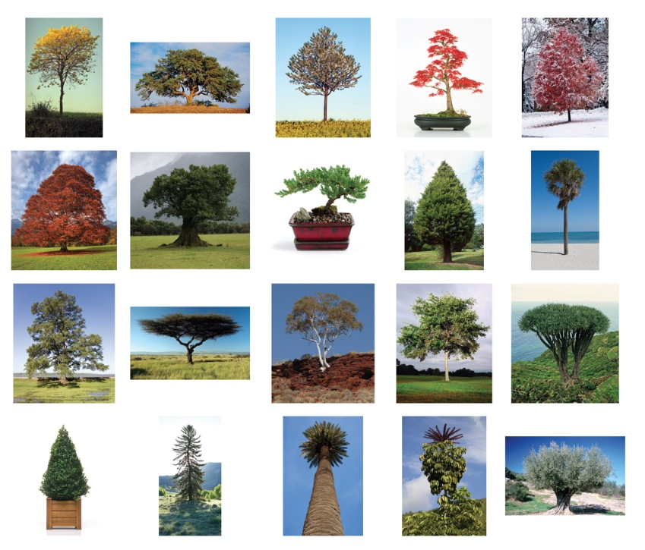
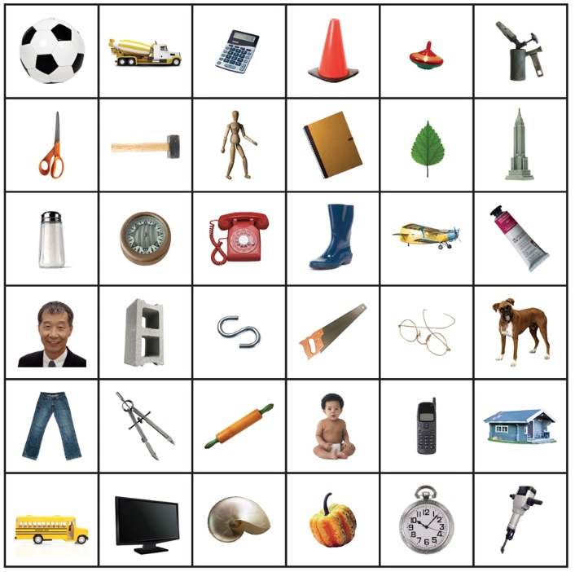
Basic Considerations
Image Clutter
Object Variety
Variable Views

Slide 3
Representation / Recognition
Representation refers to a pattern of neural activity in the brain that contains information about a stimulus and gives rise to a subjective perceptual experience of that stimulus.
Recognition refers to the process of matching the representation of a stimulus to a representation stored in long term memory, based on pervious encounters with that stimulus or with similar stimuli.

Slide 4
Perceptual Organization & Object Recognition
Perceptual Organization:
Represents edges – abrupt, elongated changes in brightness and/or colour.
Represents uniform regions bounded by edges.
Divide these regions into figure and ground, and assign border ownership.
Group together regions that have similar properties
Fill in the missing edges and surfaces – that is, edges and surfaces that are partly occluded – to obtain more complete representations of candidate objects.
Object Recognition:
Use higher-level processes to represent objects fully enough to recognize them, by matching their representations to representations stored in memory.

Slide 5
Perceptual Organization & Object Recognition
Figure (object)
Ground (background)
Border ownership (border/region)
Perceptual grouping (group regions that are similar)
Perceptual interpolation (represent entirety of a partially visual object)

Slide 6
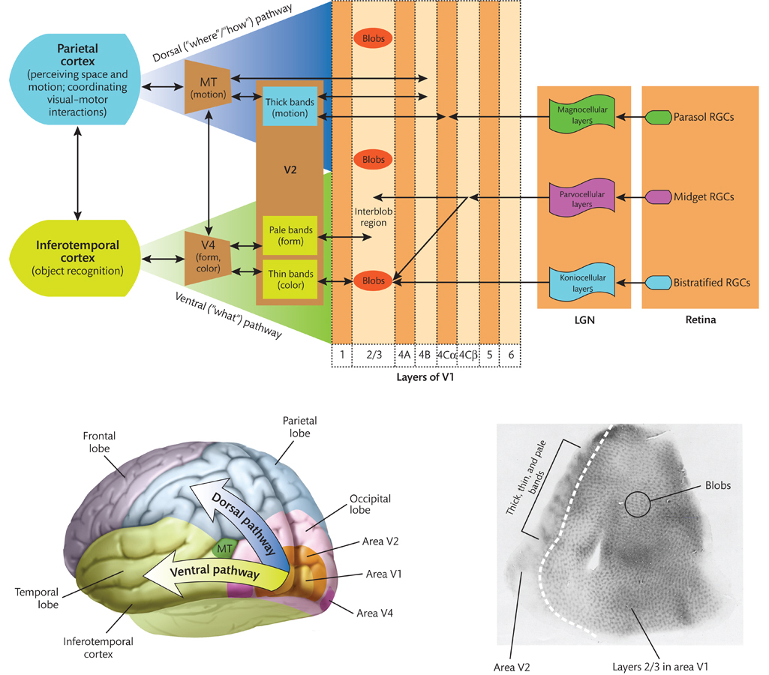

Slide 7
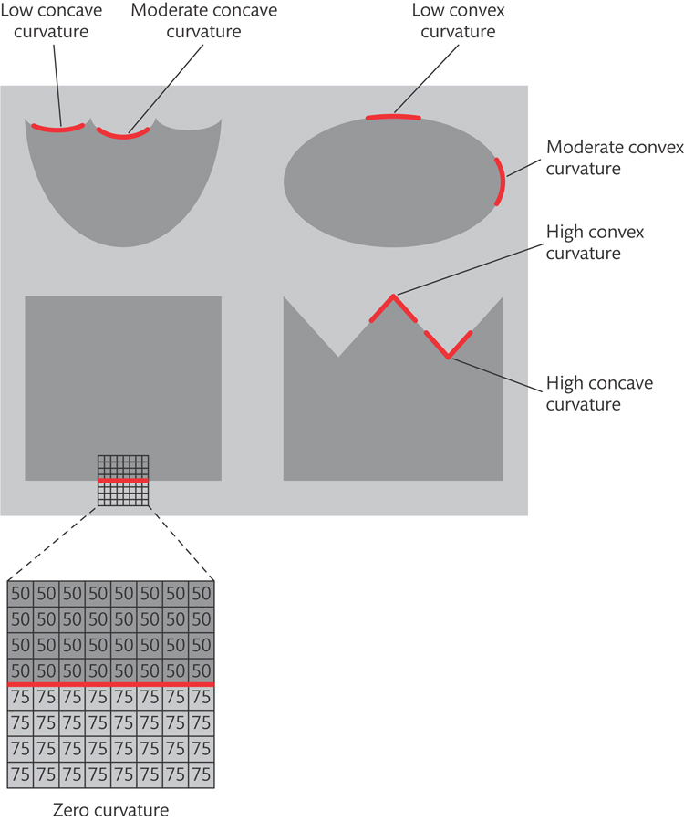
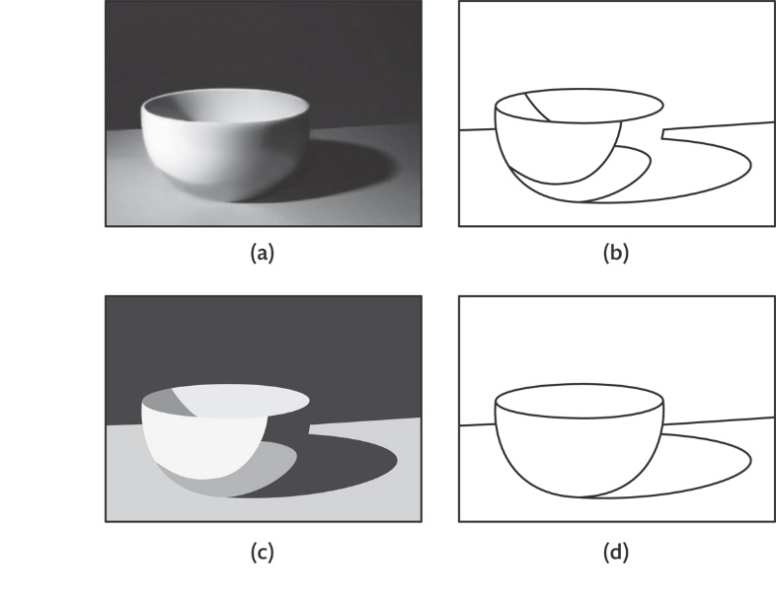
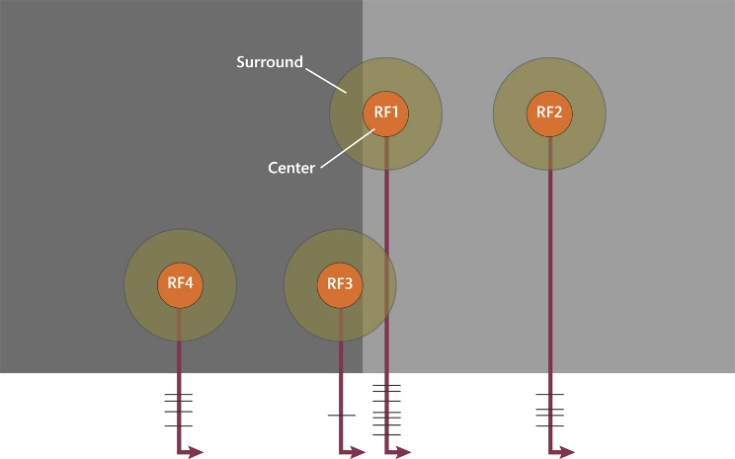
Perceptual Organization
Edges and Regions
Uniform connectedness
Image clutter – occlusion, shading, shadows

Slide 8
Figure-Ground: Assigning Border Ownership

Slide 9
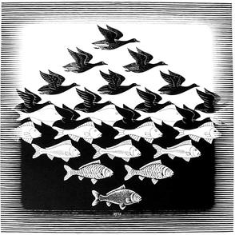
Figure-Ground

Slide 10
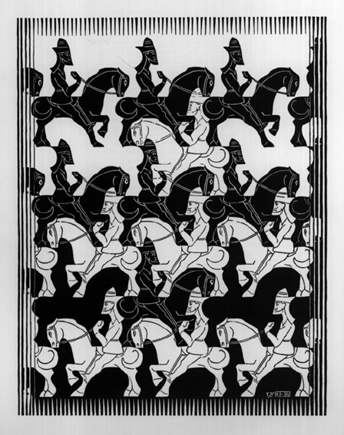
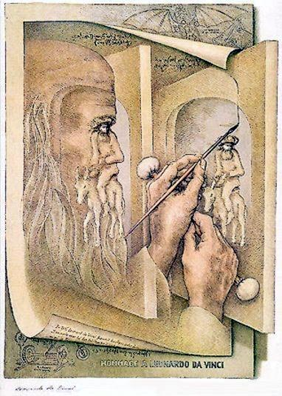
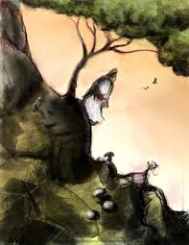
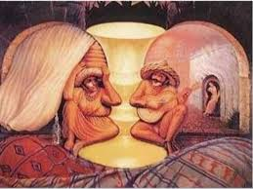
Figure-Ground

Slide 11
Principles of Figure-Ground Organization
Depth – Things in front own the border between regions and is perceived as the figure.
Surroundedness – A region completely surrounded by another region tends to be perceived as owning the border and also perceived as the figure
Symmetry – A region with symmetrical borders are more likely seen as the figure than as the ground
Convexity – Convex borders are more likely to be seen as belonging to the figure than concave borders
Meaningfulness – Patterns that correspond to objects and shapes in our memory are identified more easily
Simplicity – Visual system is biased to interpret any image in the simplest way possible

Slide 12
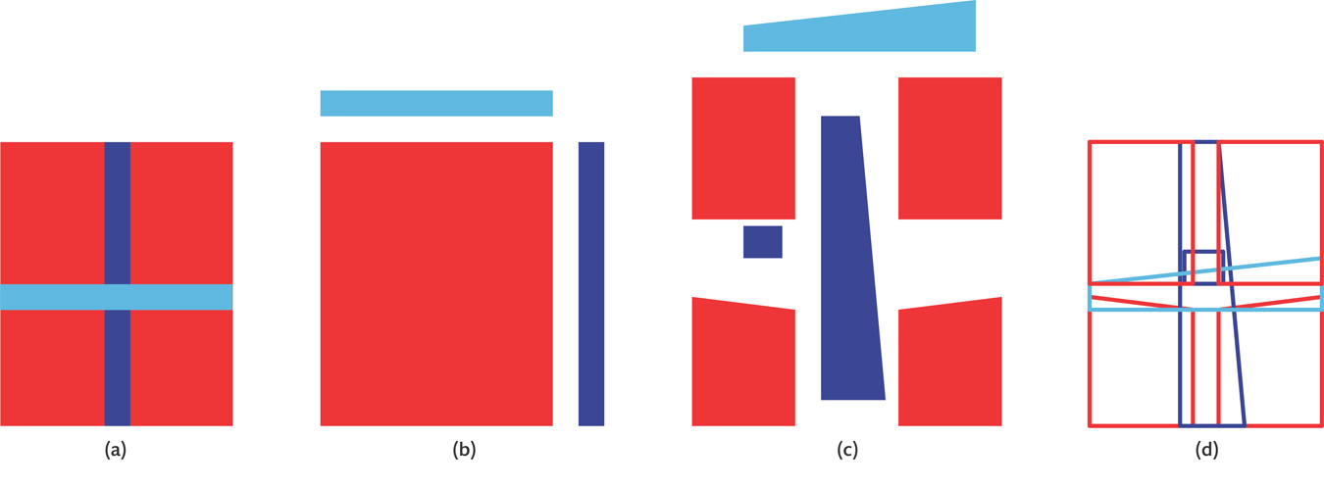
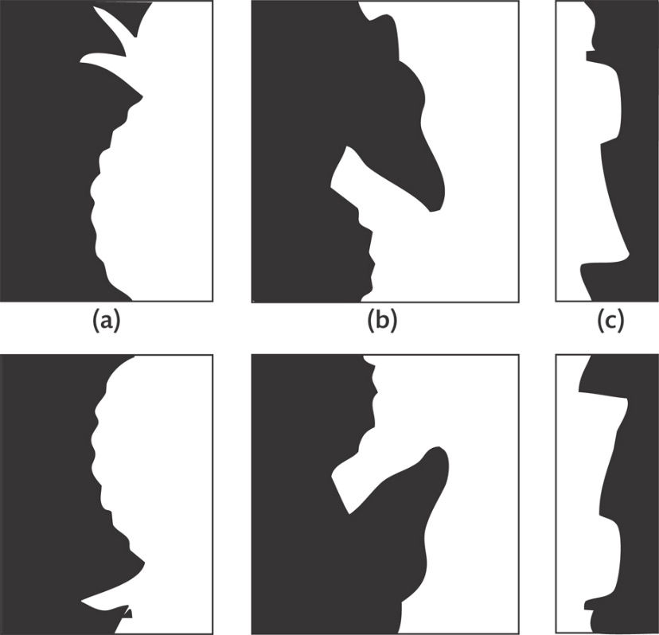
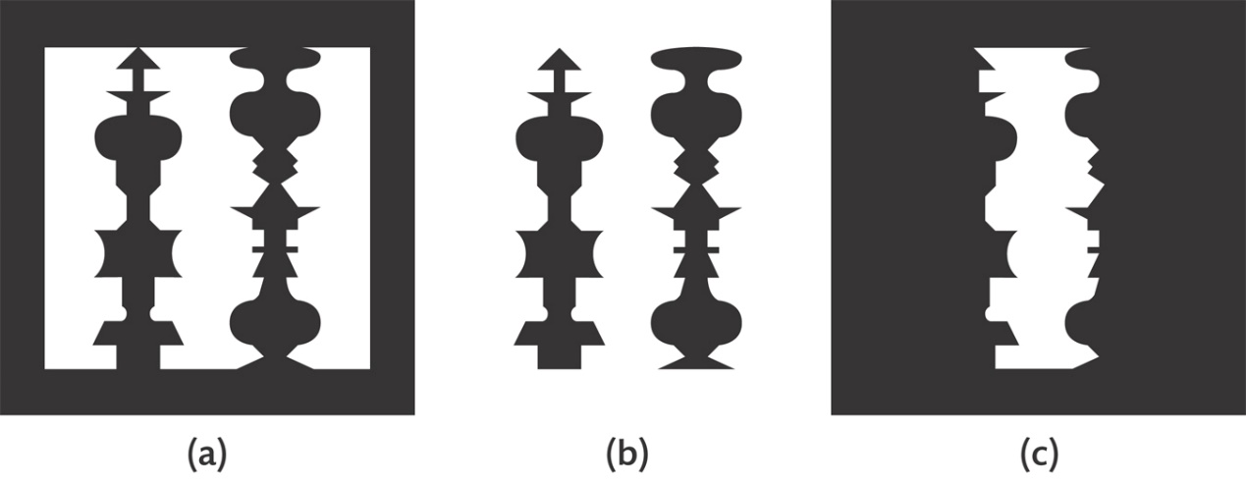

Slide 13
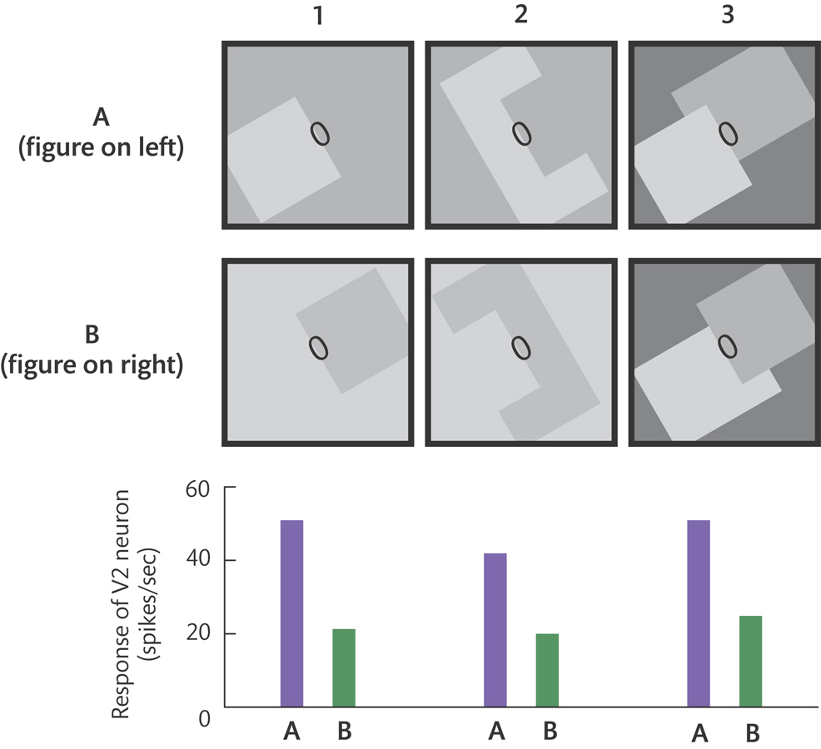
Neural Basis of Border Ownership Assignment
V2 Area

Slide 14
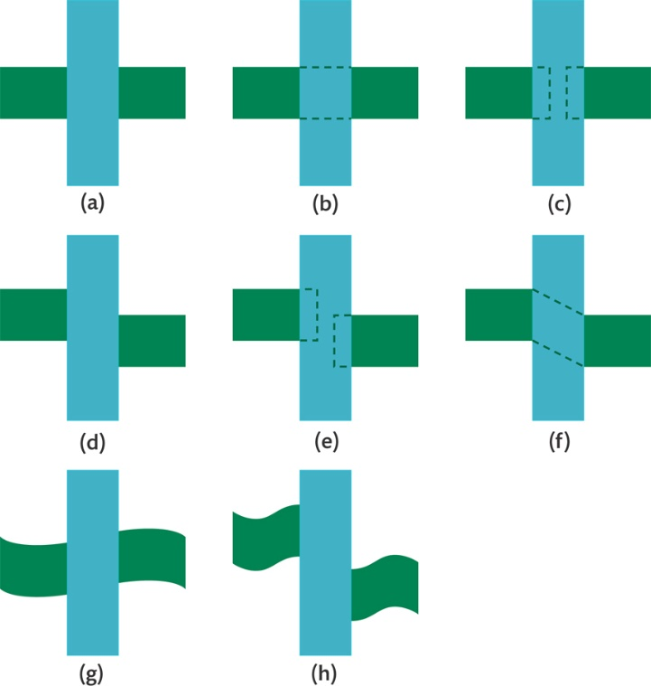
Perceptual Grouping: Combining Regions
(i) good continuation

Slide 15
Neural Basis for Perceptual Grouping
Similarity
Good Continuation
Common Motion

Slide 16
Perceptual Interpolation

Slide 17
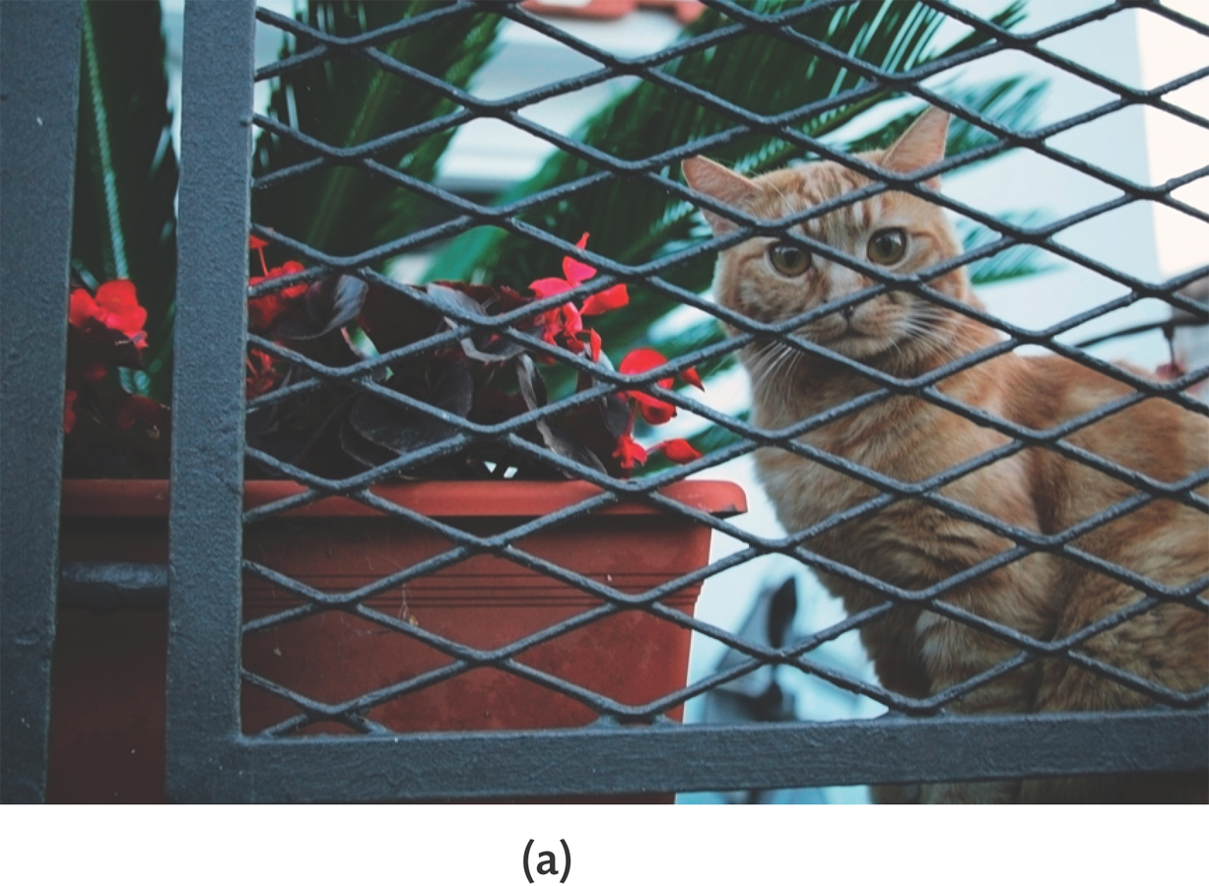
Perceptual Interpolation

Slide 18
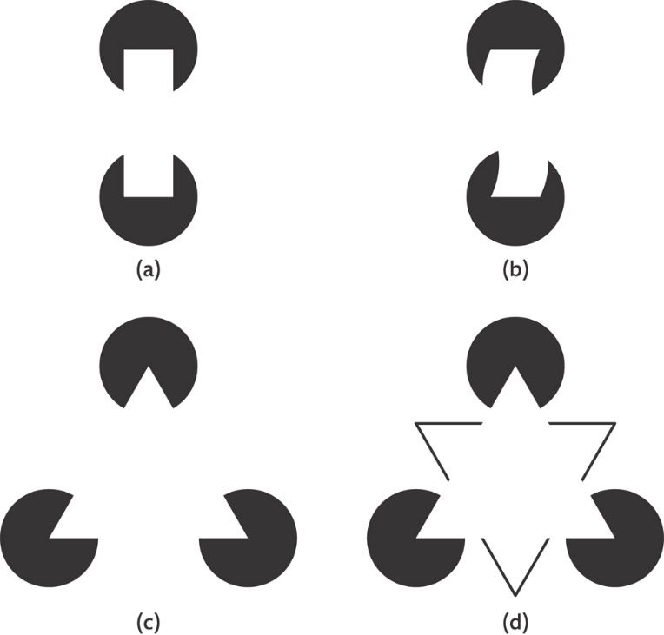
Perceptual Interpolation
Edge completion
Surface completion

Slide 19
Neural Basis of Perceptual Interpolation
V2 Neuron

Slide 20
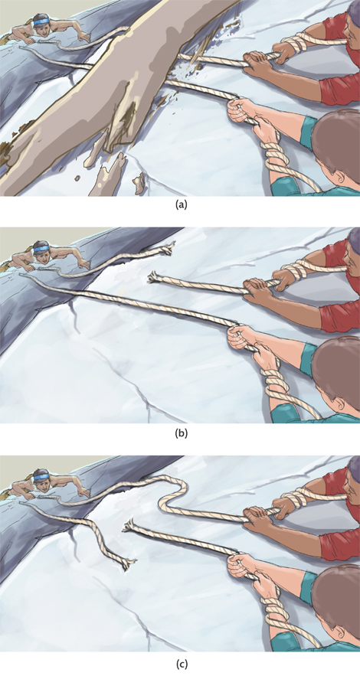
Evolutionary Theories of Perceptual Organization
Promote survival
Not always accurate
No absolute laws
Heuristics (rules of thumb)
Perceptual inference

Slide 21
Object Recognition
Invariance – Object being the same despite changes in retinal image
V1 – Edges
V4 – Curvature

Slide 22
Hierarchical Process: Shape Representation in V4 and Beyond

Slide 23
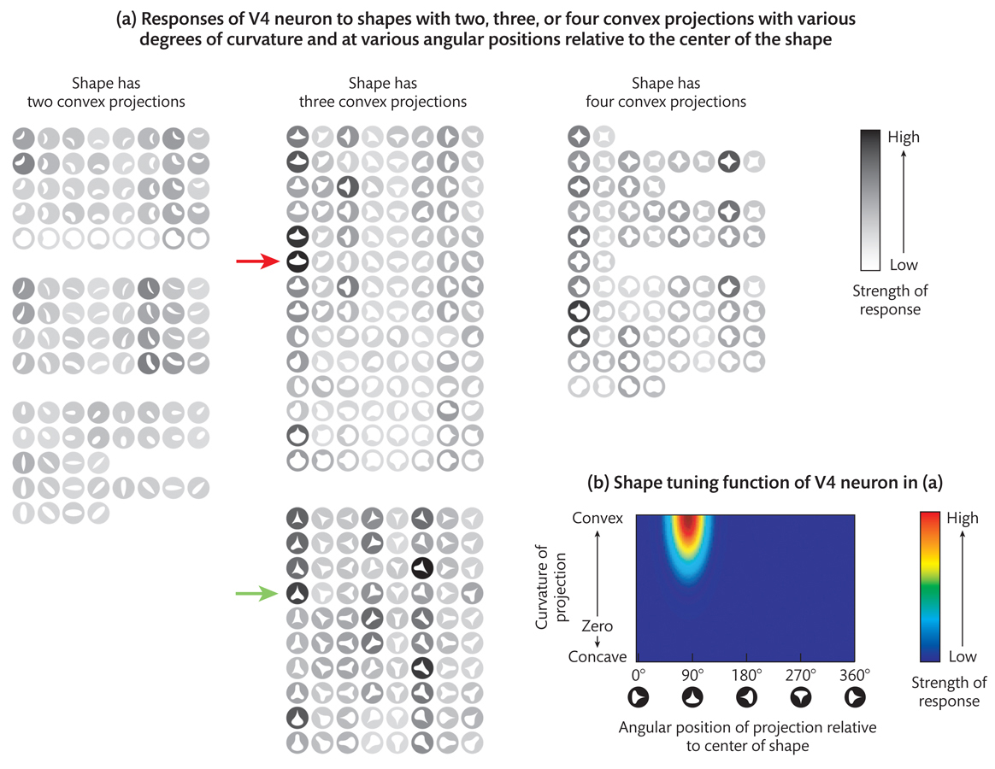
Shape Representations in V4
Straight or curved edges
Preferred orientation
Preferred location
Shapes are represented in the V4 by the combined activity of all the neurons responding to the contour fragments making up the shape

Slide 24
Modular and Distributed Representations

Slide 25
Modular and Distributed Representations
Modular coding – certain parts of the infrotemporal (IT) and occipital cortex along the ventral pathway are specialized for representing objects of specific categories
Distributed coding – Regardless of object category, objects are represented by patterns of activity across relatively wide expanses of cortex along the ventral pathway
Visual agnosia – An impairment in object recognition
Prosopagnosia – A type of visual agnosia in which the person is unable to recognize faces, with little or no loss of the ability to recognize other types of objects.
Topographic agnosia – Inability to recognize buildings or special layouts.

Slide 27
Questions?
Have a great day!
I will be available in the G-lounge:
Wednesday, November 25th, 1PM – 2PM
Tuesday, December 1st, 4PM – 6 PM

