Slide 1
Fundamentals of Sensation and Perception
Speech & music
Erik Chevrier
November 3rd, 2015

Slide 2
Revised Course Schedule
November 3rd Perceiving Speech and Music Chapter 11
November 10th Light and the Eyes - Group Project Meeting 2 Chapter 2
November 17th Visual Brain - Preliminary Assessment Due Chapter 3
November 24th Recognizing Visual Objects Chapter 4
December 1st Class Presentations
December 22nd – 7PM – Tentative Exam Date
You are responsible to make surer the exam date does not change
I will e-mail the results of the exams by Saturday morning and make myself available to meet in person in NDG or by phone by request.

Slide 3
Group Project 2nd Meeting
1 – Your group must read all the articles in your reference – 10 to 20 articles before class
2 – You will meet with your group and discuss all the articles in order to formulate your paper/presentation
3 – You will get ready to prepare the preliminary assessment
4 – You MUST come to class

Slide 4
Video
Tom Thum: Orchestra in my Mouth

Slide 5
The Sound of Speech
Phonemes
Basic sounds of a language
International Phonetic Alphabet (IPA)
Each symbol stands for a different speech sound

Slide 6
Production of Speech

Slide 7
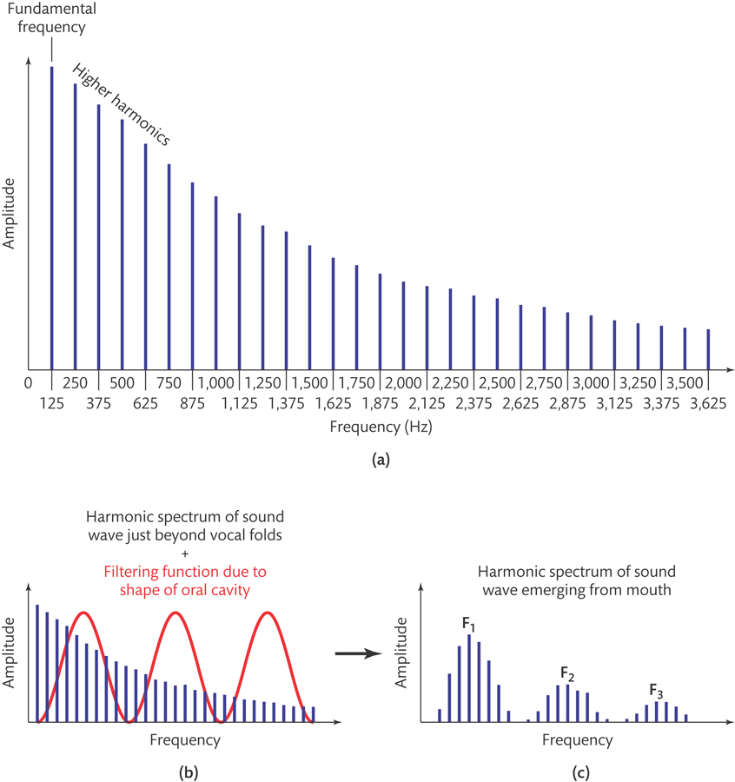
Production of Speech - Producing Vowels
Relatively unrestricted airflow
Formant

Slide 8
Producing Consonants
Produced by restricting airflow
Place of articulation – place of restriction
Manner of articulation – nature of restriction
Voicing – voice or voiceless

Slide 9
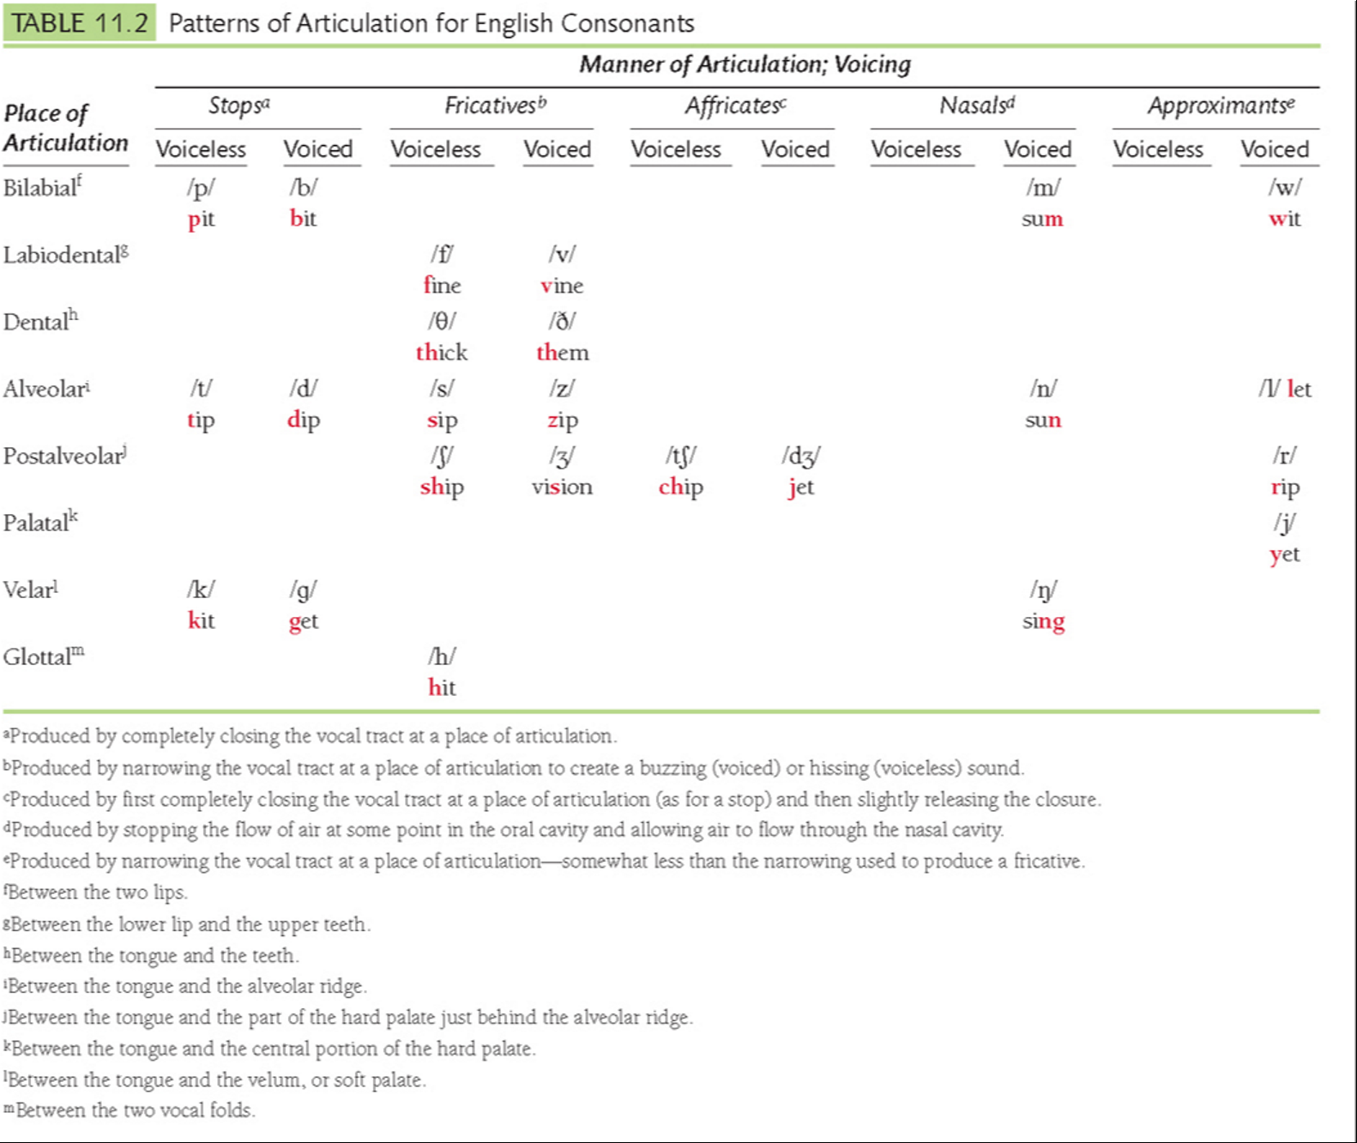
Pit
Bit
Tip
Dip
Fine
Vine
Sip
Zip
Kit
Get
Ship
Vision
Thick
Them
Chip
Jet
Sing
Let

Slide 10
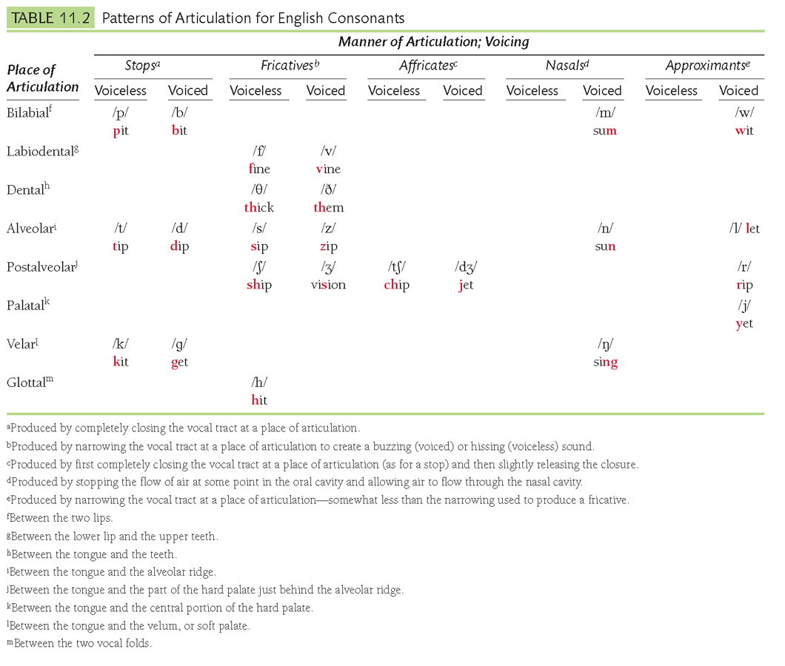

Slide 11
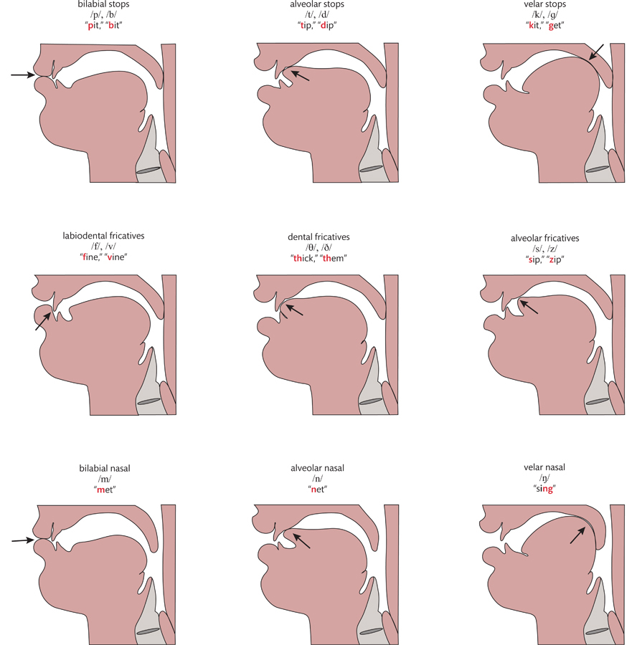

Slide 12
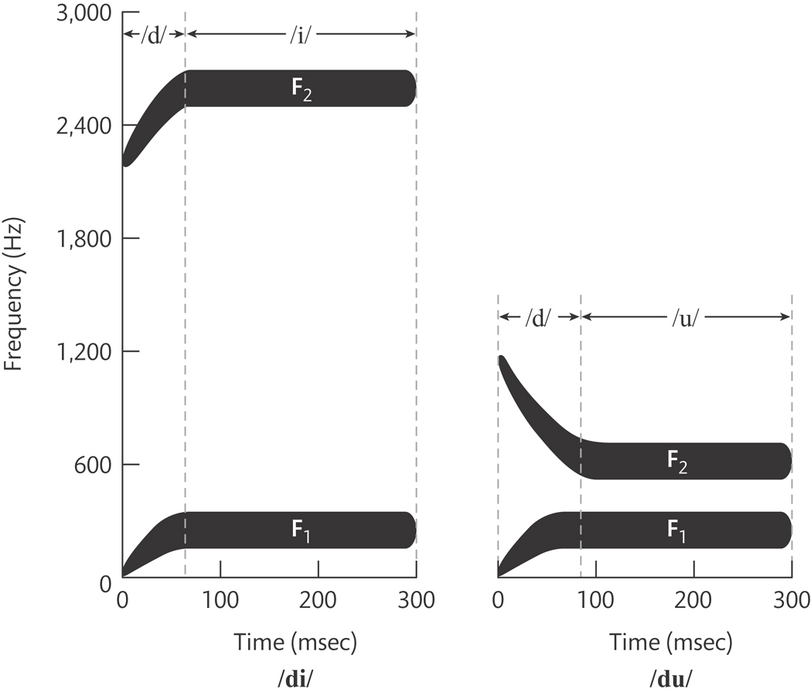
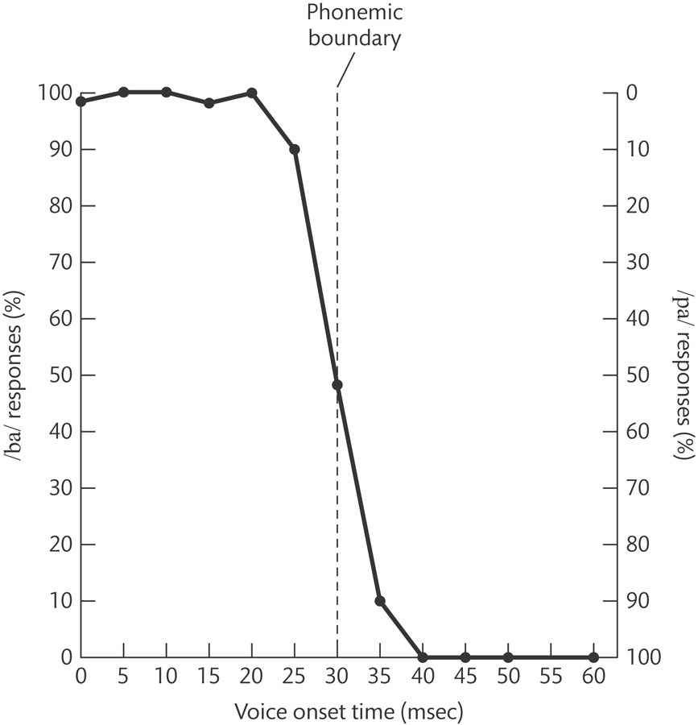
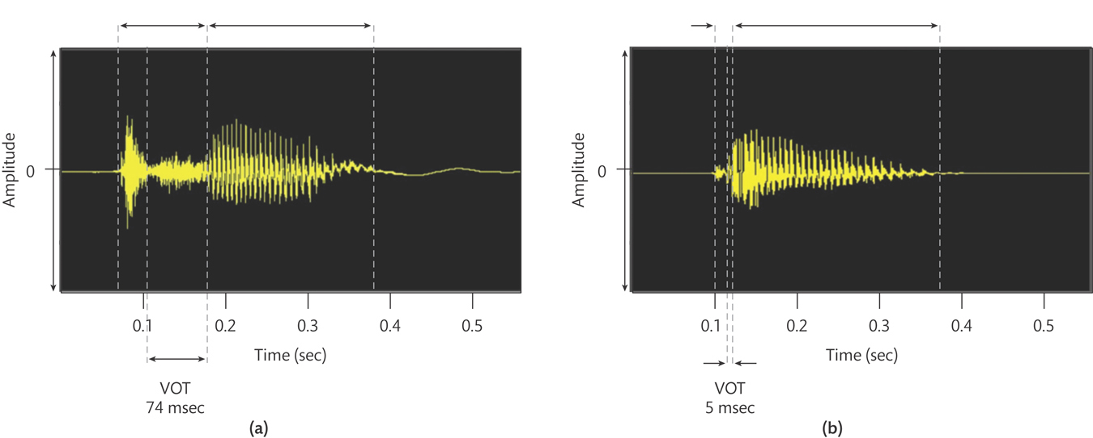
Perceiving the Sound of Speech
Coarticulation and Perceptual Consistency
Categorical Perception of Phonemes
Phonemic boundary / Voice onset time
Vision and Speech Perception
McGurk Effect
Knowledge and Speech Perception
Probability of sequences & context
Word segmentation, probability of transitions & Perceptual completion

Slide 13
Neural Basis of Speech Perception and Production
AC = Audio Cortex
PN – Phonological network
Ventral = What
Dorsal = Where/How

Slide 14
Video
Michael Tilson Thomas: Music and Emotion Through Time
Victor Wooten: Music as a Language

Slide 15
Dimensions of Music
Pitch
Loudness
Timing
Timbre

Slide 16
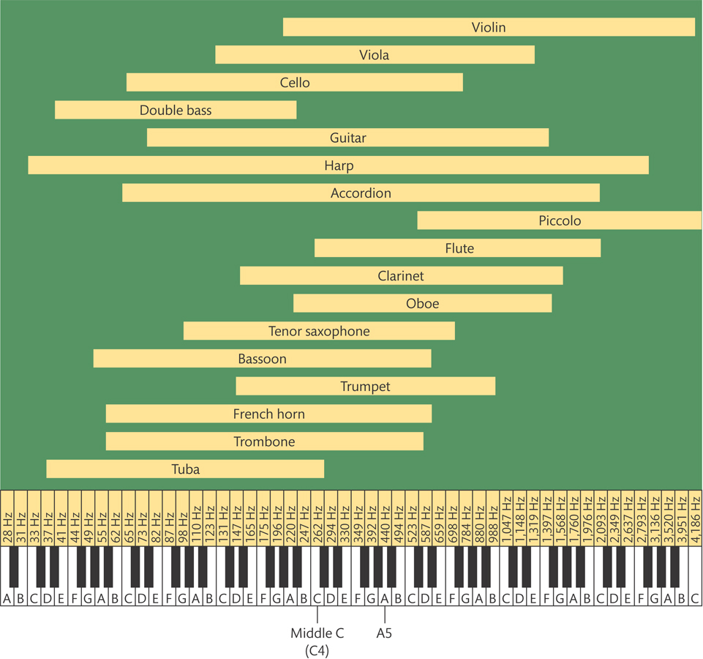
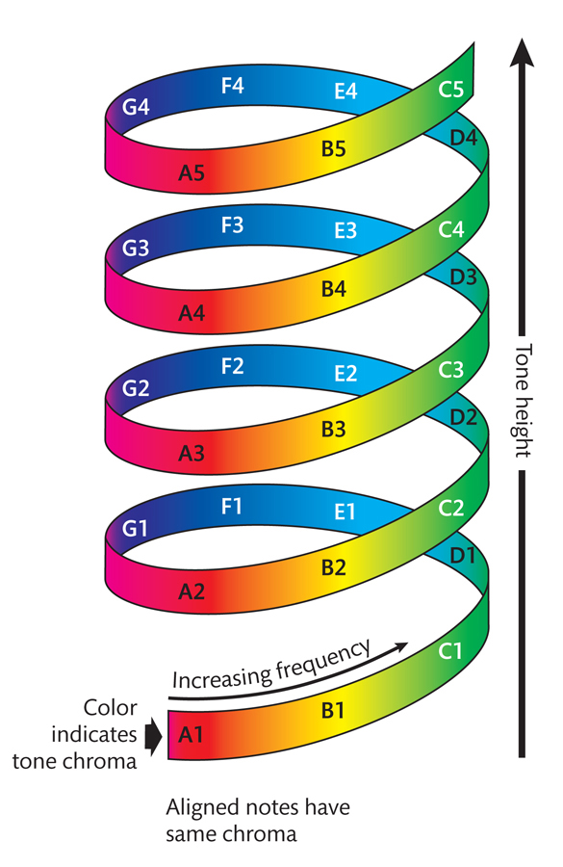
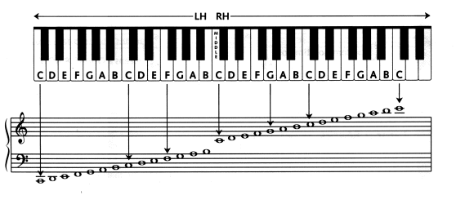
Pitch
Name that instrument
Virtual Piano
Virtual Piano Chords
Octave
Semitone

Slide 17
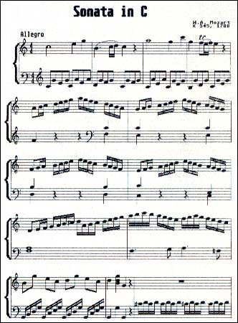
Loudness, Timing, Timbre
Dynamics
Rhythm

Slide 18
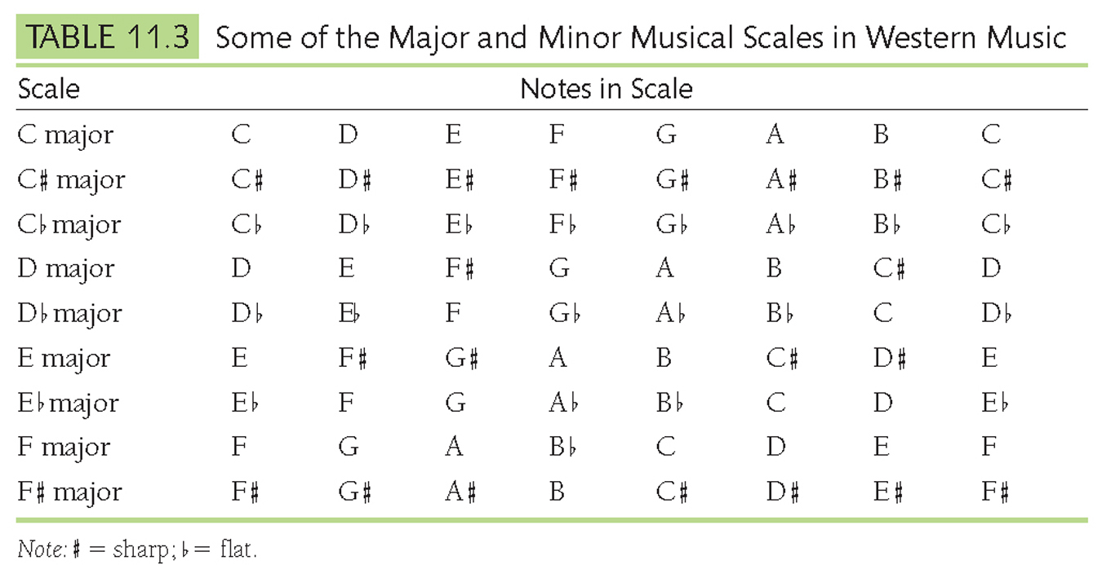
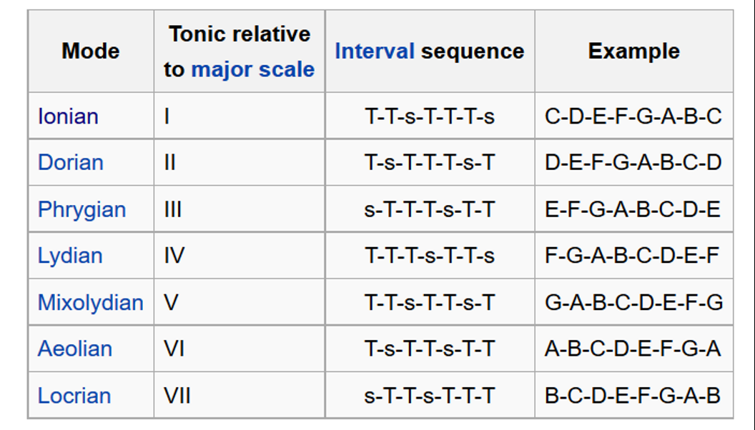
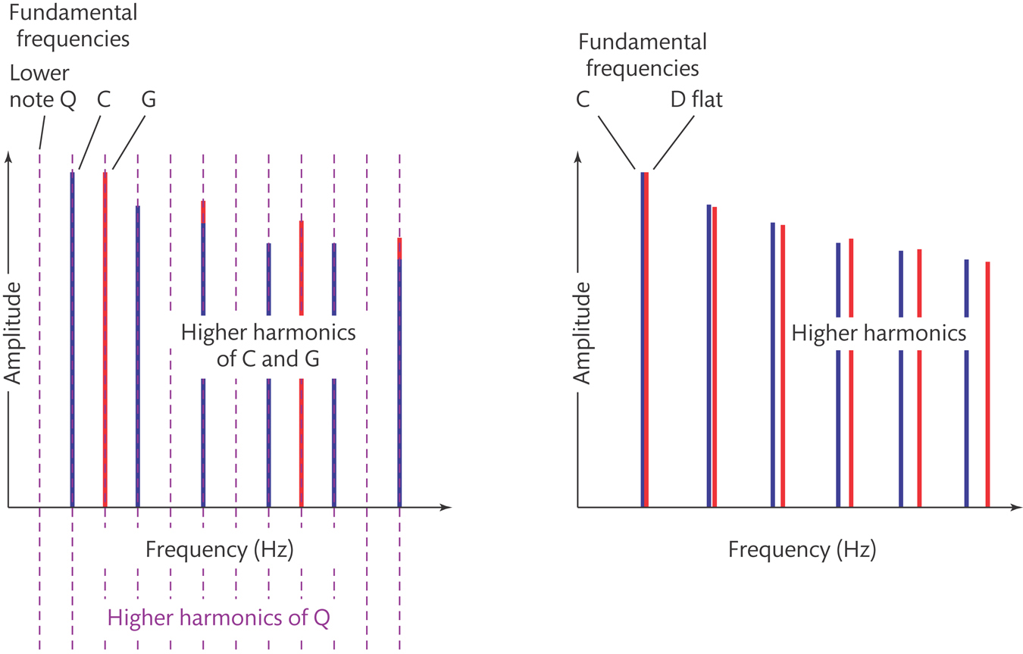
Melody, Key, Scales
Melody - Sequence of musical notes arranged in a particular rhythmic pattern, which listeners perceive as a single, recognizable unit
Scales – Major (2-2-1-2-2-2-1), Minor (2-1-2-2-1-2-2) Key
Consonance Dissonance

Slide 19
Notes on Guitar and Piano

Slide 20
Music Analysis
Radiohead – Subterranean Homesick Alien
Pink Floyd – Money
Dave Matthews – Satellite
OutKast – Hey Ya!
Living in the Past – Jethro Tull
Sesame Street – Pinball
The Beatles
Robert Johnson – Love in Vain
The D-Tales

Slide 21
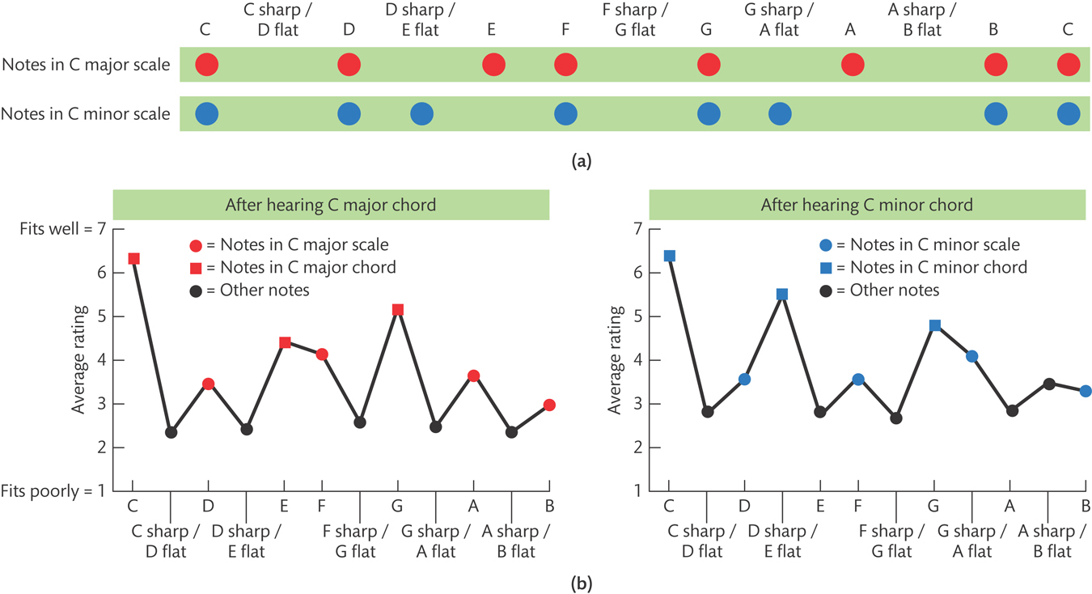
Knowledge and Music Perception
People can recognize tonic notes well
People acquire accumulated knowledge about music
Less than 1% have perfect pitch (absolute pitch)
Less than 4% have amusia – Impairment in perceiving and remembering melodies

Slide 22
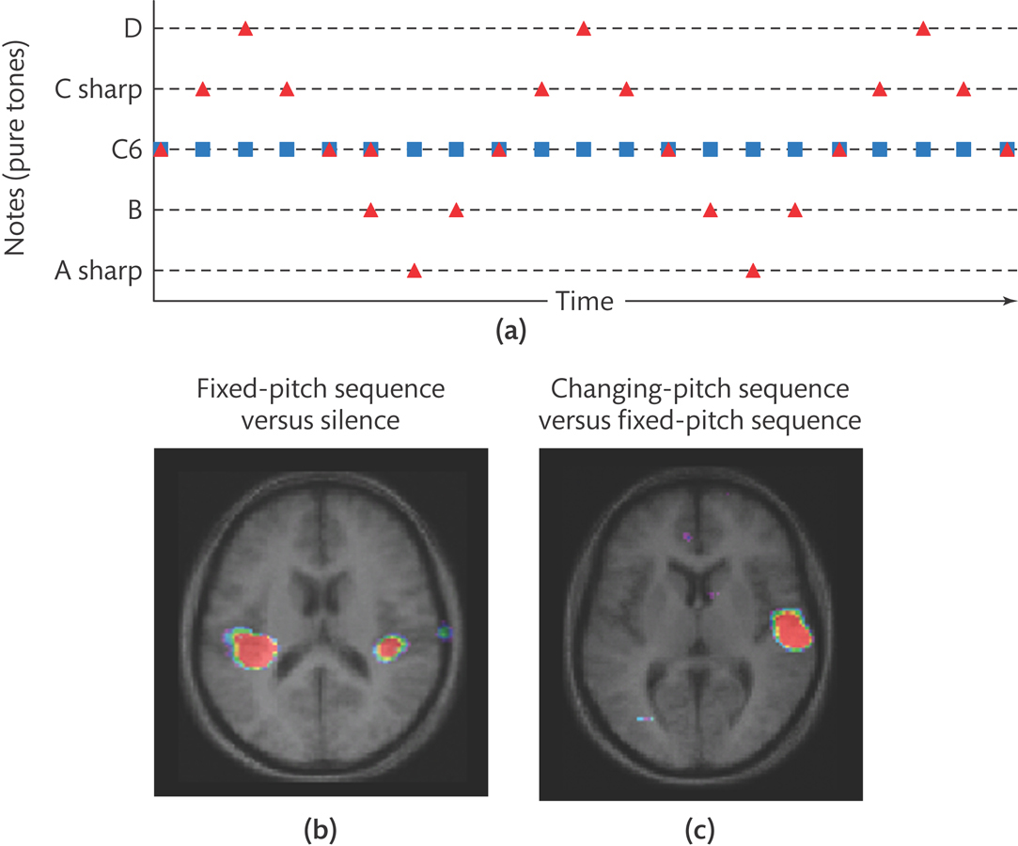
Neural Basis of Music Perception
Auditory areas of right hemisphere responds better to changing pitches
Auditory areas of left hemisphere responds better to timing of sounds

Slide 23
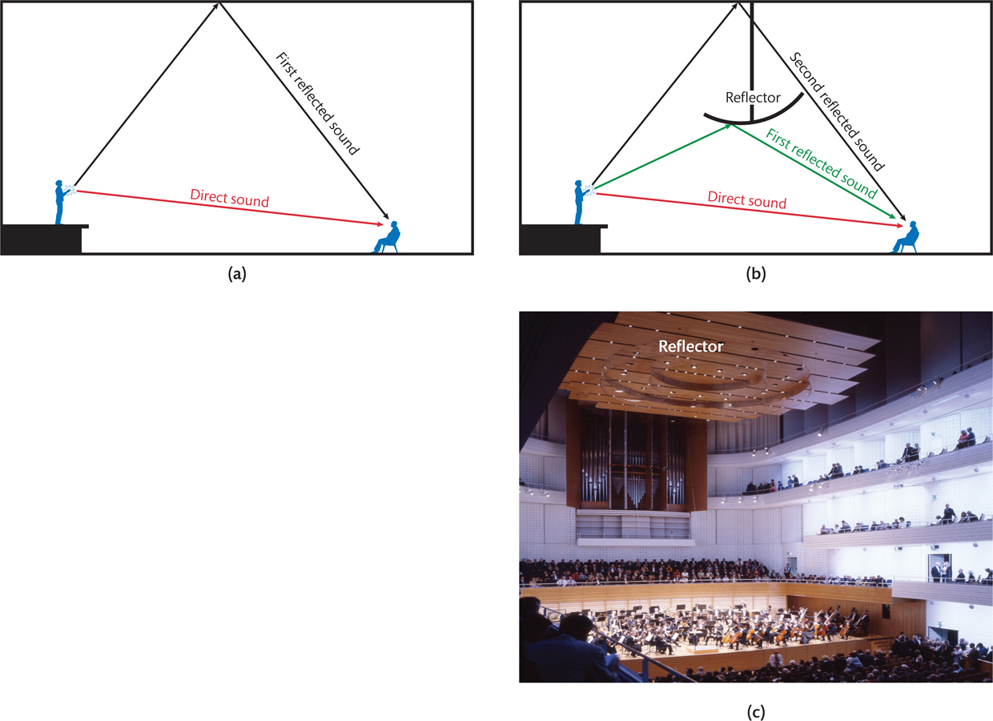
Concert Halls

Slide 24
Questions?
Rock on!

