Slide 1
Media, Technology and Politics
Political and Socio-Economic Environment
Erik Chevrier
January 27th, 2016

Slide 2
Instructions for Paper
Chose a media product – message, campaign, blog post, video, movie, song
Perform an analysis of the media product using the theories developed in class
Must be between 3 and 5 pages (double spaced; not including references & title page)
Point allocation:
3 points theory development (do you understand the theory you are using to explain the media product?)
3 points idea development (main thesis, support, examples)
3 points structure, grammar and clarity
1 point originality of idea

Slide 3
Videos
YUL-LAB
Advertising and the End of the World

Slide 4
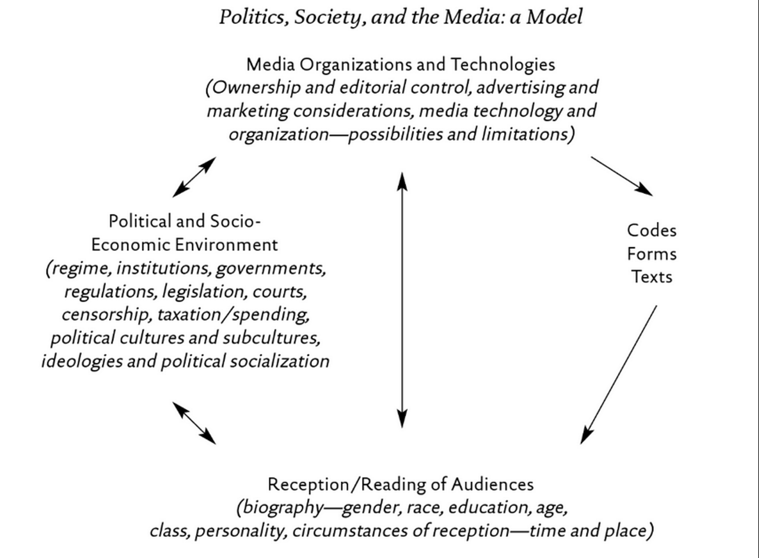
Focus of this class

Slide 5
History of Political Economy
Feudalism Feudal lords Self sustaining production Surplus to feudal lords
Mercantilism Trade Formation of towns and cities at junctures of trade routes
Classical Economics Comparative advantage Free market (invisible hand) Competition Industrialization
Marxism/Socialism Exploitation Alienation Critique of bourgeoisie owning the means of production Labour theory of value
Neoclassical Economics Focus on individuals Mathematics Market equilibrium Supply constrained/emphasis on production
Fordism Assembly lines Workers get living wage
Keynes Effective demand/demand constrained Government stimulus
Neo-Liberal/Monetarism/Corporatism/Globalization Fall of gold standard in early 1970s Dominance of high finance Austerity measures Global markets/trade agreements/world capitalism

Slide 6
Four Types of Economic Behaviour
Polanyi (1944) The Great Transformation
Practices Patterns
Redistribution Centralization
Reciprocity Symmetry
Householding (œconomy) Autarchy
Exchange, barter, truck Markets
Economic systems contain these practices in varying degrees and scales.
An economic system is defined by the most dominant of the practices.
Early economies were based on Reciprocity, Redistribution and Householding.
It is only within the last 400 years that market patterns have become dominant.
Notes:
6

Slide 7
How to think about Economic Systems
John Pearce (2003) What is the Social Economy

Slide 8
What is Capitalism?
Private ownership of the means of production
Labourers work for capitalists
Capital is virtual and physical
An exchange based system (money)
A system that permits the endless accumulation of wealth
Profit motive
Workers do not own the products of their labour
Alienation/exploitation/monopoly
Can manifest in many ways
Corporatism
No state intervention

Slide 9
The Birth of Consumerism
We Deliver Young People

Slide 10
Early Capitalism (1600 - 1900)
Little to no leisure time for working class
Rampant poverty
Mostly subsistence wages
Work mainly done by hand or with assistance from basic machines and animals
Billboard and print advertising
People mainly consumed what they needed to survive

Slide 11
Middle Capitalism (Late 1800 - 1950)
Development of more advanced machinery
Fordism & the introduction of more efficient assembly line practices
Workers are better paid
Work hours were reduced (more leisure time)
Introduction of psychology into advertising
Workers are able to consume luxury items over and above what they need to survive

Slide 12
Later Capitalism (1950 - today)
Rapid advancement of science and technology
Built obsolescence
Global expansion of industrialized capitalism
Expansion of products and services
Consumption is a central part of the market
Advanced advertising techniques
Workers must be able to continuously consume in order for the capitalist market to function

Slide 13
Rise of Modern Advertising
Begin at about late 1600 in France billboard
1700 – Newspaper & magazine & advertising agencies as brokers
1900 – Sears & Cosmopolitan Magazine
1920 – Psychology & Ed Bernays & Radio
1950 – Television & motion picture
1980 – Internet & data mining
2000 – Product integration & interactive advertising
Today – Multiple profuse convergent network (clutter)

Slide 14
How is this Relevant to Media?
Media can be produced by governments, companies, groups, and individuals.
In a capitalist system:
Media companies are capitalist firms in a global market
Media messages (adverting) facilitate consumerism
Media products are sold on the capitalist market
Media companies have private owners/shareholders
Media can be produced by governments, companies, groups, and individuals
The media reflects the ideology of capitalism at the same time as it produces it

Slide 15
Creating Culture and Ideology

Slide 16
Creating Ideology

Slide 17
Three Main Theories – Nesbitt-Larking
Liberal Pluralism:
Unified totality, with common values & ideals that have come to sustain society
Everyone pursues private interest
A set of responsive institutions that enact demands from the plurality (liberal democracy)
Media are mirrors reflecting reality (they do not shape reality)
Competition of ideas (everyone can express their viewpoint)
Elite Theory:
Small group of men control the means of production of communication
Culture is determined by the small group of men who control communications
Masses are passive consumers who are being manipulated
Critical Theory:
Marx, Gramsci, Raymond Williams
Media produces and reflects hegemonic ideology
Media is owned by wealthy elite but each have their own interests (profit)

Slide 18
Semiology

Slide 19
Political Culture, Ideology, and Media
Signs – A combination of signifier and signified
Signifier – The physical existence of what carries meaning
Signified – The mental representation that is the meaning
Denotative meaning – Common sense, obvious meaning
Connotative - Interaction of denotative meaning and one’s subjective feelings
Counter ideology?
Factors that influence the extent to which people are impacted by cultural symbols (Schudson)
Retrievable in memory (priming)
Rhetorical force (ability to move us)
Resonance (ability to tie to other cultural symbols)
Institutional retention (linking to existing structures of power and influence)
Resolution (ability to motivates, convinces, structures understanding)

Slide 20
Modern Signs and Symbols

Slide 21
Modern Signs and Symbols

Slide 22
Modern Signs and Symbols

Slide 23
Modern Signs and Symbols

Slide 24
Modern Signs and Symbols
First MacDonald's TV Ad
Molson Hockey Ad
I am Canadian I am not Canadian

Slide 25
Culture Jamming
Reverend Billy
Banksy
Culture Jam
Global Invisible Theater

