Slide 1
Building a Better Food System at Concordia and Beyond
The Concordia student-run food groups Research project
By: Erik Chevrier

Slide 2
The Concordia Student-Run Food Groups Research Project
Web Based Archive
Provide a database of research on the student-run food groups at Concordia University
Create timeline of food groups/services at Concordia
Map of the landscape
Relationship map – economic landscape – geographical landscape
Safeguard institutional memory of the food system
Facilitate the development of better food systems
Defining criteria & implementation process
Feature Length Documentary Movie

Slide 3
Research Methods
Main question: How can we develop better food systems?
What is the problem? Critique of food system at Concordia University Critique of the global food system
There are a multitude of problems to address. The focus of this project is on the practices of progressive food organizations at Concordia University. They provide examples of cooperative, socially responsible, environmentally sustainable services.
Multidisciplinary
Sociology – Anthropology – Communications – Psychology – Geography – Biology
Internships available! Come be part of the team!

Slide 4
The Project
Phase 1 – Information Gathering
Gather as much information about the food system at Concordia and post it on the website
Conduct video interviews with people involved with the food system at Concordia – past & present
Film the activities of the groups over a year of operation
Find and make available media artifacts regarding the food organizations at Concordia
Gather information about ‘ideal food system’ indicators
Phase 2 – Analysing and Synthesizing the Information
Construct a timeline of the food services at Concordia – student-run & administration-run services
Create a feature length film
Provide maps of the food system – organizational, partnerships, economic landscape, geographical landscape, etc.
Make recommendations for action!

Slide 5
Why is Food Important?
Food is a commodity that everyone needs
Food is central to our survival
Major multinational corporations control food production, processing and distribution
Their practices are harmful to our health and the sustainability of our biosphere
Building better economic practices must begin with food
Addressing climate change also must begin with changing food practices

Slide 6
Food Services at Concordia
History
For over 20 years, students have been dissatisfied with the multinational food service providers
Concordia students have founded an array of food organizations to rival the multinational corporations
These organizations provide concrete examples of how to develop a better food system
Critique of the Multinational Food Services at Concordia
Creation of food monopoly
Residence students MUST purchase a meal plan
Food quality has been put into question many times
Meal plan encourages unhealthy eating practices
Ethical practices put into question
Dietary restrictions not always met
Zev Teifenbach on Concordia’s Relationship with Multinational Food Service Providers Rob Green on the History of Multinational food Corporations

Slide 7
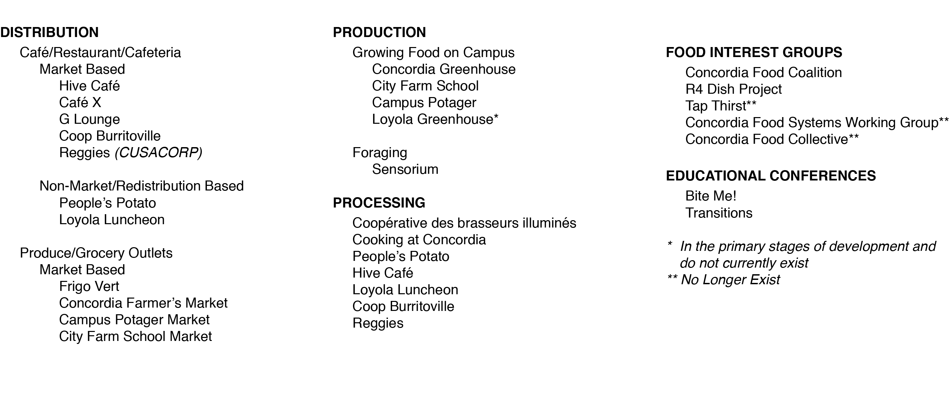

Slide 8
Highlighting Better Practices
Redistribution based economy
Loyola Luncheon
People’s Potato
Cooperative economy
Burritoville Cooperative
The Hive Cooperative
Connecting with the community at large
Marcus Lobb on The Green Club
City Farm School – B.A.S.E program at St. Monica’s School in NDG
City Farm School – Seed Saving Garden
Local Markets
Farmers Market
Campus Potager Market
City Farm School Market
Connecting with larger activist movements
The People’s Potato connecting with local activists

Slide 9
What’s Missing
Better and more processing facilities
More space for student groups
More kitchen space, even in dorms
More connections with the community at large
Education programs connecting Concordia students to food initiatives
Urban agriculture
Culinary arts
Proactive health and nutrition courses – meal planning

Slide 10
My Recommendations
Administration
Give more space to Concordia student groups – especially processing facilities
Run in-house food services (do not go through public tendering – RFP)
Abandon mandatory meal plan
Food Groups
Work together to develop a more closed loop system
Make more ties to community groups
Meet to form demands and lobby the administration to meet these needs
Professors
Engage your students in community initiatives (especially regarding community food projects)
Develop courses and programs that focus on food
Become members of the food cooperatives on campus
Students
Pass referendum questions regarding food services
Become members of the food cooperatives on campus
Participate with food groups on campus
Form new groups
Take action!

Slide 11
Questions?
Thank you!

