Slide 1
Media, Technology and Politics
Political and Socio-Economic Environment
Erik Chevrier
February 3rd, 2016

Slide 2
Contents of Midterm Exam
Class discussions – Study the PowerPoint slides as well as what was discussed in class
Politics, Society and Media (Paul Nesbitt-Larking) – Chapters 1, 2, 3, 4, 5, 6
Documentary Movie – The Century of Self

Slide 3
Format for Midterm Exam
Three sections:
Multiple choice (10 questions)
Short answer (answer 6 of 7 questions)
Essay question (1 question)
Exam time
Multiple choice – 3 min per question X 10 questions (30 minutes)
Short answer – 5 minutes per question X 6 questions (30 minutes)
Essay question – 15 minutes (15 minutes)
Exam Time = 75 Minutes

Slide 4
Exam Weight
Point Allocation
Multiple choice – 3 points per question (30 marks total)
Short answer – 6 points per question (30 marks total)
Essay Question – 20 points (20 points)
30+30+20 = 80 Points
X / 80 * 100 = your grade on 100

Slide 5
Examples of How Points are Allocated
Multiple Choice – Right or Wrong (0 or 3)
Short Answer – Scale of (0 – 5)
0 = You wrote nothing
1 = You wrote something but it is not right at all
2 = You wrote something that is partially true but mainly wrong
3 = You are correct but extremely vague
4 = You are correct but slightly vague
5 = You are correct, clear and complete. You provide examples to back up your claim(s), when necessary.

Slide 6
Examples of How Points are Allocated
Essay Question – Points (0 – 20)
0 = You wrote nothing
1 – 10 = You wrote something but it is not right at all
10 – 12 = You wrote something that is partially true but mainly wrong
12 – 14 = You are correct but extremely vague
14 – 16 = You are correct but slightly vague
16 – 18 = You are correct and are clear. You provide examples to back up your claim(s).
18 – 20 = You are spot on. You provide a range of examples to back up your claim(s). Your answer is full. You don’t leave anything out. Each part of your answer is completely correct.

Slide 7
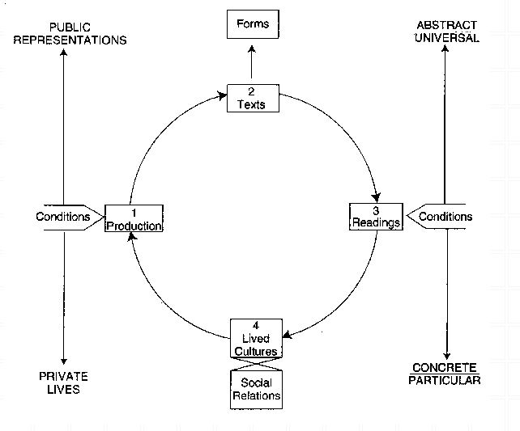
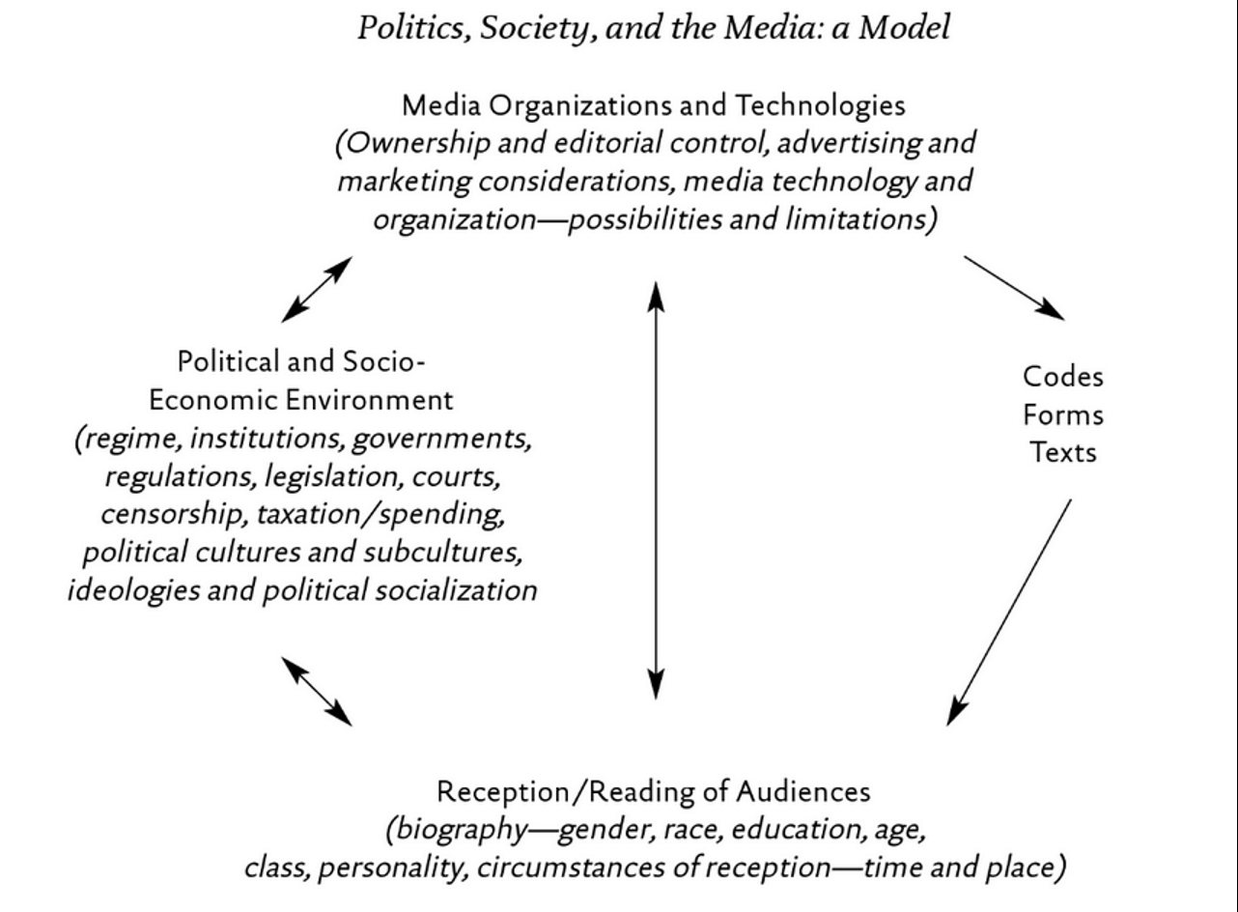
Focus of this class

Slide 8
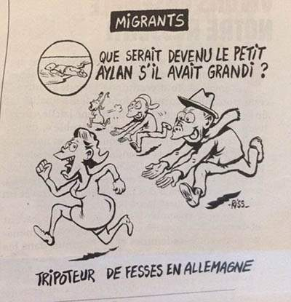
Video
What happens when the media’s priority is profit?
How do we balance freedom of expression with social responsibility?

Slide 9
The State
Max Weber – A compulsory organization with a territorial basis… The use of force is regarded as legitimate only so far as it is either permitted by the state or prescribed by it.
Nesbitt-Larking – A bundle of formal and more-or-less permanent institutions, notably the executive, the legislature, the judiciary, the constitution, the armed forces, the public services, and other state organizations.
The state uses the media as a mechanism to construct ideology and shape culture. However, media mechanisms also lead politicians to shape their political messages.
Liberal market vs totalitarian states = Media apparatuses are controlled by different actors

Slide 10
The State (Immanuel Wallerstein)
States
Sovereignty
Borders
Reciprocal Recognition from other States
Legitimacy
Part of an Interstate System
States assert authority in at least seven principal arenas of direct interest to them
1 – Sets rules on how capital & labour flows in and out of its border (people, capital and goods)
2 – Sets rules on property
3 – Sets rules about employment and compensation
4 – Decides which costs are internalized
5 – Decides which economic process may be monopolized and to what degree
6 - They tax
7 – They protect its own core production process internationally

Slide 11
Institutions in a Capitalist World Economy (Immanuel Wallerstein)
Market - Concrete & Virtual - Quasi-Monopoly
Firms - Main actors in the market - Cyclical rhythm and Curve (Kondratieff Cycles) - Core, periphery, semi-periphery
(degree of profitability in the production process)
State maintains quasi-monopolies by:
- Maintaining patents
- Putting restrictions on imports
- Providing subsidies and tax benefits
- Regulations

Slide 12
The State and the Media (Nesbitt-Larking)
The state has multiple roles in relation with media apparatuses.
Proprietor
Custodian of national heritage
Regulator
Censor
Patron (awards, prizes and grants)
Catalyst (subsidies)
Actor (providing content)
Masseur (managing news releases)
Ideologue (shaping political reality)
Conspirator

Slide 13
Canada and the Media
Since 1982 Supreme court can interpret the Charter of Rights and their decisions cannot be removed by the Canadian Parliament.
Charter of Rights and Freedoms
Freedom of expression & of the press, section 2(b)
Notwithstanding clause
Access to Information Act
Privacy Act
Security of Information Act
Anti-Terrorism Act
Interview with Osama Bin Laden – Should Canada prevent people from interviewing “terrorists”?

Slide 14
Government Censorship in Canada
John Keane – There are four categories that are identified as tools that the state uses to promote its interests through media control.
Invoke emergency powers
Through armed secrecy
Providing information to mislead the public
Mobilizes people through advertising
Kent Commission (1981)
- Corporate mindset takes over newsrooms - Media concentration reduces the range of diversity of viewpoints - Media concentration increases pro-business editorializing - Growing commercialization leads to reliance on American sources - Corporate media concentration leads to reduced accountability - Large corporations bully the government for tax breaks and subsidies

Slide 15
Wartime Reporting
Frontline – Iraq War
John Stewart – Grills Miller
Operation Persuasion: What is the role of the media in modern day war reporting
Control Room – Propaganda of the Iraq War

Slide 16
Libel in Canada
1843 – Defendants can defend libel by demonstrating the truth
Libel is an “unjustified statement, published or broadcast, that subjects a person to hatred, ridicule, or contempt or, put differently, is a false statement to a person’s discredit”
3 defences against libel include:
Statements were true
Comments were fair or opinion (highly critical must be based on facts)
Consent is an acceptable defence if the party said that it was acceptable to make the comments
The Sourcebook on Canadian Media Law

Slide 17
Media and Politics – Dual Control
Jamieson and Campbell identify a number of ways where media organizations and politicians control each other:
1 – Use of spin-doctors
2 – Staging of press conferences
3 – Venues, seating arrangements and camera angles
4 – Timing of statements to be released to the general public
5 – Negative announcements timed for release
6 – Trial balloons used to deal with proposals when a politician is uncertain
7 – Leaks employed to weaken an enemy
8 – Direct recipient addresses
9 – Access and denial of access to reward journalists who are supportive and punish those that are critical

Slide 18
Social Media and Freedom of Expression
Should censorship take place in social media like Facebook or twitter?
What consequences occur in an environment of censorship vs unregulated social media?
Would you censor Roosh V or others like him who spread hateful messages?

Slide 19
The Century of Self
Questions for discussion:
What is the relationship between capitalism and democracy?
Who is Edward Bernays and what did he do?
Who is Ernest Dictor and what did he do?
Who is Ewen Cameron and what did he do?
What is planned obsolescence and why is this important to a capitalist society and media?
What is a focus group and why is this important to advertising?

